Slide 1
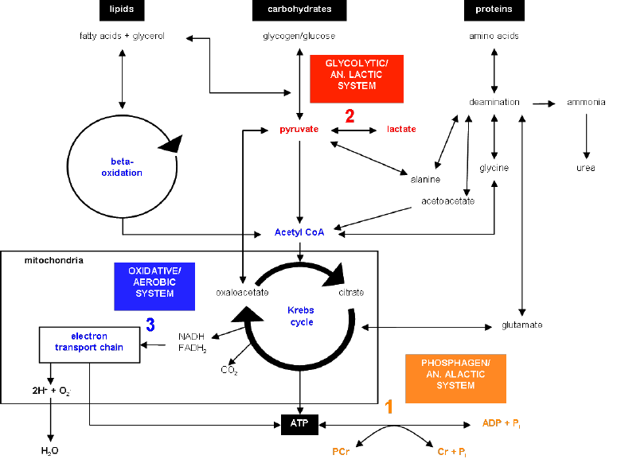
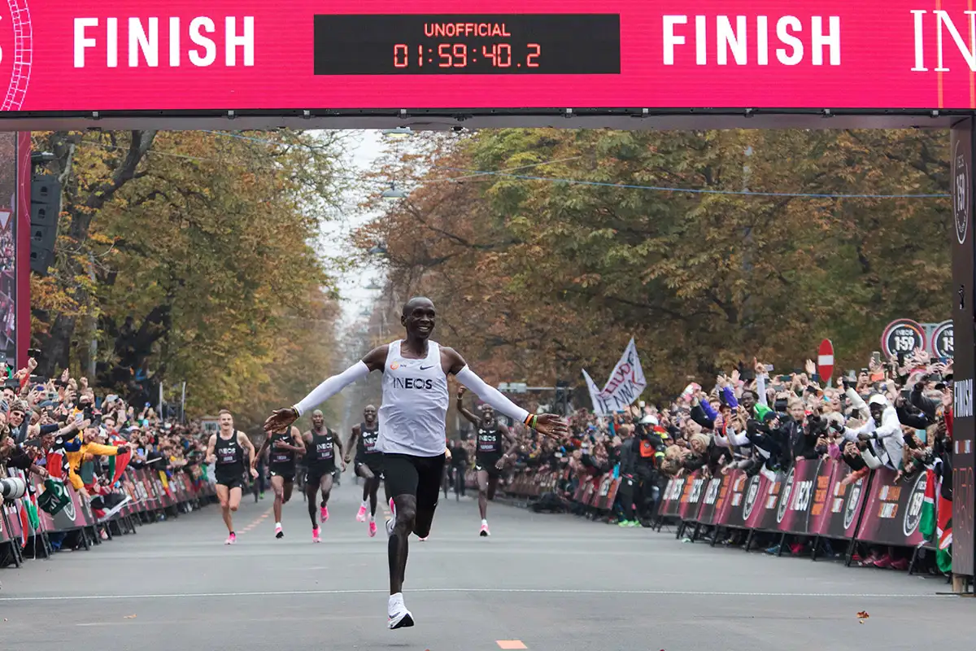
Applied Exercise Physiology & Sports Nutrition for Health & Performance
Training Session Planning & Summary
Jasper Suttmeyer

Slide 2
Todays Topics
Training Sessions
Summary Seminar Content

Slide 3
Group Tasks
Create one of the following sessions:
1.) Increase power @ FatMax
2.) Increase Sprint performance
3.) Increase V̇O₂max
4.) Decrease vLamax
5.) Increase power @ the anaerobic threshold
Explain the overall structure as well as the underlying physiology!
Notes:
Four groups, each group should start with a different scenario
Power-time
PCr-Time
V̇O2-time (% max)
vLa-time (% max)
cLa-time
Before starting with case studies: Is there anything that interests you in particular for the last session?;
Open test result in the back

Slide 4
Summary Exam

Slide 5
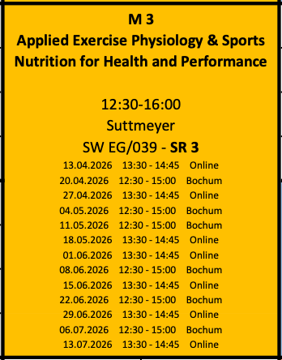
Object of the seminar
Block 1.)
- Basics of the energy metabolism and model application
Block 2.)
- Performance Testing
Block 3.)
- Adaptation and Implementation

Slide 6
Marathon Performance Amanal Petros (2024)
V̇O₂max
%V̇O₂max
at LT
Running Economy
Values for High Performance Athletes
70 – 84 ml/min/kg 75 – 85 % 11 – 13.5 ml/min/kg/m/s
Marathon Performance = V̇O₂max * % V̇O₂max at LT / Running Economy
Marathon Performance = 80 * 0.8 / 11.46 = 5.58 m/s
Marathon Performance
Joyner (1991)

Slide 7

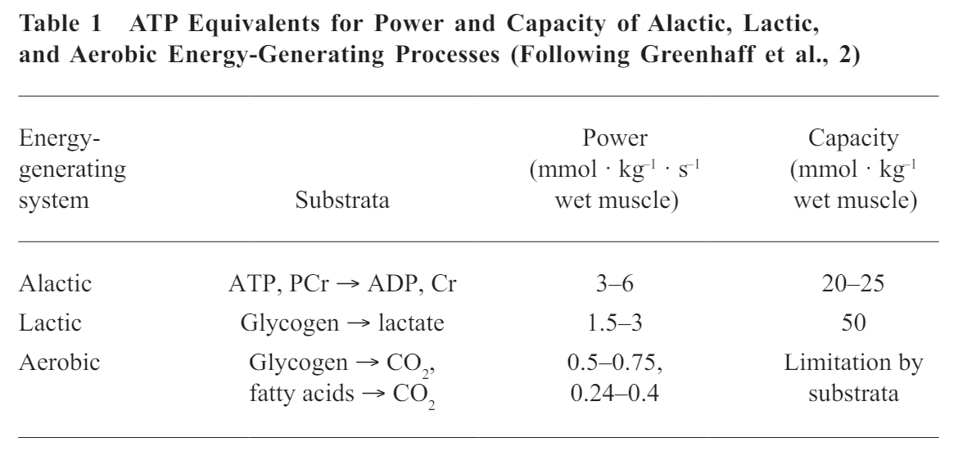
ATP Pool
Constant resynthesis of ATP tuned to ATP breakdown is needed!
Aerobic
Lactic-Anaerobic
Alactic-Anaerobic
Heck et al., 2003
Notes:
Discuss differences between Power and Capacity, Transition to the three different energy systems
-> Afterwards we will have a rough view at the different systems

Slide 8
Processes of ATP-Synthesis
Anaerobic
Aerobic
Glucose
ß-Oxidation
Glycogen
⚡ATP ⚡
Citric Acid Cycle
⚡ATP/GTP ⚡
Lactate
⚡ATP ⚡
Electron Transport Chain
Notes:
Reduced Complexity,
Both Pathways are interconnected!

Slide 9
Glucose and Glycolysis
Glucose
2 ATP
+ 4 ATP
___________
+ 2 ATP
Net ATP-Gain:
2 ATP per Glucose
1 ATP per Pyruvate/Lactate
Glycogen
1 ATP
+ 4 ATP
___________
+ 3 ATP
Net ATP-Gain:
3 ATP per Glucose
1.5 ATP per Pyruvate/Lactate
What used ratio of the substrates?

Slide 10

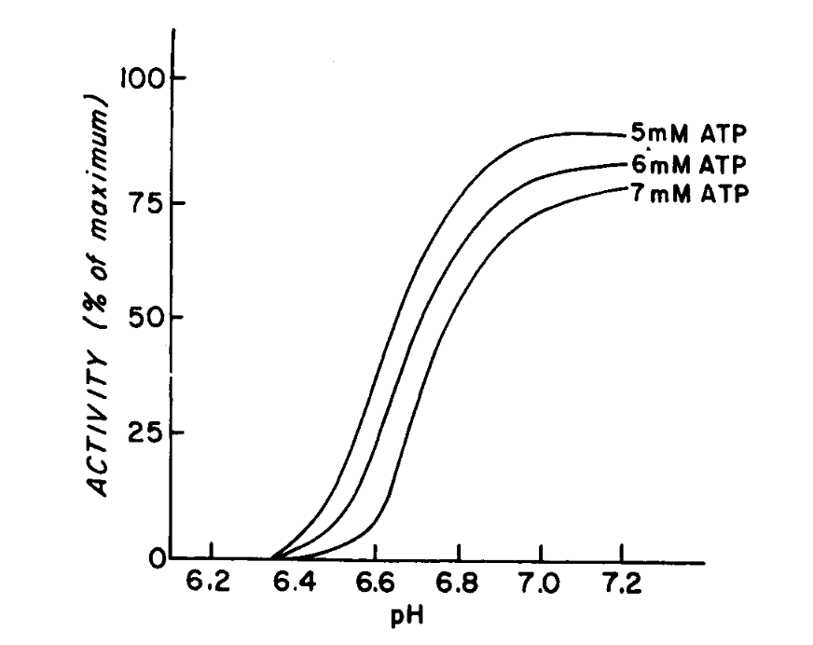
Regulating effect of pH on Glycolysis
Activation
ADP & AMP
H⁺
1 Glucose
1 Glycogen
-1 ATP
Inhibition
-1 ATP
Key Enzyme:
Phosphofruktokinase (PFK)
+2 ATP
Inhibition!
+2 ATP
2 Lactate + 2 H⁺
Danforth, 1965

Slide 11
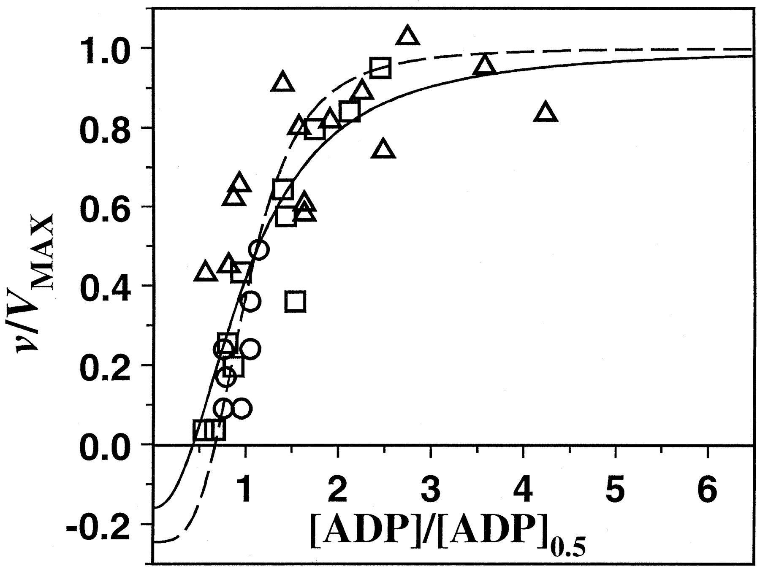
V̇O2-[ADP]
N_{ox} = 2
Ks = 0.035
Jeneson et al.,1996
Notes:
Dependence of specific velocity of MOP (v/V_{max}) on specific ADP concentration ([ADP]/[ADP]_{0.5}) in different mammalian cell types (□, in vivo human skeletal muscle (present study); ∘, in vivo canine heart muscle(14); ▵, ex situ perfused transgenic mouse liver(15)).
https://www.jbc.org/article/S0021-9258(18)35102-0/fulltext#fig1

Slide 12
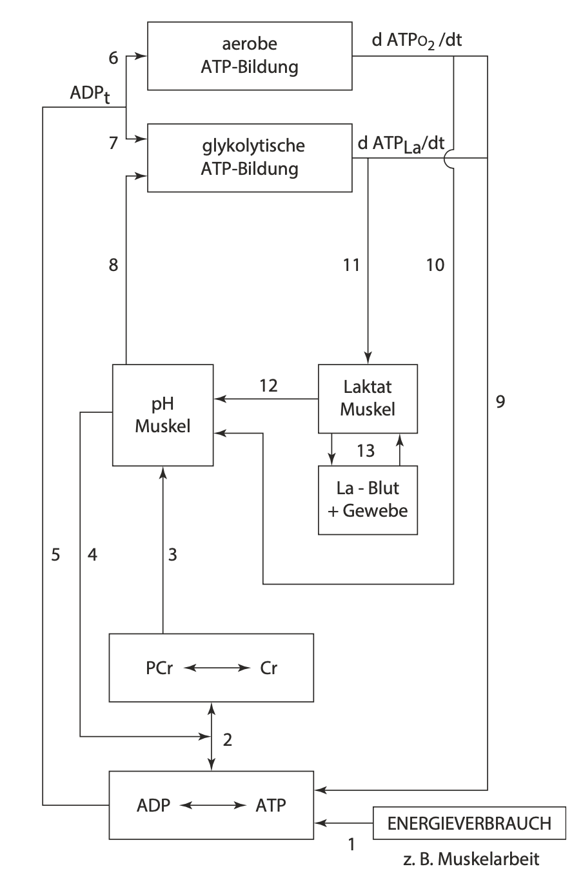
Summary
Aerobic ATP
Kausal chain of metabolic pathway activation/inhibtion as a function of ATP breakdown
How are these processes influenced by individual characteristics?
e.g. high/low V̇O₂max?
Glykolytic ATP
pH Muscle
Lactate active
Lactate passive
Energy utilisation through muscle contraction
Mod. from Heck, 1990 & Heck et al., 2022

Slide 13
Outline
What steps are needed to build the model?
Quantification of so far qualitatively discussed phenomena (2-Steps)
Variation of PCr
Glycolysis
Aerobic
Capacity
Inhibition
Power
H⁺
Activation
Activation
% V̇O₂max
% vLamax
+
PCr
PCr
related to [ADP] & [AMP]
related to [ADP]
ATP

Slide 14
Outline
What steps are needed to build the model?
Quantification of so far qualitatively discussed phenomena (2-Steps)
Variation of PCr
Glycolysis
Aerobic
Capacity
Inhibition
Power
H⁺
Activation
Activation
% V̇O₂max
% vLamax
+
PCr
PCr
related to [ADP] & [AMP]
related to [ADP]
ATP

Slide 15
Outline
What steps are needed to build the model?
Quantification of so far qualitatively discussed phenomena (2-Steps)
Variation of PCr
Glycolysis
Aerobic
Capacity
Inhibition
Power
H⁺
Activation
Activation
% V̇O₂max
% vLamax
+
PCr
PCr
related to [ADP] & [AMP]
related to [ADP]
ATP

Slide 16
Outline
What steps are needed to build the model?
Quantification of so far qualitatively discussed phenomena (2-Steps)
Variation of PCr
Glycolysis
Aerobic
Capacity
Inhibition
Power
H⁺
Activation
Activation
% V̇O₂max
% vLamax
+
PCr
PCr
related to [ADP] & [AMP]
related to [ADP]
ATP

Slide 17
Outline
What steps are needed to build the model?
Quantification of so far qualitatively discussed phenomena (2-Steps)
Variation of PCr
Glycolysis
Aerobic
Capacity
Inhibition
Power
H⁺
Activation
Activation
% V̇O₂max
% vLamax
+
PCr
PCr
related to [ADP] & [AMP]
related to [ADP]
ATP

Slide 18
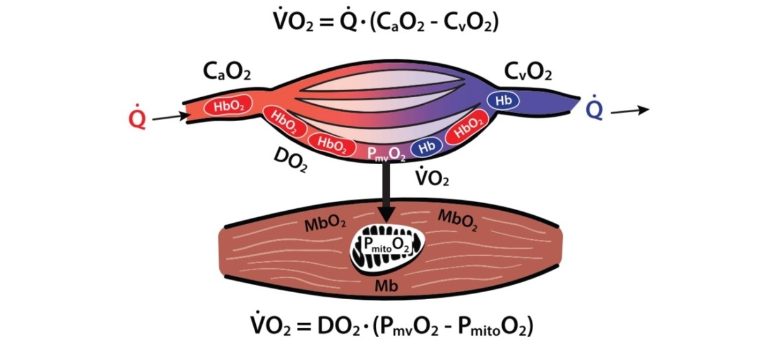

https://sparecycles.blog/2020/06/17/muscle-oxygenation-overview/
V̇O₂max
What is V̇O₂max?
V̇ -> Volume per unit of time
O₂ -> Oxygen
Max -> Maximal
Arteriovenous Difference in O₂
ml O₂/L
C: Concentration
a: arterial
v: venous
Ficks Principle
$\text{V}\text{̇}O_{2}max= \text{Qmax} × (CaO2 −CvO2)$
Cardiac output
= Stroke Volume * Heart Rate
Notes:
Dot above V, first derivative: rate of change vs stock,
Peripheral vs central limitations of VO2max,
So far we have only focused on peripheral limitations

Slide 19
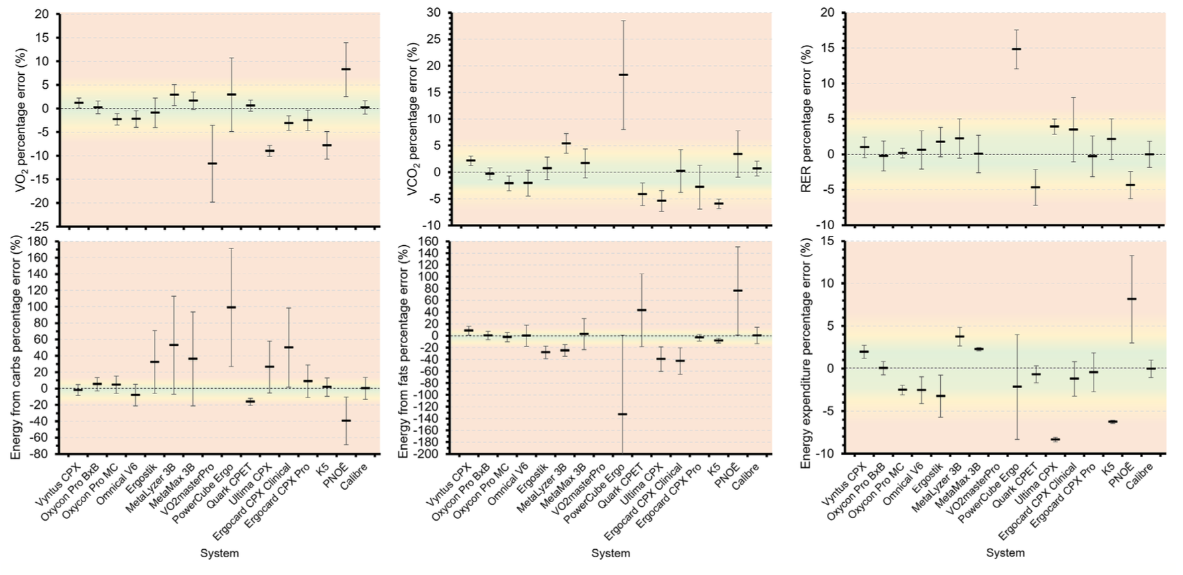
Spirometric Devices
Accuracy & Precision
Notes:
Green 3% (good agreement)
Yellow 5% (acceptable agreement)
Outside >5% poor agreement
-> Remember that this the average -> Lets have a look how this behaves over the different stages

Slide 20
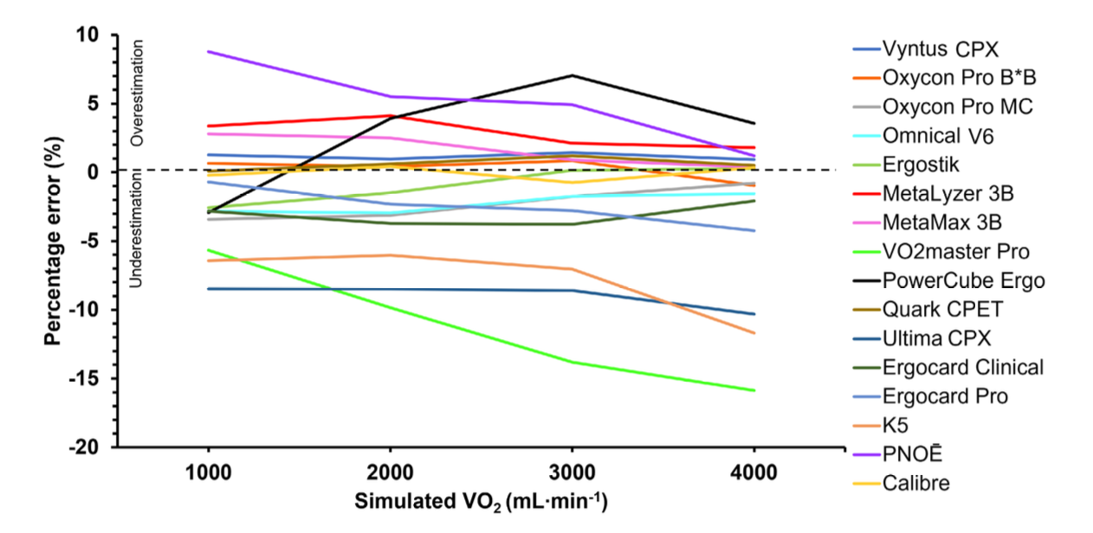
Spirometric Devices
Accuracy & Precision
Notes:
Overall most devices are pretty constant (e.g. Oxycon Pro B*B)
Some are deterioriating (V̇O2masterPro)
Other are heterogenous (PowerCube Ergo)
-> What can we do with this information? Calculation of the smallest worthwhile change
-> No one size fits all rule can be applied

Slide 21

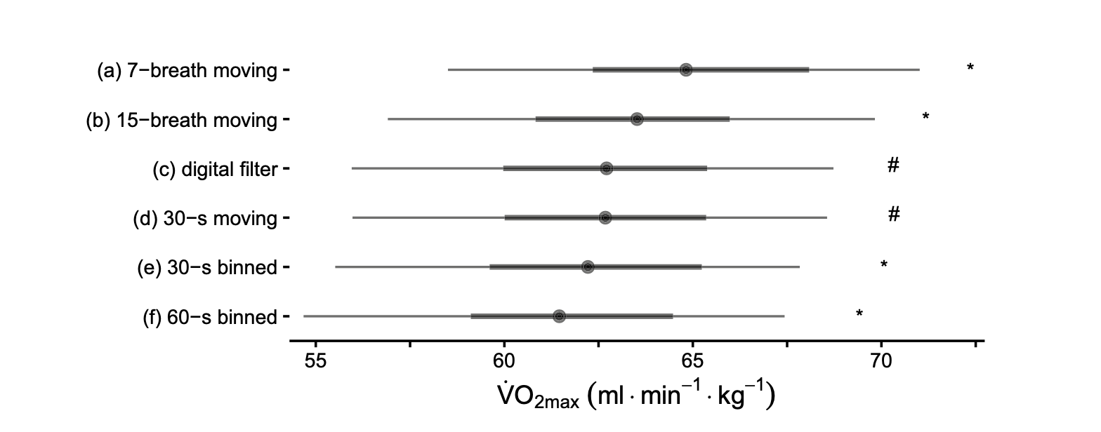
Spirometric Devices
Filtering Data
Always apply a filter to spirometric data !
Nolte et al., 2023
Notes:
Problem: Often in scientific literature it is not reported how this is done!

Slide 22
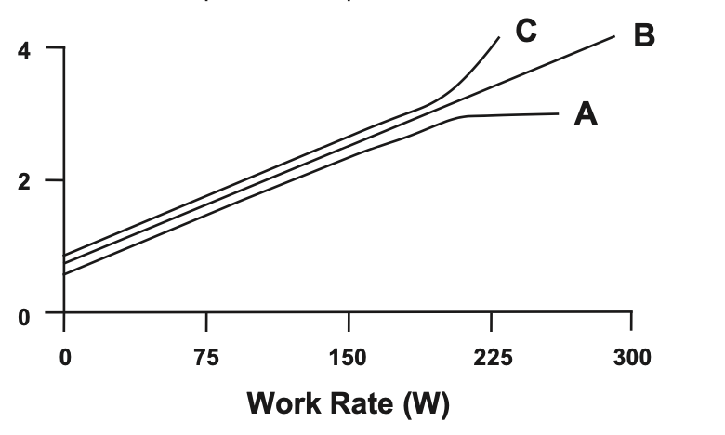
Truly Assessing V̇O₂max
V̇O₂ reaction to exercise
V̇O₂max ?
V̇O₂max !
Criteria for V̇O₂max
Leveling of the V̇O₂ – Work Rate Relationship
HR 5 – 10 beats below prediction, Blood Lactate > 8 mmol/L, RER > 1, 1.1, 1.15

Slide 23
Spirometric Devices
Indirect Calorimetrie – Relationship RQ and Substrate Use
100
%Fat Oxidation
Theorethical Relationship!
RQ ≠ RER
0
0.7
1
RQ
Assumptions of indirect Calorimetrie
1.) RQ = RER
2.) Gas exhange at mouth accurately reflects tissue level
Notes:
RQ measured at the muscular level only on the basis of ATP Synthesis processes
RER involves all processes, measured at the mouth level

Slide 24
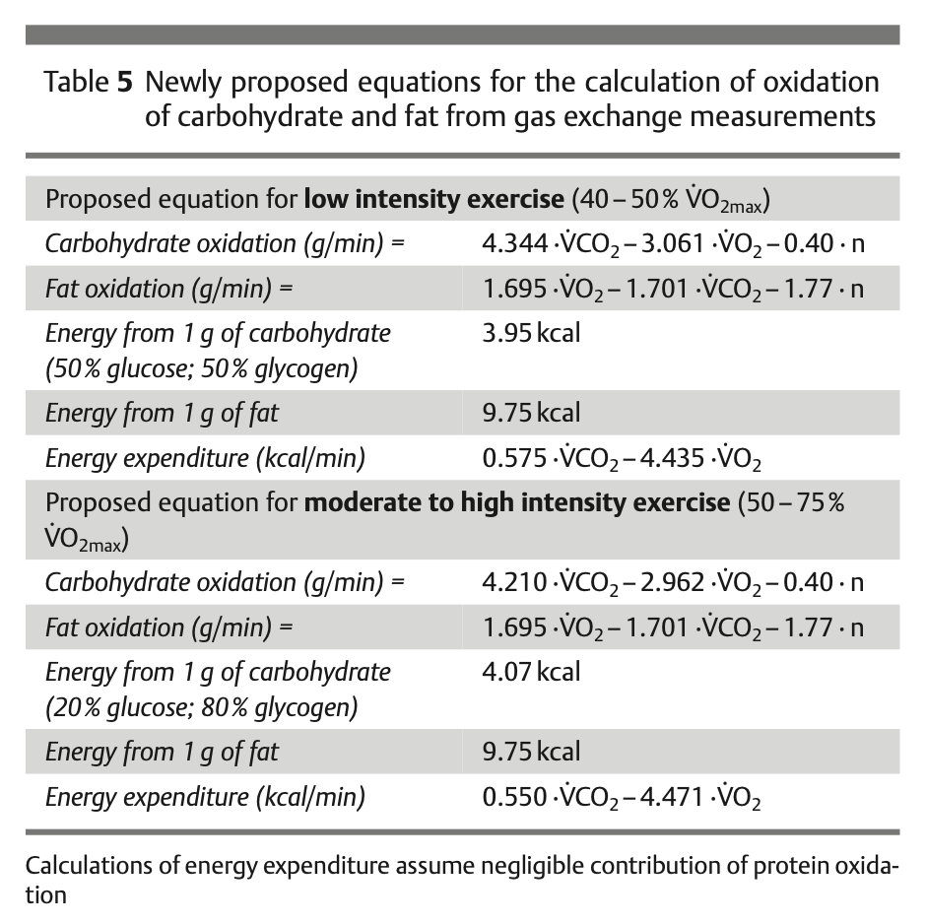
Spirometric Devices
Indirect Calorimetrie – Relationship RQ and Substrate Use
Notes:
Focus on different equations for different intensities -> Higher intensities we also have more La Production and thus more buffering and more „non-metabolic“ CO2
Also these equations directly calculate substrate use in g/min (which is kinda nice).
-> As a Home work they will need to calculate Substrate use for a step test and also V̇O2max from a ramp test

Slide 25
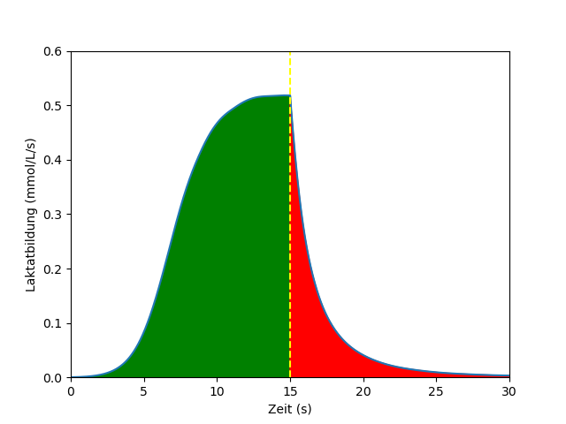

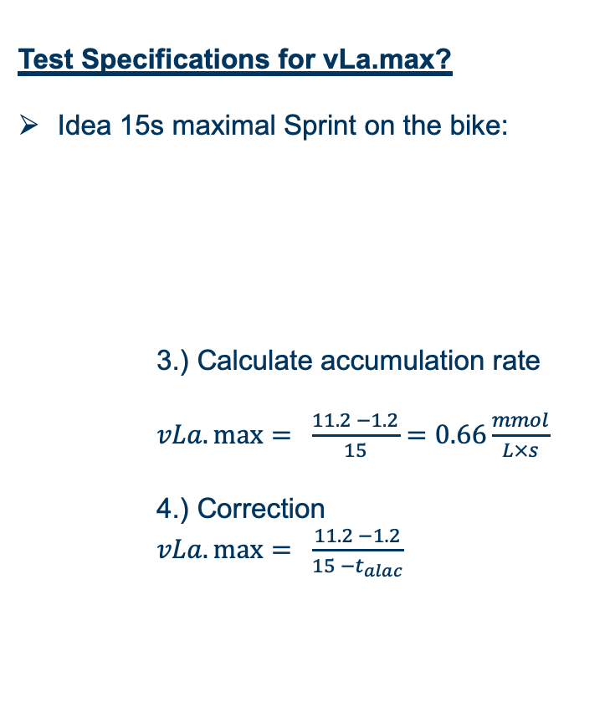
Measuring vLa_{max}
Test Specifications for vLa.max?
Idea 15s maximal Sprint on the bike:
3.) Calculate accumulation rate
$vLa.\max{= \frac{11.2 −1.2}{15}}=0.66\frac{mmol}{L×s}$
4.) Correction
$vLa.\max{= \frac{11.2 −1.2}{15 −t_{alac}}}$
t_{alac}
t_{alac}
Lactate production
Correction for
Delayed activation
Delayed deactivation
t_{alac} ~ 3.4s
(for 15s sprint)
Notes:
Delayed Activation gives positiv t_alax
Delayed deactivation gives negative t_alac
-> Activation effect is higher, overall we get a postive number

Slide 26
Insufficient ADP/AMP activation
Acidosis inhibits glycolysis
Peak lactate flux short
talac correction highly variable
Problems associated
with vLamax testing
Lactate clearance unaccounted for
No vLamax verification criterion
*(Glycolytic ATP after exercise cessation)
Wackerhage et al., 2025

Slide 27
La⁻
= 1 mmol
Measuring [La⁻]
La⁻
La⁻
La⁻
La⁻
La⁻
La⁻
2 L
La⁻
La⁻
La⁻
0.25 L
8 mmol / 2 L -> 4 mmol / L
Remember: For 1 mmol La⁻ 1.4 mmol is resynthesized
Absolute ATP : 8 * 1.4 = 11.2 mmol ATP
1 mmol / 0.25 L -> 4 mmol/L
Absolute ATP = 1 * 1.4 = 1.4 mmol ATP
Notes:
8 / 2 = 4
1 / 0.25 = 4
Concentration * absolute distribution space = absolute quantity
ATP yield is highly different, eventhough the concentration is the same.
Therefore: If we are measuring the concentration, we also have to take into account the overall distribution volume

Slide 28
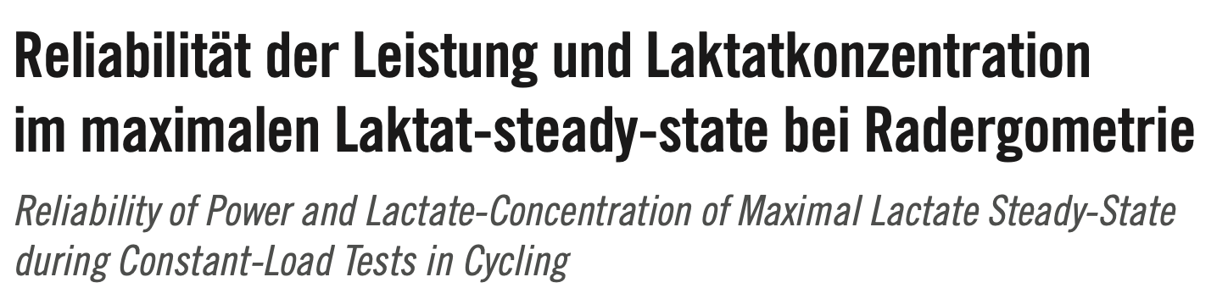
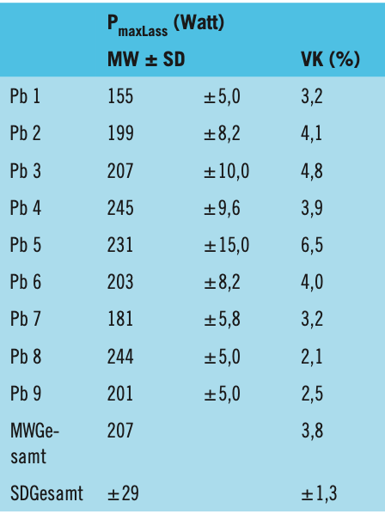
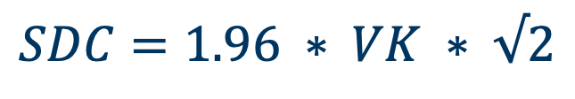
$$SDC=1.96 ∗ VK ∗ √2$$
Example:
12 Week Training intervention
Pre-Test: 200W
Post-Test: 220W
SDC = 1.96 * 0.038 * 200 * 1.41 = 21 W
Idea: Use 1 VK for „trending“
SDC = 1 * 0.038 * 200 * 1.41 = 11 W
THIS VK IS ONLY APPLICABLE TO MAXLASS TESTING
Hauser et al., 2011

Slide 29
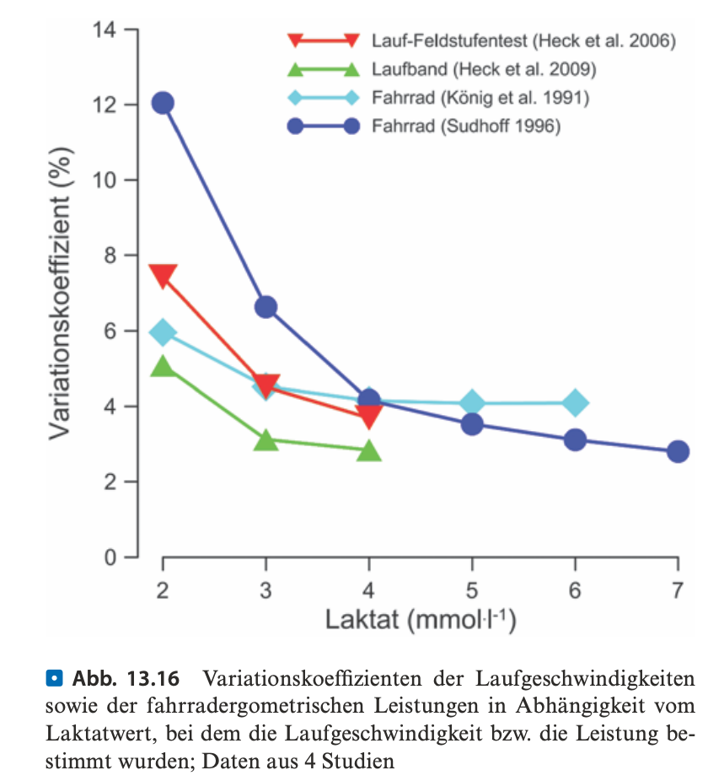
Heck et al., 2022, Chapter 13

Slide 30





What is Training?
Response Matrix
Signal Transduction
External Stimulus
Internal Stimulus
metabolic hormonal
neuronal mechanical
Adapting
Processing
Detecting
Adaptational Effect
mod. from Toigu & Boutellier, 2006
Notes:
Layers of response matrix: muskuloskeletal adaptations, proteins (enzymes, structural proteins),
Principles of adaptation induced stimuli

Slide 31
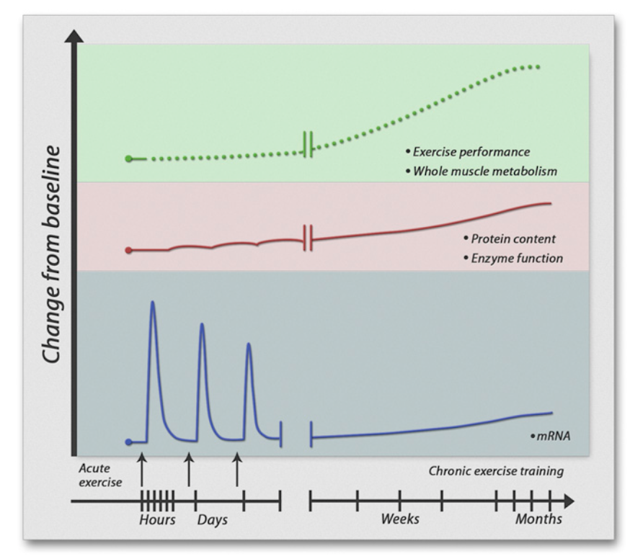
What is Training?
Engan & Zierath, 2013

Slide 32
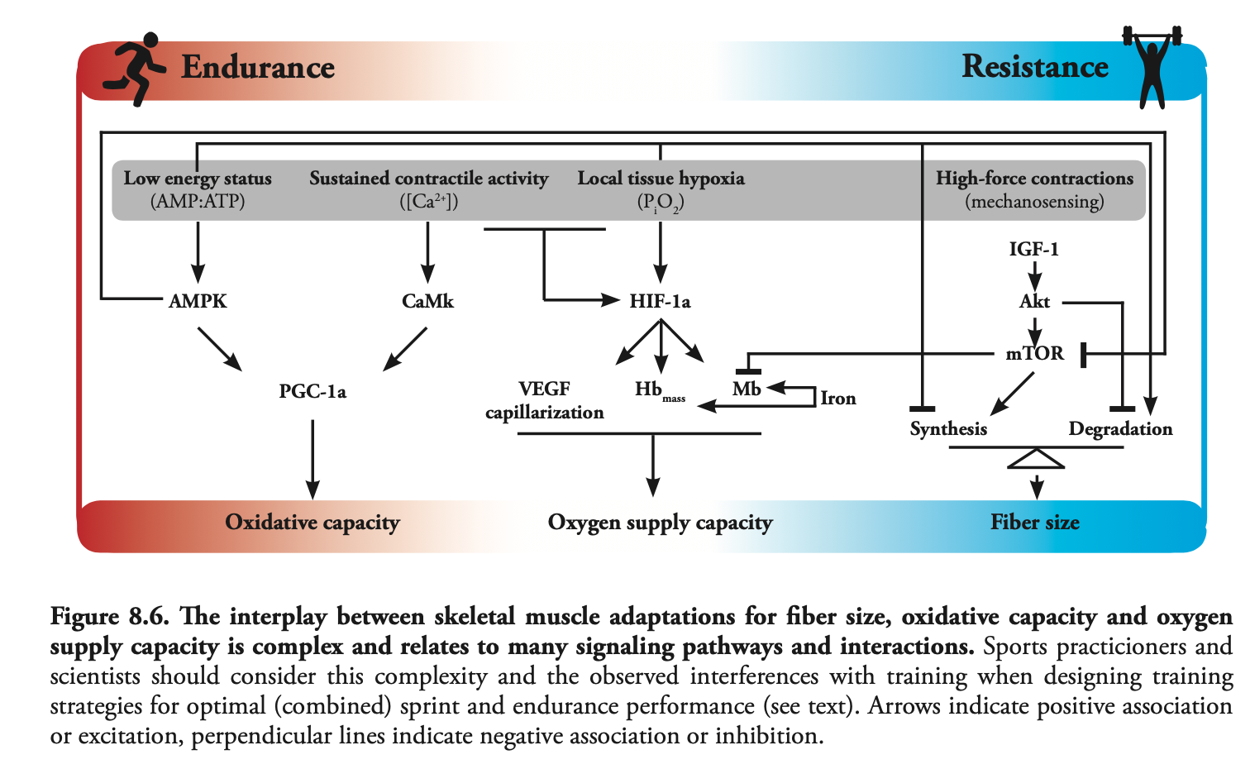
Metabolic Pathways for external stimuli
Van der Zwaart, 2016

Slide 33
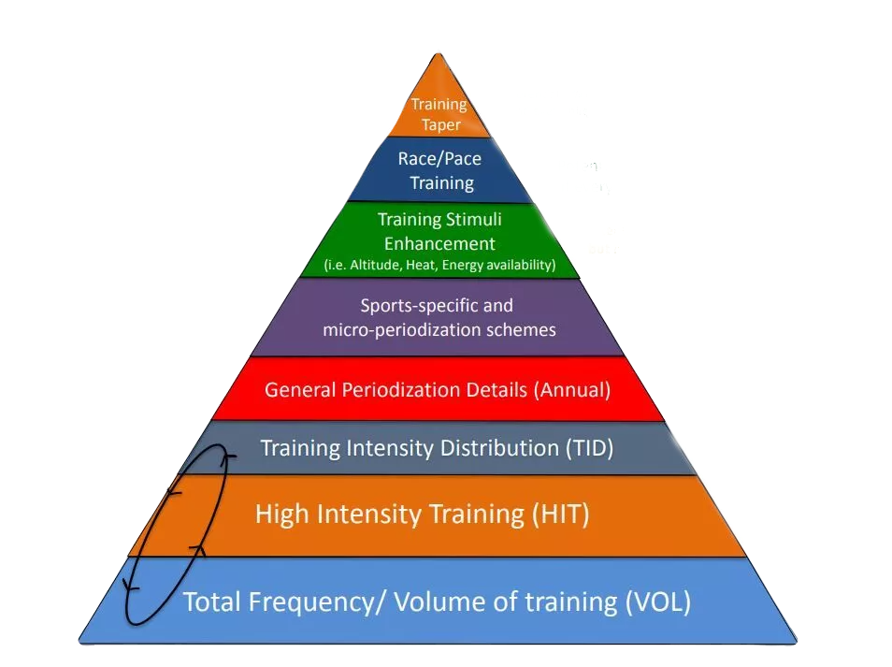
Analysis of previous training records
Where does the endurance performance i have measured come from?
Analysis of training records:
  Training Diary
  Records (GPS, Heart Rate)
  Anamnesis
  Volume
  Frequency
  Intensity
  Type of Training

Slide 34
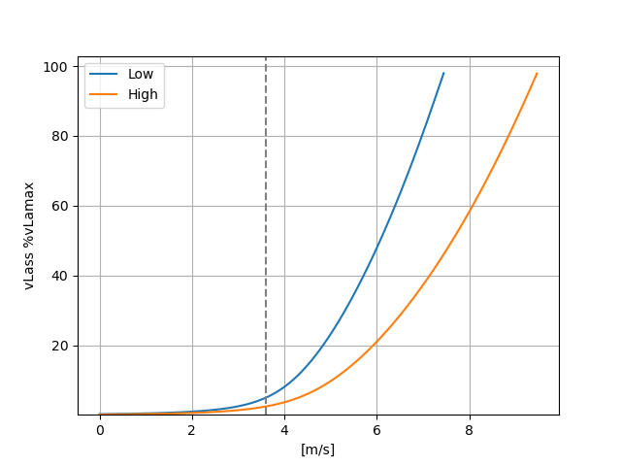
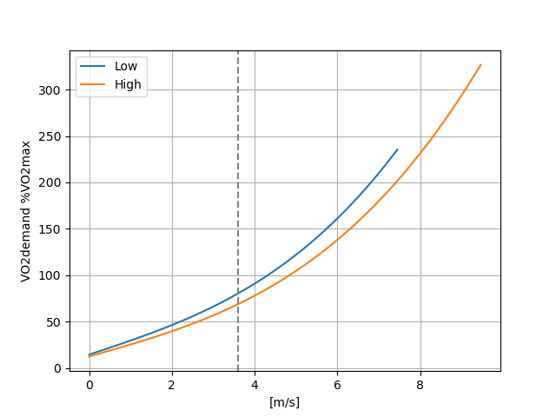

Interval Training as %AT/%FTP
Setting Intensity for V̇O₂max intervals as %AT likely yields interindividually different adaptations!
Notes:
Idea: %vlamax as low as possible, %VO2max as high as possible

Slide 35
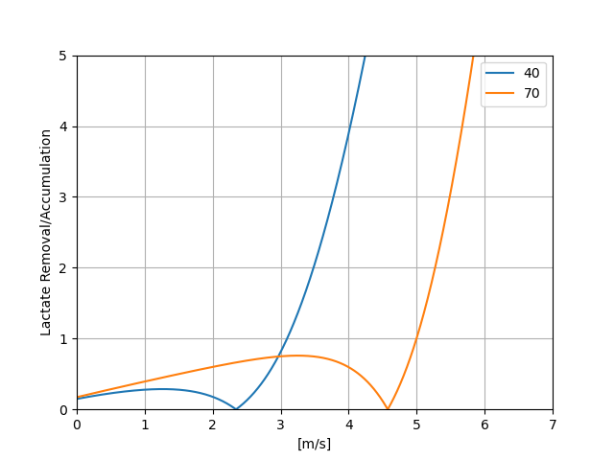
Fitness level considerations
Notes:
Time for lactate removal is much different for both of them because of different VO2max.

Slide 36
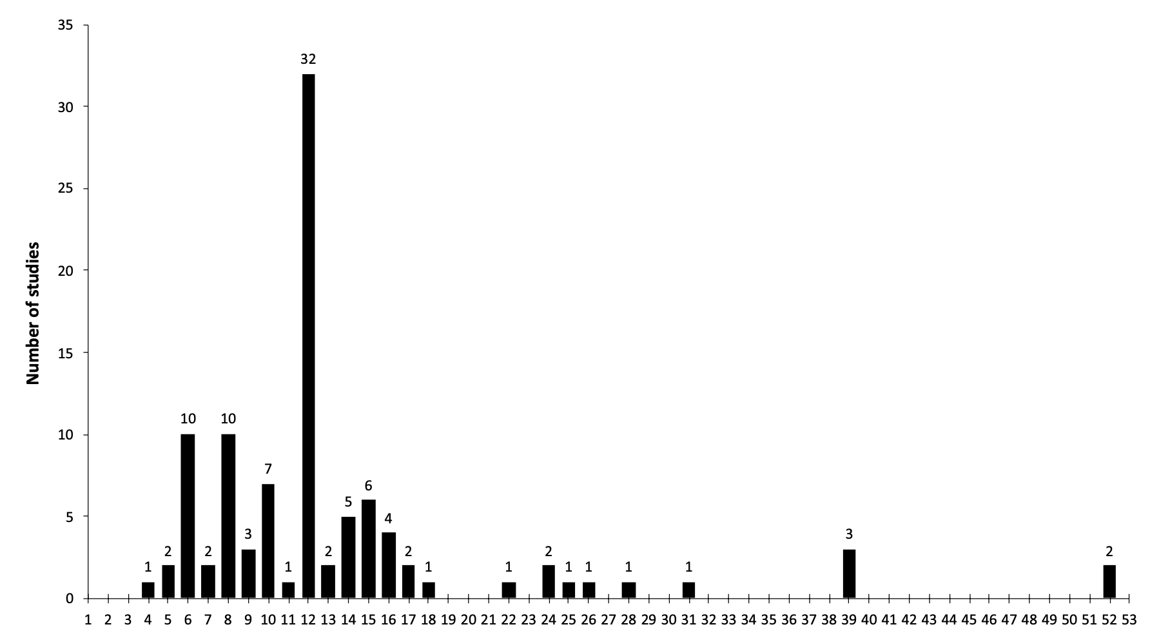
Kataoka et al., 2021
Notes:
Reverse periodization, linear periodization and so on…

Slide 37
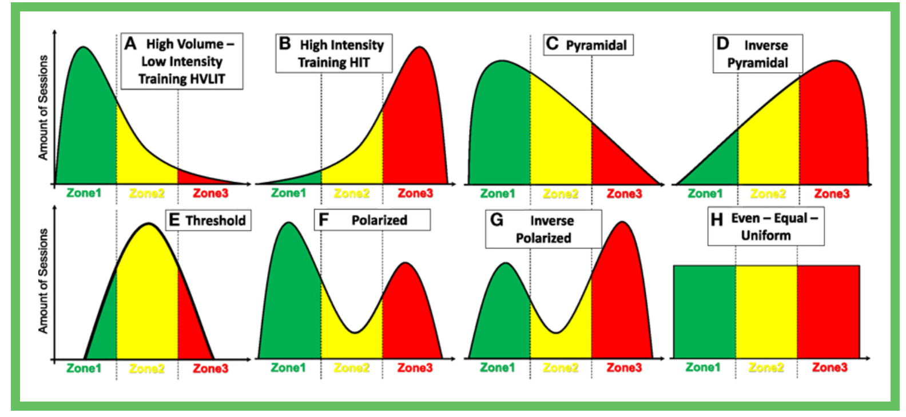
Analysis of previous training records
Training intensity distribution
Stöggl, 2018

Slide 38
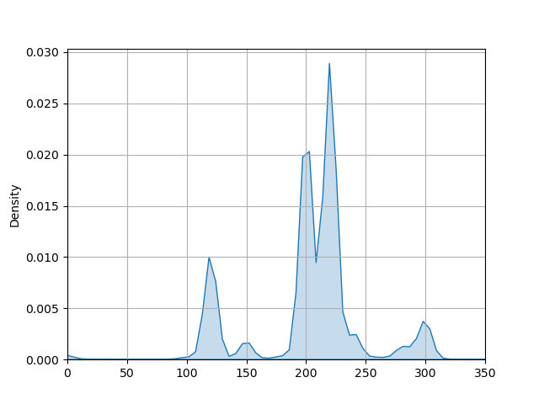

Slide 39
Exam Structure
45 MC questions (15 per Seminar)

Slide 40
Which statements about energy metabolism are correct?
The caloric equivalent is the amount of energy in joule released during the reaction of the substrate with 1 litre of oxygen.
The caloric equivalent of glucose, fat and protein is 19.6 kJ/l O₂ , 21.1 kJ/l O₂, and 18.8 kJ/l O₂, respectively.
A respiratory quotient of 0.7 corresponds to a caloric equivalent of 21.1 kJ/l O_{2.}
The basal metabolic rate of a person is approximately between 3 - 5 ml/min/kg V̇O₂.
The energy value of carbohydrates, fats, and proteins are 4.1 kcal/g, 9.3 kcal/g and 4.1 kcal/g, respectively.
Only 1, 4 and 5 are correct.
All statements 1-5 are correct.
Only 1, 3, 4, and 5 are correct.
Only 2 and 5 are correct.
Only 1 and 4 are correct.

Slide 41
Which statements about energy metabolism are correct?
The caloric equivalent is the amount of energy in joule released during the reaction of the substrate with 1 litre of oxygen.
The caloric equivalent of glucose, fat and protein is 19.6 kJ/l O₂ , 21.1 kJ/l O₂, and 18.8 kJ/l O₂, respectively.
A respiratory quotient of 0.7 corresponds to a caloric equivalent of 21.1 kJ/l O_{2.}
The basal metabolic rate of a person is approximately between 3 - 5 ml/min/kg V̇O₂.
The energy value of carbohydrates, fats, and proteins are 4.1 kcal/g, 9.3 kcal/g and 4.1 kcal/g, respectively.
Only 1, 4 and 5 are correct.
All statements 1-5 are correct.
Only 1, 3, 4, and 5 are correct.
Only 2 and 5 are correct.
Only 1 and 4 are correct.

Slide 42
Feel free to reach out for any topic you want to discuss…

