Slide 1
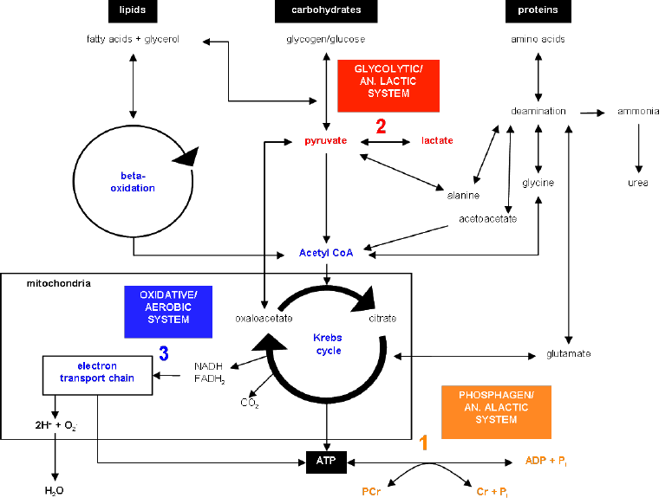
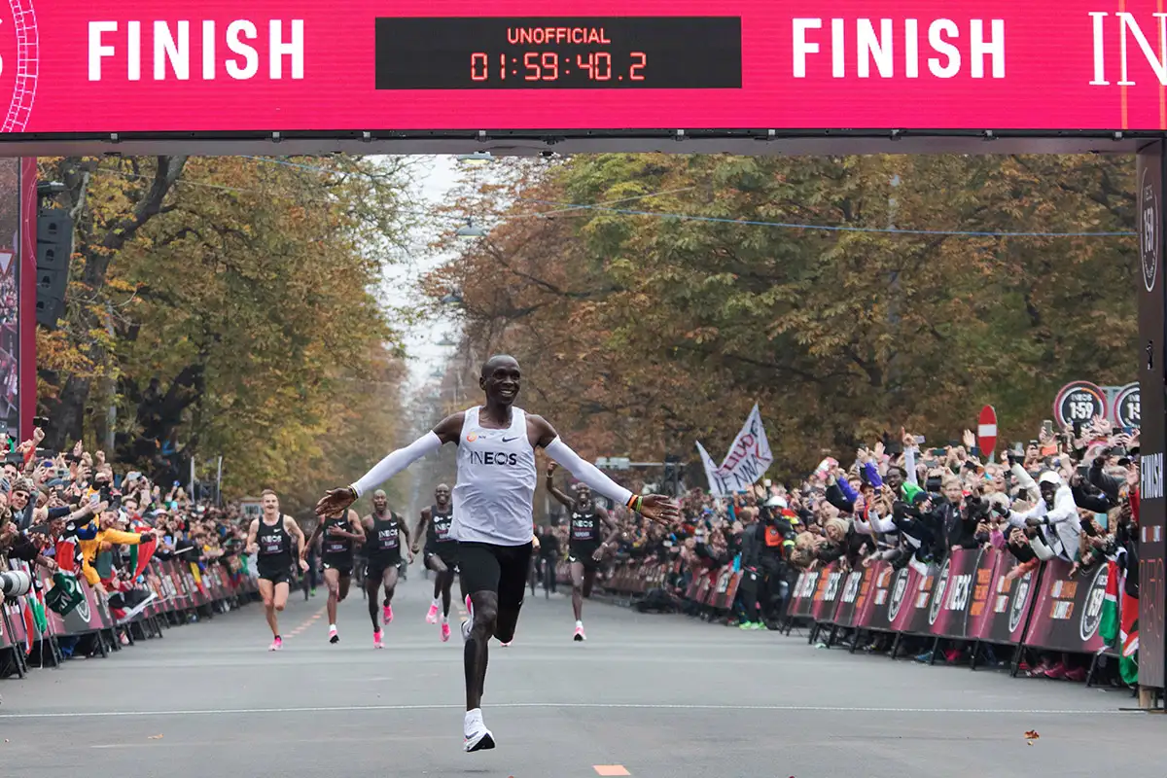
Applied Exercise Physiology & Sports Nutrition for Health & Performance
Jasper Suttmeyer

Slide 2
Todays Agenda
Recap Rothschild Paper
Bottlenecks to overall training volume
Designing Single Training Sessions & Microcycles

Slide 3
Todays Agenda
Different AMPK Markers are correlated, but not interchangeable
Glycogen – it is not where you start, but where you end
Carbohydrate use before and during exercise has a minimal effect
Disrupting cellular energy charge is key!
Notes:
Calculated in Hedges g‘, which is simply the difference in means (pre to post) divided by the pooled standard deviation (pre and post).
T test: Is the change statistically significant (not due to chance)
Effect size: how large is the change
Normally cohens d‘ is calculated, but hedges g‘ corrects for smaller sample sizes

Slide 4
Steps in training planning
Needs Analysis
(Previous) Training records
Testing
Identifying bottlenecks to performance
Writing training plan
Repeat

Slide 5
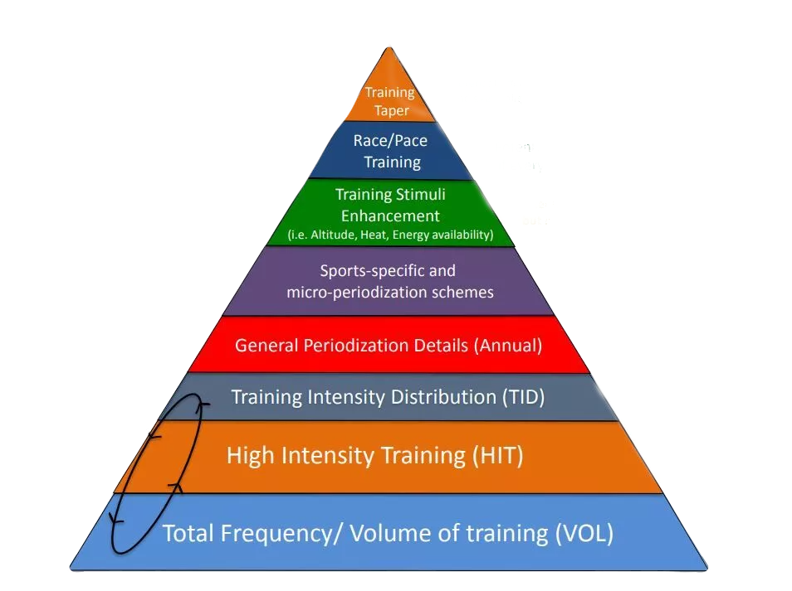
Analysis of previous training records
Analysis of training records:
  Training Diary
  Records (GPS, Heart Rate)
  Anamnesis
  Volume
  Frequency
  Intensity
  Type of Training
Seiler, 2016

Slide 6
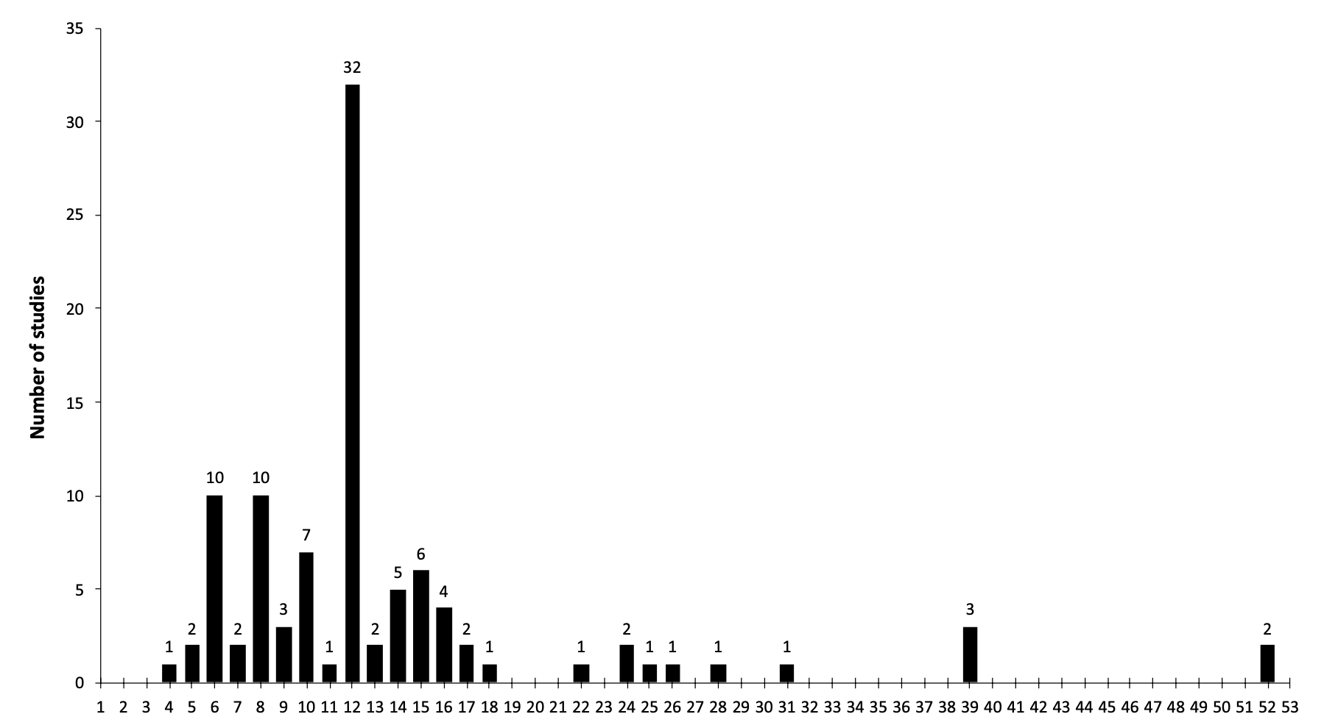
Kataoka et al., 2021
Focus on training principles instead of chasing numbers, distributions etc.
Notes:
Reverse periodization, linear periodization and so on…

Slide 7
How much volume can we train?
Potential Bottlenecks:
-> Mechanical Stress?
-> Substrate Availability?
Task:
- Read through the abstract of the uploaded paper and be prepared to summarize the findings

Slide 8
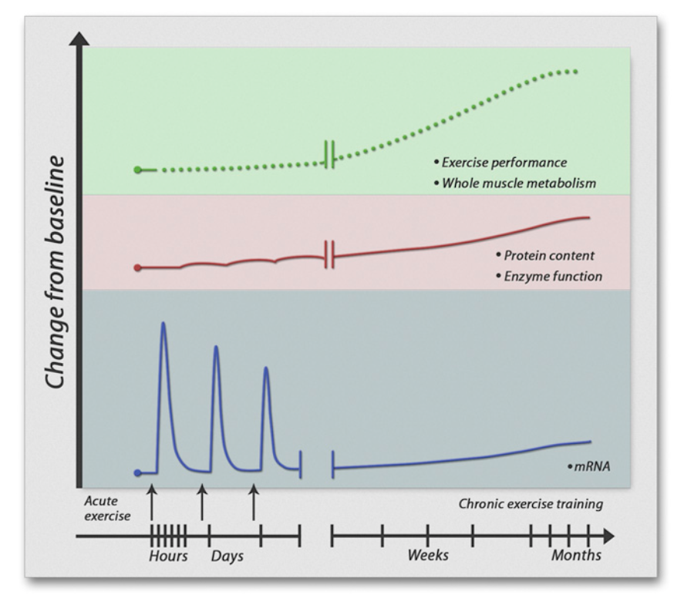
What is Training?
Engan & Zierath, 2013

Slide 9
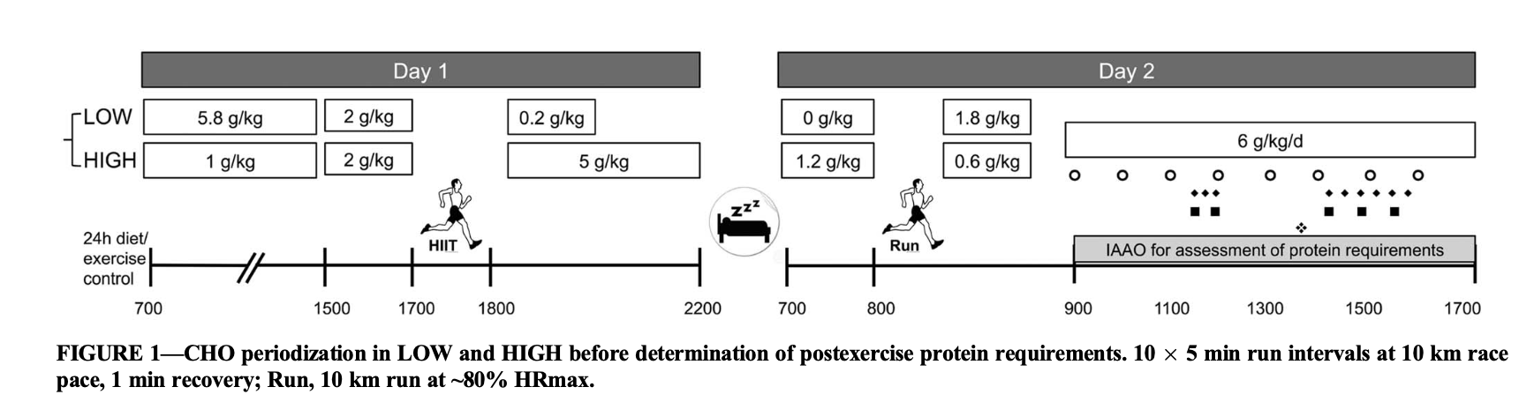
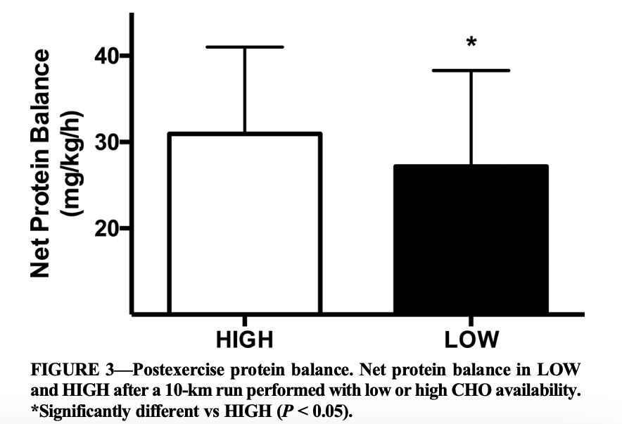
Gillen et al., 2016
Notes:
Acute vs chronic effects

Slide 10
Amino acids normally provide ~5% of exercise energy.
Low muscle glycogen can increase this to ~10%.
Glycogen depletion increases BCAA (especially leucine) oxidation.
This is linked to greater muscle protein breakdown.
Overall, low glycogen leads to increased use of amino acids as fuel during exercise.
Training chronically on low carbohydrate stores?

Slide 11
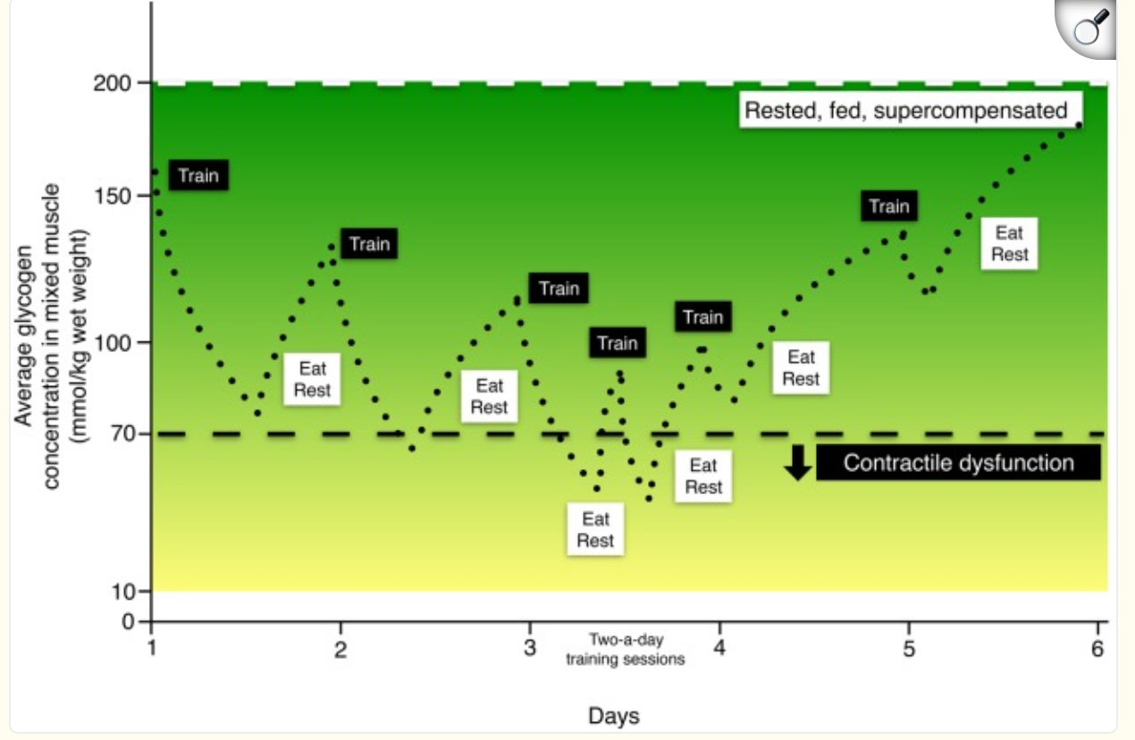
What confines overall possible training volume?
Murray & Rosenbloom, 2018
Notes:
Also explain what happens, when glycogen levels are too low

Slide 12
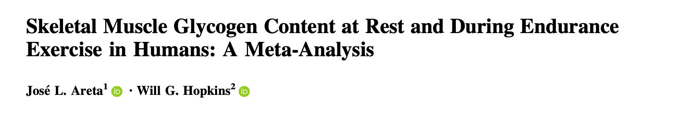
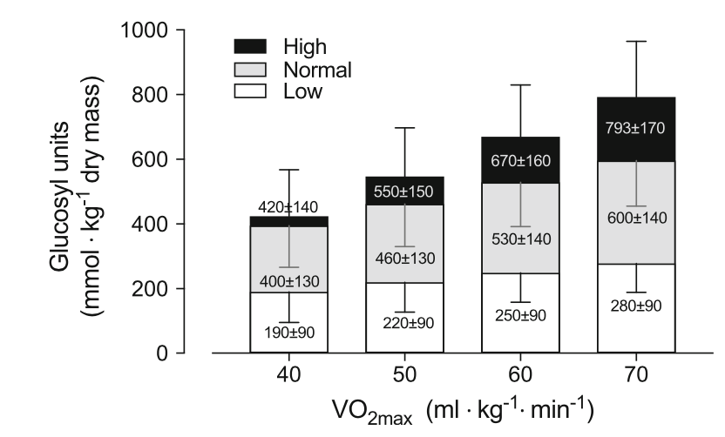
Areta & Hopkins, 2018

Slide 13
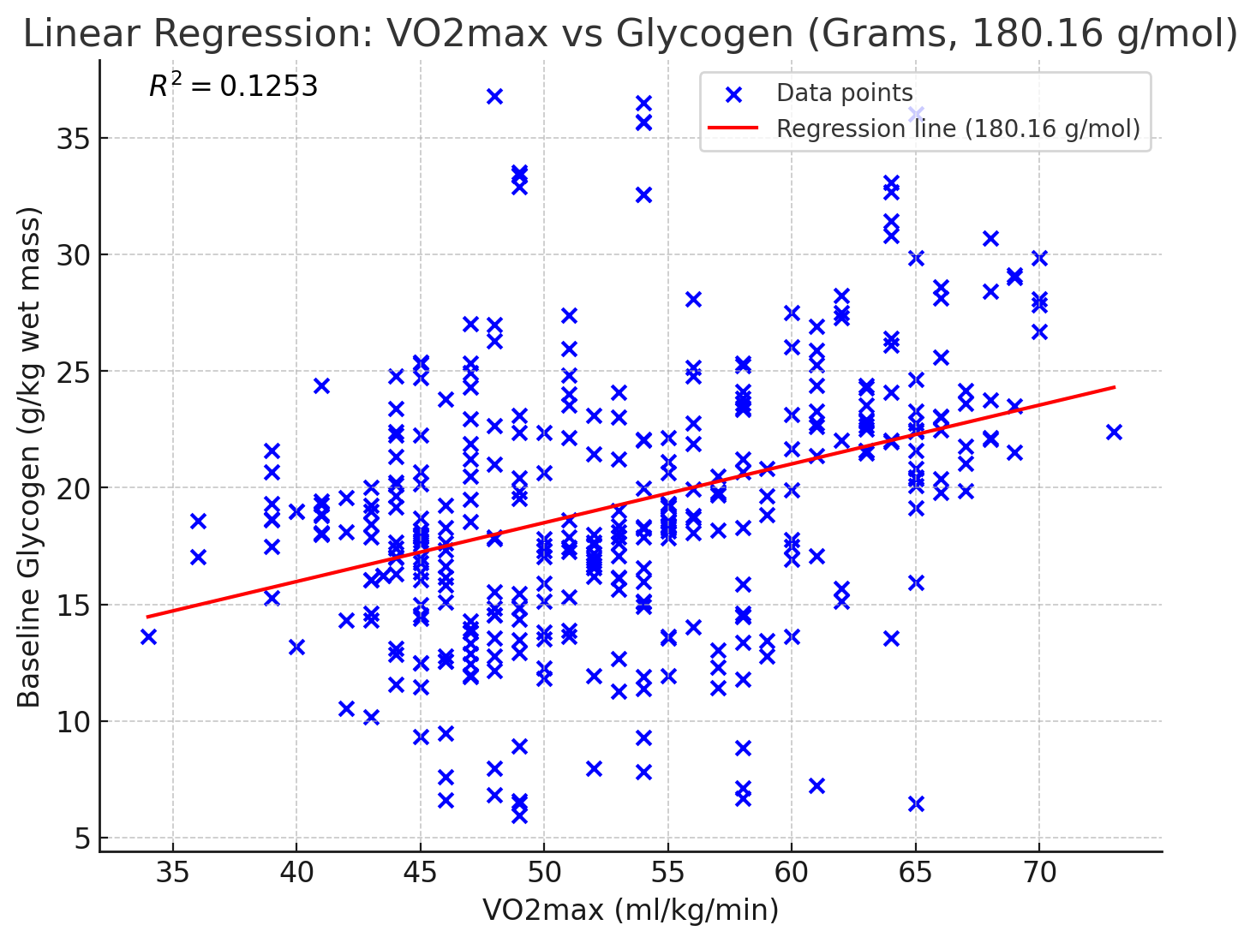
Example:
Mass = 72
Active Muscle = 26%
V̇O₂max = 59
72 * 0.26 * 20 = ~374g
based on appendix date from Areta & Hopkins, 2018

Slide 14
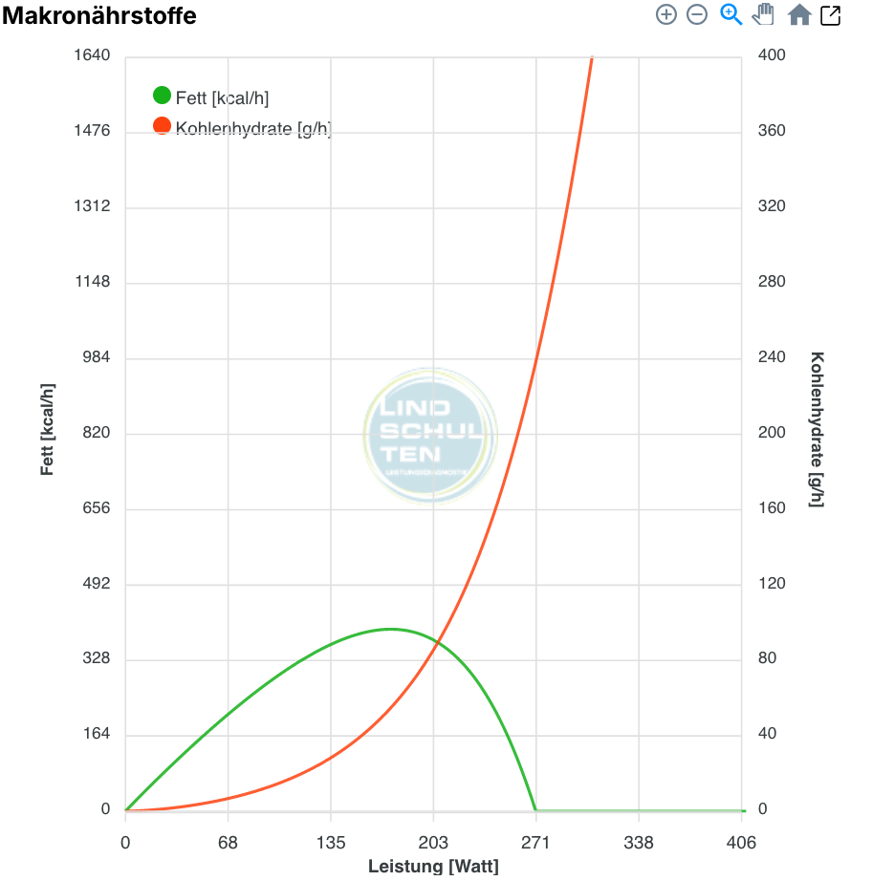
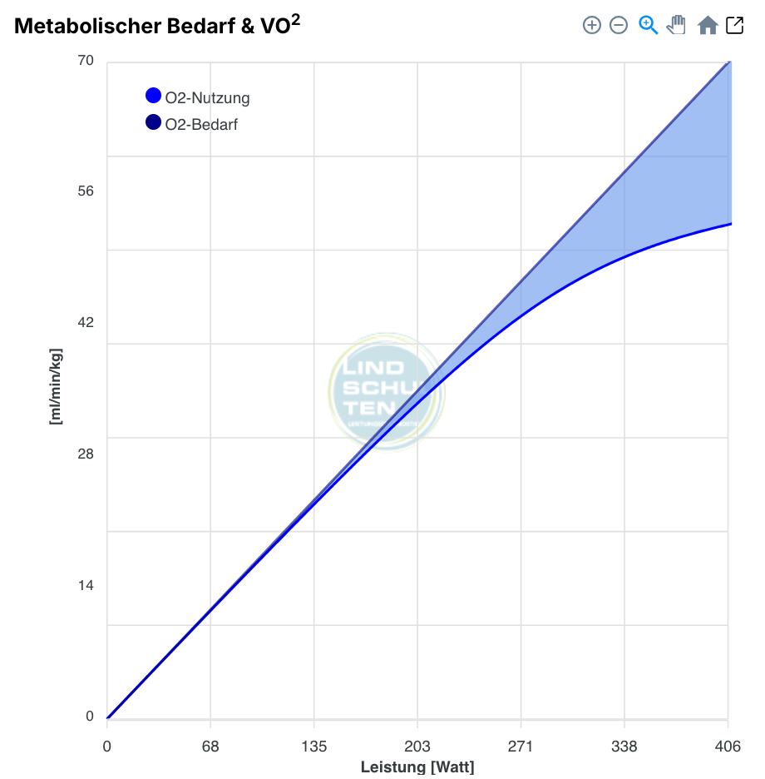
Notes:
VO2max 59, 0.26 active muscle = 72 * 0.26 * 20 = 374
Make the calculations with them -> How long will carbohydrate stores be good for? How much oxygen can be used?

Slide 15
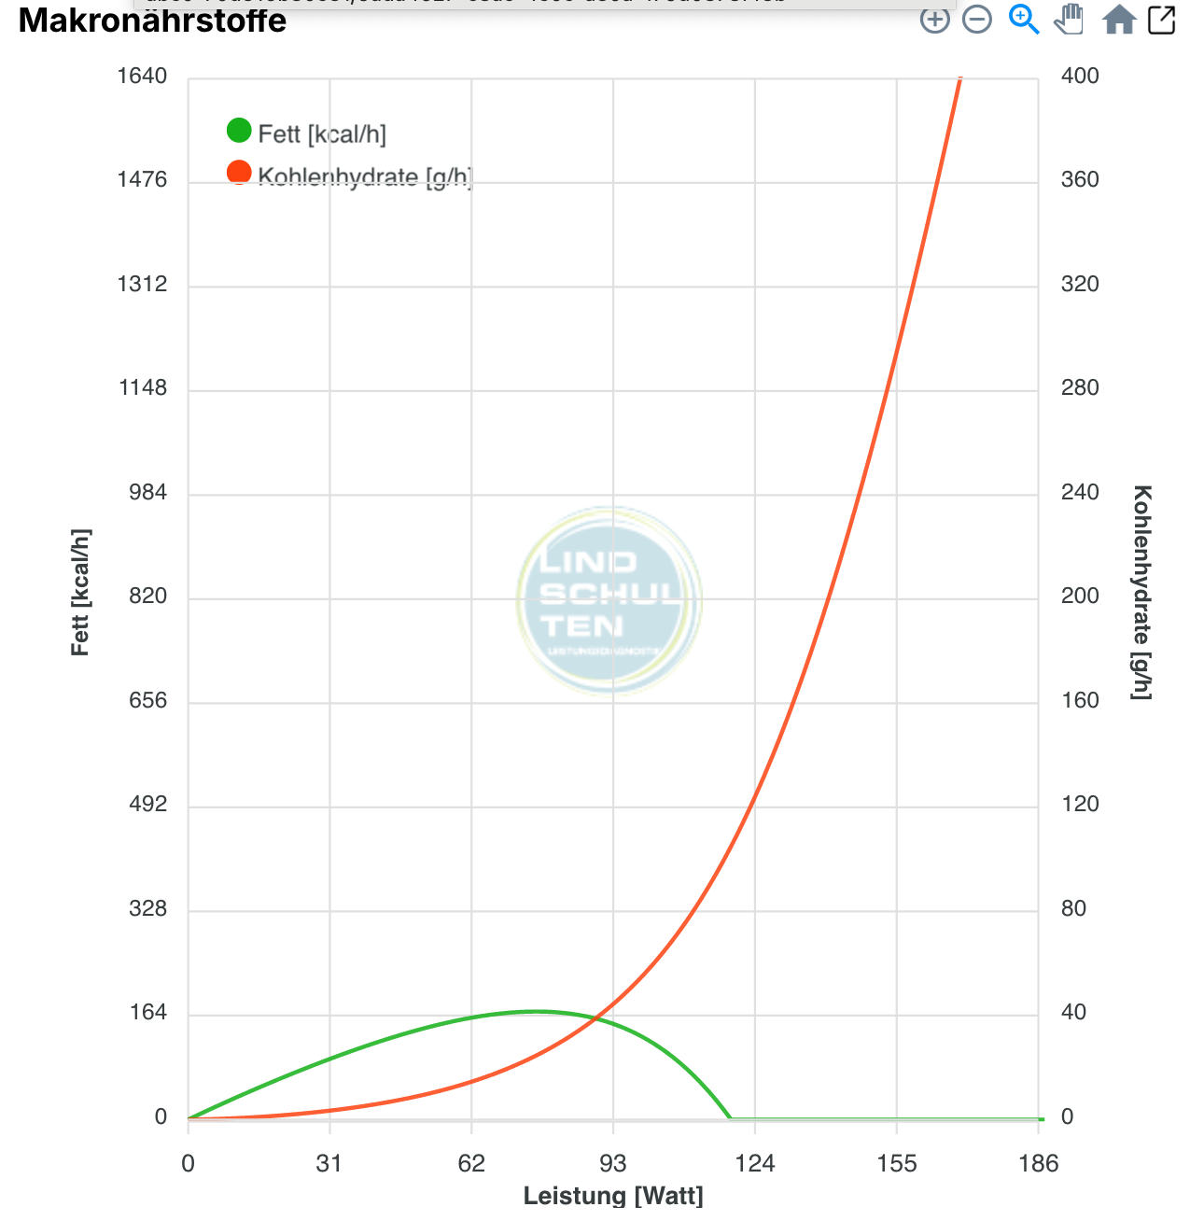
Example of a less fit athlete…
Example:
V̇O₂max = 35 ml/min/kg
Notes:
She can train at a higher % of AT because likely lower volume in the week and overall less carbohydrate utilisation in relation to stores

Slide 16
Summary
Definition of Training?
Limitation of training volume based on carbohydrate availability
Trap of highly trained athletes and carbohydrate stores
TASK:
Read through one of the uploaded papers for this session and prepare a short presentation (5min)
(Haugen et al.: Highlight on Table 2, 3 and 5)
(Molmen & Ronnestadt: Highlight Figure 2)

Slide 17
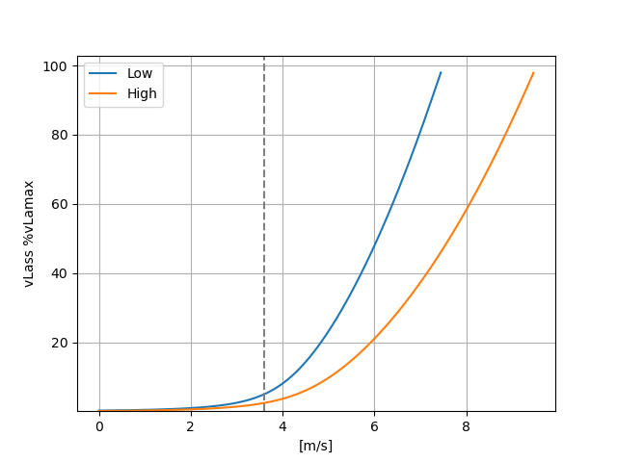
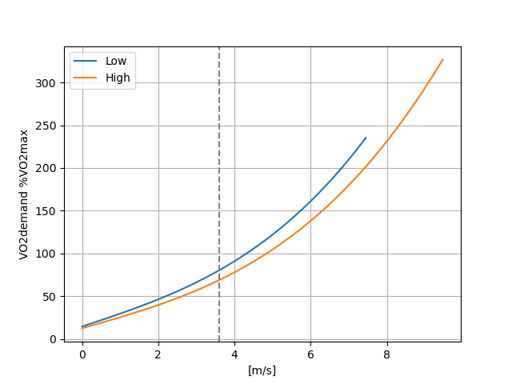

Interval Training as %AT/%FTP
Setting Intensity for V̇O₂max intervals as %AT likely yields interindividually different adaptations!
Notes:
Idea: %vlamax as low as possible, %VO2max as high as possible
orange high vlamax/high vo2max, blue low vlamax/low vo2max

Slide 18
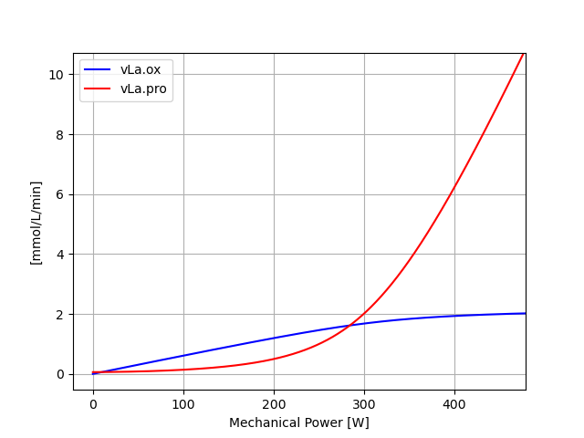
@ 400W Lactate accumulation roughly 4 mmol/L/min
@ 200W: Lactate deficit roughly 0.5 mmol/L/min
Notes:
Just to remind where the graphs on the next slide come from

Slide 19
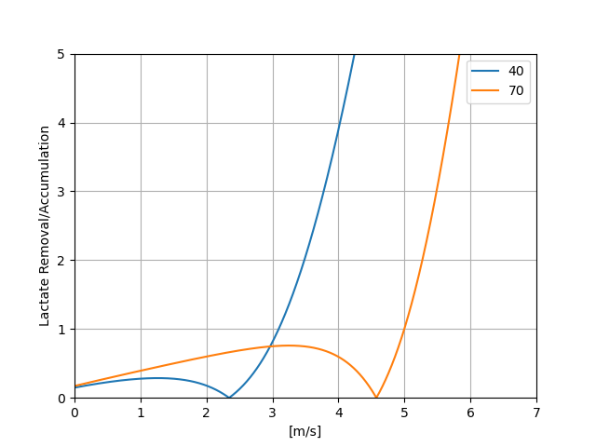
Fitness level considerations
Notes:
Time for lactate removal is much different for both of them because of different VO2max.

Slide 20
Group Tasks
Create one of the following sessions:
1.) Increase power @ FatMax
2.) Increase Sprint performance
3.) Increase V̇O₂max
4.) Decrease vLamax
5.) Increase power @ the anaerobic threshold
Explain the overall structure as well as the underlying physiology!
Notes:
Four groups, each group should start with a different scenario
Power-time
PCr-Time
V̇O2-time (% max)
vLa-time (% max)
cLa-time
Before starting with case studies: Is there anything that interests you in particular for the last session?;
Open test result in the back

Slide 21
Group Tasks
Same, but create an entire training week:
1.) Increase power @ FatMax
2.) Increase Sprint performance
3.) Increase V̇O₂max
4.) Decrease vLamax
5.) Increase power @ the anaerobic threshold
Explain the overall structure as well as the underlying physiology!
Notes:
Four groups, each group should start with a different scenario
Power-time
PCr-Time
V̇O2-time (% max)
vLa-time (% max)
cLa-time
Before starting with case studies: Is there anything that interests you in particular for the last session?

Slide 22
Next week
Sport Science as a business
Summary + Examen + Feedback
Notes:
Four groups, each group should start with a different scenario
Power-time
PCr-Time
V̇O2-time (% max)
vLa-time (% max)
cLa-time
Before starting with case studies: Is there anything that interests you in particular for the last session?

Slide 23
Literature
Areta JL, Hopkins WG. Skeletal Muscle Glycogen Content at Rest and During Endurance Exercise in Humans: A Meta-Analysis. Sports Med. 2018 Sep;48(9):2091-2102. doi: 10.1007/s40279-018-0941-1. PMID: 29923148.
Egan B, Zierath JR. Exercise metabolism and the molecular regulation of skeletal muscle adaptation. Cell Metab. 2013 Feb 5;17(2):162-84. doi: 10.1016/j.cmet.2012.12.012. PMID: 23395166.
Gillen JB, West DWD, Williamson EP, Fung HJW, Moore DR. Low-Carbohydrate Training Increases Protein Requirements of Endurance Athletes. Med Sci Sports Exerc. 2019 Nov;51(11):2294-2301. doi: 10.1249/MSS.0000000000002036. PMID: 31083047.
Kataoka R, Vasenina E, Loenneke J, Buckner SL. Periodization: Variation in the Definition and Discrepancies in Study Design. Sports Med. 2021 Apr;51(4):625-651. doi: 10.1007/s40279-020-01414-5. Epub 2021 Jan 6. PMID: 33405190.
Murray B, Rosenbloom C. Fundamentals of glycogen metabolism for coaches and athletes. Nutr Rev. 2018 Apr 1;76(4):243-259. doi: 10.1093/nutrit/nuy001. PMID: 29444266; PMCID: PMC6019055.
Seiler (2016), Seiler's Hierarchy of Endurance Training Needs.. 10.13140/RG.2.2.16667.05924

