Slide 1
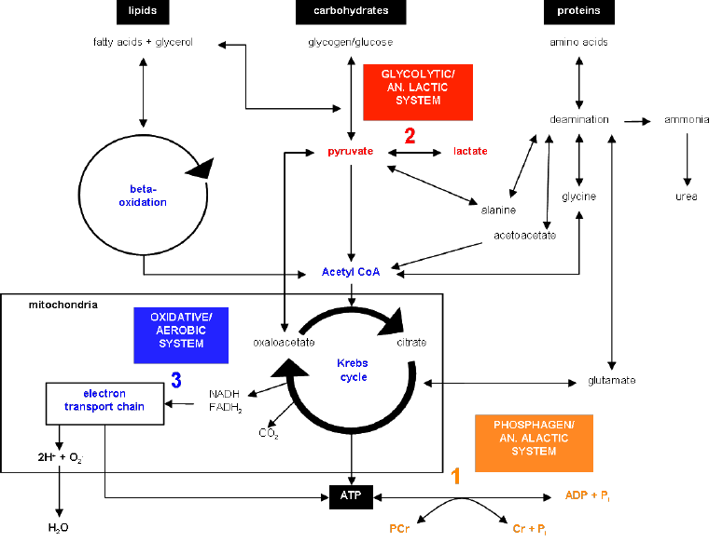
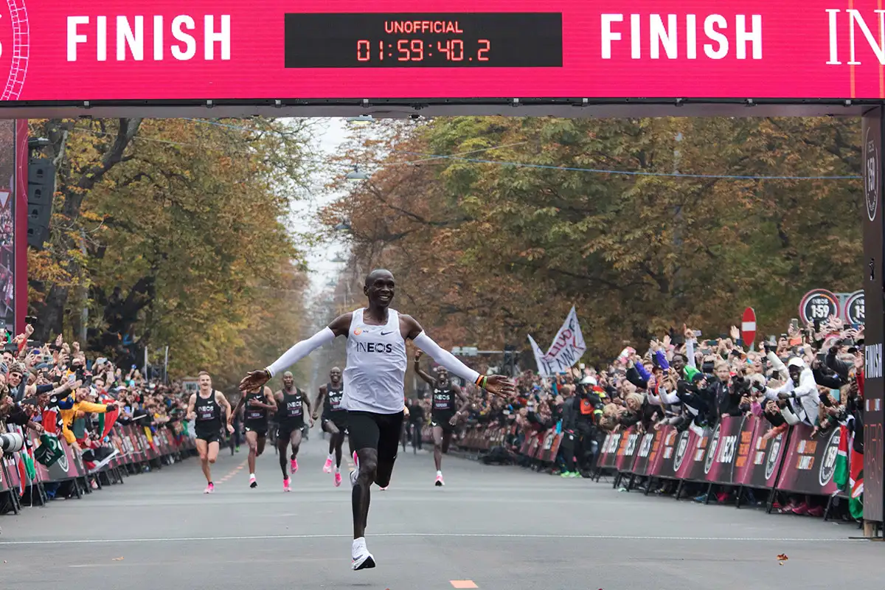
Applied Exercise Physiology & Sports Nutrition for Health & Performance
Jasper Suttmeyer

Slide 2
Agenda Today
Wrap Up vLamax-Testing
Validity of the model?!
Live Testing Session
Training planning

Slide 3
Summary reliability
Due to the reduction in variability with increasing lactate concentrations, performance values measured at higher lactate levels should be preferred for evaluating changes in endurance capacity, since reliability is higher in this range.
Also: Longer Stages -> Higher Lactate Concentrations at lower external workload -> better reliability…
Communication of results to Athletes -> What is a detectable change? What is potential noise in data?
Pitfall: Testing Economy?!
Further reading: Heck 2022, Laktat, Chapter 13.5

Slide 4





What is Training?
Response Matrix
Signal Transduction
External Stimulus
Internal Stimulus
metabolic hormonal
neuronal mechanical
Adapting
Processing
Detecting
Adaptational Effect
mod. from Toigu & Boutellier, 2006
Notes:
Layers of response matrix: muskuloskeletal adaptations, proteins (enzymes, structural proteins),
Principles of adaptation induced stimuli
Can you define training?

Slide 5
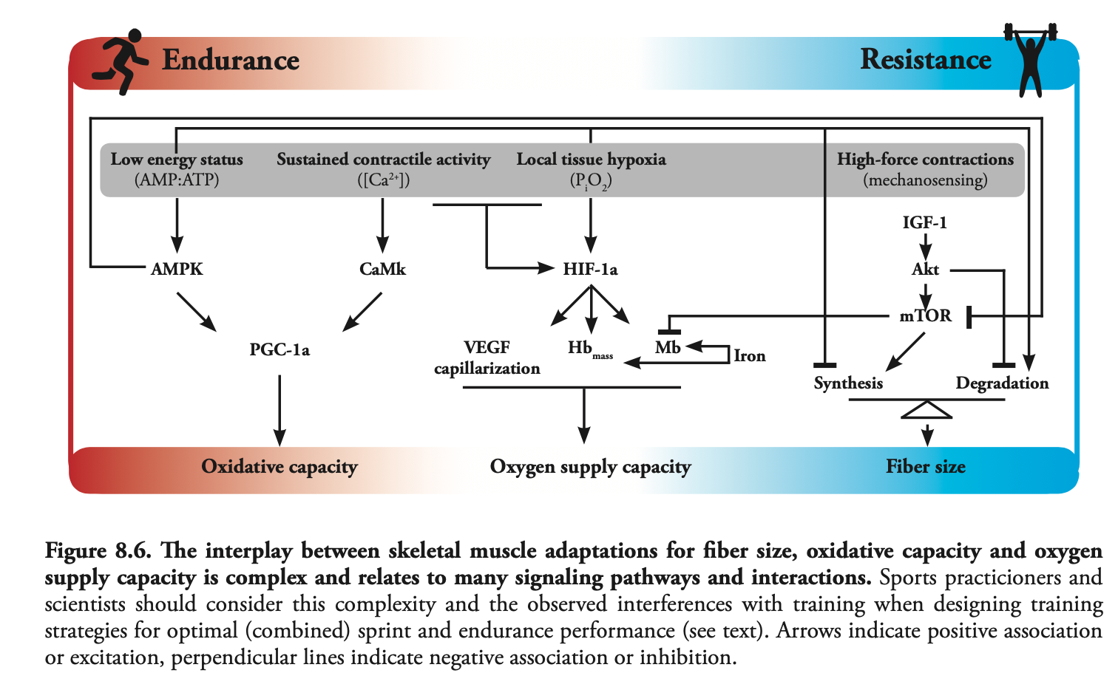
Metabolic Pathways for external stimuli
Van der Zwaart, 2018

Slide 6
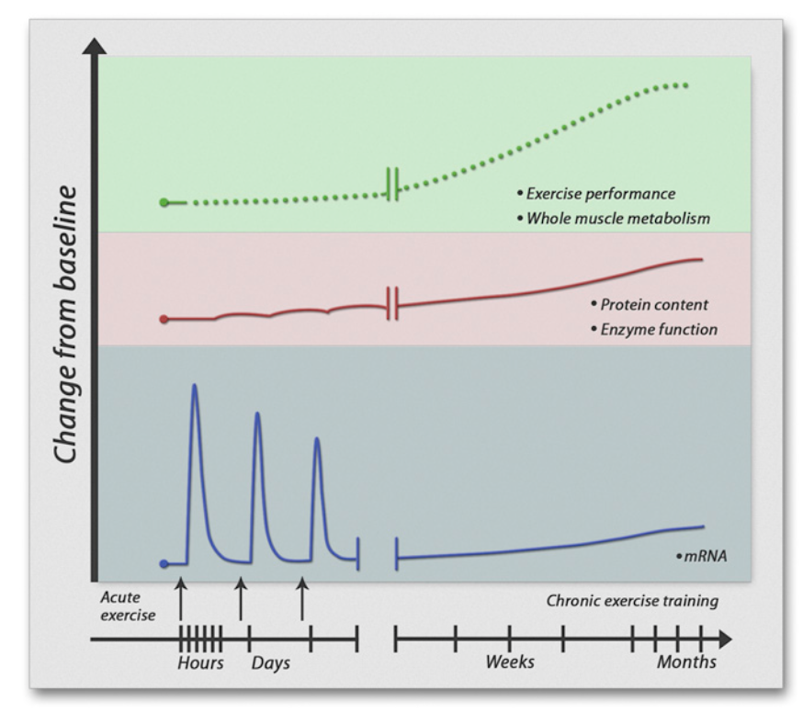
What is Training?
Engan & Zierath, 2013

Slide 7
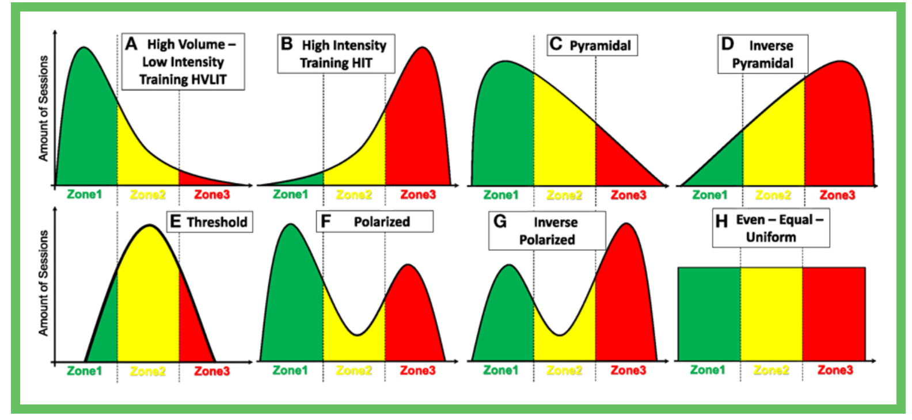
Analysis of previous training records
Training intensity distribution
Stöggl, 2018

Slide 8
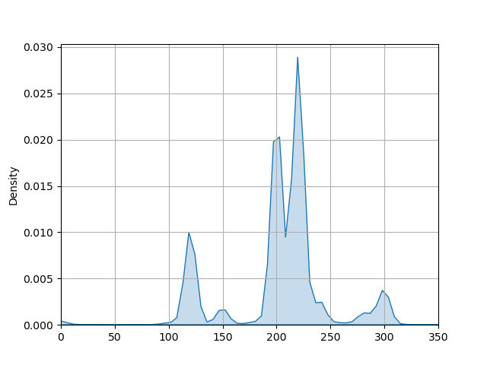

Slide 12
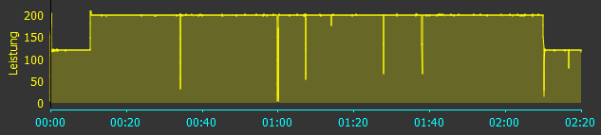
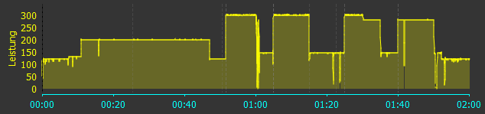

Slide 13
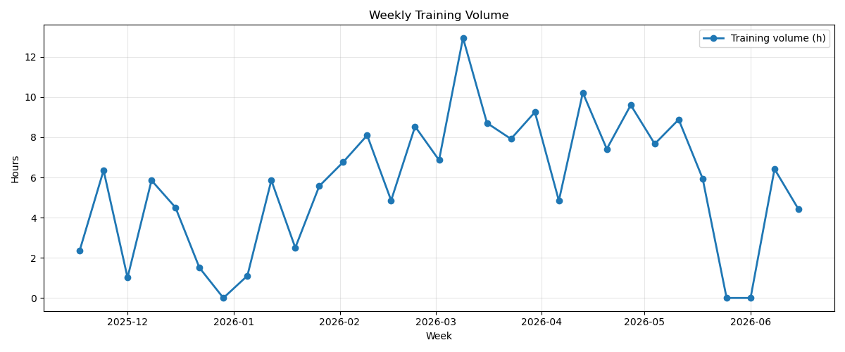
Training Camp?
Christmas?
Injury?

Slide 14
Needs Analysis 70.3 Triathlon Racing
1.9km Swim
90km Bike
21.1km Run

Slide 15
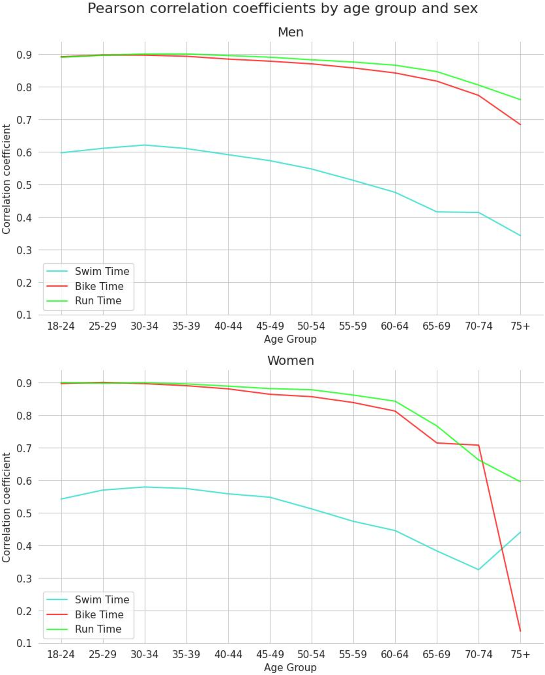
Knechtle et al, 2025

Slide 16
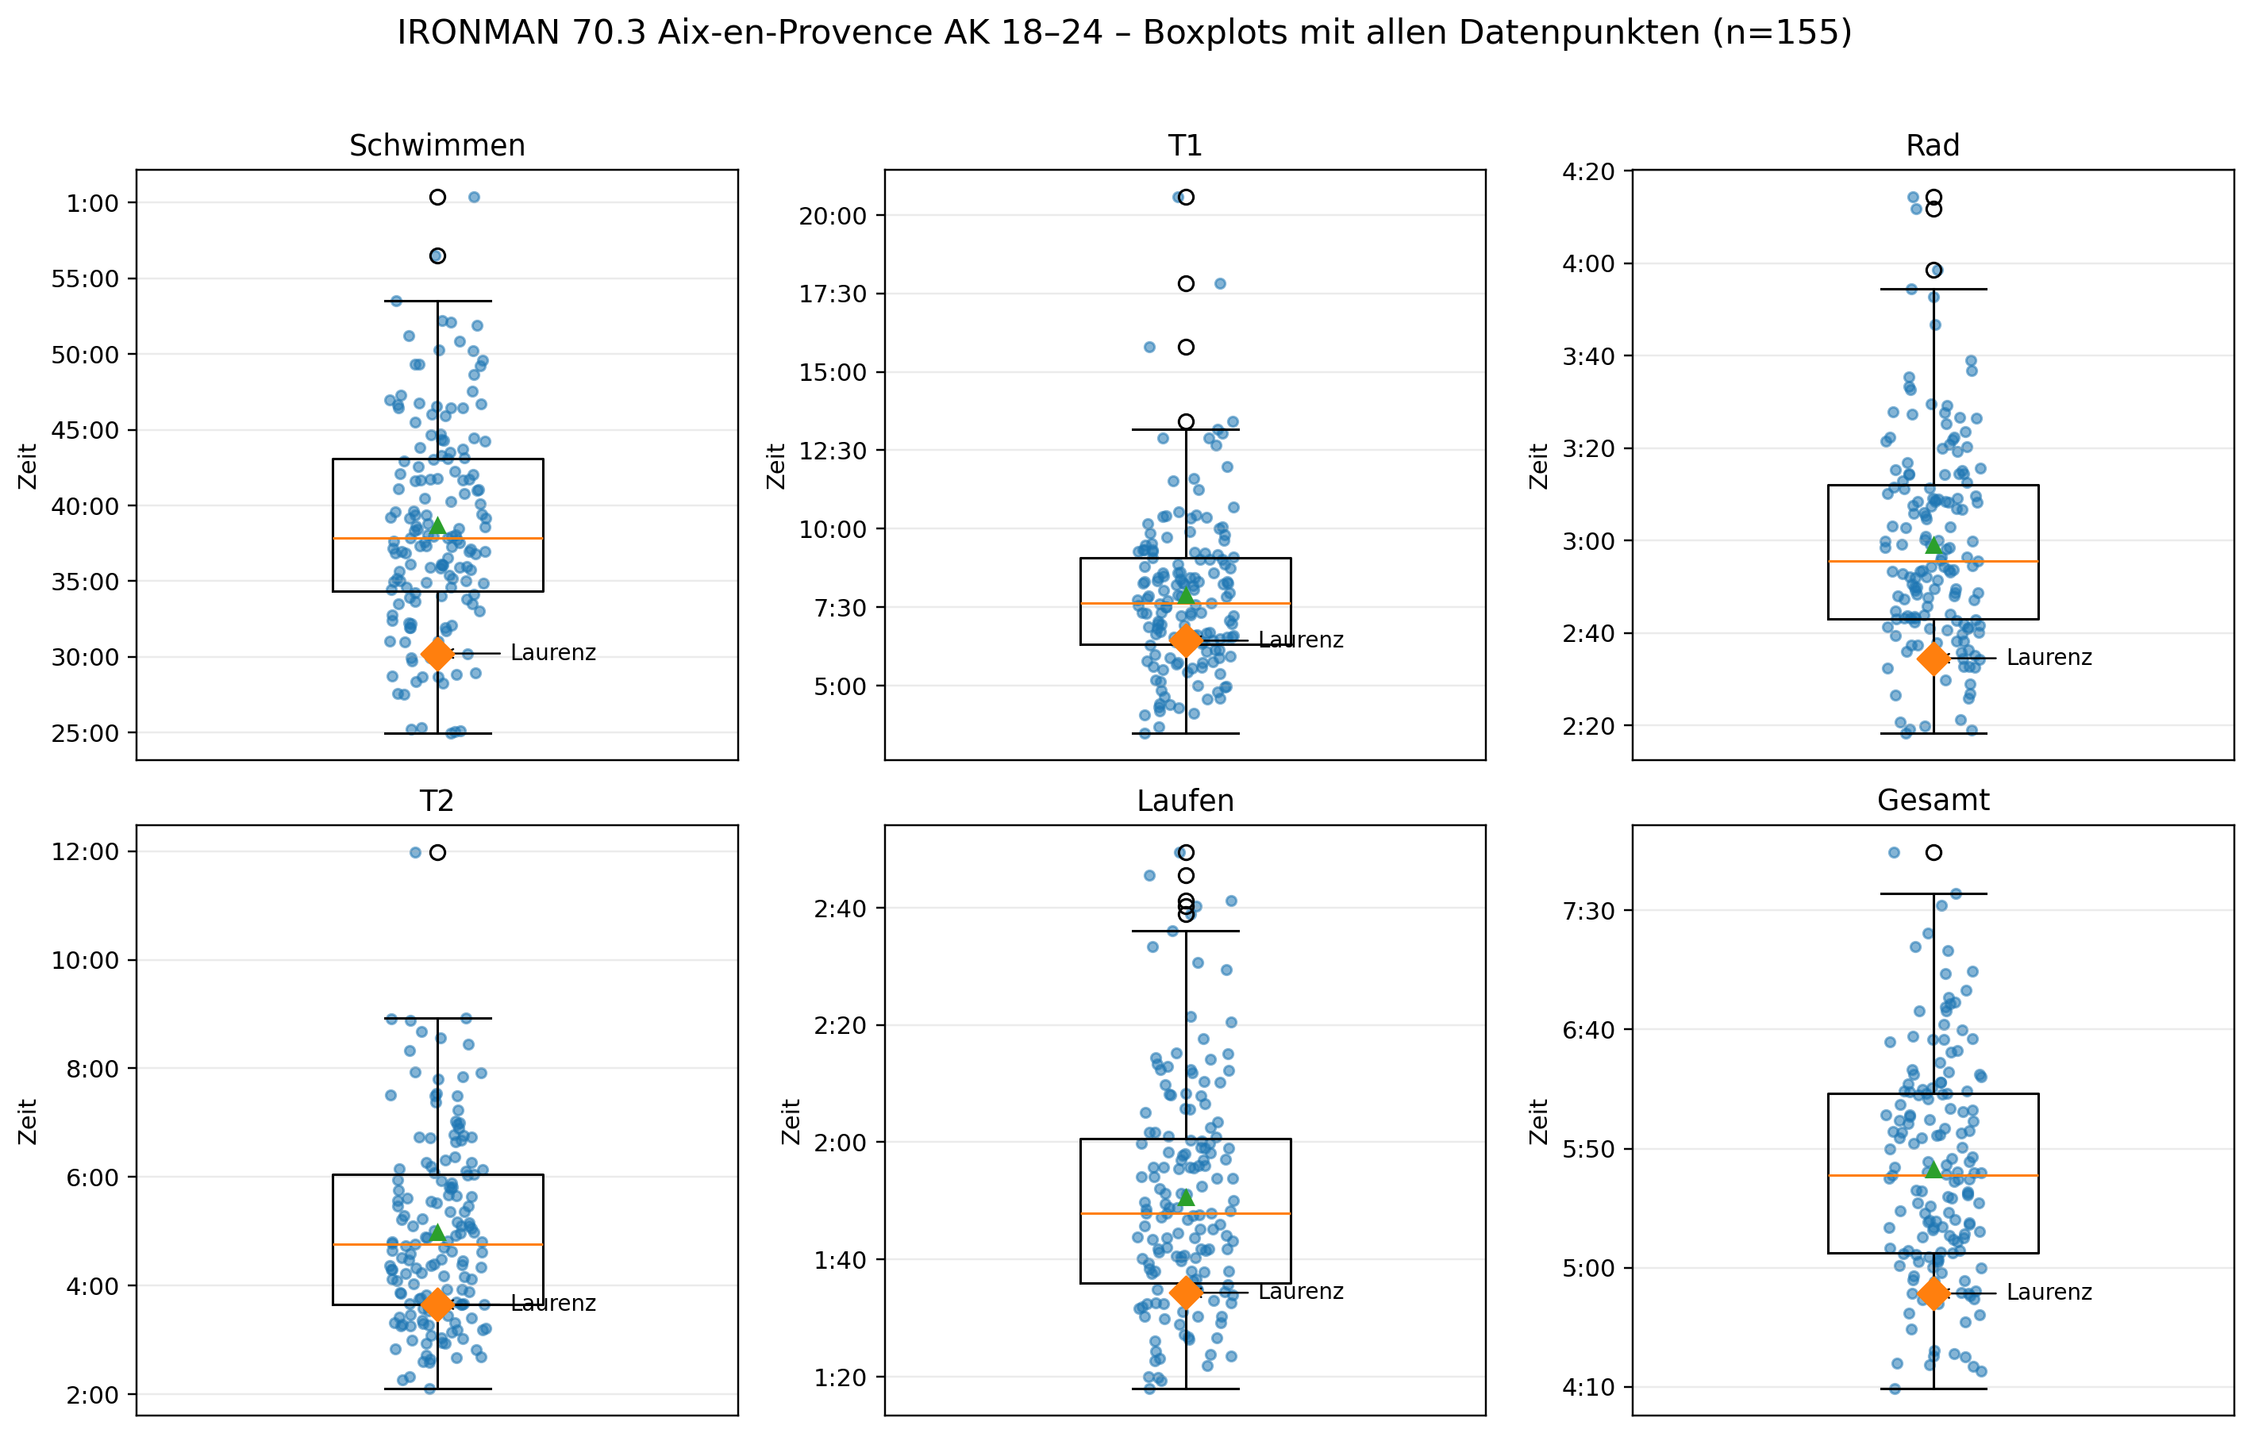
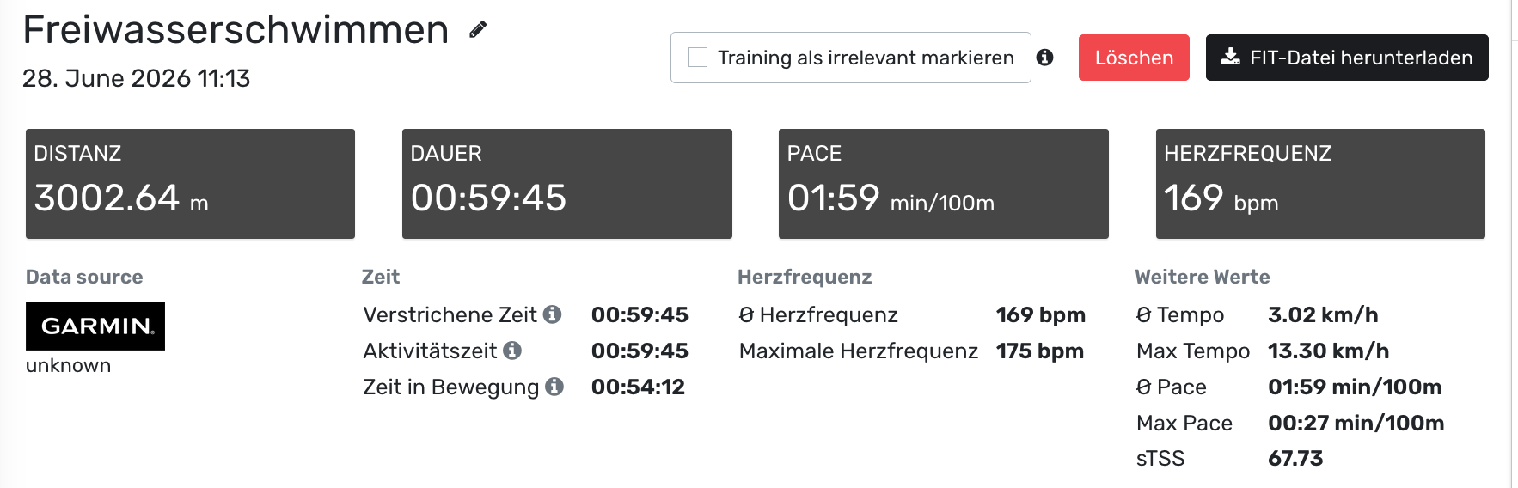
Wetsuit effect

Slide 17
Needs Analysis 70.3 Triathlon Racing
1.9km Swim (25 – 45 minutes)
90km Bike (2:00 – 3:00h)
21.1km Run (1:05 – 2:30h)
Overall Carbohydrate availability limiting factor
Bike Performance
Power -> 1 W = 12.5 ml/min -> The higher the V̇O₂max the better
-> Also: low vLamax
Aerodynamics, Drive Train efficiency, Rolling Resitance, Body Mass
(How much velocity for a given power?)

Slide 18
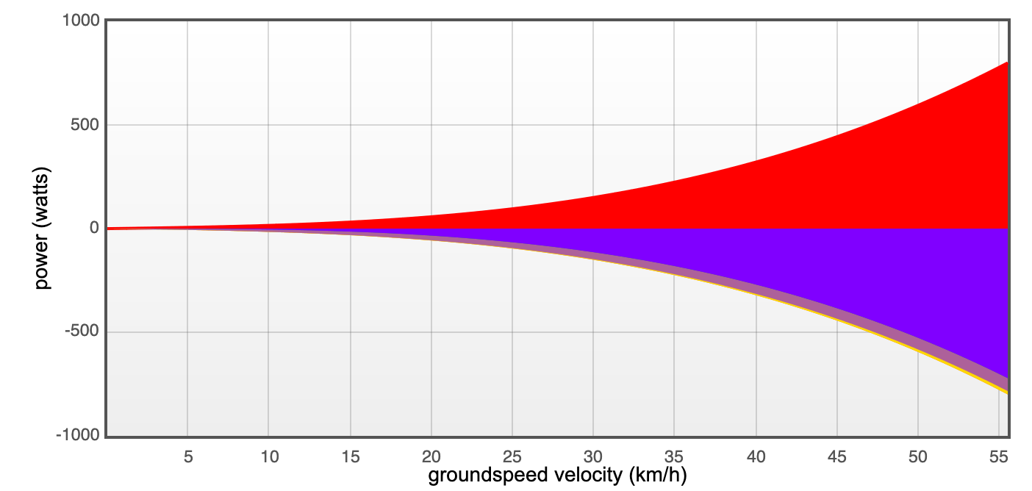
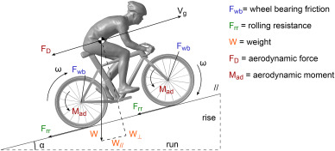
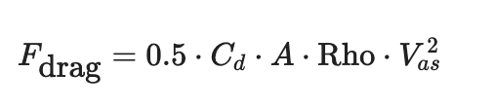
Blocken & Malizia, 2020

Slide 19
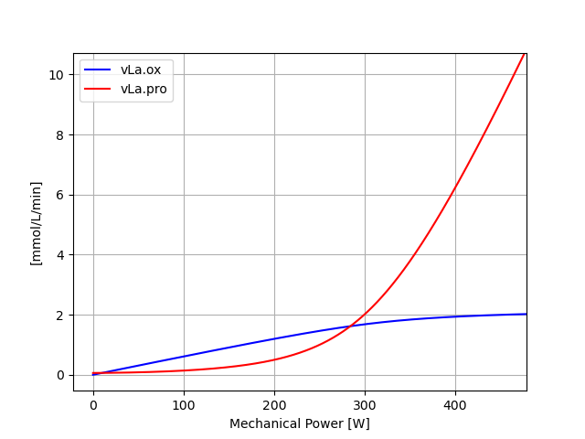
Related to V̇O₂max and vLamax
Notes:
Ideas about interval training or also race planning

Slide 20
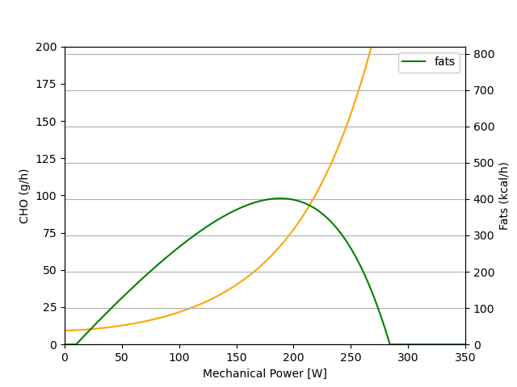
Macronutrient utilisation
Increased V̇O₂max and reduced vLamax
Notes:
Talk about the different usages of these substrates on a global scale

Slide 21
Literature
Blocken, B. & Malizia, F. (2020). Bicycle aerodynamics. Journal of Wind Engineering and Industrial Aerodynamics,
Egan B, Zierath JR. Exercise metabolism and the molecular regulation of skeletal muscle adaptation. Cell Metab. 2013 Feb 5;17(2):162-84. doi: 10.1016/j.cmet.2012.12.012. PMID: 23395166.
Knechtle B, Valero D, Villiger E, Thuany M, Cuk I, Forte P, Andrade MS, Nikolaidis PT, Rosemann T, Weiss K. Cycling and Running are More Predictive of Overall Race Finish Time than Swimming in IRONMAN® Age Group Triathletes. Sports Med Open. 2025 Mar 28;11(1):30. doi: 10.1186/s40798-025-00835-8. PMID: 40153133; PMCID: PMC11953511.
Leonhard Stöggl T (2018) What is the Best Way to Train to Become a Star Endurance Athlete?. Front. Young Minds. 6:17. doi: 10.3389/frym.2018.00017
Toigo M, Boutellier U. New fundamental resistance exercise determinants of molecular and cellular muscle adaptations. Eur J Appl Physiol. 2006 Aug;97(6):643-63. doi: 10.1007/s00421-006-0238-1. PMID: 16845551.
Van der Zwaart, Why muscles matter: Optimizing sprint and endurance performance in athletes. (2018)

