Slide 1
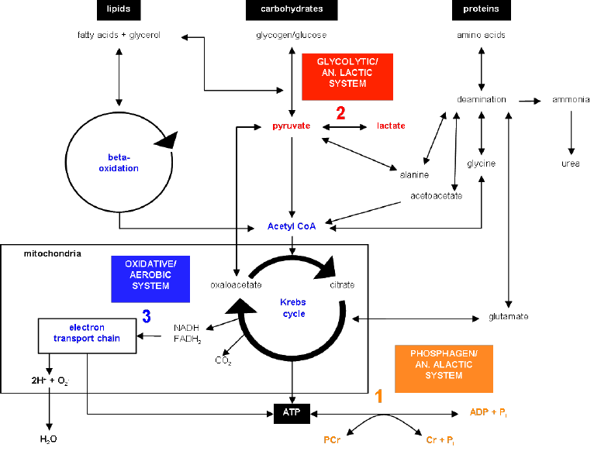
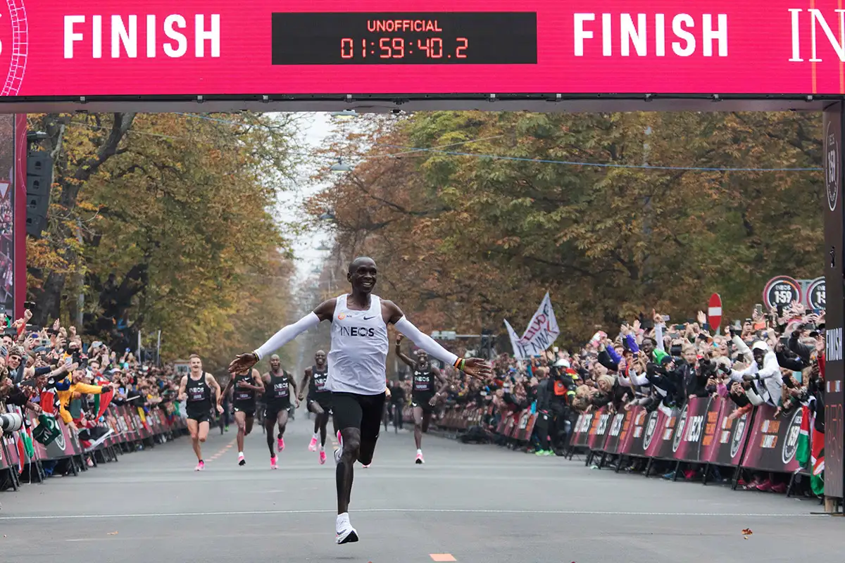
Applied Exercise Physiology & Sports Nutrition for Health & Performance
Jasper Suttmeyer

Slide 2
Agenda Today
Wrap Up vLamax-Testing
Validity of the model?!
Live Testing Session
Training planning

Slide 3
~5 min
5 min
???
320W
280W
240W
5min
200W
Active recovery
Active recovery
160W
0‘, 1‘ & 2‘
0‘, 1‘, 3‘ & 5‘
0‘, 1‘, 3‘, 5‘, 7‘ & 9‘
Notes:
What do we expect during the test inside the muscle?
PCr
V̇O2 (%)
vLa (%)
pH
La (Muscle + Blood)

Slide 4
Summary vLa.max testing
Insufficient ADP/AMP activation
Acidosis inhibits glycolysis
Peak lactate flux short
t_{alac} correction highly variable
Problems associated
with vLamax testing
Lactate clearance unaccounted for
No vLamax verification criterion
*(Glycolytic ATP after exercise cessation)
Wackerhage et al., 2025

Slide 5

Measuring vLa_{max}
Validity & Reliability
Validity
No experimental data
Evaluation only on theoretical basis and with
major limitations possible
Ergometer settings, application to other sports
(e.g. running), t_{alac}
Muscle Biopsies, ³¹P-NMR

Slide 6
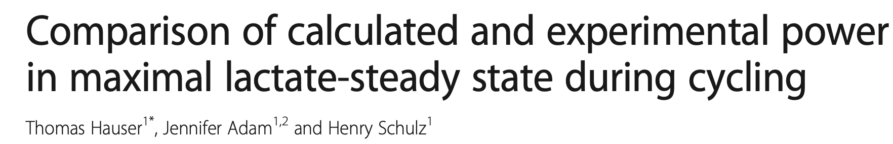
Rampentest
Rampentest
Sprinttest
V̇O₂max
vLa.max
Experimentally determmied
Calculatoins in 1-Copmartment Modell
Metabolic Profile / AT
Ergebnis der Simulation
Notes:
Influences of measuring vo2max and vlamax on profile:
Lactate oxidation? Lactate accumulation?
Carbohydrates? Fats?
Economy?
AT?

Slide 7
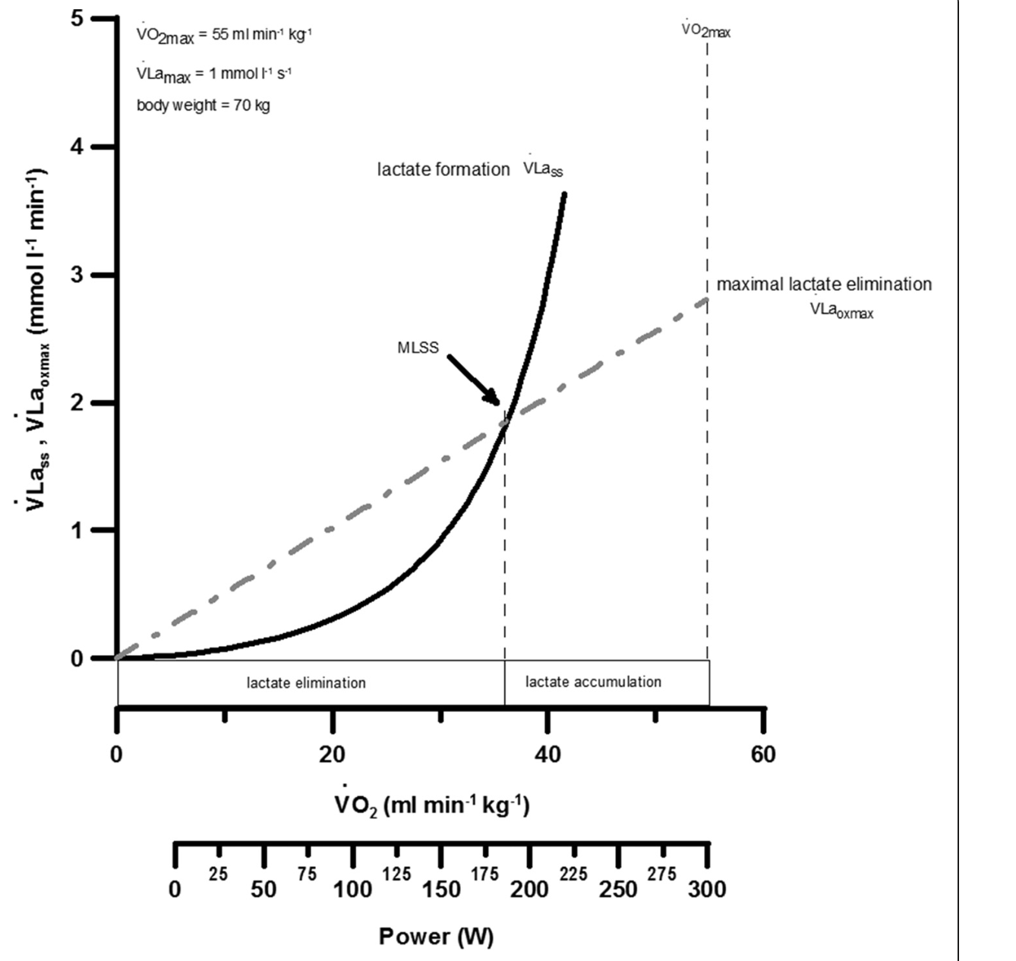

If V̇O₂ is a linear function and x-axis is in power
Glycolytic ATP is neglected…
Hauser et al., 2014

Slide 8
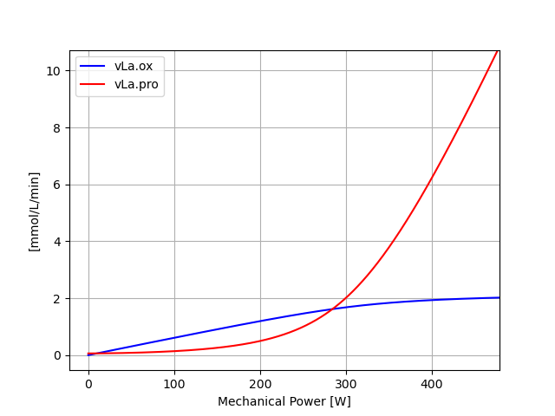
Notes:
Ideas about interval training or also race planning

Slide 9
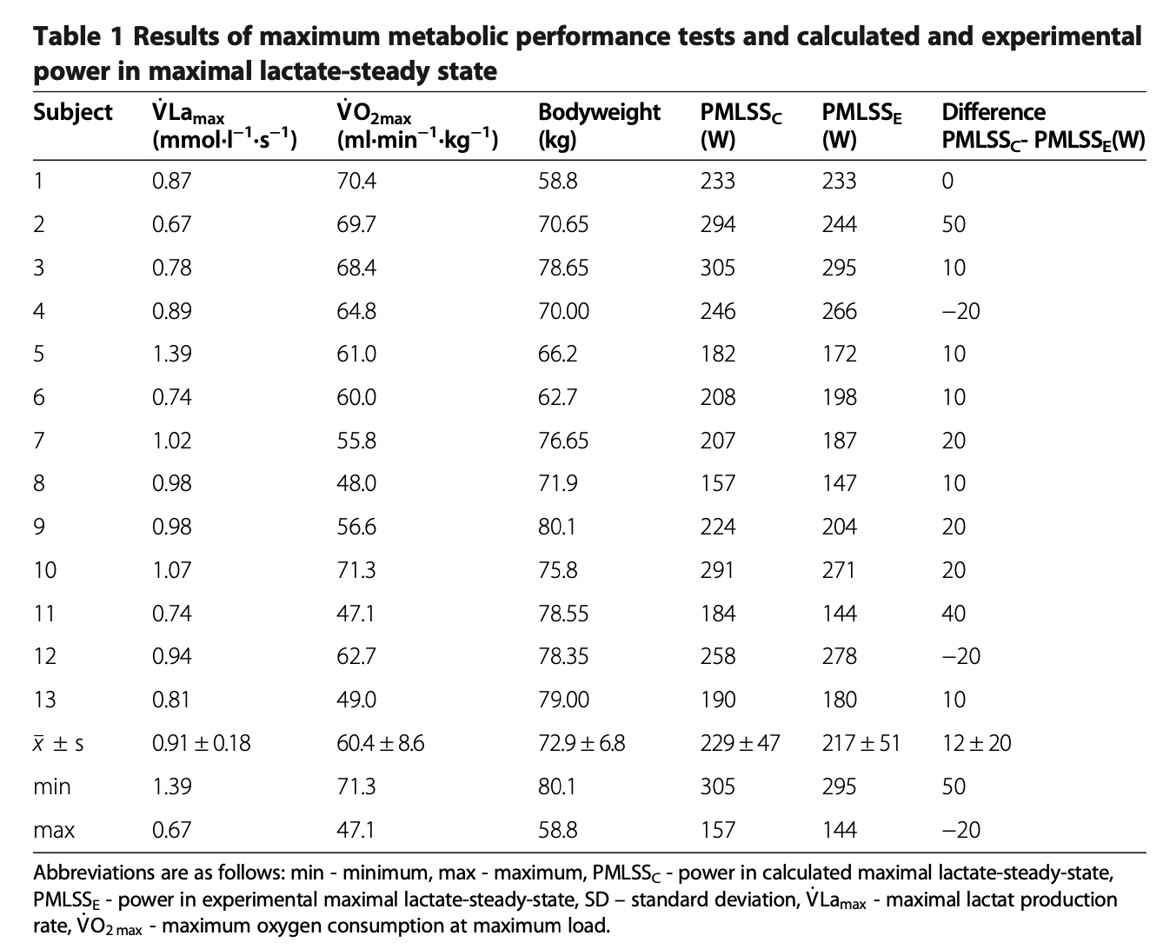
Hauser et al., 2014

Slide 10
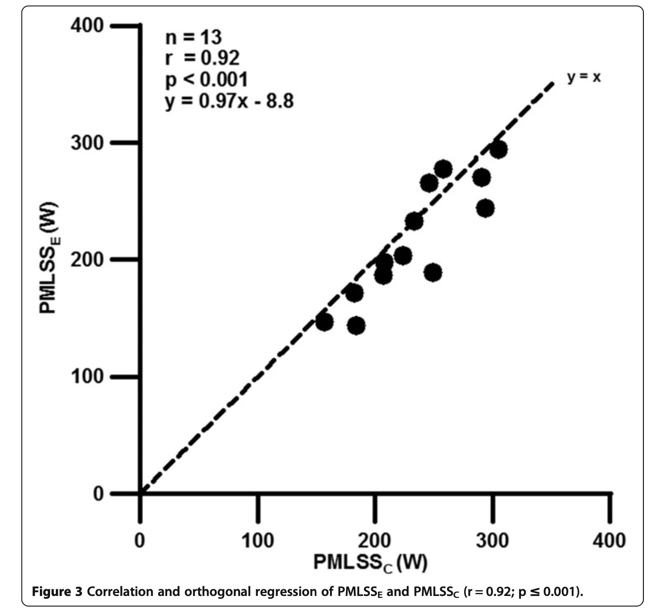
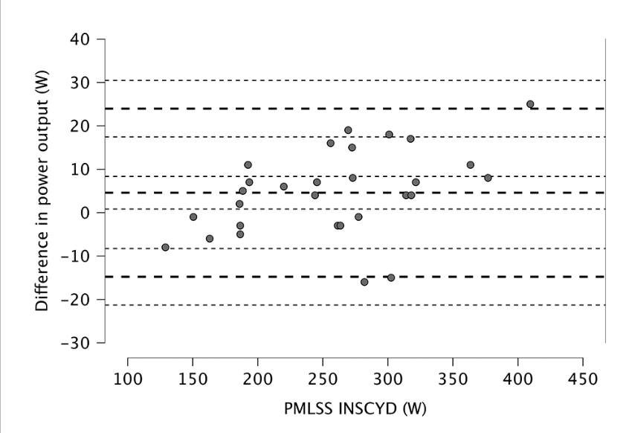
Poffé et al., 2024
Hauser et al., 2014
Notes:
Hauser: Problem with the calculation!
Poffé: Not transparently described
-> Likely different basis for calculation!

Slide 11
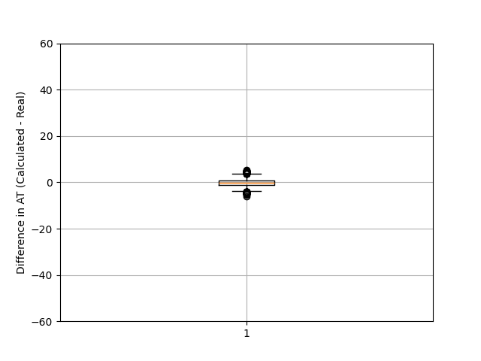
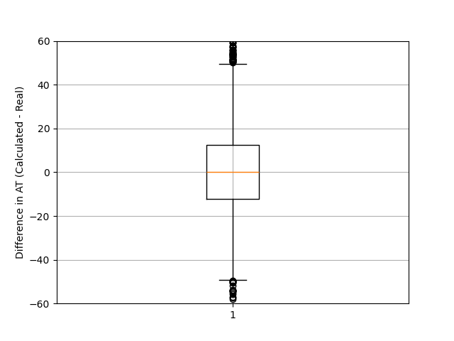
Error std: 0.1 V̇O₂max, 0.01 vLamax
Error std: 2.5 V̇O₂max, 0.08 vLamax
If independent variables are prone to errors dependent variables (in this case AT) will come with high errors!
Notes:
Box 50% of data
Whiskers: 1.5x Box +- box edges
Outliers above and below as dots

Slide 12
Vorstellung des Studienprotokolls
Lactate-Power
Lactate-Time-Curve
Rampentest
Ramptest
Sprinttest
V̇O₂max
vLa.max
Experimentally
Experimentally
Simulated in 2K-Model
Simulated in 1K Model
Results of Simulation
Results of Simulation
V̇O₂max
vLa.max
Metabolisches Profil / CP
Results of Simulation
MLSS
Results of Simulation

Slide 13
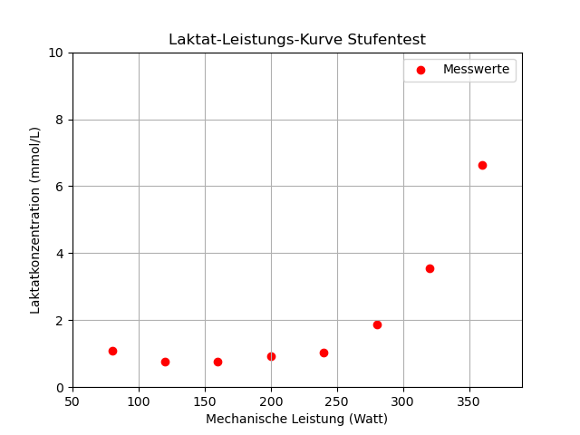
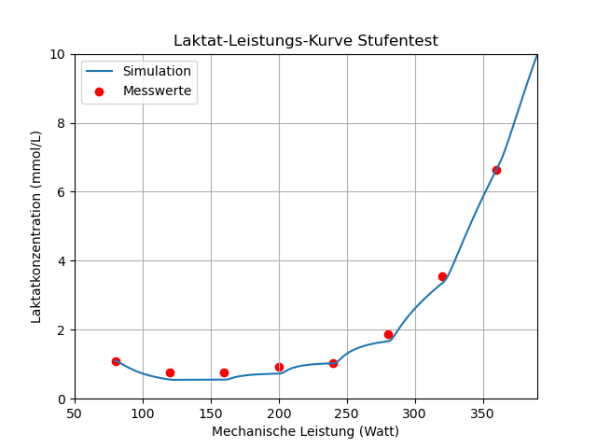
Simulation based approaches for performance testing
Calculation of V̇O₂max & vLamax based on lactate curve
Levenberg-Marquart-Algorithmus

Slide 14
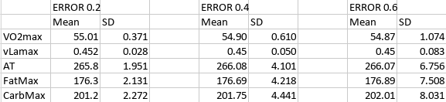
MC-Sim alternative option
Std Error [La⁻]
Based on the MC-Analysis -> This is the better option!
Limitation
Error of Model not involved and other potential sources
-> this is rather a first estimate!

Slide 15
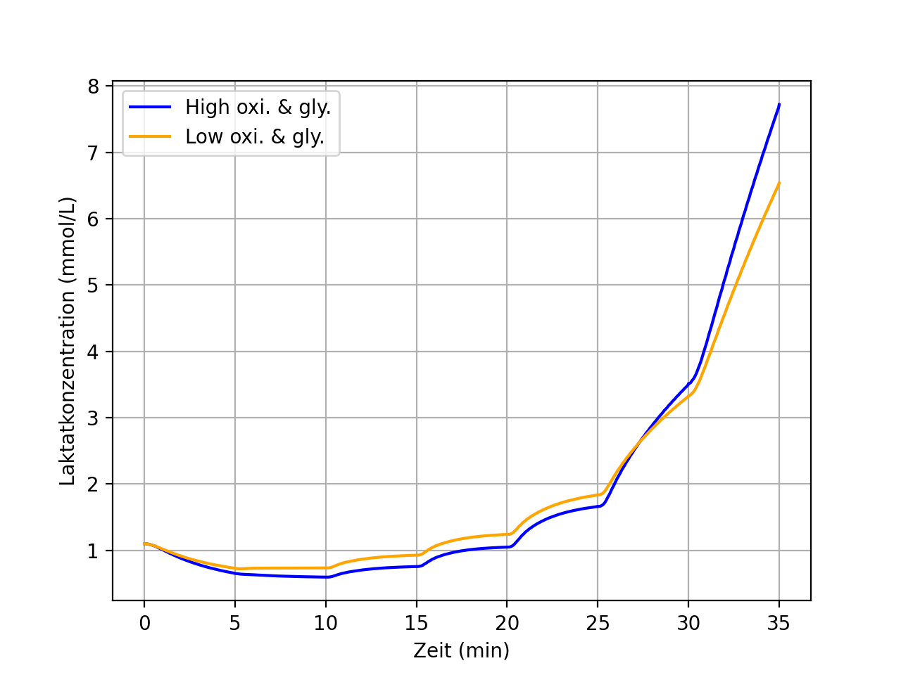
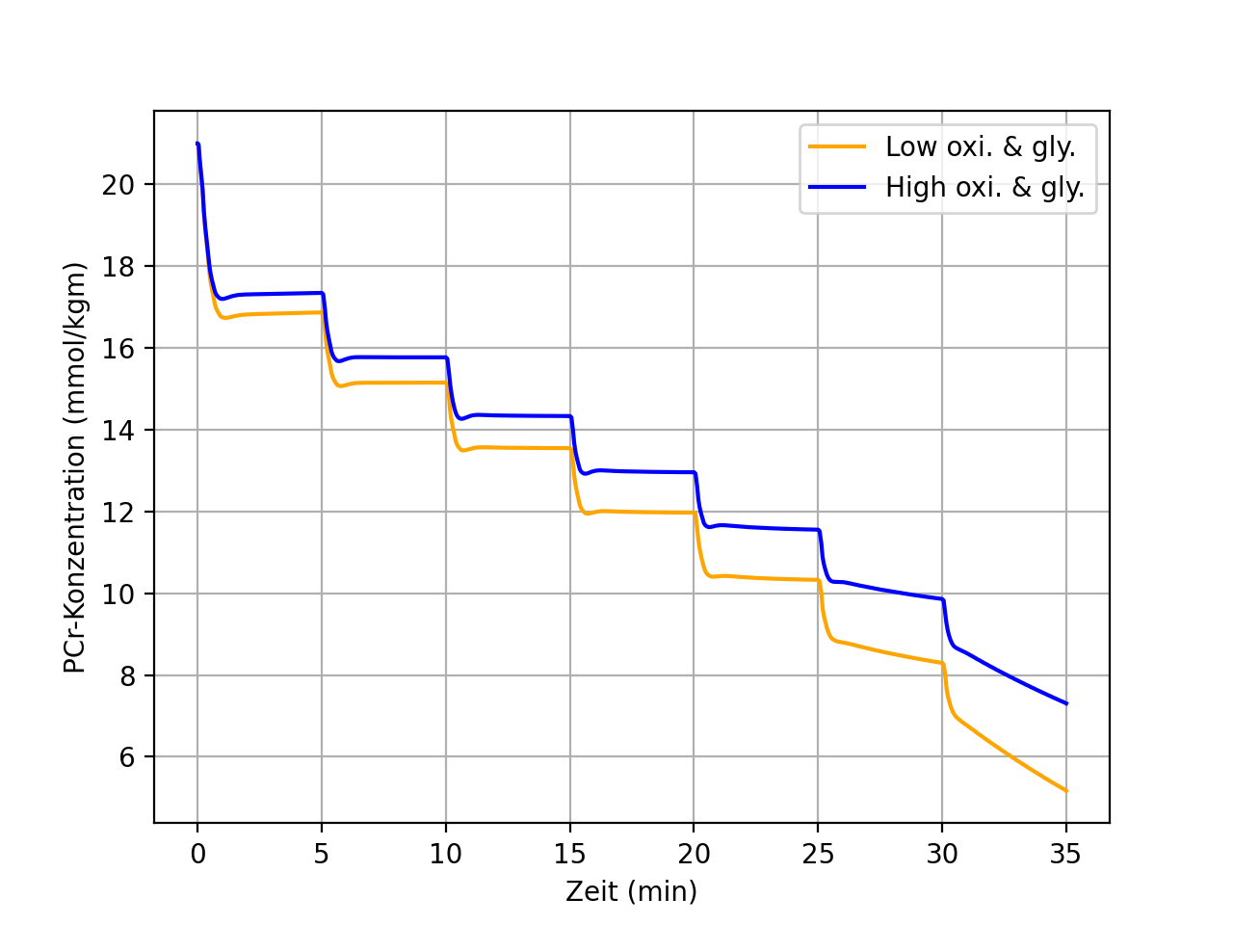


Simulation based approaches for performance testing
Steptest 80W + 40W every 5 Minutes; Athlete 75kg, 45% vol.rel
High: 57 ml/min/kg & 0.60 mmol/L/s
Low: 50 ml/min/kg & 0.30 mmol/L/s

Slide 16
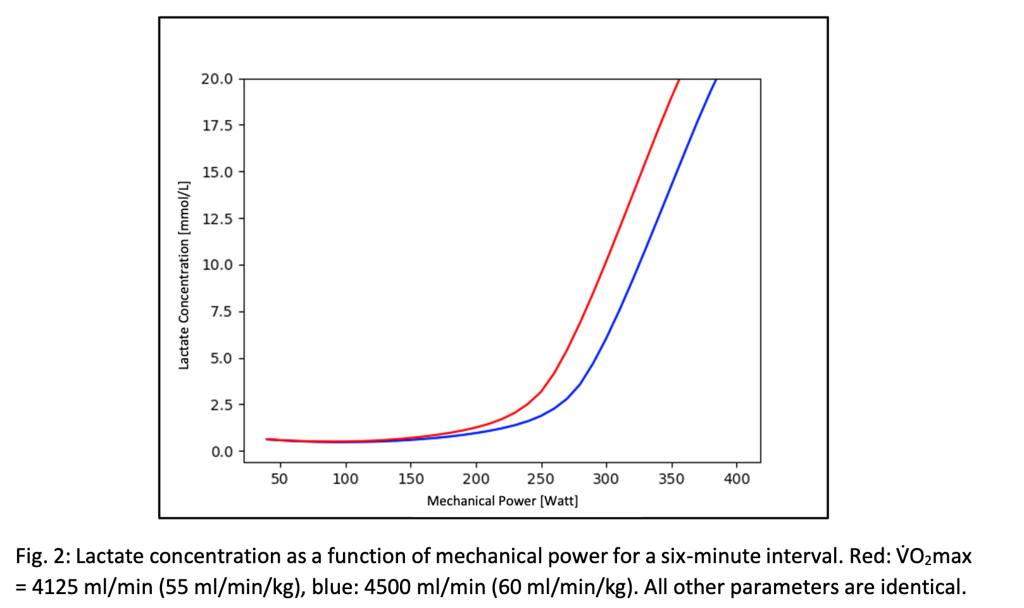

Slide 17
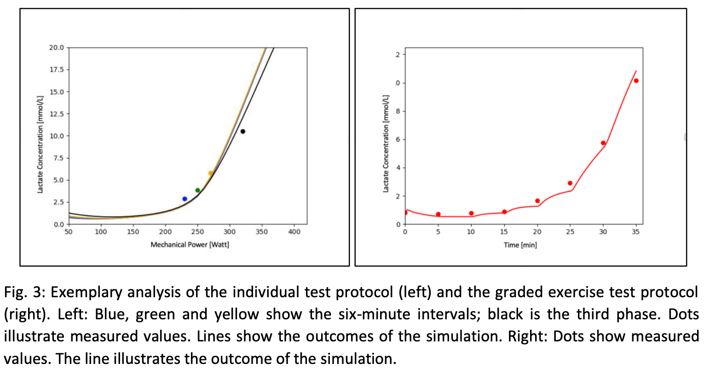
Summary (iii)

Slide 18
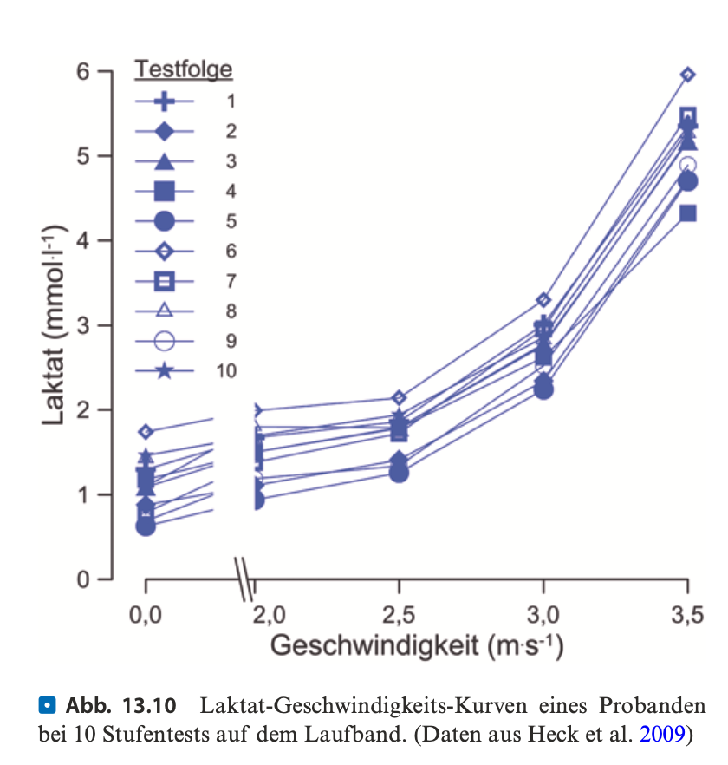
How can we be sure, a change in performance is real not just noise?
Heck et al., 2022, Chapter 13

Slide 19
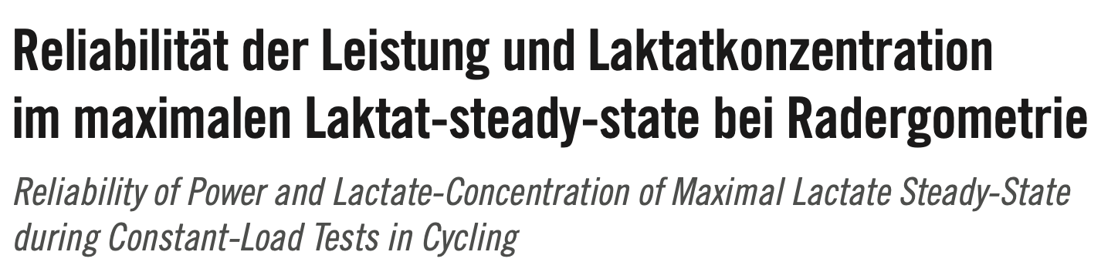
Summary (ii)
Standardize testing as best as you can!
-> Nutrition
-> Training before test day
-> Time of day
-> Equipment
Apply statistics…
Hauser et al., 2011

Slide 20
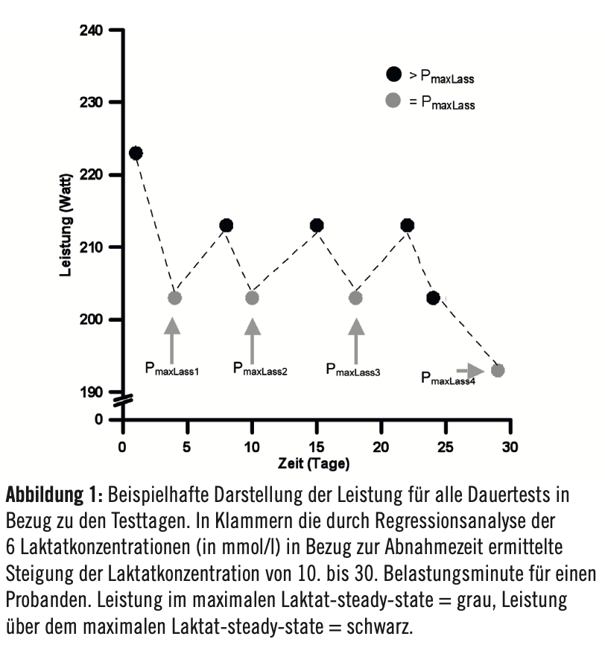
Performing 4 maxLass Tests per participant
N = 9
Hauser et al., 2011

Slide 21
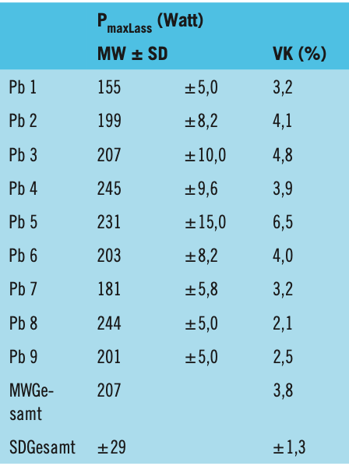
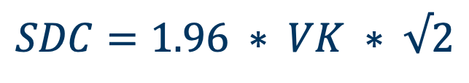
SDC : Smallest Detectable Change
$$SDC=1.96 ∗ VK ∗ √2$$
95 % Confidence Interval
To respect for variance in both tests
Hauser et al., 2011

Slide 22
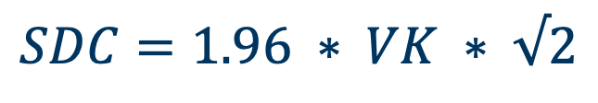
$$SDC=1.96 ∗ VK ∗ √2$$
Example:
12 Week Training intervention
Pre-Test: 200W
Post-Test: 220W
SDC = 1.96 * 0.038 * 200 * 1.41 = 21 W
Idea: Use 1 VK for „trending“
SDC = 1 * 0.038 * 200 * 1.41 = 11 W
THIS VK IS ONLY APPLICABLE TO MAXLASS TESTING
Hauser et al., 2011

Slide 23
Examples:
Calculate the barriers for no change (< 1 sd), trending (1-1.96 sd) and change (>1.96 sd)
MaxLass Testing (CV 3.8%)
100 W
FTP Testing (CV 2.9%)
250 W
V̇O₂max Test (CV 2%)
55.35 ml/min/kg
Klitzke et al., 2011
Kirkeberg et al., 2011
Notes:
Reliability of the Functional Threshold Power in Competitive Cyclists

Slide 24
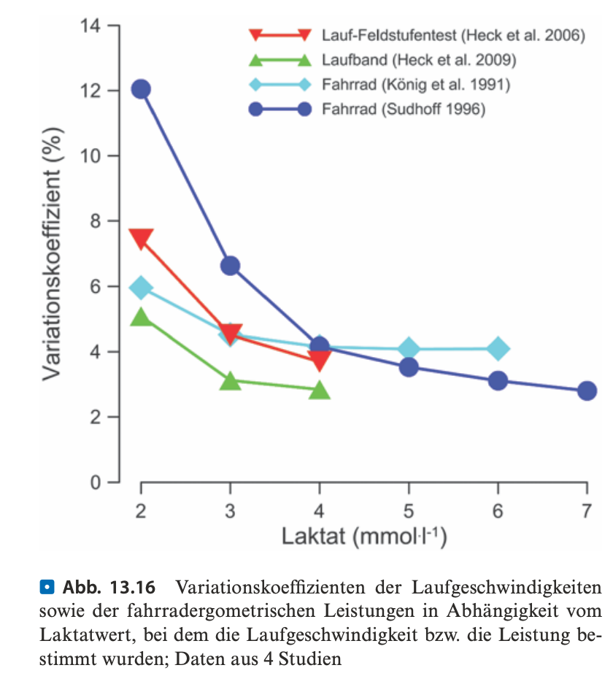
Heck et al., 2022, Chapter 13

Slide 25
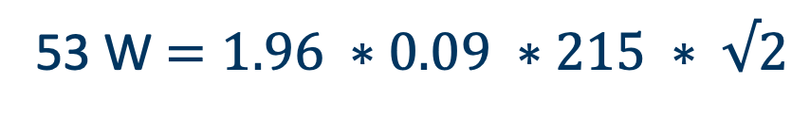
53 W$=1.96 ∗0.09 ∗215 ∗ √2$

Slide 26
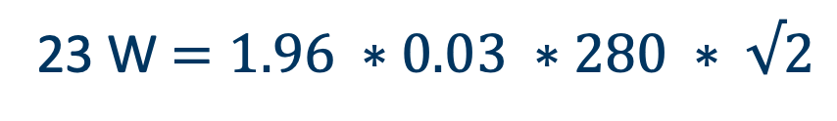
23 W$=1.96 ∗0.03 ∗280 ∗ √2$

Slide 27
Summary reliability
Due to the reduction in variability with increasing lactate concentrations, performance values measured at higher lactate levels should be preferred for evaluating changes in endurance capacity, since reliability is higher in this range.
Also: Longer Stages -> Higher Lactate Concentrations at lower external workload -> better reliability…
Communication of results to Athletes -> What is a detectable change? What is potential noise in data?
Pitfall: Testing Economy?!
Further reading: Heck 2022, Laktat, Chapter 13.5

Slide 28
Literature
Hauser T, Adam J, Schulz H. Comparison of calculated and experimental power in maximal lactate-steady state during cycling. Theor Biol Med Model. 2014 May 27;11:25. doi: 10.1186/1742-4682-11-25. Erratum in: Theor Biol Med Model. 2016 Sep 8;13(1):18. doi: 10.1186/s12976-016-0044-3. PMID: 24886168; PMCID: PMC4052616.
Hauser, T., Bartsch, D. & Schulz, H. (2011): Reliability of Power and Lactate-Concentration of Maximal Lactate Steady-State during Constant-Load Tests in Cycling. Konferenzbeitrag. Verfügbar über ResearchGate. Abgerufen am 24.06.2026.
Heck, H., Bartmus, U., & Grabow, V. (2022). Laktat: Stoffwechselgrundlagen, Leistungsdiagnostik, Trainingssteuerung. Springer. https://doi.org/10.1007/978-3-662-59835-1
Kirkeberg JM, Dalleck LC, Kamphoff CS, Pettitt RW. Validity of 3 protocols for verifying VO2 max. Int J Sports Med. 2011 Apr;32(4):266-70. doi: 10.1055/s-0030-1269914. Epub 2011 Jan 26. PMID: 21271494.
Klitzke Borszcz F, Tramontin AF, Costa VP. Reliability of the Functional Threshold Power in Competitive Cyclists. Int J Sports Med. 2020 Mar;41(3):175-181. doi: 10.1055/a-1018-1965. Epub 2020 Jan 17. PMID: 31952081.
Poffé C, Van Dael K, Van Schuylenbergh R. INSCYD physiological performance software is valid to determine the maximal lactate steady state in male and female cyclists. Front Sports Act Living. 2024 May 7;6:1376876. doi: 10.3389/fspor.2024.1376876. PMID: 38774278; PMCID: PMC11107085.
Wackerhage H, Kabasakalis A, Seiler S, Heck H. Is the vLamax for Glycolysis What the V˙O2 max is for Oxidative Phosphorylation? Sports Med. 2025 Aug;55(8):1853-1866. doi: 10.1007/s40279-025-02259-6. Epub 2025 Jul 17. PMID: 40676393; PMCID: PMC12460440.

