Slide 1
⚡
Muscular Kinetics During a Maximal Sprint
Goal: explain how PCr, glycolysis, pH, and blood lactate change over time, and why the useful test window is roughly between 5 and 20 seconds.

Slide 2
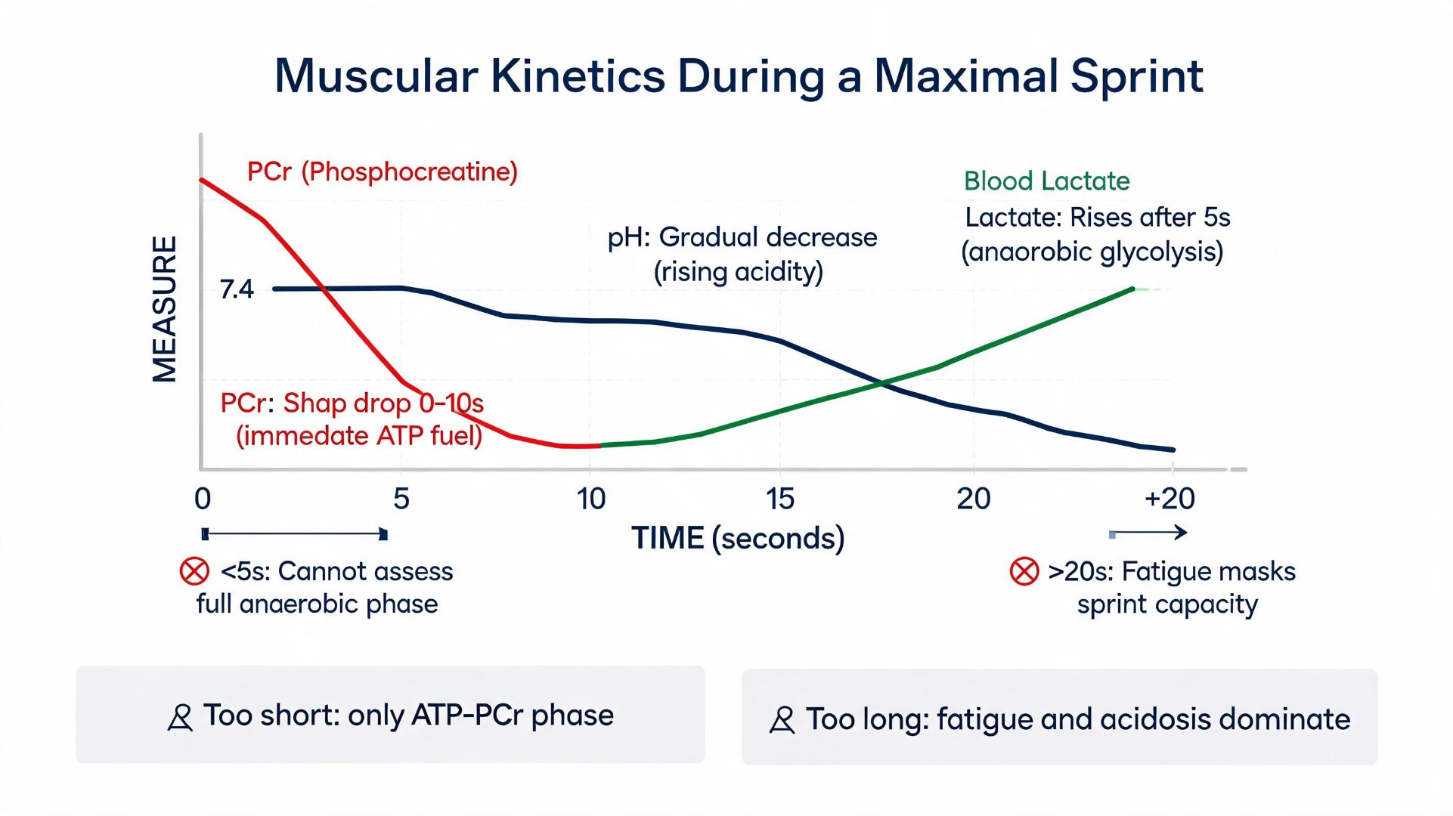
Time course of the sprint
Later phase
pH falls. Acidity increases, fatigue appears, and performance becomes less specific to pure glycolytic power.
0-5 s
~6-15 s
PCr dominates. The muscle needs ATP immediately, so phosphocreatine provides the fastest energy source.
Glycolysis peaks. Lactate production rises and vLass is best represented in this middle phase.

Slide 3
Why shorter than 5 s and longer than 20 s are not ideal
Too short: < 5 s
Too long: > 20 s
Mostly measures ATP-PCr power.
Glycolysis has not fully reached its maximal rate yet.
The test underestimates vLass and anaerobic glycolytic capacity.
Aerobic contribution becomes larger.
pH keeps falling and acidosis limits enzyme activity.
Fatigue masks true sprint-specific glycolytic performance.
Key message: the best sprint test duration is long enough for glycolysis to fully activate, but short enough to avoid major fatigue and aerobic interference.

