Slide 1
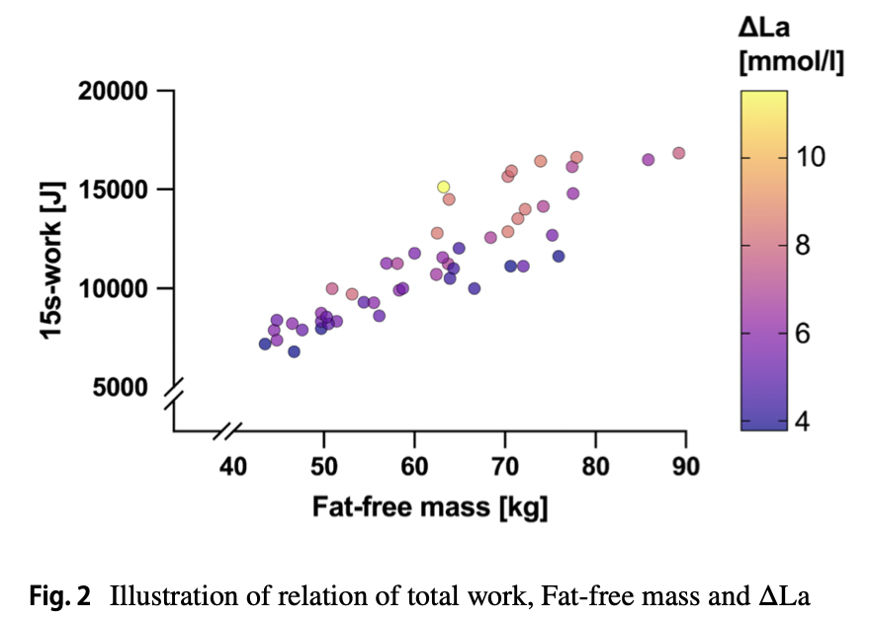
Group 2: La-Space
Research the relationship between body fat and lactate distribution space. Find an article describing the relationship between body fat and total body water → From there you can calculate the lactate distribution space.
Rationale:
Majority of FFM = skeletal muscle → primary tissue for La-production during heavy exercise
Increase in muscle mass → higher potetial for La-production & increase in La-Space
Total body water = 73% of FFM
Available La-Space = 69% of total body water
→ La-Space = 0.5 x FFM (approx.)
higher FFM → higher 15s (glycolytic) work → higher La-values
Reference:
Meixner, B. J., Nusser, V., Koehler, K., Sablain, M., Boone, J., & Sperlich, B. (2024). Relationship of peak capillary blood lactate accumulation and body composition in determining the mechanical energy equivalent of lactate during sprint cycling. European Journal of Applied Physiology, 124(11), 3399–3407. https://doi.org/10.1007/s00421-024-05529-9

