Slide 1
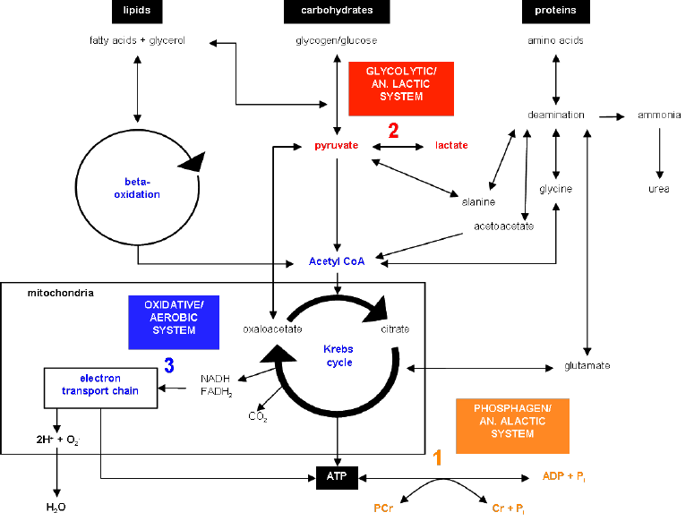
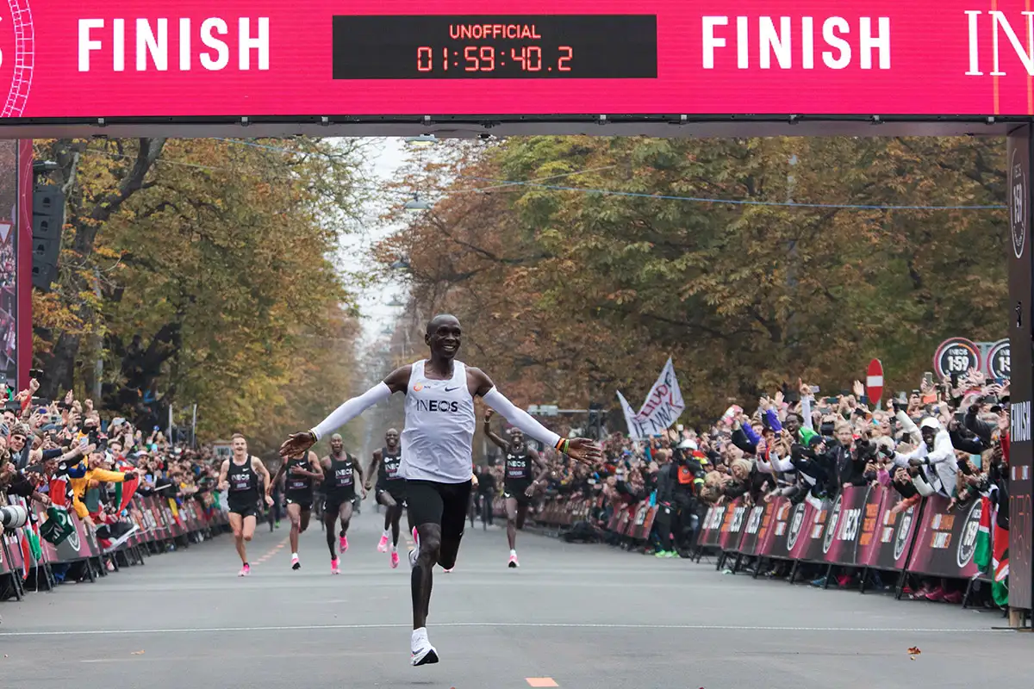
Applied Exercise Physiology & Sports Nutrition for Health & Performance
Diagnostics of Aerobic and Anaerobic-Lactic Power
Jasper Suttmeyer
AEPSN 2024 | Organisation & Outline of the course| Jasper Suttmeyer

Slide 2
Summary last session
Measurement Errors in Spiroergometry
Filtering Spirometric Data
V̇O₂max testing
Indirect Calorimetrie assumptions and pitfalls

Slide 3
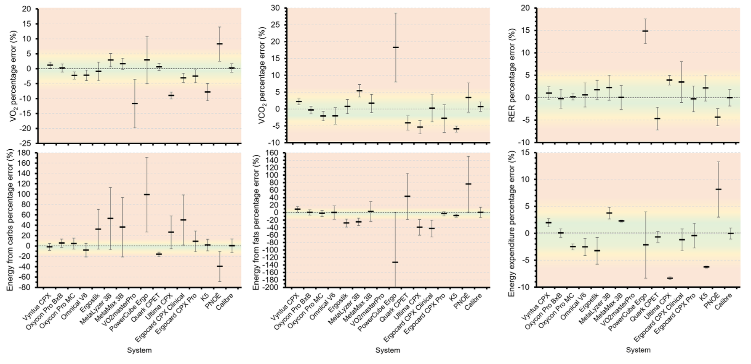
Spirometric Devices
Accuracy & Precision
Van Hooren et al., 2024
Notes:
Green 3% (good agreement)
Yellow 5% (acceptable agreement)
Outside >5% poor agreement
Van Hooren B, Souren T, Bongers BC. Accuracy of respiratory gas variables, substrate, and energy use from 15 CPET systems during simulated and human exercise. Scand J Med Sci Sports. 2024 Jan;34(1):e14490. doi: 10.1111/sms.14490. Epub 2023 Sep 11. Erratum in: Scand J Med Sci Sports. 2024 Mar;34(3):e14607. doi: 10.1111/sms.14607. PMID: 37697640.

Slide 4
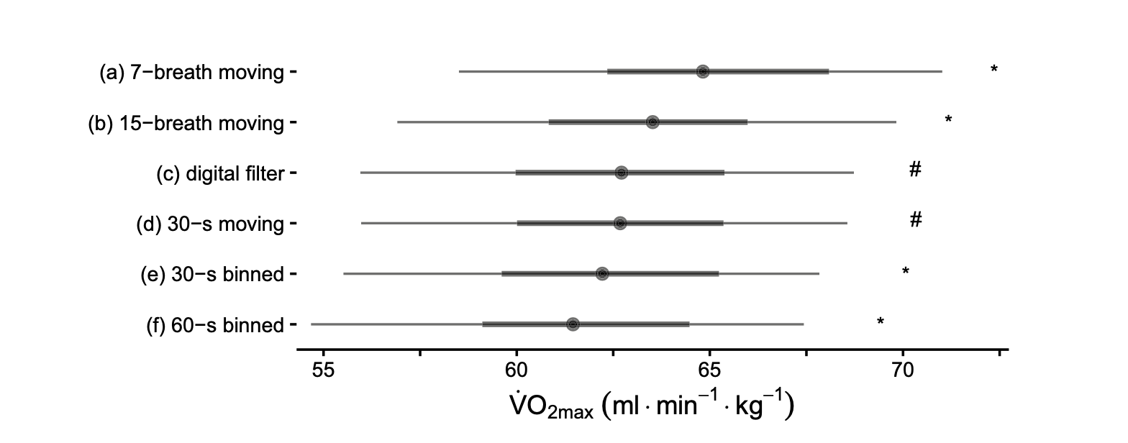
Summary last session
Measurement Errors in Spiroergometry
Filtering Spirometric Data
V̇O₂max testing
Indirect Calorimetrie assumptions and pitfalls
Nolte et al., 2024
Notes:
Nolte S, Rein R, Quittmann OJ. Data Processing Strategies to Determine Maximum Oxygen Uptake: A Systematic Scoping Review and Experimental Comparison with Guidelines for Reporting. Sports Med. 2023 Dec;53(12):2463-2475. doi: 10.1007/s40279-023-01903-3. Epub 2023 Aug 21. PMID: 37603201; PMCID: PMC10687136.

Slide 5
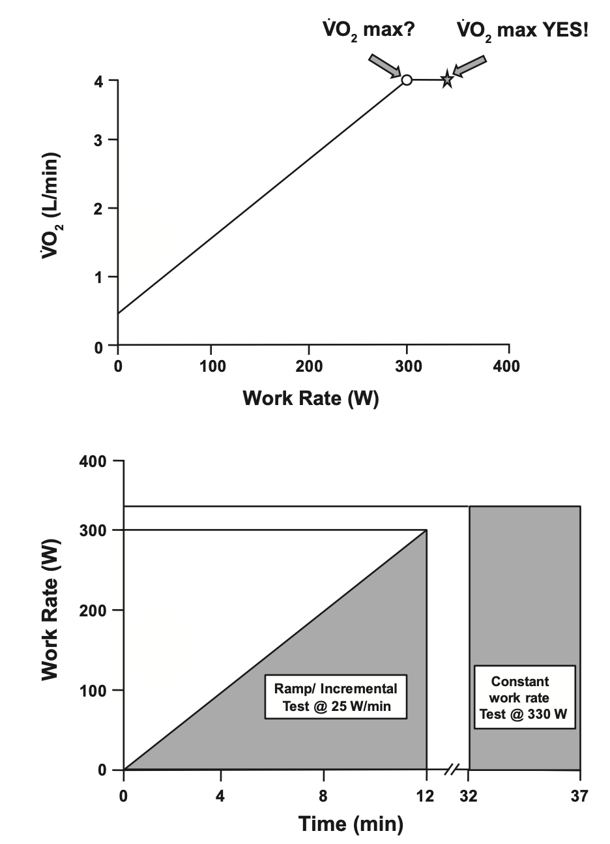
Summary last session
Measurement Errors in Spiroergometry
Filtering Spirometric Data
V̇O₂max testing
Indirect Calorimetrie assumptions and pitfalls
Poole & Jones, 2017
Notes:
Poole DC, Jones AM. Measurement of the maximum oxygen uptake V̇o2max: V̇o2peak is no longer acceptable. J Appl Physiol (1985). 2017 Apr 1;122(4):997-1002. doi: 10.1152/japplphysiol.01063.2016. Epub 2017 Feb 2. PMID: 28153947.

Slide 6
Summary last session
Indirect Calorimetrie assumptions and pitfalls
100
%Carb. Oxidation
Theoretical Relationship!
RQ ≠ RER
0
0.7
1
RQ
Assumptions of indirect Calorimetrie
1.) RQ = RER
2.) Gas exhange at mouth accurately reflects tissue level

Slide 7
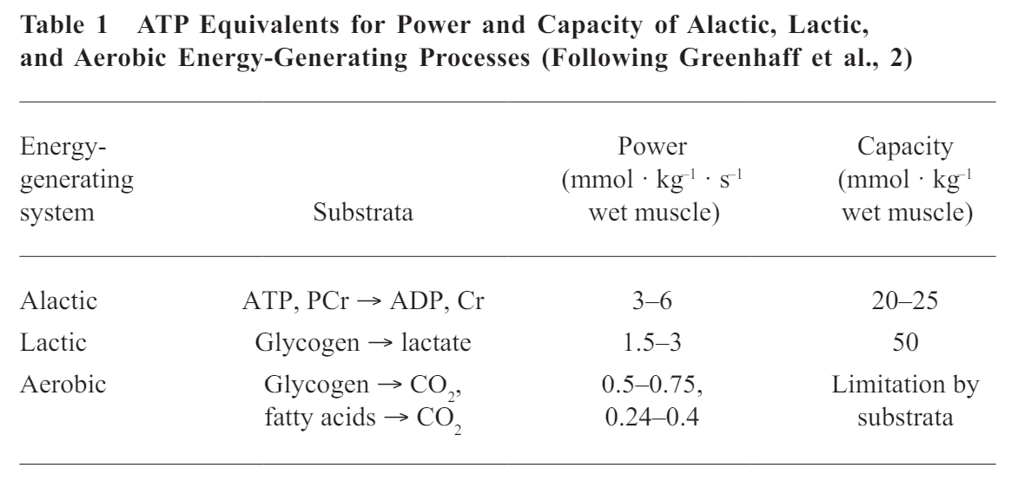
Anaerobic Power vs. Capacity
How can we assess this for individuals?
Notes:
Lets start with looking at capacity

Slide 8
Glycolysis and Glycogenolysis
Possible Quantities to measure
Glucose/Glycogen decline?
PFK concentrations?
Lactate concentrations?
1 Glucose
1 Glycogen
-1 ATP
unfeasible
-1 ATP
Key Enzyme:
Phosphofruktokinase (PFK)
+2 ATP
+2 ATP
2 Lactate + 2 H⁺
Notes:
Lets have a look at measuring lactate concentrations;
We need to understand what we are actually measuring -> where does the lactate go from the muscle?

Slide 9
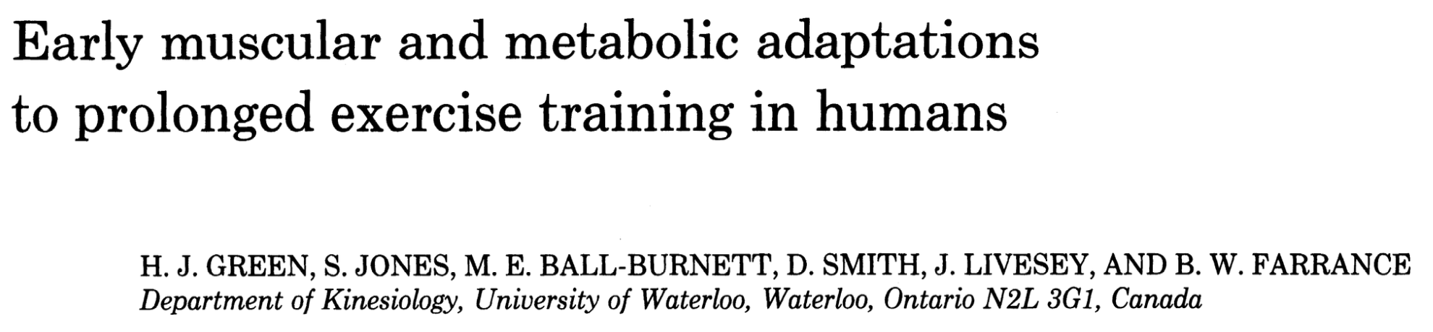
Methods
10-12 days daily cycling at 59% of V̇O2max
Active but untrained males, V̇O2max 53 +- 2 ml/min/kg
Four Muscle biopsy before and after training block (Pre, 15, 60, 99 min)
Dependent Variables
ATP (mmol/kg dry wt)
CrP (mmol/kg dry wt)
Glycogen (mmol glucosyl u/kg dry wt)
Enzymes (PFK etc.)
Green et al., 1991
Notes:
Green HJ, Jones S, Ball-Burnett ME, Smith D, Livesey J, Farrance BW. Early muscular and metabolic adaptations to prolonged exercise training in humans. J Appl Physiol (1985). 1991 May;70(5):2032-8. doi: 10.1152/jappl.1991.70.5.2032. PMID: 1864784.

Slide 10
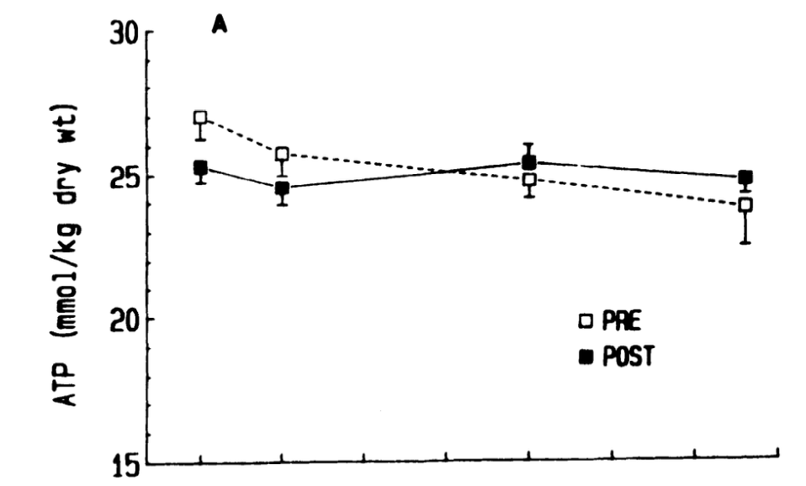
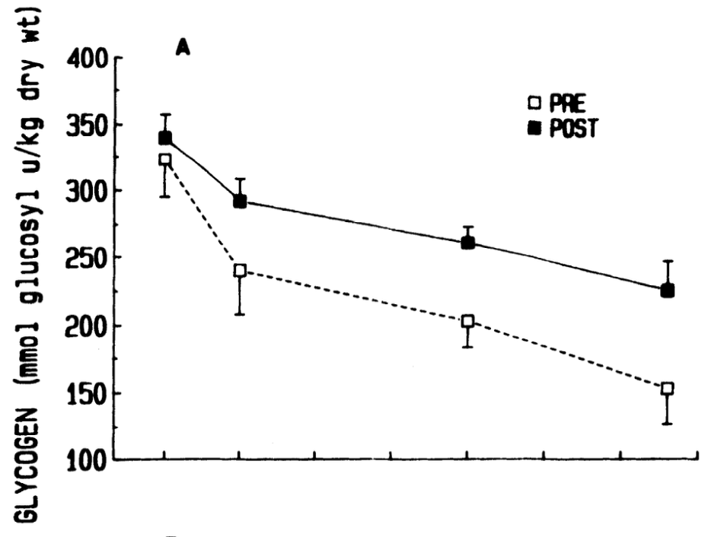
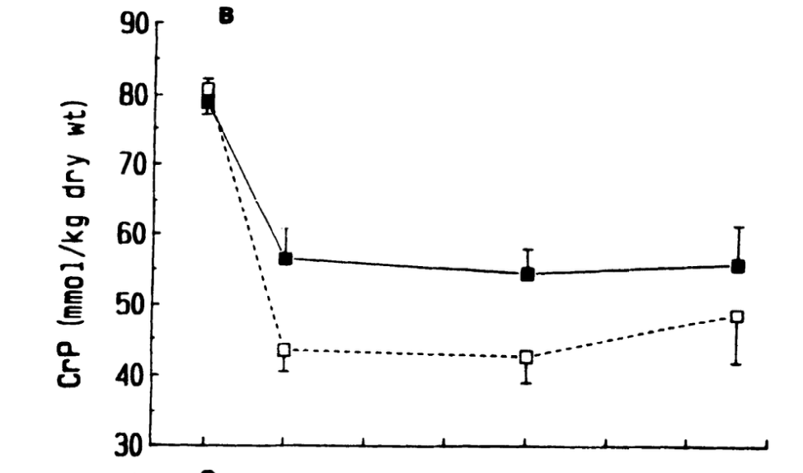
Green et al., 1991

Slide 11
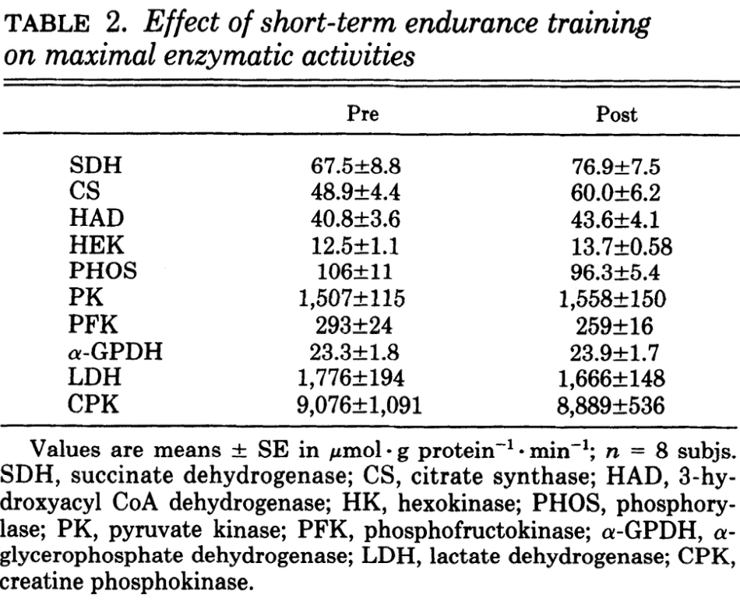
Green et al., 1991
Notes:
None of these were statistically significant (only n= 8)
Phosphorylase (PHOS) → Glykogenolyse
Spaltet Glykogen zu Glucose-1-phosphat
Wichtig für die Bereitstellung von Kohlenhydraten aus den Glykogenspeichern
Hexokinase (HK) → Beginn der Glykolyse
Phosphoryliert Glucose zu Glucose-6-phosphat
Erster Schritt der intrazellulären Glucoseverwertung
Phosphofructokinase (PFK) → Glykolyse
Schrittmacherenzym der Glykolyse
Regelt maßgeblich die Geschwindigkeit des Glucoseabbaus
Pyruvatkinase (PK) → Ende der Glykolyse
Bildet Pyruvat
Produziert ATP
α-Glycerophosphat-Dehydrogenase (α-GPDH) → Glykolyse / NADH-Shuttle
Beteiligt an der Übertragung von Reduktionsäquivalenten
Unterstützt die Energiegewinnung aus Glucose
Laktatdehydrogenase (LDH) → Anaerober Stoffwechsel
Wandelt Pyruvat in Laktat um (und umgekehrt)
Wichtig bei hoher Belastungsintensität und Sauerstofflimitierung
3-Hydroxyacyl-CoA-Dehydrogenase (HAD) → β-Oxidation
Schlüsselenzym des Fettsäureabbaus
Marker für die Fähigkeit zur Fettverbrennung
Citratsynthase (CS) → Citratzyklus
Erstes Enzym des Citratzyklus
Klassischer Marker für mitochondriale Dichte und aerobe Kapazität
Succinatdehydrogenase (SDH) → Citratzyklus und Atmungskette
Einziges Enzym, das sowohl im Citratzyklus als auch in der Atmungskette wirkt
Marker für die oxidative Kapazität der Muskulatur
Kreatinphosphokinase (CPK/CK) → ATP-PCr-System
Überträgt Phosphat zwischen Kreatinphosphat und ATP
Wichtig für die schnelle ATP-Bereitstellung bei Belastungsbeginn

Slide 12

Carnosine is a promising marker for muscle fiber type composition. It is stable over time and largely unaffected by short-term training.
Major influences: long-term vegetarianism ↓ and beta-alanine supplementation ↑.
Fast-twitch (FT) fibers contain ~2× more carnosine than slow-twitch (ST) fibers.
Study aim: Develop a non-invasive method to estimate muscle fiber composition using ¹H-MRS measurement of muscle carnosine.
Baguet et al., 2011
Notes:
1H-MRS (Proton magnetic resonance spectroscopy)
Baguet A, Everaert I, Hespel P, Petrovic M, Achten E, Derave W. A new method for non-invasive estimation of human muscle fiber type composition. PLoS One. 2011;6(7):e21956. doi: 10.1371/journal.pone.0021956. Epub 2011 Jul 7. PMID: 21760934; PMCID: PMC3131401.

Slide 13
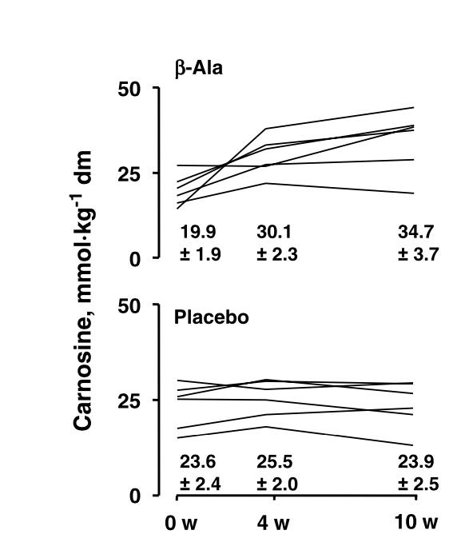
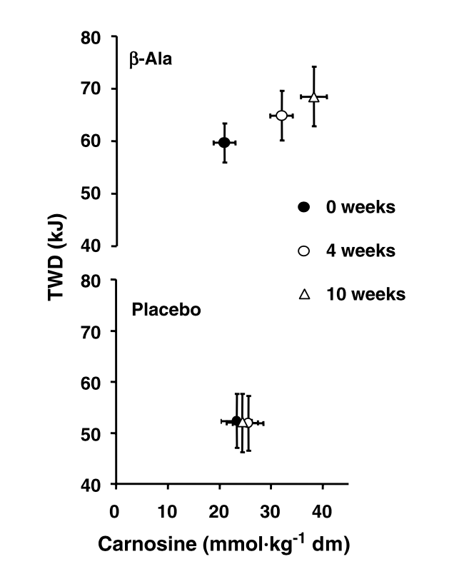
Side Note on Carnosine
Metabolic Origin
pKa = 6.83
pKa close to muscle pH: Efficient buffer!
Hill et al., 2007
Notes:
Ramp test and then kJ is work possible at 110% of Wmax, which is the 60s average at the end of the ramp
Hill CA, Harris RC, Kim HJ, Harris BD, Sale C, Boobis LH, Kim CK, Wise JA. Influence of beta-alanine supplementation on skeletal muscle carnosine concentrations and high intensity cycling capacity. Amino Acids. 2007 Feb;32(2):225-33. doi: 10.1007/s00726-006-0364-4. Epub 2006 Jul 28. PMID: 16868650.

Slide 14
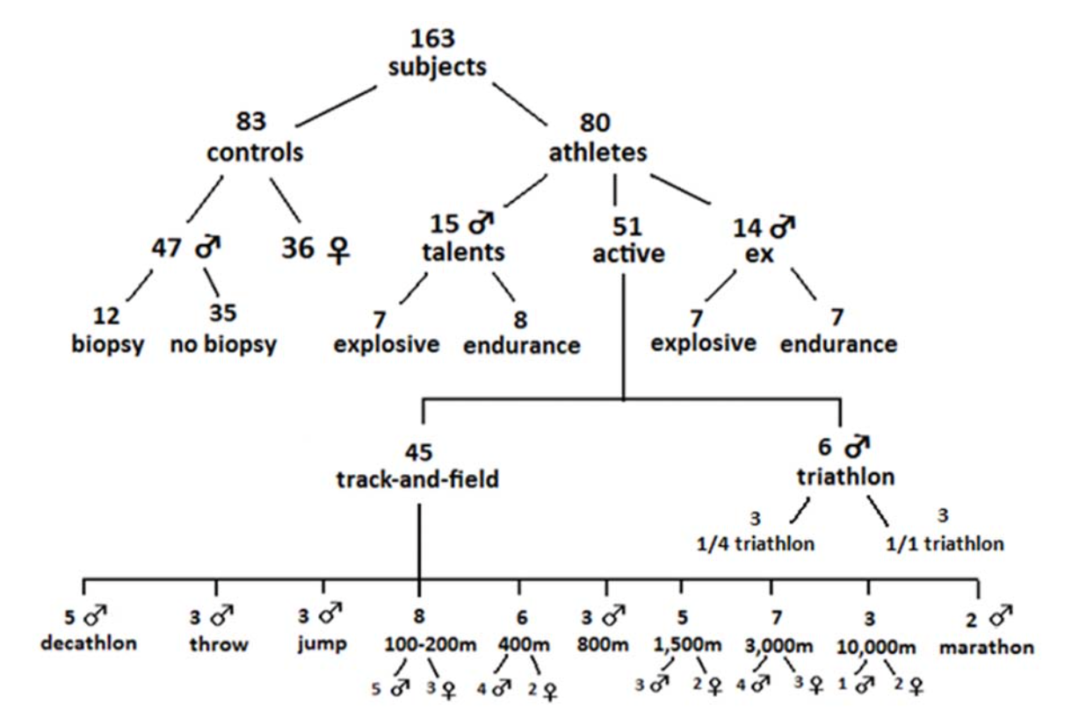
Baguet et al., 2011
Notes:
Concentration measured in gastrocnemius

Slide 15
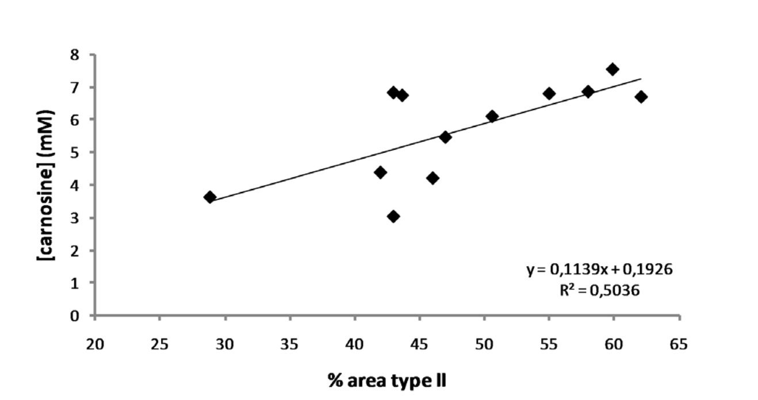
Baguet et al., 2011
Notes:
Untrained cohort correlation

Slide 16
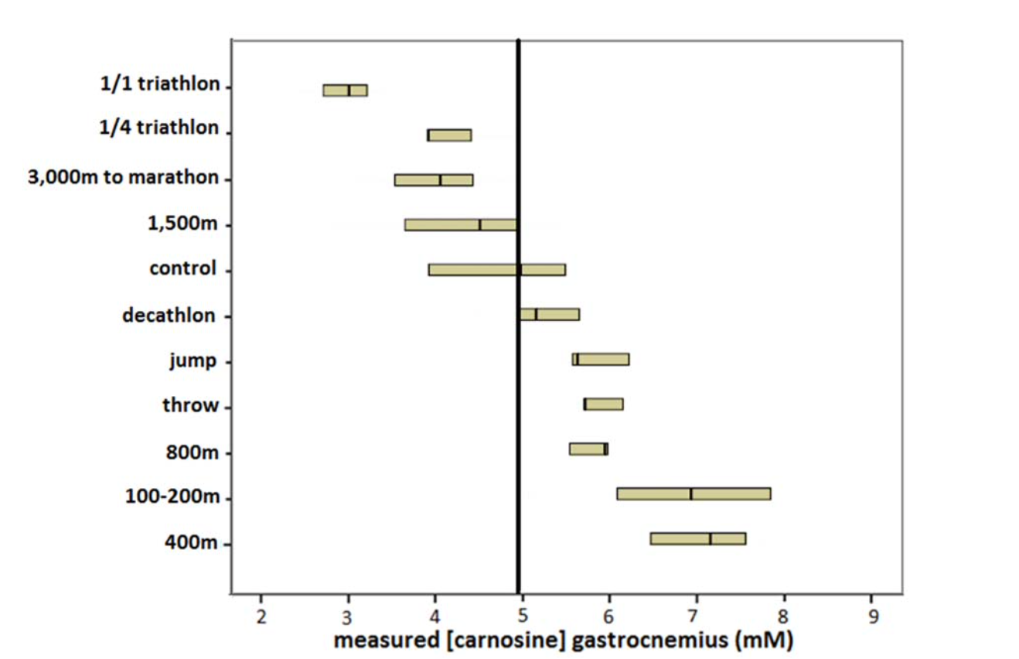
Baguet et al., 2011

Slide 17
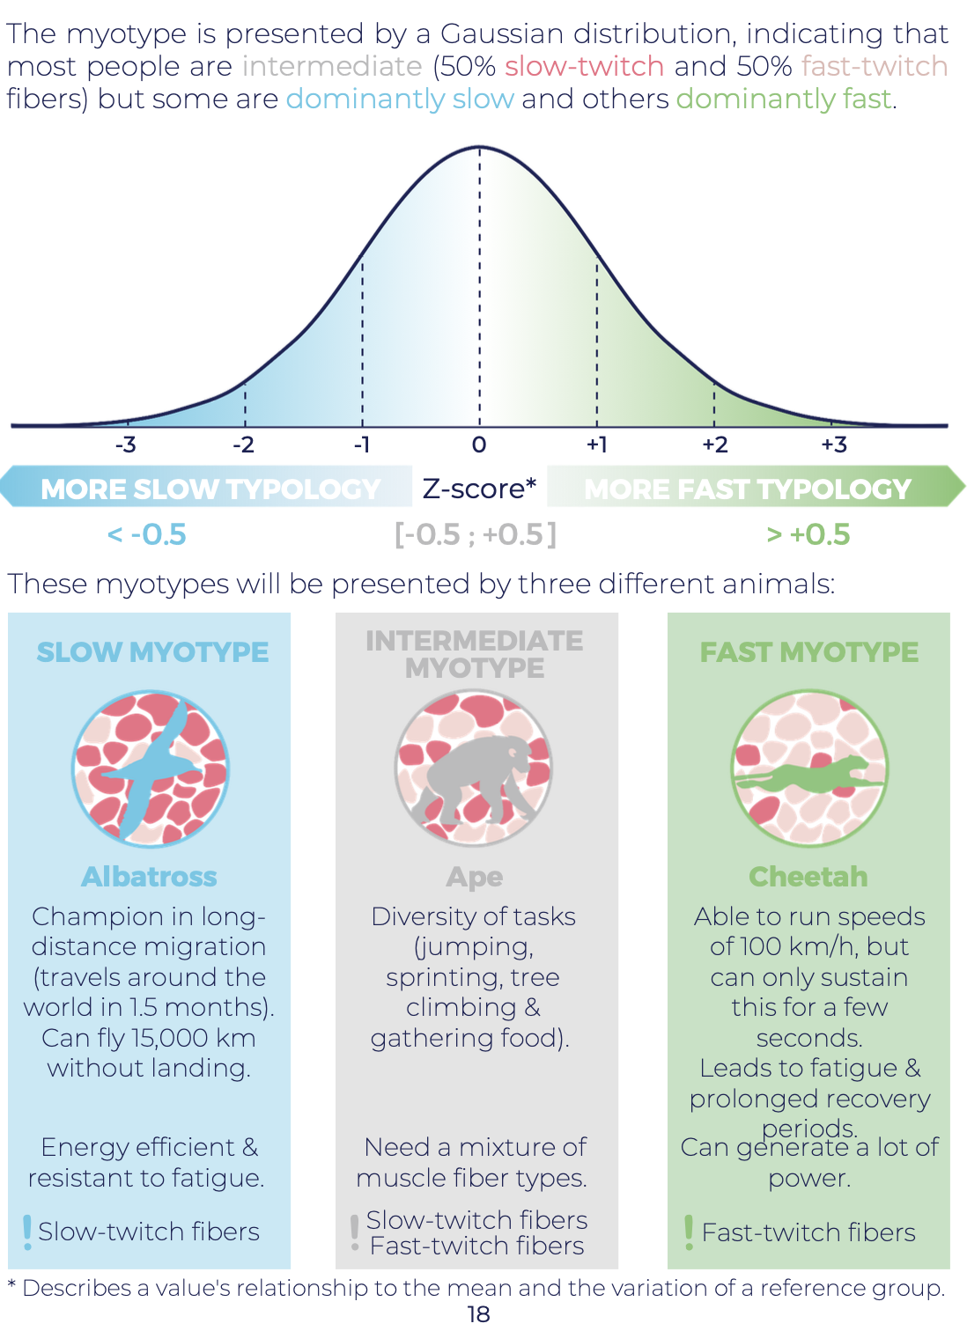
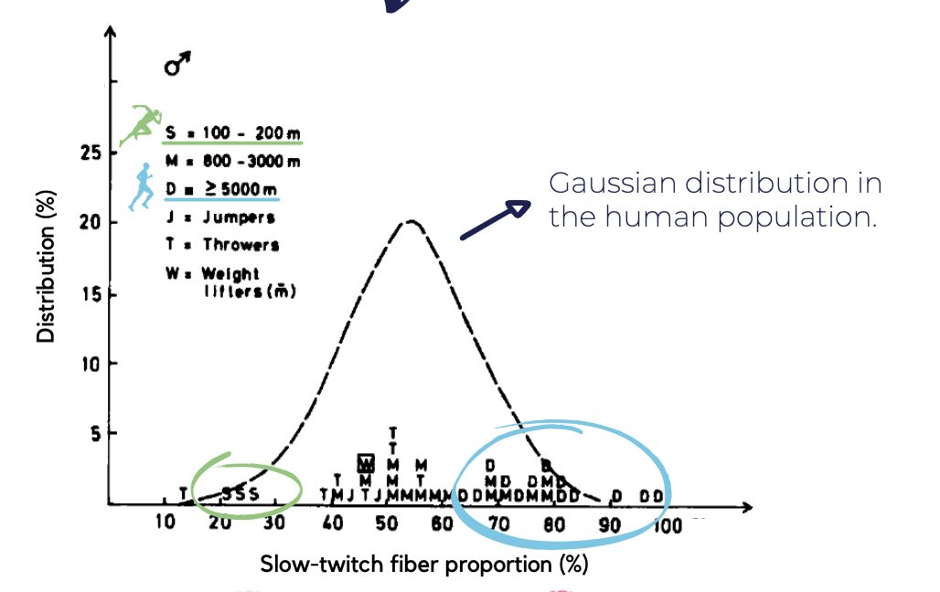

Slide 18
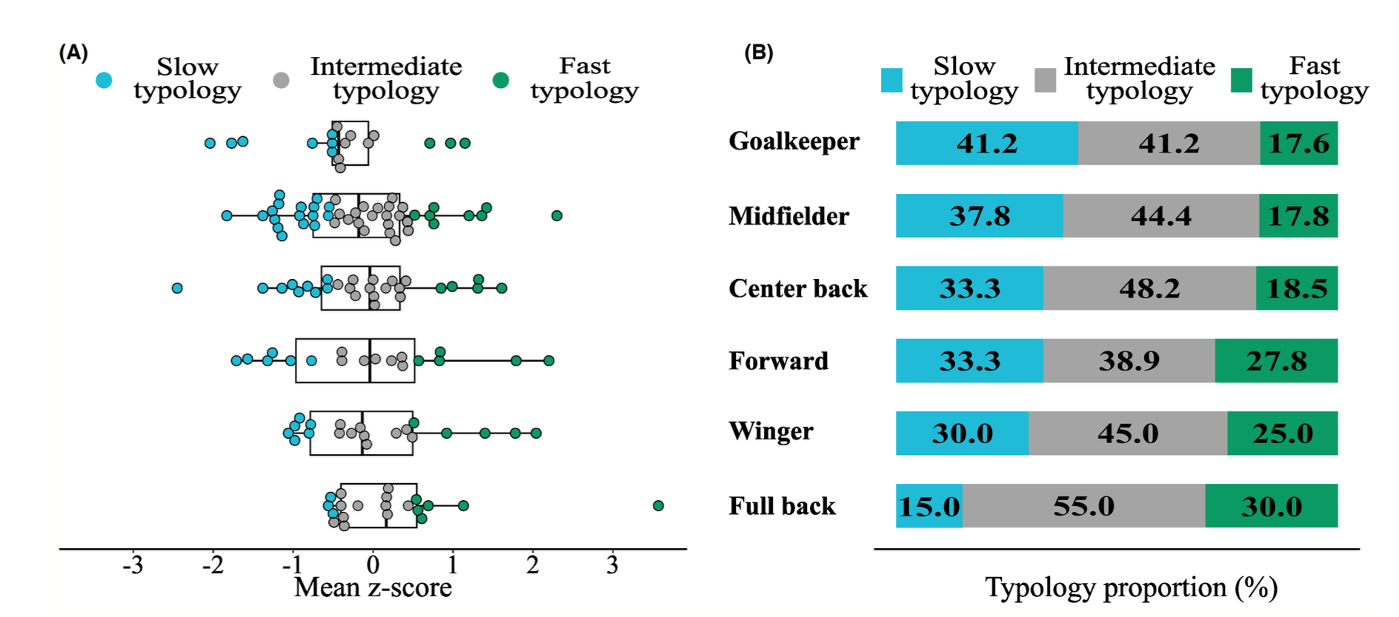
Van de Casteele et al., 2024
Notes:
Van de Casteele F, Deprez D, Van Haaren J, Derave W, Lievens E. In professional football the decline in high-intensity running activities from first to second half is more pronounced in players with a fast muscle typology. Scand J Med Sci Sports. 2024 Jan;34(1):e14508. doi: 10.1111/sms.14508. Epub 2023 Oct 4. PMID: 37792860.

Slide 19
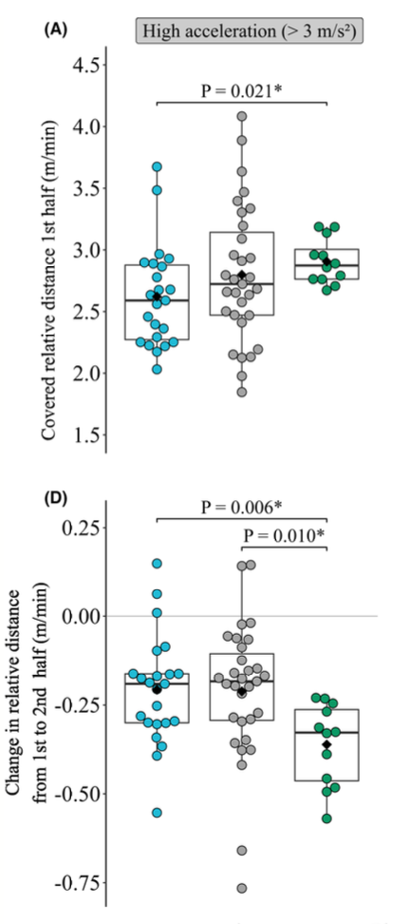
Van de Casteele et al., 2024

Slide 20
Summary (i)
Assessing glycolyitic with
  Enzyme activity
  Carnosine Concentrations

Slide 21
Glycolysis and Glycogenolysis
Possible Quantities to measure
Glucose/Glycogen decline?
PFK concentrations?
Lactate concentrations?
1 Glucose
1 Glycogen
-1 ATP
unfeasible
-1 ATP
Key Enzyme:
Phosphofruktokinase (PFK)
+2 ATP
+2 ATP
2 Lactate + 2 H⁺
Notes:
Lets have a look at measuring lactate concentrations;
We need to understand what we are actually measuring -> where does the lactate go from the muscle?

Slide 22
Measuring [La⁻]
Blood
MCT
La⁻
Mitochondrium
Glycolysis

Slide 23

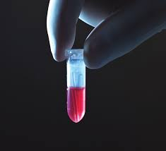
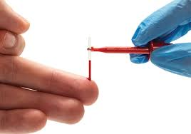
Measuring [La⁻]
Blood
La⁻
La⁻
La⁻
La⁻
La⁻
La⁻
La⁻
La⁻
La⁻
La⁻
Typical sample 20 ul capillary blood
Sampling site: Earlob
Notes:
Predefined mixture of heparinated sodium (preventing of blood clotting and also break open erythrocytes),
After that: Experimental Demonstration taking blood samples

Slide 24
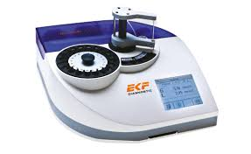
Measuring [La⁻]
Enzymatic-Amperomatical Method
1.)
Lactate + O₂ <- LOD -> Pyruvate + H₂O₂
2.)
H₂O₂ ←→ 2H⁺ + O₂ + 2e⁻
Electrical Current is proportional to lactate concentration!
Notes:
LOD -> Lacate oxidase (enzyme)

Slide 25
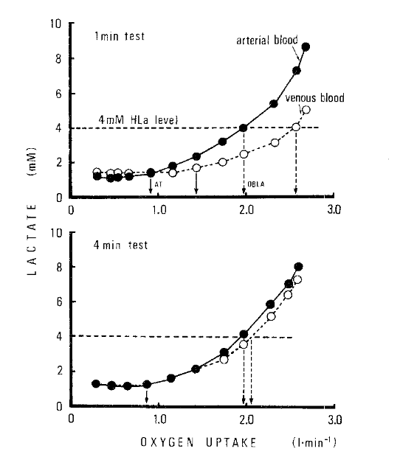
Measuring [La⁻]
Blood compartments
Blood components
Handheld vs stationary

Slide 26
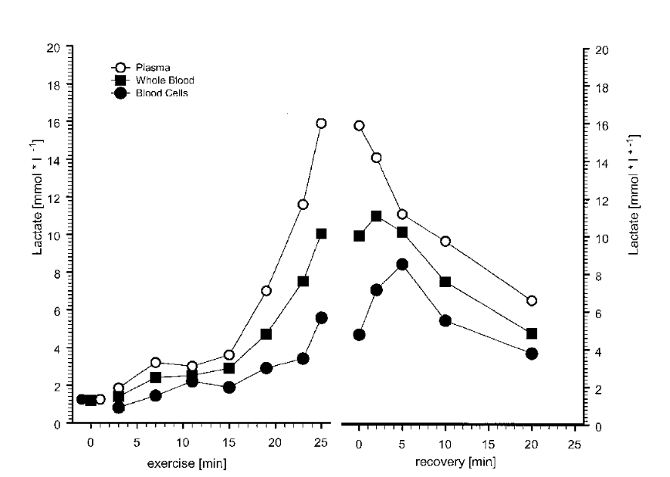
Measuring [La⁻]
Blood compartments
Blood components
Handheld vs stationary
Notes:
Plasma (55% of blood, of which mostly water ~90%)
Erythrocytes 45 %

Slide 27
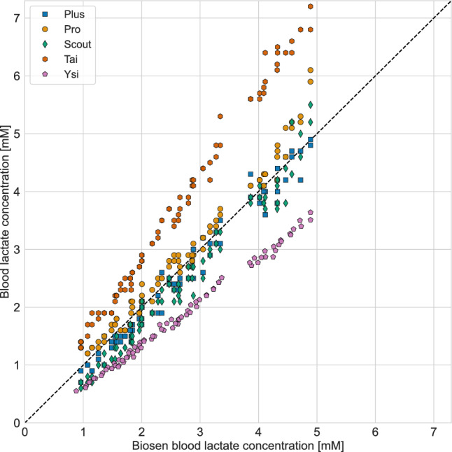
Measuring [La⁻]
Blood compartments
Blood components
Handheld vs stationary
Notes:
TE 0.2 – 0.4 mmol/L

Slide 28
Measuring [La⁻]
What are we actually measuring?
1 mmol/L ?
La⁻
= 1 mmol
= 6.022 * 10²⁰ mol⁻¹
(Million = 10⁶)
1 L
La⁻
1 mmol/L

Slide 29
Measuring [La⁻]
What are we actually measuring?
1 mmol/L ?
La⁻
= 1 mmol
= 6.022 * 10²⁰ mol⁻¹
(Million = 10⁶)
1 L
La⁻
La⁻
2 mmol/L

Slide 30
Measuring [La⁻]
What are we actually measuring?
1 mmol/L ?
La⁻
= 1 mmol
1 L
1 L
La⁻
La⁻
La⁻
La⁻
2 mmol / 0.5 L
4 mmol/L
Absolute: 2 mmol
2 mmol / L
Absolute: 2 mmol

Slide 31

La⁻
= 1 mmol
Measuring [La⁻]
1 L
La⁻
La⁻
La⁻
La⁻
1 L
2 mmol / 0.5 L
4 mmol/L
Absolute: 2 mmol
2 mmol / L
Absolute: 2 mmol
The same absolute quantity can have different concentrations!
Notes:
Take away: Same concentration have different absolute amounts! (VERY IMPORTANT eventhough it seems easy)
-> Lets make a practical example from this (on the next slide)

Slide 32
La⁻
= 1 mmol
Measuring [La⁻]
La⁻
La⁻
La⁻
La⁻
La⁻
La⁻
2 L
La⁻
La⁻
La⁻
0.25 L
8 mmol / 2 L -> 4 mmol / L
Remember: For 1 mmol La⁻ 1.4 mmol is resynthesized
Absolute ATP : 8 * 1.4 = 11.2 mmol ATP
1 mmol / 0.25 L -> 4 mmol/L
Absolute ATP = 1 * 1.4 = 1.4 mmol ATP
Notes:
8 / 2 = 4
1 / 0.25 = 4
Concentration * absolute distribution space = absolute quantity
ATP yield is highly different, eventhough the concentration is the same.
Therefore: If we are measuring the concentration, we also have to take into account the overall distribution volume

Slide 33
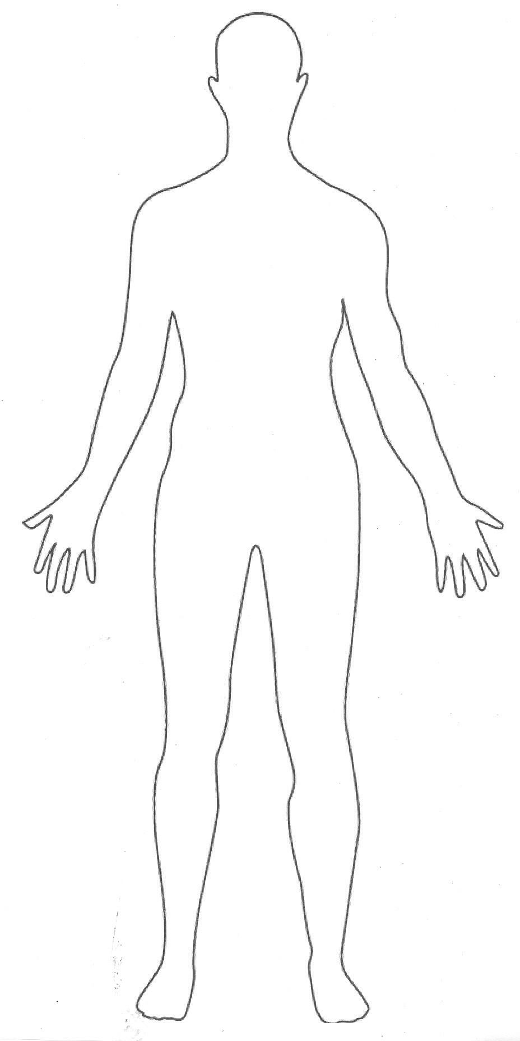
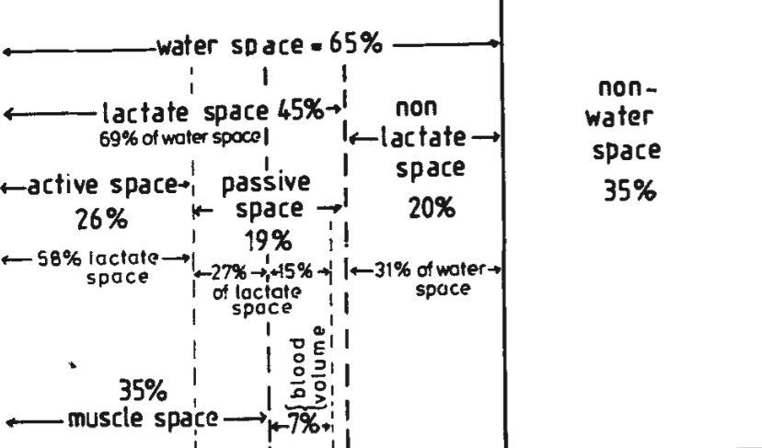
Measuring [La⁻]
Where can we find La⁻ in the human body?
100% body mass

Slide 34
Measuring [La⁻]
75% of muscle mass*
85% of blood mass*
Additionally 5% of intercellular water
69% of overall body water
*Assumed density of 1 kg/L
For Practical Application:
TBW = Fat-Free Mass * 0.73
range ~40 – 50%
Notes:
Remember roughly 45% of body mass is lactate distribution space
-> Most important variable is the muscle mass!

Slide 35
Measuring [La⁻]
Example 1 Vol_{rel}
Body Mass: 60kg
Vol_{rel} : 45%
vLa_{max} : 1 mmol/L/s
60 * 0.45 * 1 = 27 mmol/s La⁻
27 * 1.4 = 37.8 mmol/s ATP
Body Mass: 90kg
Vol_{rel} : 45%
vLa_{max} : 1 mmol/L/s
90 * 0.45 * 1 = 40.5 mmol/s La⁻
40.5 * 1.4. = 56.7 mmol/s ATP

Slide 36
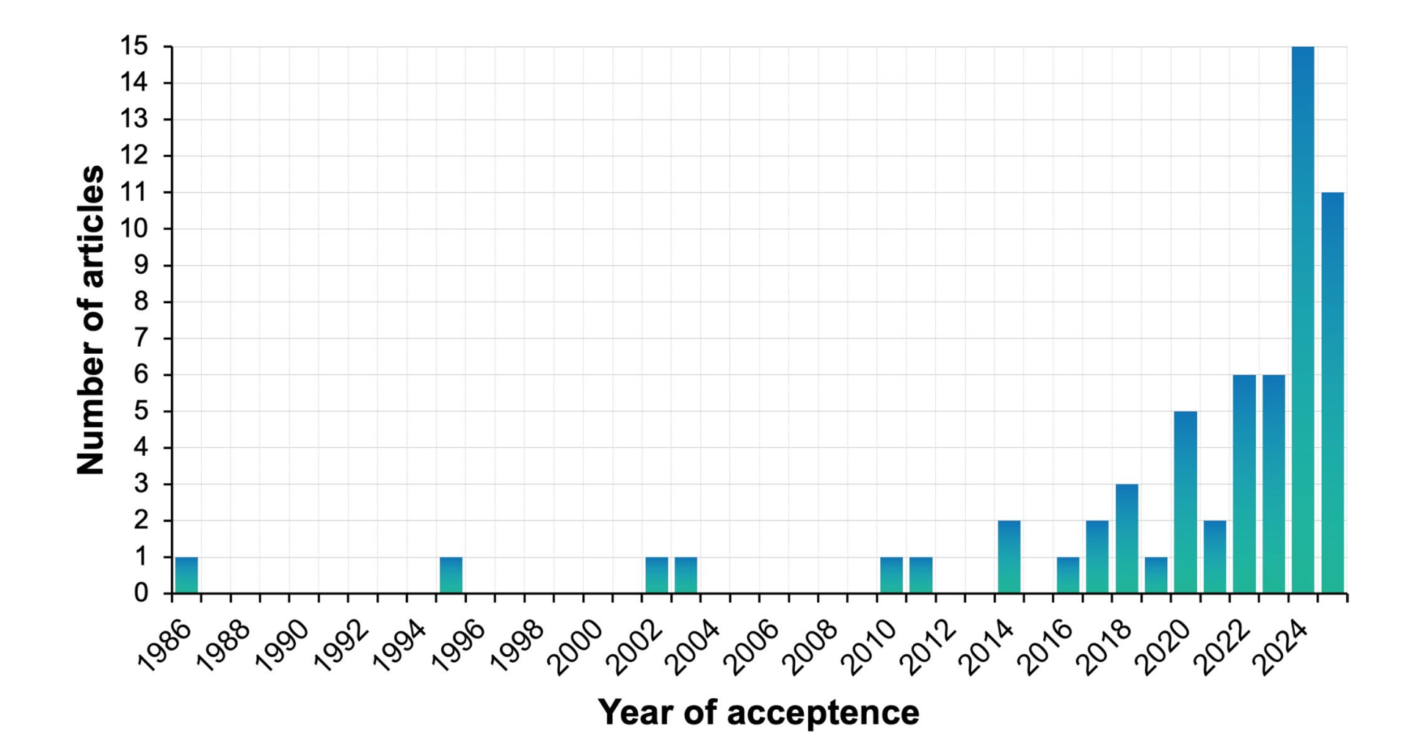
Publications vLamax
Quittmann, 2025
Notes:
Maximal lactate accumulation rate (ċ Lamax): Current evidence and future directions for exercise testing and training

Slide 37
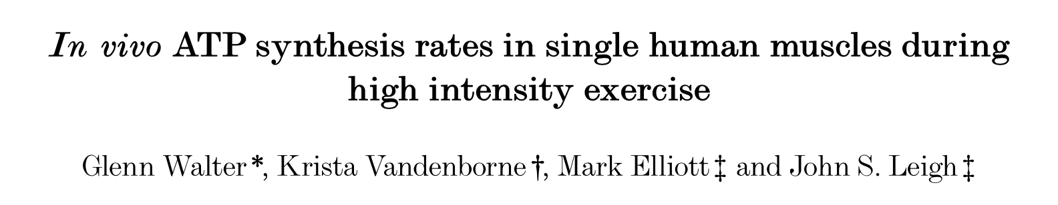
Measuring vLa_{max}
Criteria for a valid test
Duration?
Intensity?
Notes:
Brainstorm from the group in comparison to V̇O2max test?
Capacity divided by power = time? -> 50/1.5 = 33.3s; 50/3=16.6s

Slide 38
Measuring vLa_{max}
³¹P-NMRS (Phosphor-Nucleomagnetresonancespectroscopy)
Plantarflexion for 30s, 2-3 Hz, 30% MVC, 40° ROM
Measurement of ATP, PCr, Pi, pH, Anaerobic & Anaerobic ATP-Synthesis
Notes:
Method to Asses the biochemical composition of biological tissue:
Briefly, biological tissue exposed to magnetic field -> Spin of nucleus inteferes with magnetic field -> signal can be interpreted for relative changes;
MVC -> Maximal Voluntary Contraction
ROM -> Range of Motion
High repetition rate (2-3Hz) to cause (near) maximal fibre recruitment
Walter G, Vandenborne K, Elliott M, Leigh JS. In vivo ATP synthesis rates in single human muscles during high intensity exercise. J Physiol. 1999 Sep 15;519 Pt 3(Pt 3):901-10. doi: 10.1111/j.1469-7793.1999.0901n.x. PMID: 10457099; PMCID: PMC2269548.

Slide 39
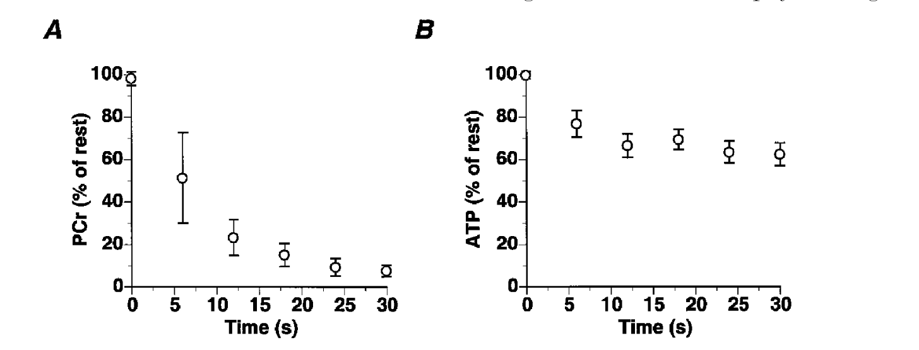
Measuring vLa_{max}
³¹P-NMRS (Phosphor-Nucleomagnetresonancespectroscopy)
Plantarflexion for 30s, 2-3 Hz, 30% MVC, 40° ROM
Measurement of ATP, PCr, Pi, pH, Anaerobic & Anaerobic ATP-Synthesis
Walter et al., 1999
Notes:
Thinks we know:
PCr concentration & ATP concentration as function of time

Slide 40
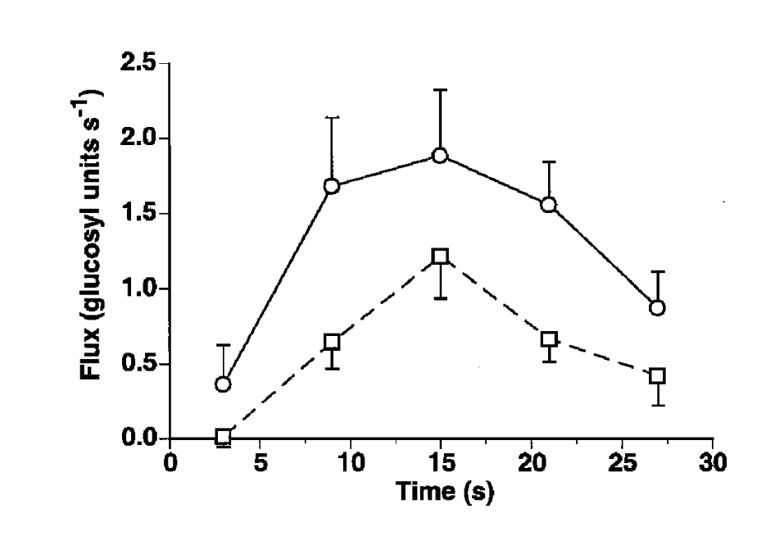
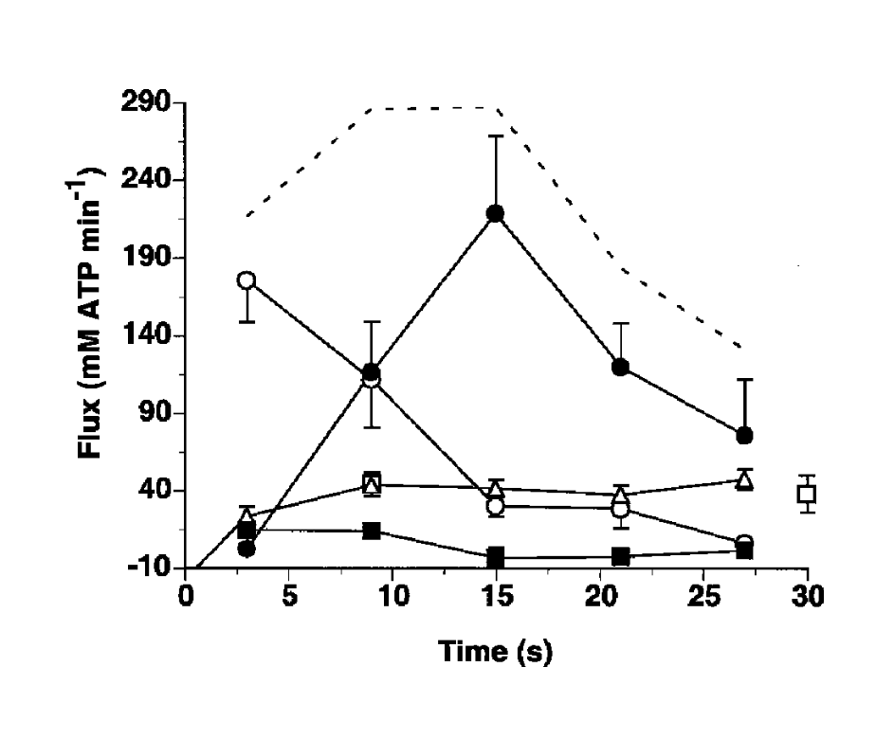
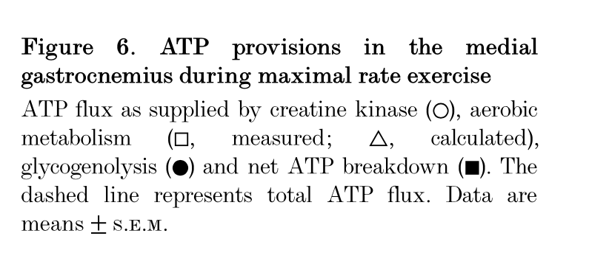
Measuring vLa_{max}
³¹P-NMRS (Phosphor-Nucleomagnetresonancespectroscopy)
Plantarflexion for 30s, 2-3 Hz, 30% MVC, 40° ROM
Measurement of ATP, PCr, Pi, pH, Anaerobic & Anaerobic ATP-Synthesis
Walter et al., 1999
Notes:
(left) Have a look at the timecourse of glycolytic activity -> Peak after 15s
(right) Have a look at overall ATP Flux -> Peak after 15s, also iterate of contributions of different systems
Also ask: Why is Glycolytic flux ATP flux downregulated after 15?

Slide 41
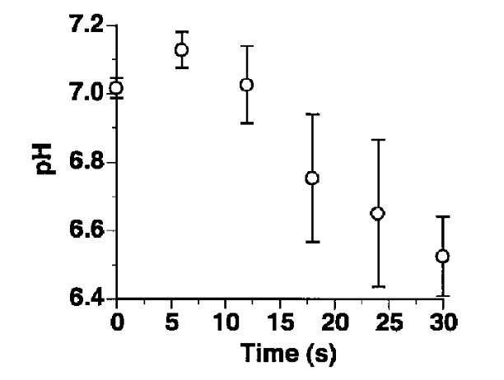
Measuring vLa_{max}
Inhibition of glycolysis due to decreasing pH
Test Specifications for vLa.max?
Duration: 15 – 20s
Intensity: Maximal
Correct Set-Up (individual)
Walter et al., 1999
Notes:
Explain increasing & decreasing pH
Link pH to glycolytic flux (PCr activation looses to pH inhibition after 10-15s).
Use this knowledge to create a test!
-> High Frequency for maximal fibre recruitment in test

Slide 42
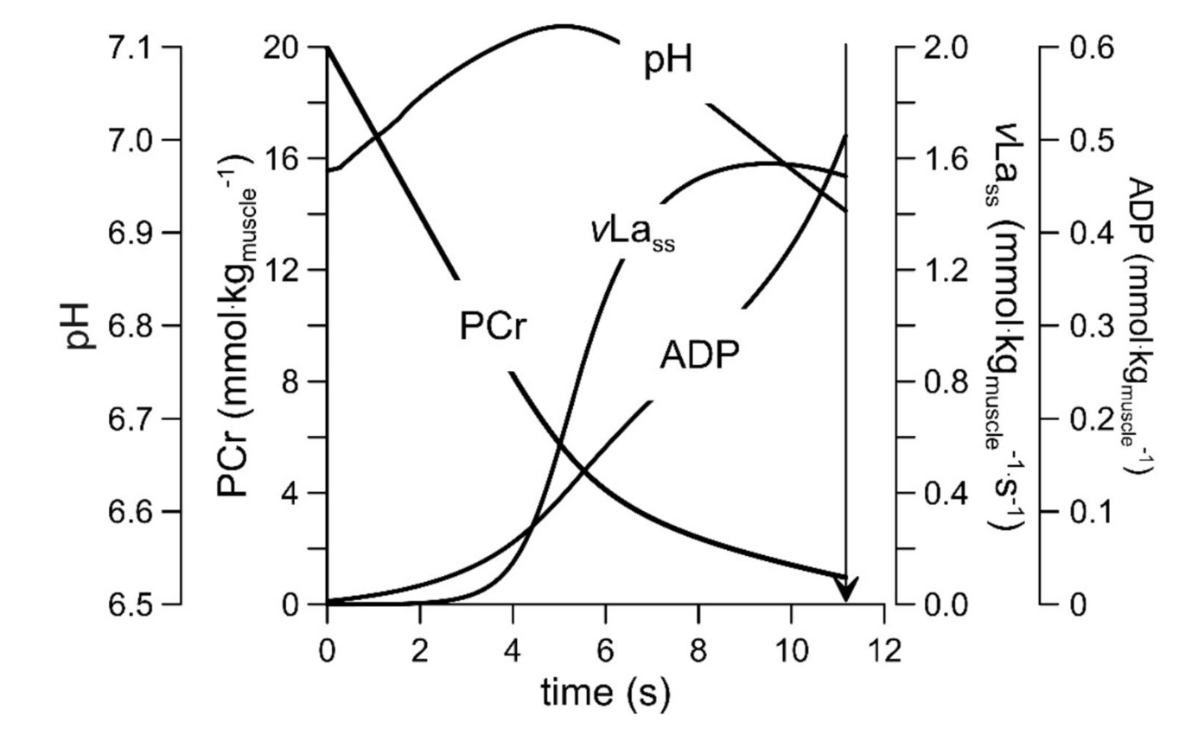
Kinetics during sprint test
Wackerhage et al., 2025
Notes:
Wackerhage H, Kabasakalis A, Seiler S, Heck H. Is the vLamax for Glycolysis What the V˙O2 max is for Oxidative Phosphorylation? Sports Med. 2025 Aug;55(8):1853-1866. doi: 10.1007/s40279-025-02259-6. Epub 2025 Jul 17. PMID: 40676393; PMCID: PMC12460440.

Slide 43
Measuring vLa_{max}
Test Specifications for vLa.max?
Idea 15s maximal Sprint on the bike:
1.) Measure [La⁻] before test
2.) Measure peak [La⁻] after test
3.) Calculate accumulation rate
Notes:
Shortcomings: The Method is unfeasible, we need an easier method

Slide 44
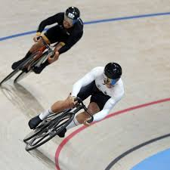
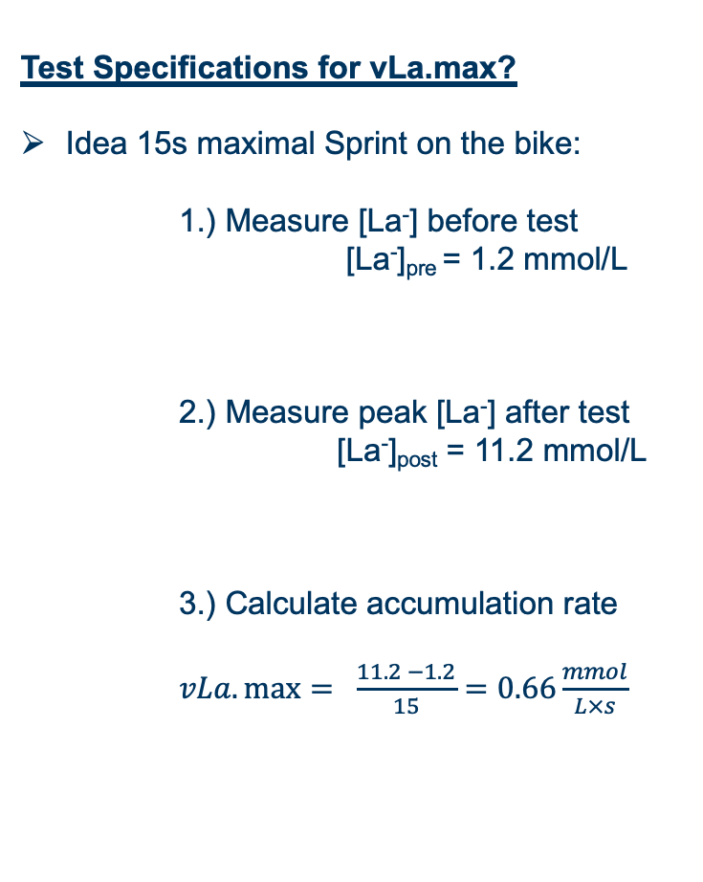
Measuring vLa_{max}
Test Specifications for vLa.max?
Idea 15s maximal Sprint on the bike:
1.) Measure [La⁻] before test
[La⁻]_{pre} = 1.2 mmol/L
2.) Measure peak [La⁻] after test
[La⁻]_{post} = 11.2 mmol/L
3.) Calculate accumulation rate
$vLa.\max{= \frac{11.2 −1.2}{15}}=0.66\frac{mmol}{L×s}$
https://www.tagesspiegel.de/sport/sommerspiele-bahnrad-sprinter-weit-weg-von-der-weltspitze-viel-arbeit-12163478.html
Formula calculates mean instead of maximal rate!
Notes:
Problem: Calculation of mean vs max!

Slide 45
Measuring vLa_{max}
Test Specifications for vLa.max?
Idea 15s maximal Sprint on the bike:
1.) Measure [La⁻] before test
[La⁻]_{pre} = 1.2 mmol/L
2.) Measure peak [La⁻] after test
[La⁻]_{post} = 11.2 mmol/L
3.) Calculate accumulation rate
$vLa.\max{= \frac{11.2 −1.2}{15}}=0.66\frac{mmol}{L×s}$
https://www.tagesspiegel.de/sport/sommerspiele-bahnrad-sprinter-weit-weg-von-der-weltspitze-viel-arbeit-12163478.html
Formula calculates mean instead of maximal rate!
Notes:
Show how the glycolytic flux takes a couple of seconds to build up
Formula calculates mean instead of max;
NORMVALUES (0.2 – 1.1 mmol/L/s)

Slide 46
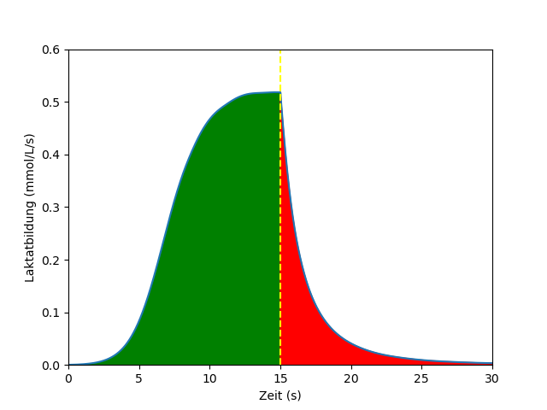
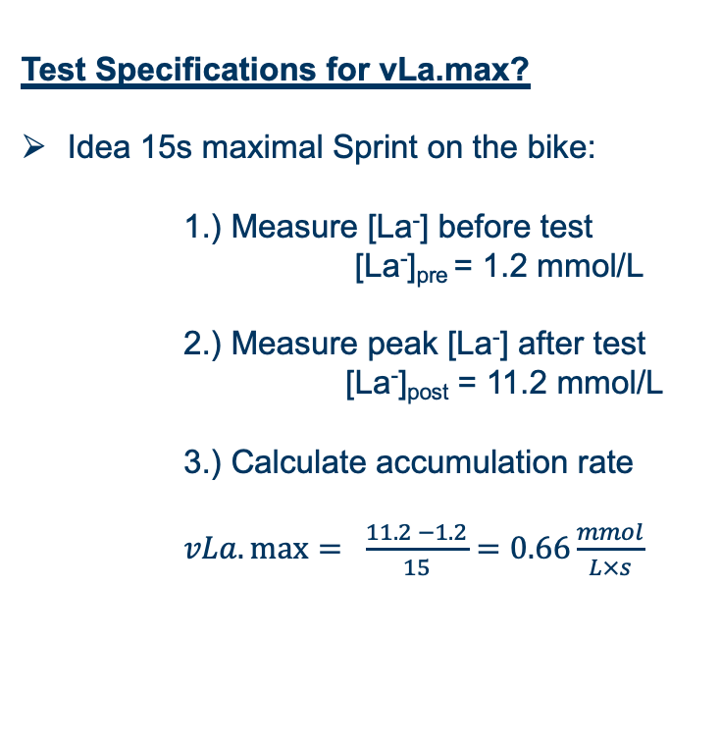
Measuring vLa_{max}
Test Specifications for vLa.max?
Idea 15s maximal Sprint on the bike:
1.) Measure [La⁻] before test
[La⁻]_{pre} = 1.2 mmol/L
2.) Measure peak [La⁻] after test
[La⁻]_{post} = 11.2 mmol/L
3.) Calculate accumulation rate
$vLa.\max{= \frac{11.2 −1.2}{15}}=0.66\frac{mmol}{L×s}$
Lactate production
Correction for
Delayed activation
Delayed deactivation
Notes:
This is the assumption of the formula→ Direct maximal activiation and inhibtion at end of exercise

Slide 47

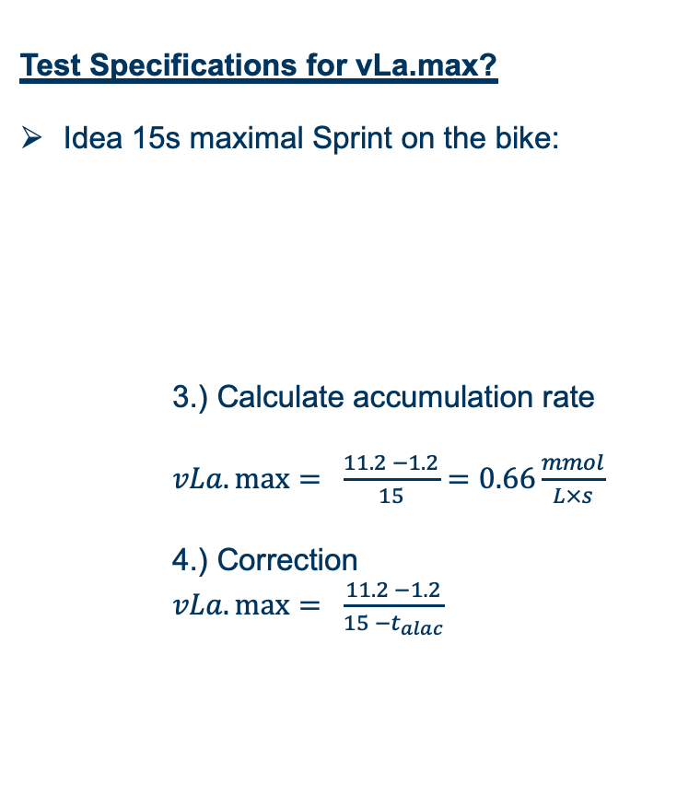
Measuring vLa_{max}
Test Specifications for vLa.max?
Idea 15s maximal Sprint on the bike:
3.) Calculate accumulation rate
$vLa.\max{= \frac{11.2 −1.2}{15}}=0.66\frac{mmol}{L×s}$
4.) Correction
$vLa.\max{= \frac{11.2 −1.2}{15 −t_{alac}}}$
t_{alac}
t_{alac}
Lactate production
Correction for
Delayed activation
Delayed deactivation
t_{alac} ~ 3.4s
(for 15s sprint)
Notes:
Delayed Activation gives positiv t_alax
Delayed deactivation gives negative t_alac
-> Activation effect is higher, overall we get a postive number

Slide 48
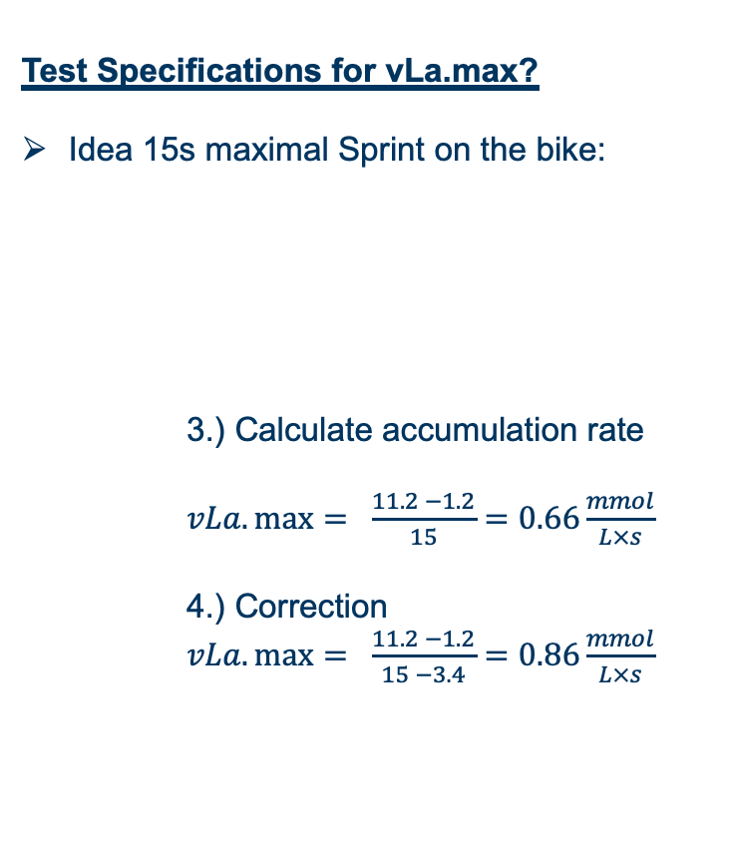
Measuring vLa_{max}
Test Specifications for vLa.max?
Idea 15s maximal Sprint on the bike:
3.) Calculate accumulation rate
$vLa.\max{= \frac{11.2 −1.2}{15}}=0.66\frac{mmol}{L×s}$
4.) Correction
$vLa.\max{= \frac{11.2 −1.2}{15 −3.4}=0.86\frac{mmol}{L×s}}$
t_{alac}
t_{alac}
Lactate production
Correction for
Delayed activation
Delayed deactivation
t_{alac} ~ 3.4s
(for 15s sprint)
What about quality criteria?

Slide 49
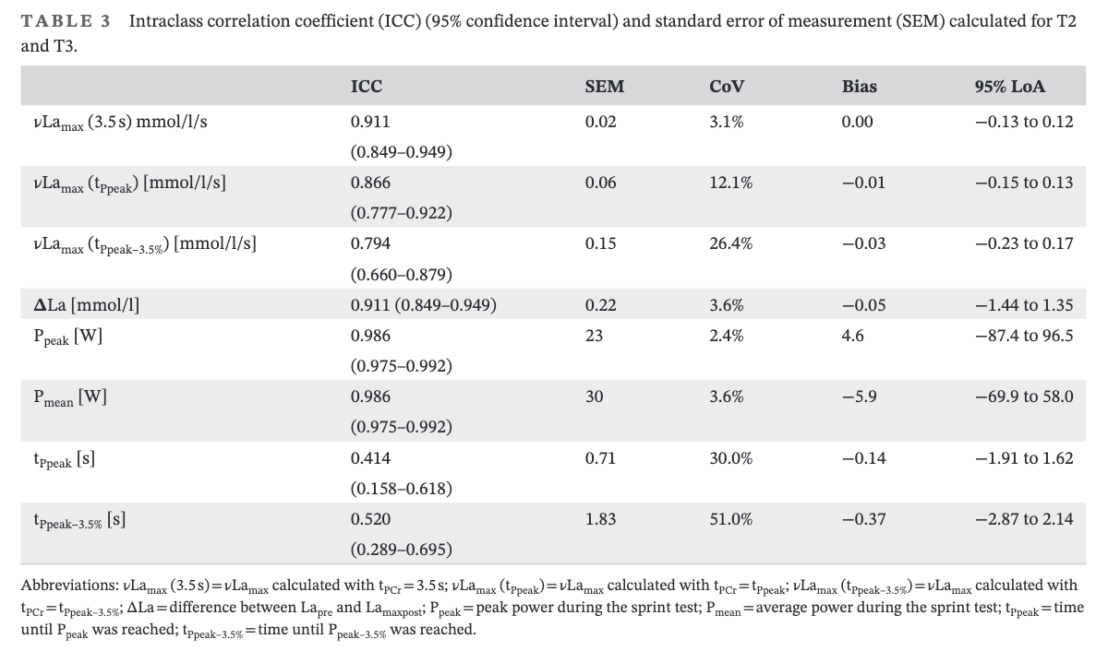
Measuring vLa_{max}
Validity & Reliability
Meixner et al., 2024
Notes:
Reliability of power output, maximal rate of capillary blood
lactate accumulation, and phosphagen contribution time
following 15-s sprint cycling in amateur cyclists

Slide 50
Breakout Sessions
Group Reliability
You can find the Meixner 2024 paper in moodle. Investigate the effects of the different inputs to the vLamax equations on the results.
Group La-Space
Research the relationship between body fat and lactate distribution space. Find an article describing the relationship between body fat and total body water -> From there you can calculate the lactate distribution space.
Group PCr, pH, vLass
Explain the muscular kinetics during a maximal sprint test. Also highlight why test shorter than 5s and longer than 20s are not suitable.
Group vLamax to mechanical Power
Calculate the theorethical mechanical power for multiple with parameters (vlamax, body weight, etc.) of your own choosing. Create an excel sheet with dynamic input and output cells.

Slide 51
Insufficient ADP/AMP activation
Acidosis inhibits glycolysis
Peak lactate flux short
talac correction highly variable
Problems associated
with vLamax testing
Lactate clearance unaccounted for
No vLamax verification criterion
*(Glycolytic ATP after exercise cessation)
Wackerhage et al., 2025

Slide 52
Measuring vLa_{max}
Validity & Reliability
Validity
No experimental data
Evaluation only on theoretical basis and with
major limitations possible
Ergometer settings, application to other sports
(e.g. running), t_{alac}
Muscle Biopsies, ³¹P-NMR

Slide 53
Summary (ii)
Difficulties in assessing anaerobic-lactic power (vLa.max)
Mean vs. Maximal activation
Correction for delayed activation & deactivation
Good Reliability
Questionable Validity
Relationship of anaerobic power and capacity

Slide 54
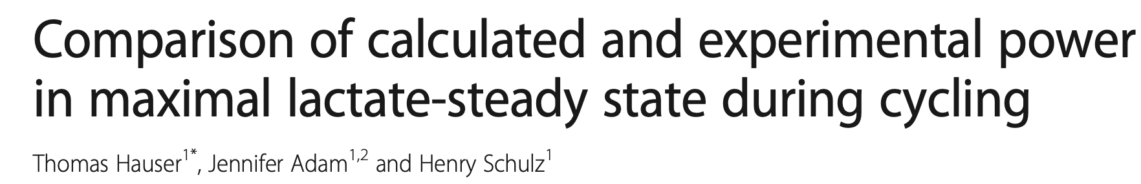
Rampentest
Rampentest
Sprinttest
V̇O₂max
vLa.max
Experimentally determmied
Calculatoins in 1-Copmartment Modell
Metabolic Profile / AT
Ergebnis der Simulation

Slide 55
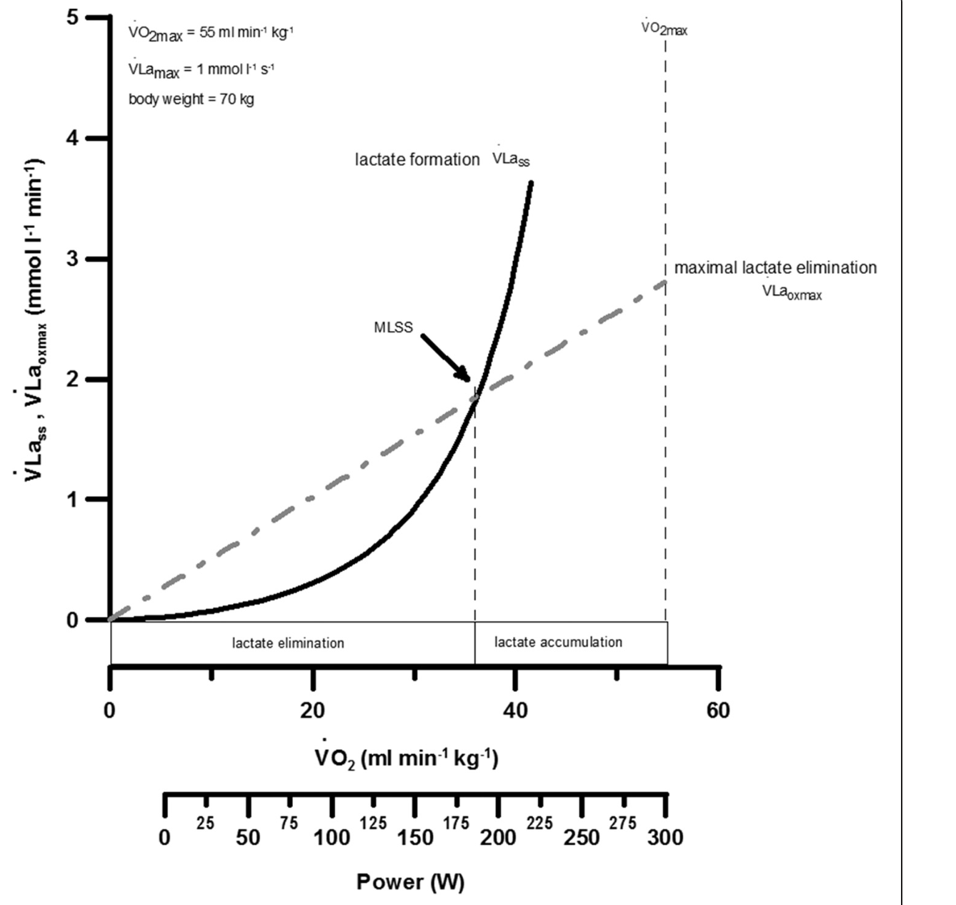
If V̇O₂ is a linear function and x-axis is in power
Glycolytic ATP is neglected…

Slide 56
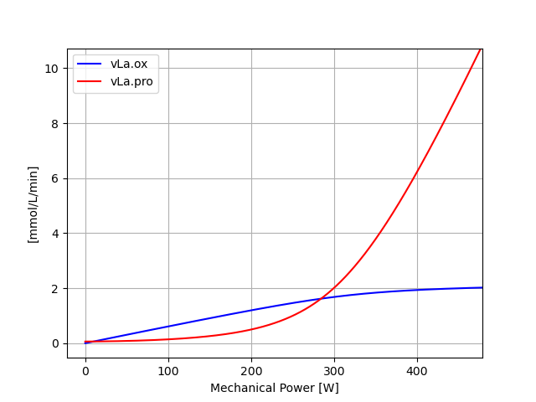
@ 400W Lactate accumulation roughly 4 mmol/L/min
@ 200W: Lactate deficit roughly 0.5 mmol/L/min
Notes:
Ideas about interval training or also race planning

Slide 57
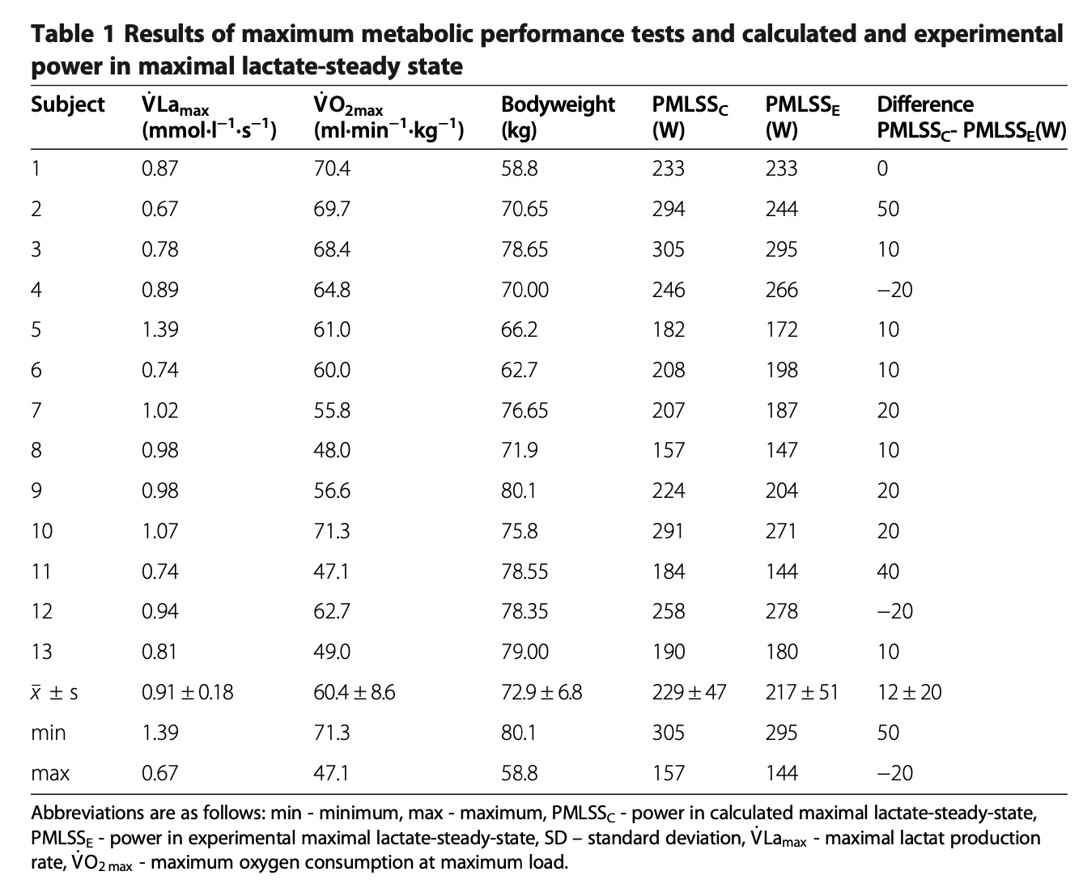

Slide 58
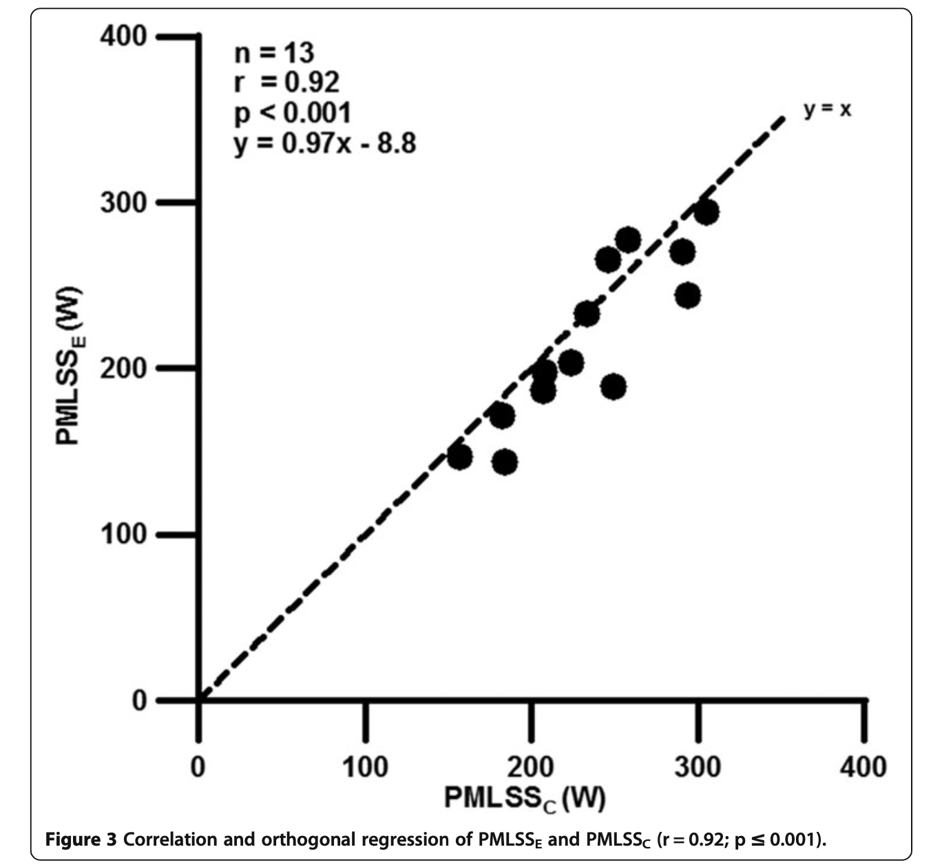
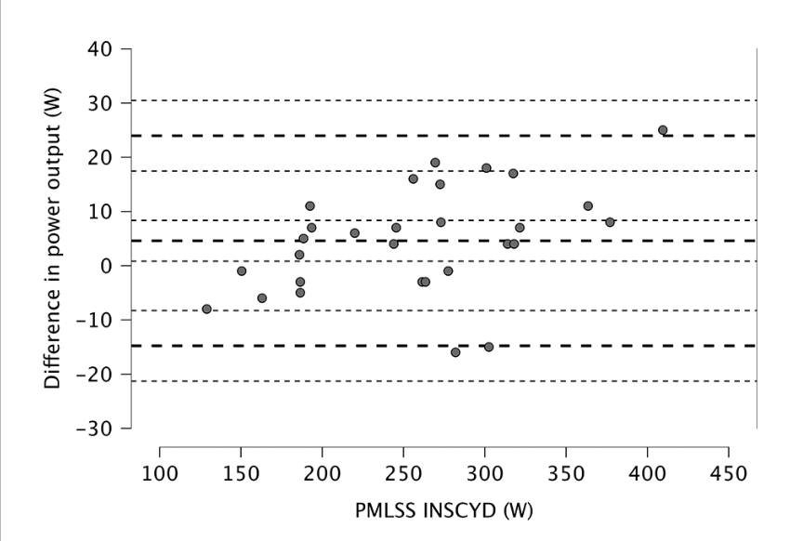
Poffé et al., 2024
Hauser et al., 2014
Notes:
Hauser: Problem with the calculation!
Poffé: Not transparently described
-> Likely different basis for calculation!

Slide 59
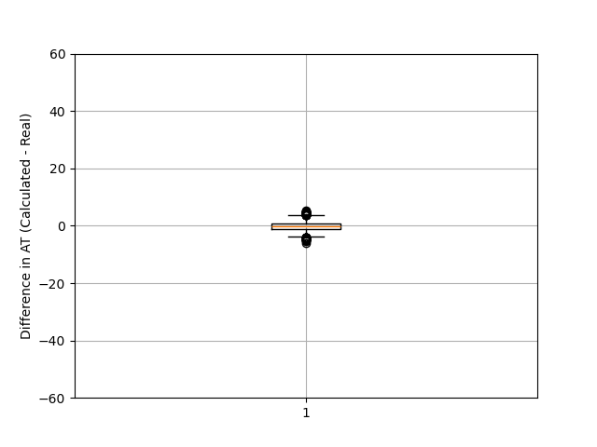

Error std: 0.1 V̇O₂max, 0.01 vLamax
Error std: 2.5 V̇O₂max, 0.08 vLamax
If independent variables are prone to errors dependent variables (in this case AT) will come with high errors!
Notes:
Box 50% of data
Whiskers: 1.5x Box +- box edges
Outliers above and below as dots

Slide 60
Vorstellung des Studienprotokolls
Lactate-Power
Lactate-Time-Curve
Rampentest
Ramptest
Sprinttest
V̇O₂max
vLa.max
Experimentally
Experimentally
Simulated in 2K-Model
Simulated in 1K Model
Results of Simulation
Results of Simulation
V̇O₂max
vLa.max
Metabolisches Profil / CP
Results of Simulation
MLSS
Results of Simulation

Slide 61


Simulation based approaches for performance testing
Calculation of V̇O₂max & vLamax based on lactate curve
Levenberg-Marquart-Algorithmus

Slide 62




Simulation based approaches for performance testing
Steptest 80W + 40W every 5 Minutes; Athlete 75kg, 45% vol.rel
High: 57 ml/min/kg & 0.60 mmol/L/s
Low: 50 ml/min/kg & 0.30 mmol/L/s

Slide 63

MC-Sim alternative option
Std Error [La⁻]
Based on the MC-Analysis -> This is the better option!
Limitation
Error of Model not involved and other potential sources
-> this is rather a first estimate!

Slide 64
Summary (Iii)
  Validity of vLamax testing remains an enigma
  Pitfalls when calculating individual metabolic profiles from testing data
  Next Week:
  Testing Session
  -> Spirometry Group ?

Slide 65
Literature
Baguet A, Everaert I, Hespel P, Petrovic M, Achten E, Derave W. A new method for non-invasive estimation of human muscle fiber type composition. PLoS One. 2011;6(7):e21956. doi: 10.1371/journal.pone.0021956. Epub 2011 Jul 7. PMID: 21760934; PMCID: PMC3131401.
Green HJ, Jones S, Ball-Burnett ME, Smith D, Livesey J, Farrance BW. Early muscular and metabolic adaptations to prolonged exercise training in humans. J Appl Physiol (1985). 1991 May;70(5):2032-8. doi: 10.1152/jappl.1991.70.5.2032. PMID: 1864784.
Hauser T, Adam J, Schulz H. Comparison of calculated and experimental power in maximal lactate-steady state during cycling. Theor Biol Med Model. 2014 May 27;11:25. doi: 10.1186/1742-4682-11-25. Erratum in: Theor Biol Med Model. 2016 Sep 8;13(1):18. doi: 10.1186/s12976-016-0044-3. PMID: 24886168; PMCID: PMC4052616.
Hill CA, Harris RC, Kim HJ, Harris BD, Sale C, Boobis LH, Kim CK, Wise JA. Influence of beta-alanine supplementation on skeletal muscle carnosine concentrations and high intensity cycling capacity. Amino Acids. 2007 Feb;32(2):225-33. doi: 10.1007/s00726-006-0364-4. Epub 2006 Jul 28. PMID: 16868650.
Nolte S, Rein R, Quittmann OJ. Data Processing Strategies to Determine Maximum Oxygen Uptake: A Systematic Scoping Review and Experimental Comparison with Guidelines for Reporting. Sports Med. 2023 Dec;53(12):2463-2475. doi: 10.1007/s40279-023-01903-3. Epub 2023 Aug 21. PMID: 37603201; PMCID: PMC10687136.
Poffé C, Van Dael K, Van Schuylenbergh R. INSCYD physiological performance software is valid to determine the maximal lactate steady state in male and female cyclists. Front Sports Act Living. 2024 May 7;6:1376876. doi: 10.3389/fspor.2024.1376876. PMID: 38774278; PMCID: PMC11107085.
Poole DC, Jones AM. Measurement of the maximum oxygen uptake V̇o2max: V̇o2peak is no longer acceptable. J Appl Physiol (1985). 2017 Apr 1;122(4):997-1002. doi: 10.1152/japplphysiol.01063.2016. Epub 2017 Feb 2. PMID: 28153947.
Quittmann OJ. Maximal lactate accumulation rate ( c˙ Lamax): Current evidence and future directions for exercise testing and training. Eur J Appl Physiol. 2026 Jan;126(1):1-36. doi: 10.1007/s00421-025-06022-7. Epub 2025 Oct 31. PMID: 41171430; PMCID: PMC12881007.
Van de Casteele F, Deprez D, Van Haaren J, Derave W, Lievens E. In professional football the decline in high-intensity running activities from first to second half is more pronounced in players with a fast muscle typology. Scand J Med Sci Sports. 2024 Jan;34(1):e14508. doi: 10.1111/sms.14508. Epub 2023 Oct 4. PMID: 37792860.
Van Hooren B, Souren T, Bongers BC. Accuracy of respiratory gas variables, substrate, and energy use from 15 CPET systems during simulated and human exercise. Scand J Med Sci Sports. 2024 Jan;34(1):e14490. doi: 10.1111/sms.14490. Epub 2023 Sep 11. Erratum in: Scand J Med Sci Sports. 2024 Mar;34(3):e14607. doi: 10.1111/sms.14607. PMID: 37697640.
Wackerhage H, Kabasakalis A, Seiler S, Heck H. Is the vLamax for Glycolysis What the V˙O2 max is for Oxidative Phosphorylation? Sports Med. 2025 Aug;55(8):1853-1866. doi: 10.1007/s40279-025-02259-6. Epub 2025 Jul 17. PMID: 40676393; PMCID: PMC12460440.

