Slide 1
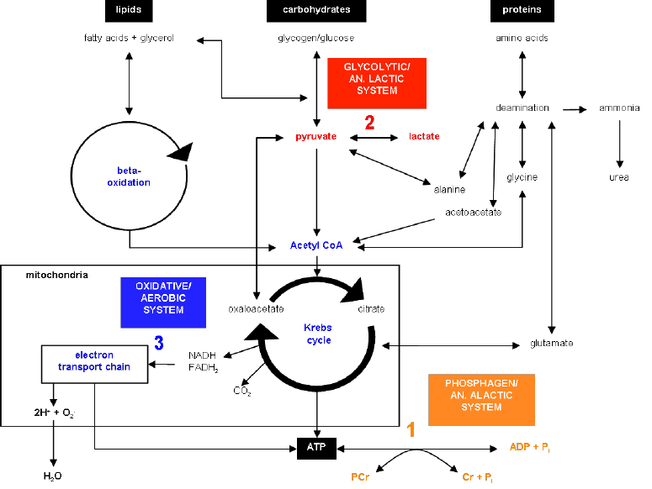

Applied Exercise Physiology & Sports Nutrition for Health & Performance
Diagnostics of Aerobic Power, I
Jasper Suttmeyer

Slide 2
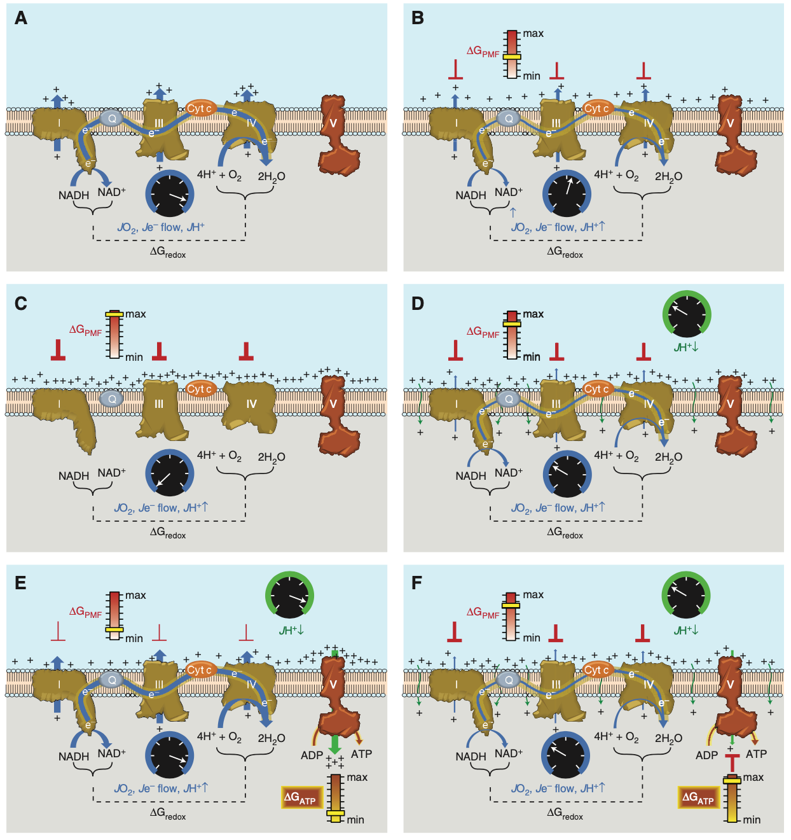
Neufer, 2018
Notes:
Figure 3. Sequential schematic detailing the driving forces governing the control of mitochondrial oxidative phosphorylation. The reader is encouraged to refer to the text for additional details. (A) Conceptual represen- tation of an electron transport system (ETS) embedded within an artificial membrane vesicle. Addition of reducing equivalents (NADH) generates immediate and rapid rates of O2 consumption (JO2), electron flow (Je2 flow), and proton pumping (JHþ ) at complexes I, III, and IV driven by the high DGredox between the O2/ H2O and NADþ/NADH redox couples. (B) As protons accumulate on the outer surface of the membrane, an electrochemical gradient or proton motive force (PMF) begins to build, creating a free energy backpressure (DGPMF) against the pumps, gradually slowing JO2, Je2 flow, and JHþ. (C) Eventually, the backpressure increases to the point that it counterbalances the proton pumps, at which point JO2, Je2 flow, and JHþ decrease to zero. (D) In mitochondria, basal proton conductance back into the matrix (JHþ ) prevents the DGPMF from reaching max, thereby allowing JO2, Je2 flow, and JHþ to proceed at a rate equivalent to the rate of JHþ . (E) Activation of ATP synthase (complex V) by addition of ADP accelerates proton conductance, thereby lowering DGPMF and thus increasing JO2, Je2 flow, and JHþ accordingly. (F) As [ATP]/[ADP]þ[Pi] increases, the free energy associated with ATP hydrolysis (DGATP) increases and creates back pressure on the ATP synthase, gradually slowing the rate of ATP synthesis, causing DGredox to climb and JO2, Je2 flow, and JHþ to slow accordingly back to the rate driven by basal proton conductance. Cyt c, Cytochrome c.

Slide 3
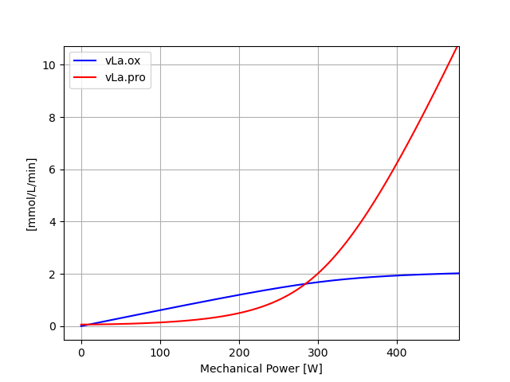
Draw [PCr], pH, [La⁻], V̇O2, vLa for the following bouts of exercise for this individual
I.)
10min 150W,
10x [30sec 350W, 30sec 150W],
10min 150W
II.)
10min 150W,
3x [2min 310W, 1min 150W],
10min 150W
III.)
10min 150W,
3x [4min 280W, 2min 150W],
10min 150W

Slide 4
V̇O₂max
What is V̇O₂max?
V̇ -> Volume per unit of time
O₂ -> Oxygen
Max -> Maximal
Notes:
Dot above V, first derivative: rate of change vs stock

Slide 5
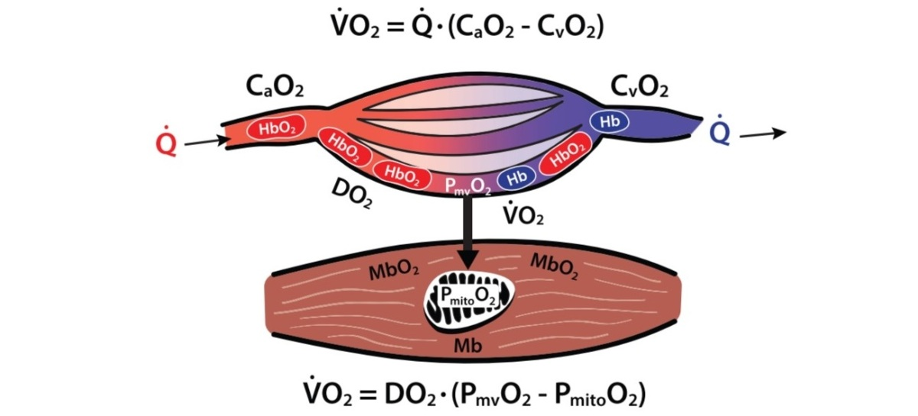

https://sparecycles.blog/2020/06/17/muscle-oxygenation-overview/
V̇O₂max
What is V̇O₂max?
V̇ -> Volume per unit of time
O₂ -> Oxygen
Max -> Maximal
Arteriovenous Difference in O₂
ml O₂/L
C: Concentration
a: arterial
v: venous
Ficks Principle
$\text{V}\text{̇}O_{2}max= \text{Qmax} × (CaO2 −CvO2)$
Cardiac output
= Stroke Volume * Heart Rate
Notes:
Dot above V, first derivative: rate of change vs stock,
Peripheral vs central limitations of VO2max,
So far we have only focused on peripheral limitations

Slide 6

V̇O₂max
Arteriovenous Difference in O₂
ml O₂/L
C: Concentration
a: arterial
v: venous
Ficks Principle
$\text{V}\text{̇}O_{2}max= \text{Qmax} × (CaO2 −CvO2)$
Cardiac output
= Stroke Volume * Heart Rate
Calculate the V̇O₂max for the following cases:
Nr | Stroke Volume (ml/b) | Heart Rate (b/min) | Qmax (L/min) | CaO2 (mlO2/L Blood) | CvO2 (mlO2/L Blood) | Body Mass (kg) | V̇O₂max (ml/min/kg)
1 | 180 | 190 |  | 213.2 | 76.0 | 70
2 | 200 |  | 41.3 | 250.5 | 45.7 | 100
3 |  | 160 | 29.0 | 168.2 | 97.3 | 60
Notes:
Trained
Untrained
Cardiovascular disease

Slide 7
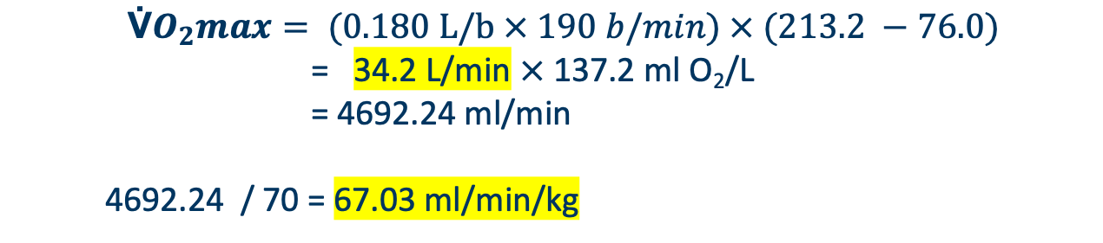
V̇O₂max
Arteriovenous Difference in O₂
ml O₂/L
C: Concentration
a: arterial
v: venous
Ficks Principle
$\text{V}\text{̇}O_{2}max= \text{Qmax} × (CaO2 −CvO2)$
Cardiac output
= Stroke Volume * Heart Rate
Calculate the V̇O₂max for the following cases:
$$\text{V}\text{̇}O_{2}max=\text{ (0.180 }\text{L}\text{/}\text{b} × 190 b/min) × (213.2 −76.0)$$
= 34.2 L/min $×$ 137.2 ml O₂/L
= 4692.24 ml/min
4692.24 / 70 = 67.03 ml/min/kg
Notes:
Trained
Untrained
Cardiovascular disease

Slide 8
V̇O₂max
Arteriovenous Difference in O₂
ml O₂/L
C: Concentration
a: arterial
v: venous
Ficks Principle
$\text{V}\text{̇}O_{2}max= \text{Qmax} × (CaO2 −CvO2)$
Cardiac output
= Stroke Volume * Heart Rate
Calculate the V̇O₂max for the following cases:
Nr | Stroke Volume (ml/b) | Heart Rate (b/min) | Qmax (L/min) | CaO2 (mlO2/L Blood) | CvO2 (mlO2/L Blood) | Body Mass (kg) | V̇O₂max (ml/min/kg)
1 | 180 | 190 | 34.2 | 213.2 | 76.0 | 70 | 67.0
2 | 200 | 206.5 | 41.3 | 250.5 | 45.7 | 100 | 84.6
3 | 181 | 160 | 29.0 | 168.2 | 97.3 | 60 | 34.3
Notes:
Trained
Impossibly trained
Untrained(
Unfeasibilty of measuring these parameters (maybe x ray for Stroke volume, heart rate is easy, oxygen concentration measuraable via saturation and haemoglobin concentration; however everything is highly complex and unfeasible) ->easier method is needed (

Slide 9
V̇O₂max
Arteriovenous Difference in O₂
ml O₂/L
C: Concentration
a: arterial
v: venous
Ficks Principle
$\text{V}\text{̇}O_{2}max= \text{Qmax} × (CaO2 −CvO2)$
Cardiac output
= Stroke Volume * Heart Rate
Calculate the V̇O₂max for the following cases:
Nr | Stroke Volume (ml/b) | Heart Rate (b/min) | Qmax (L/min) | CaO2 (mlO2/L Blood) | CvO2 (mlO2/L Blood) | Body Mass (kg) | V̇O₂max (ml/min/kg)
1 | 180 | 190 | 34.2 | 213.2 | 76.0 | 70 | 67.0
2 | 200 |  | 41.3 | 250.5 | 45.7 | 100
3 |  | 160 | 29.0 | 168.2 | 97.3 | 60
Notes:
Trained
Impossibly trained
untrained

Slide 10
V̇O₂max
Arteriovenous Difference in O₂
ml O₂/L
C: Concentration
a: arterial
v: venous
Ficks Principle
$\text{V}\text{̇}O_{2}max= \text{Qmax} × (CaO2 −CvO2)$
Cardiac output
= Stroke Volume * Heart Rate
Calculate the V̇O₂max for the following cases:
Nr | Stroke Volume (ml/b) | Heart Rate (b/min) | Qmax (L/min) | CaO2 (mlO2/L Blood) | CvO2 (mlO2/L Blood) | Body Mass (kg) | V̇O₂max (ml/min/kg)
1 | 180 | 190 | 34.2 | 213.2 | 76.0 | 70 | 67.0
2 | 200 | 206.5 | 41.3 | 250.5 | 45.7 | 100 | 84.6
3 |  | 160 | 29.0 | 168.2 | 97.3 | 60
Notes:
Trained
Impossibly trained
untrained

Slide 11
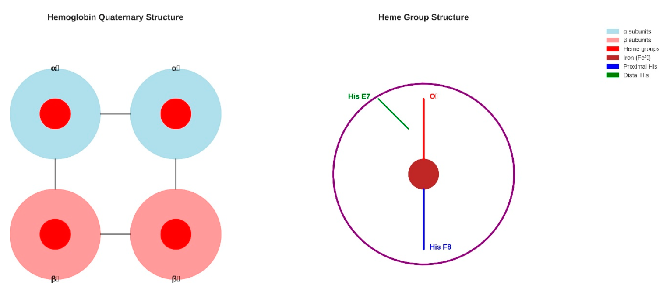
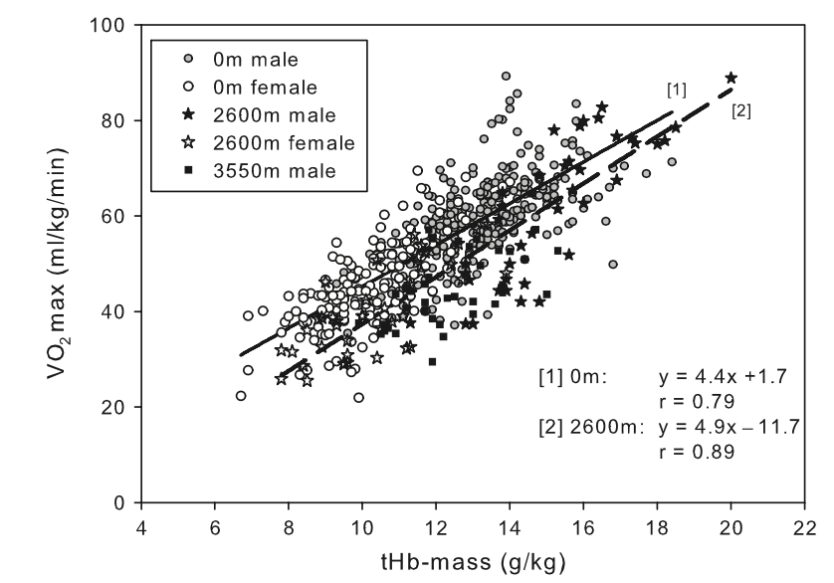
1.
Cardiac Output
HB-Mass (1g HB ~1.34 ml O₂)
Capillarization
2.
Mitochondrial Density (1ml ~3-5 ml O₂/min)

Slide 12
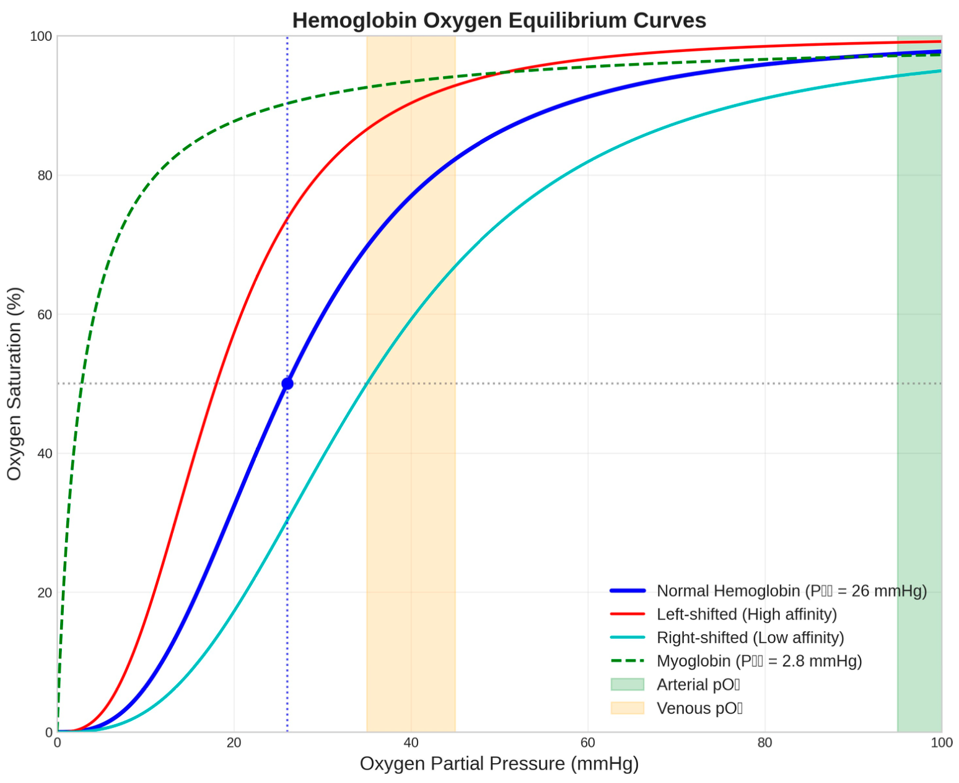
Notes:
Figure 1. Hemoglobin Oxygen Equilibrium Curves. The oxygen binding characteristics of hemoglobin demonstrate cooperative binding with a sigmoidal curve (blue line) characterised by a P50 value of 26 mmHg for normal human hemoglobin (Hill, 1910). Left-shifted curves (red line) indicate increased oxygen affinity, while right-shifted curves (cyan line) show decreased affinity. Myoglobin (green dashed line) exhibits hyperbolic binding with much higher oxygen affinity (P50 = 2.8 mmHg) (Wittenberg & Wittenberg, 1987). Physiological oxygen partial pressure ranges are indicated: arterial pO2 (green shaded area, 95-100 mmHg) and venous pO2
(orange shaded area, 35-45 mmHg). The cooperative nature of hemoglobin binding ensures efficient oxygen loading in the lungs and substantial oxygen release in peripheral tissues.

Slide 13
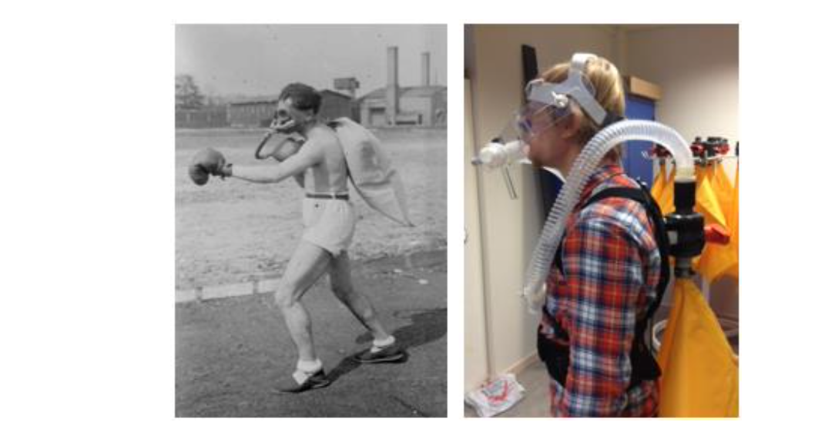
Spirometric Devices
Closed-Circuit Systems
Open-Circuit Systems
  Breath-by-Breath-Method
  Mixing Chamber
Measuring V̇O₂ / V̇CO₂
V̇ -> Volume per unit of time
O₂ -> Oxygen

Slide 14
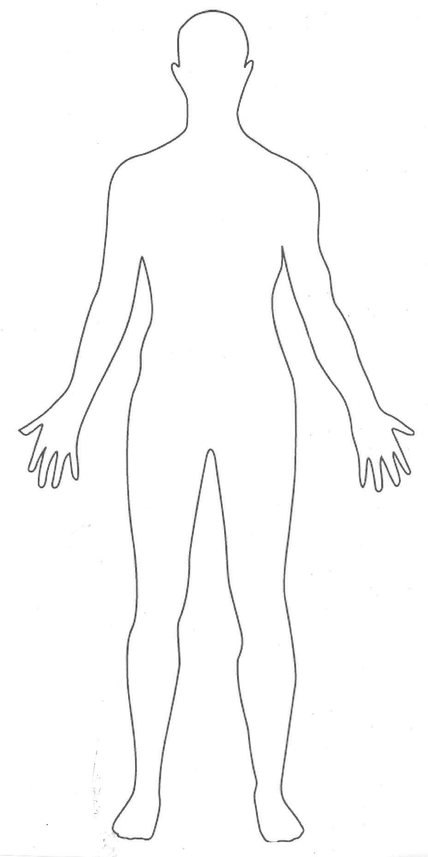
Spirometric Devices
V̇
Spirometrie
O₂
CO₂

Slide 15
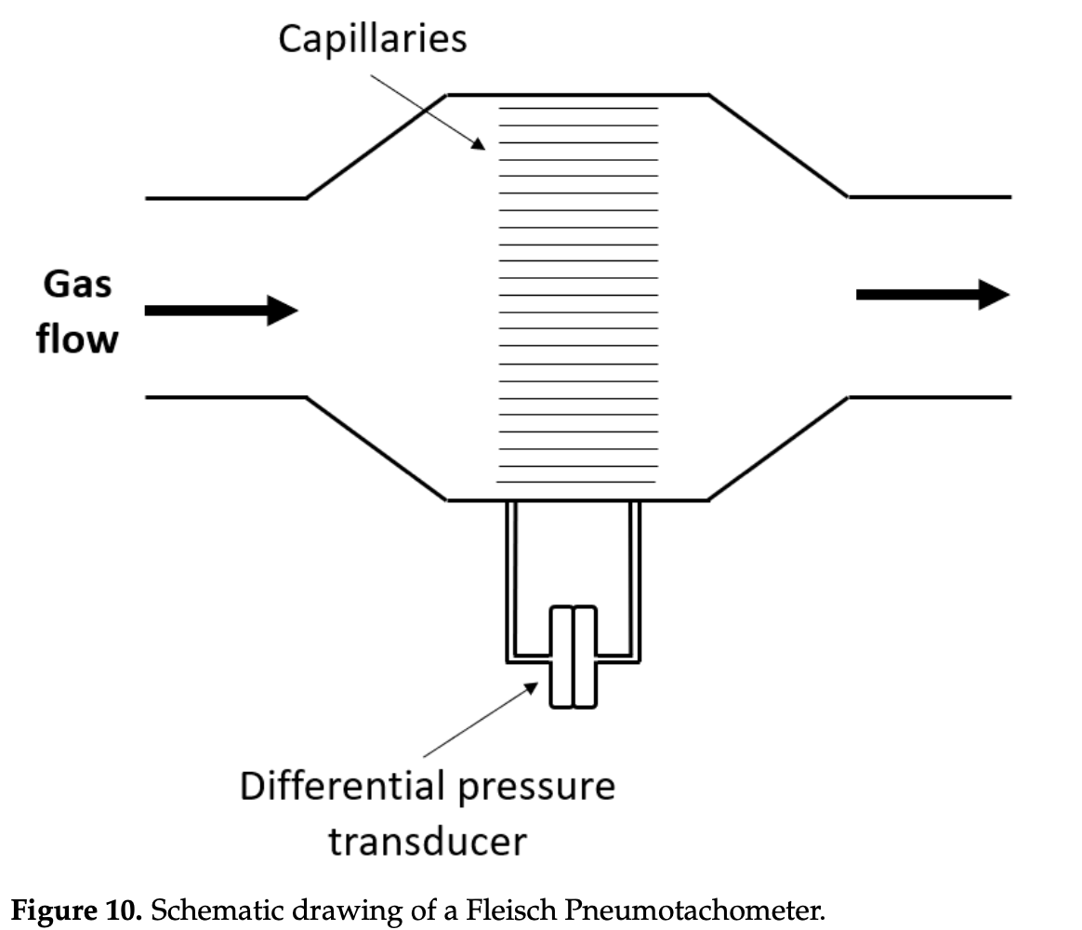
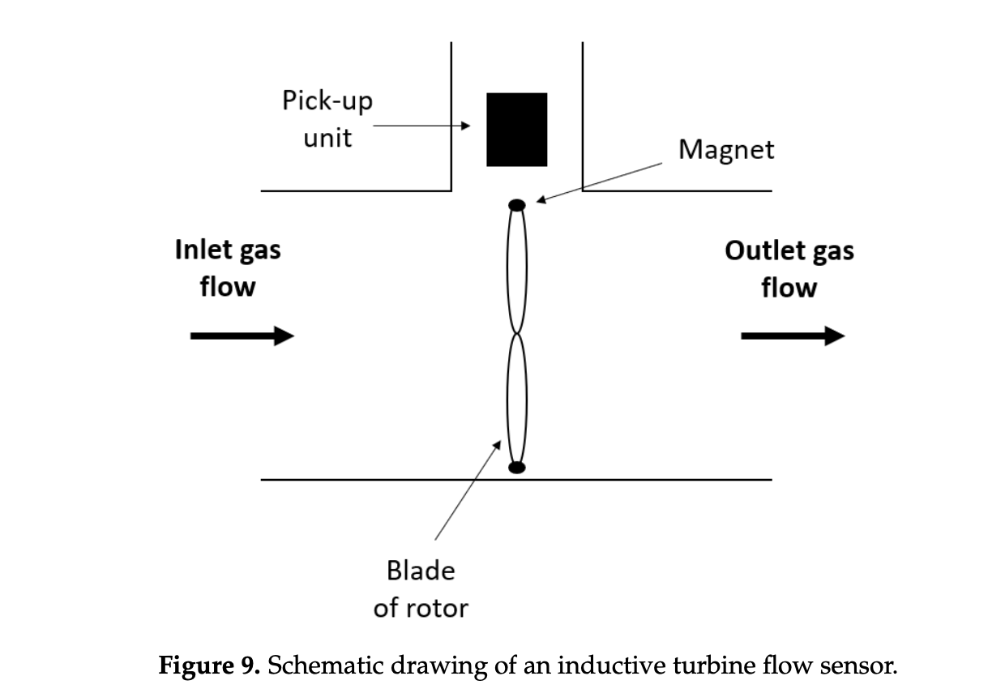
Spirometric Devices
V̇
Spirometrie
Membrane
Hagen-Poiseuille-Law
Highly influenced by turbulences
Turbine
Rotation proportional to flow
Intertia of rotor
Influenced by turbulences
O₂
CO₂
Priem et al., 2023

Slide 16
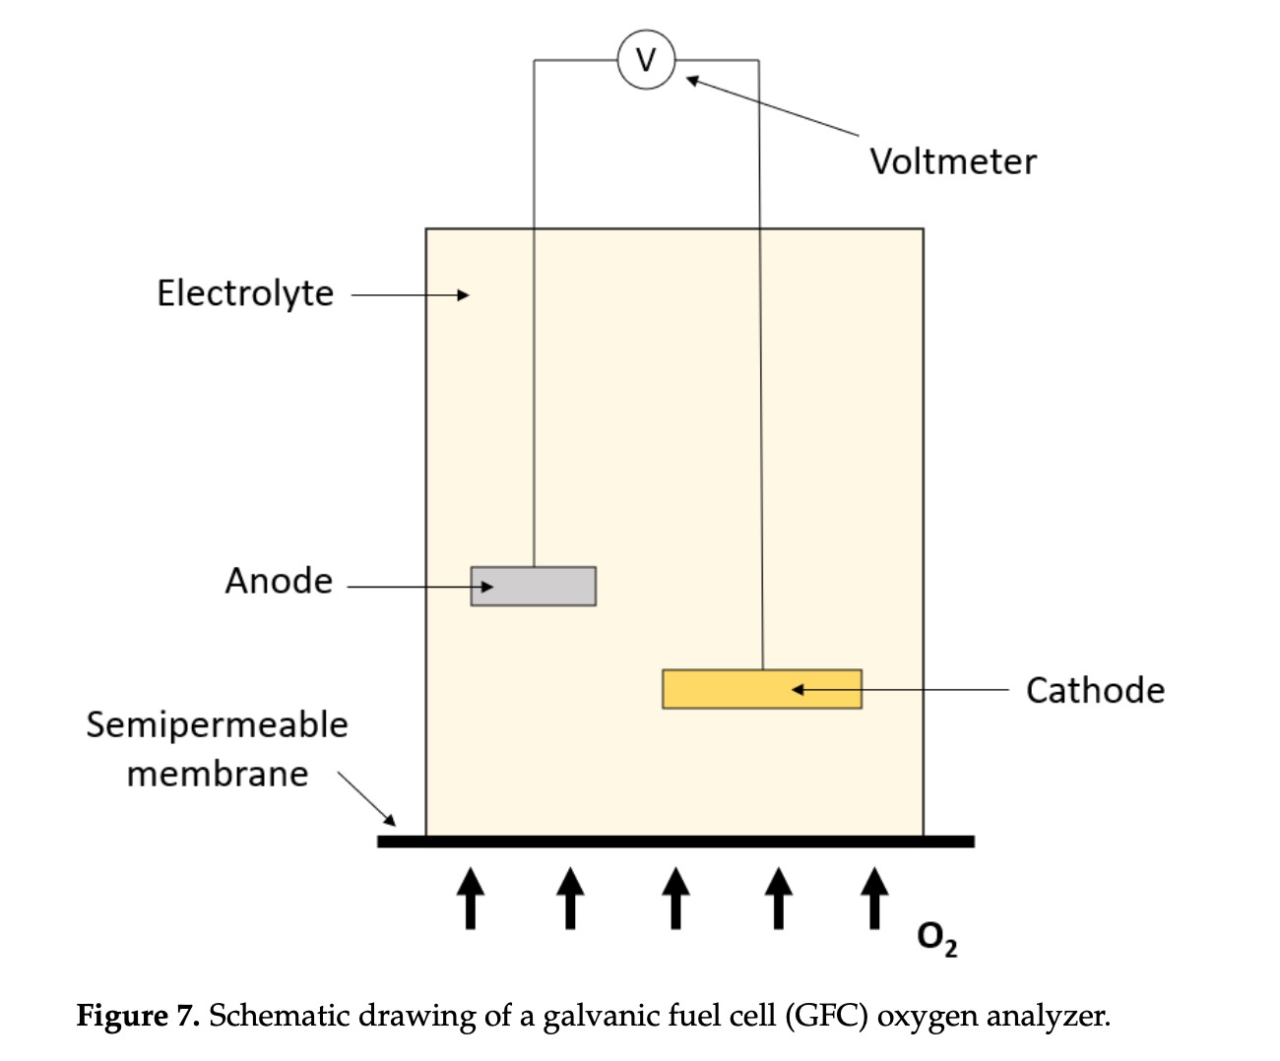
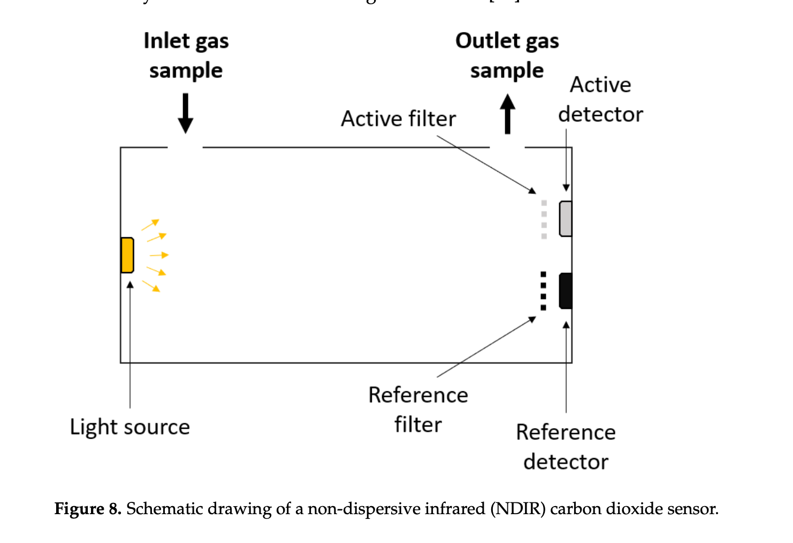
Spirometric Devices
V̇
Spirometrie
O₂
CO₂
Priem et al., 2023
Notes:
CO2: absorption of light used to measure CO2 Concentration
O2: Reaction of O2 first at the cathode (reduction to hydroxide ions) and the oxidized at the anode -> resulting electrical current is measured and proportional to O2 concentration
Talk about the calibration of these systems
-> Breath by breath system this occurs in different location (V̇ at the mouth, O2/CO2 in the machine connect to tubes)
Mixing Chamber it occurs roughly at the same place
How accurate does this work?

Slide 17
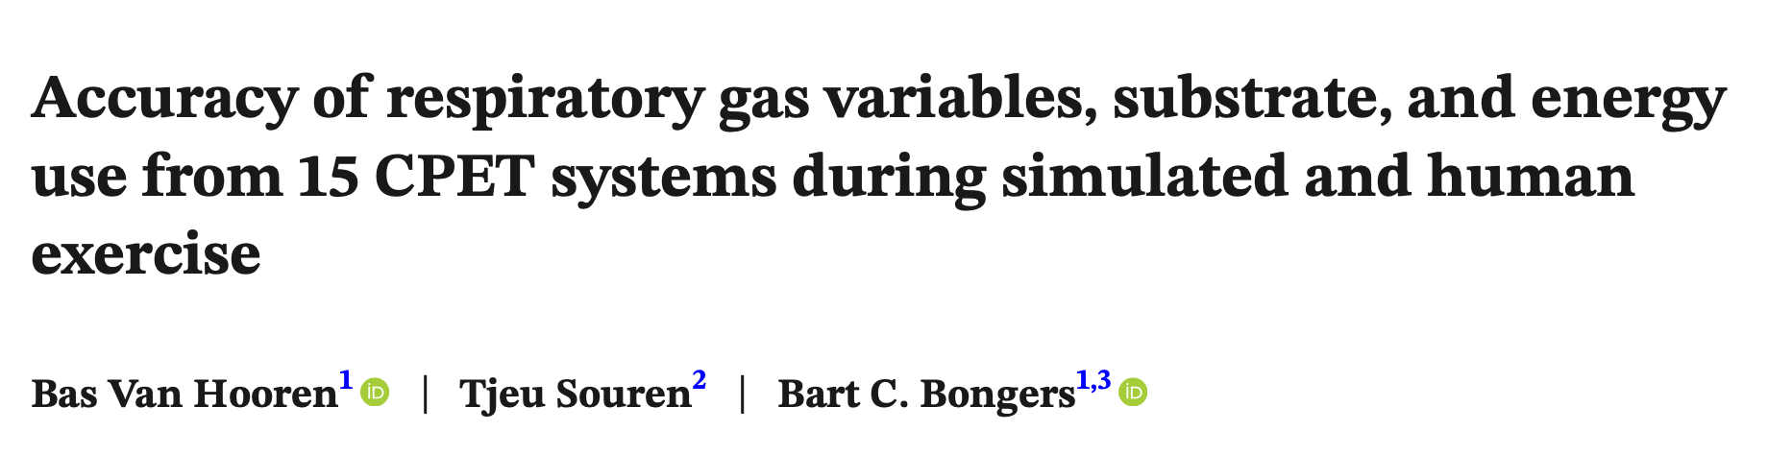

Spirometric Devices
Accuracy & Precision
Dependent Variables
V̇_{E} (Expiration Flow)
BF (Breath Frequency)
V̇O₂ (Oxygen Consumption)
V̇CO₂ (Carbon Dioxide Production)
RER (Respiratory Exchange Ratio)
Notes:
Comparison between 15 CPET (cardiopulmonary exercise testing) units

Slide 18
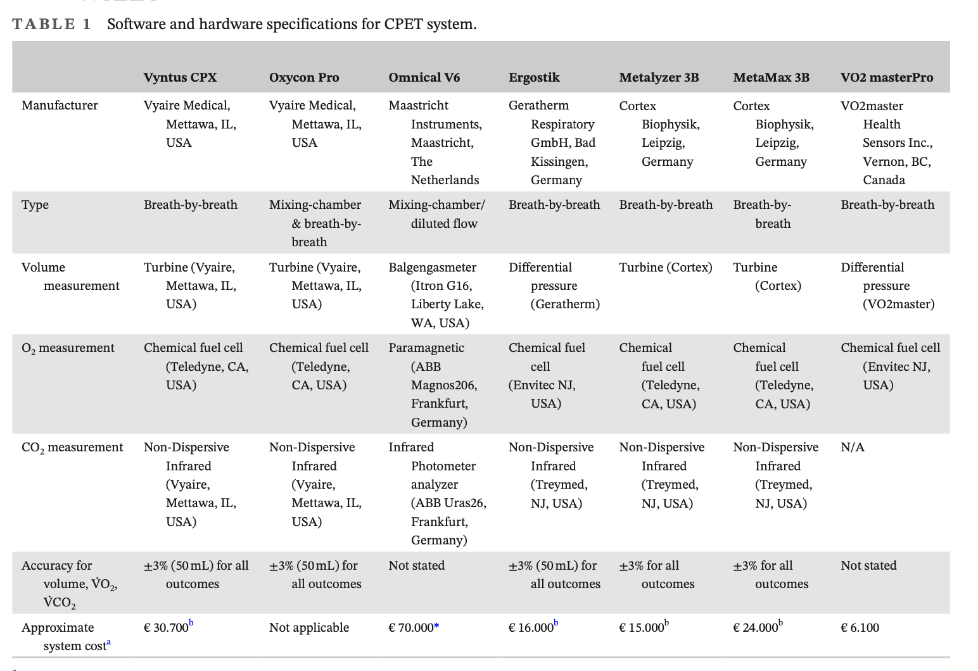
Spirometric Devices
Accuracy & Precision
Notes:
Go trough different manufacturers.
Types (BxB vs Mixing Chamber)
Flow Measurement (Turbine vs Differential Pressure)
O2 Measurement: Paramagnetic vs Chemical Fuel Cell (Same manufacturer of fuel cell in different devices)
CO2 Measurement: Non Dispersive Infrared Absorption light technique
Stated Accuracy by manufactuterers (best possible outcome)
(keep in mind that this in only 1 part of the table, more devices were tested and are listed in the paper)

Slide 19
Spirometric Devices
Accuracy & Precision
1.Test (Std)
2L Tidal Volume, RER 1
BF 20 b/min
V̇O₂ = 1 L/min
V̇CO₂ = 1 L/min
BF 40 b/min
V̇O₂ = 2 L/min
V̇CO₂ = 2 L/min
BF 60 b/min
V̇O₂ = 3 L/min
V̇CO₂ = 3 L/min
BF 80 b/min
V̇O₂ = 4 L/min
V̇CO₂ = 4 L/min
2.Test (CPX)
2L Tidal Volume
BF 20 b/min, RER 0.75
V̇O₂ = 1 L/min
V̇CO₂ = 0.75 L/min
BF 40 b/min, RER 0.85
V̇O₂ = 2 L/min
V̇CO₂ = 1.7 L/min
BF 60 b/min, RER 0.95
V̇O₂ = 3 L/min
V̇CO₂ = 2.85 L/min
BF 80 b/min, RER 1.05
V̇O₂ = 4 L/min
V̇CO₂ = 4.2 L/min
Dependent Variables
V̇_{E} (Expiration Flow)
BF (Breath Frequency)
V̇O₂ (Oxygen Consumption)
V̇CO₂ (Carbon Dioxide Production)
RER (Respiratory Exchange Ratio)
Notes:
Comparison between 15 CPET (cardiopulmonary exercise testing) units
STD?
CPX?

Slide 20
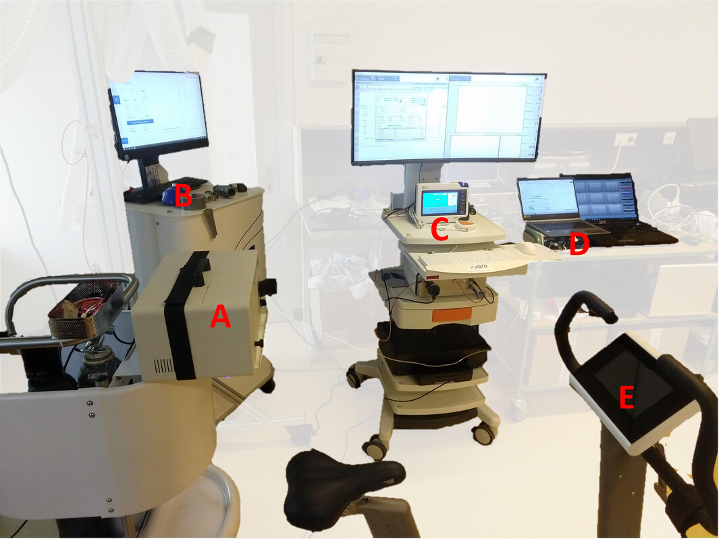
Notes:
Left: Experimental set-up with the metabolic simulator (A), three of the CPET systems (B = Omnical V6; C = Vyntus CPX; D = MetaLyzer 3B), and the bike used for the human tests (E = Lode Corival CPET). The CPET systems were connected to the outlet of the metabolic simulator as shown in the image (in this case for the Vyntus CPX).

Slide 21
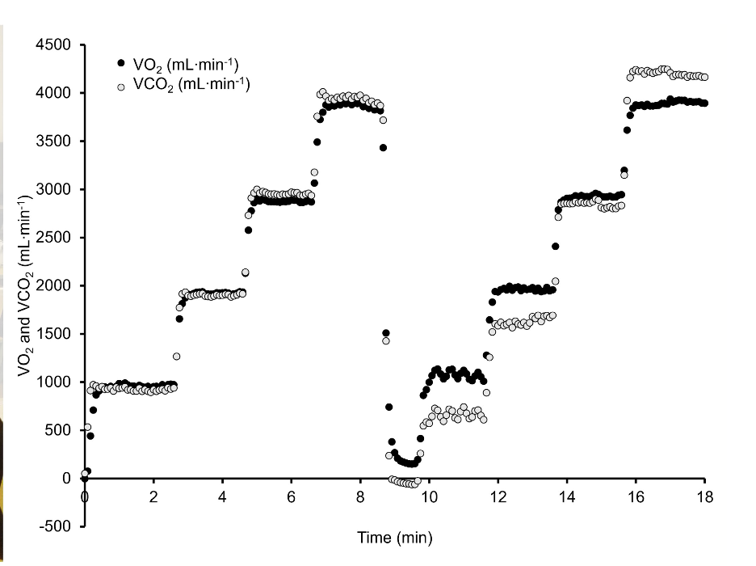
Spirometric Devices
Accuracy & Precision
Testing Protocol
std
CPX
Notes:
Right: example recording of the simulation protocol by one of the CPET systems (Omnical v6). The first stepwise increase represents the “Std” mode with a constant RER of 1.00, and the second stepwise increase the “CPX” mode with an increase in RER for each stage.

Slide 22
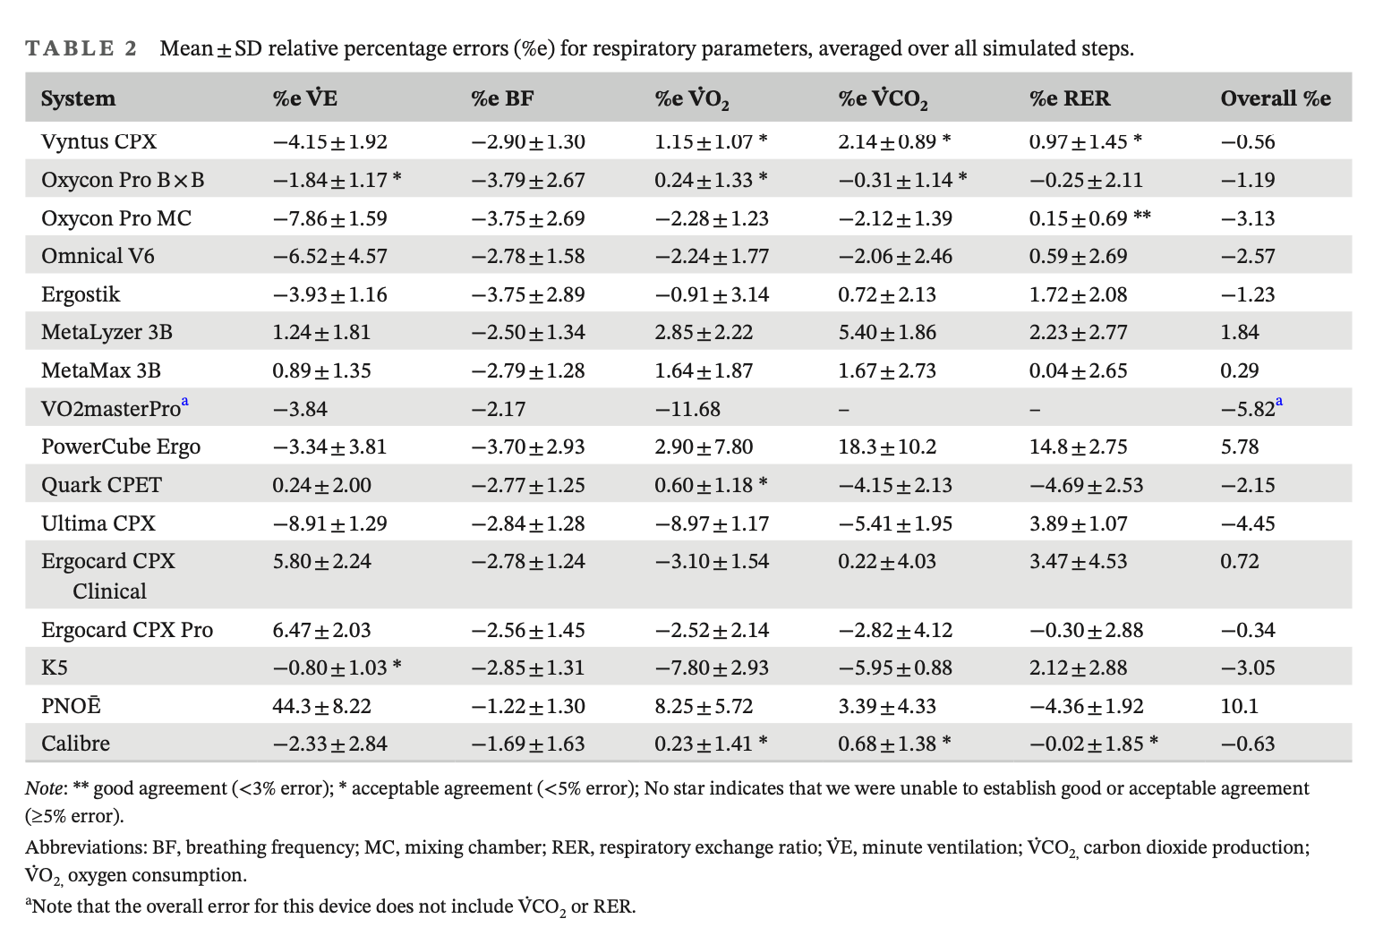
Spirometric Devices
Accuracy & Precision
Notes:
First talk about what is good agreement, acceptable agreement and *poor* agreement
1.) 11 Systems were on AVERAGE below three percent -> however this is average for repeated measures -> Including the 95% confidence interval is outside of these corridor for all devices
2.)

Slide 23
Spirometric Devices
Accuracy & Precision
Notes:
First talk about what is good agreement, acceptable agreement and *poor* agreement
1.) 11 Systems were on AVERAGE below three percent -> however this is average for repeated measures -> Including the 95% confidence interval is outside of these corridor for all devices
2.) only the remaining4 have acceptable agreement…

Slide 24
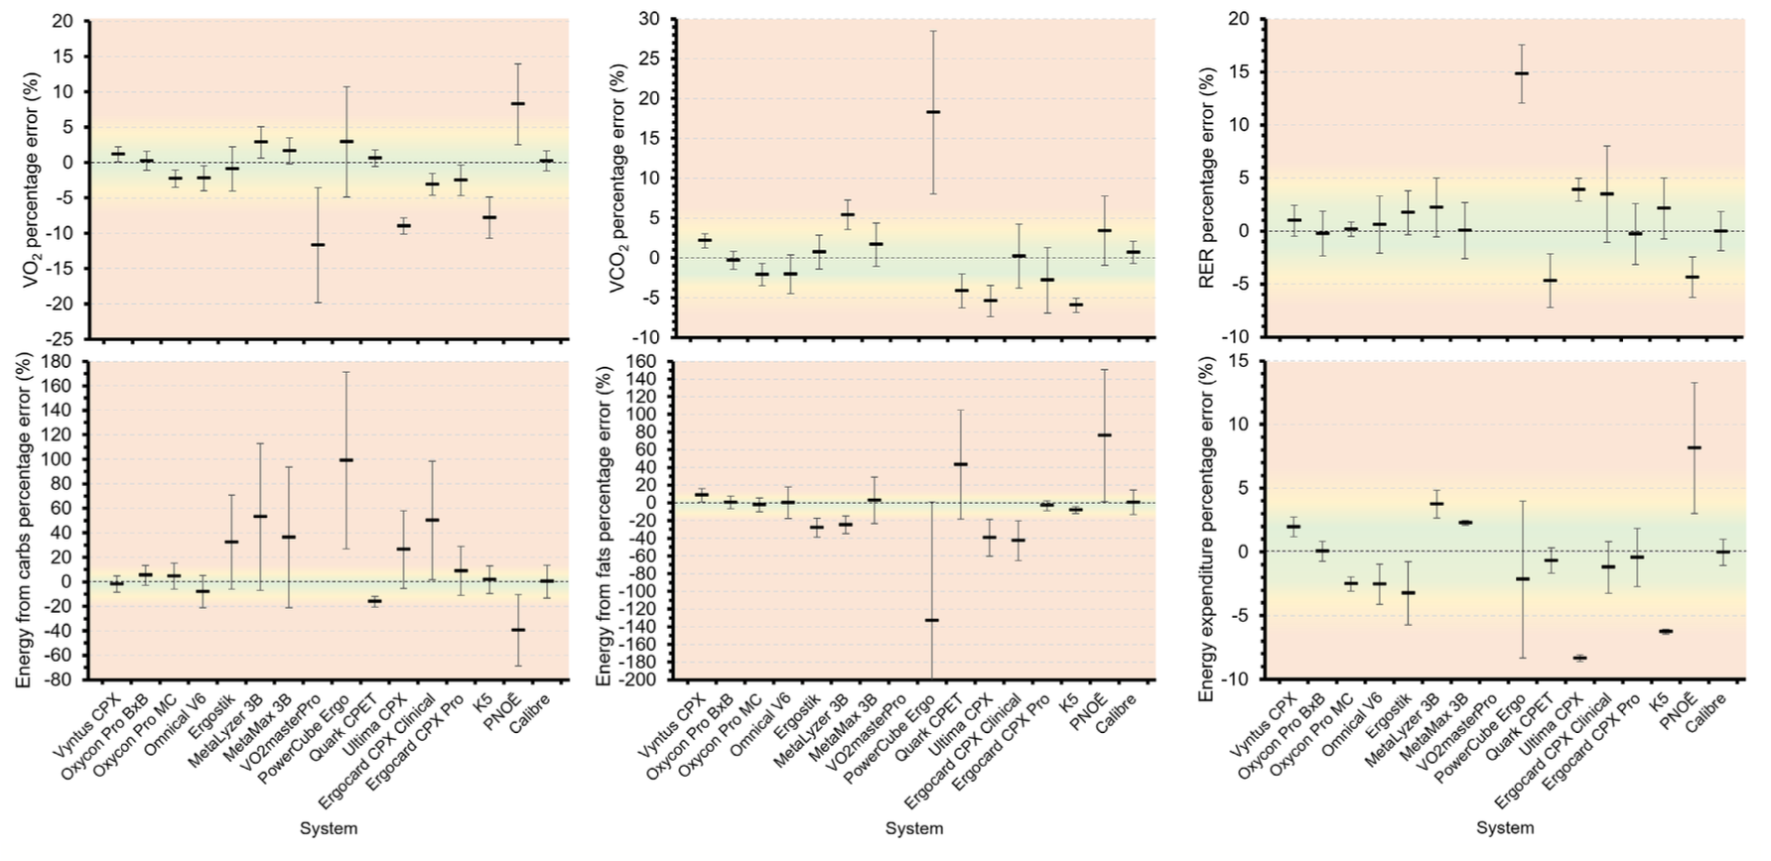
Spirometric Devices
Accuracy & Precision
Notes:
Green 3% (good agreement)
Yellow 5% (acceptable agreement)
Outside >5% poor agreement
-> Remember that this the average -> Lets have a look how this behaves over the different stages;
voiceover slide7

Slide 25
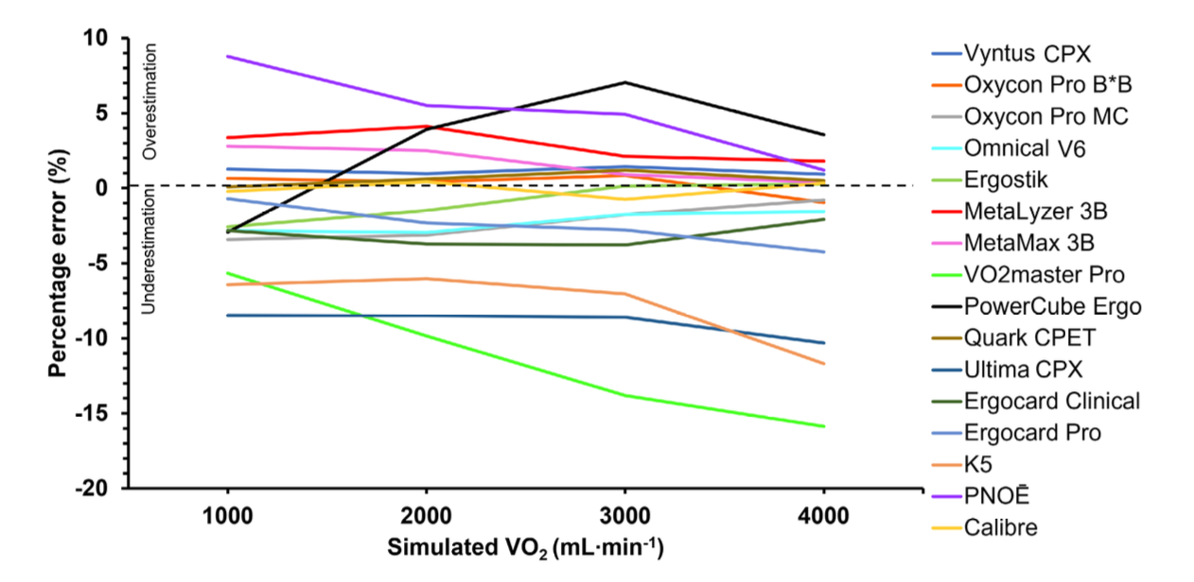
Spirometric Devices
Accuracy & Precision
Notes:
Overall most devices are pretty constant (e.g. Oxycon Pro B*B)
Some are deterioriating (V̇O2masterPro)
Other are heterogenous (PowerCube Ergo)
-> What can we do with this information? Calculation of the smallest worthwhile change
-> No one size fits all rule can be applied

Slide 26

Spirometric Devices
Accuracy & Precision
Would you perform a second V̇O₂max test after a 2 week training period?
Interpretate a 5% increase in V̇O₂max for PNOE and MetaLyzer 3B
-> V̇O₂max testing…

Slide 27
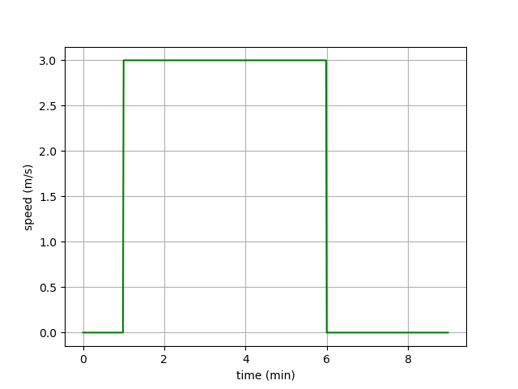
V̇O₂-Kinetics
Notes:
What will the V̇O2 response look like?
Onset and offset kinetics?
Quantitativ steady state response? = 3 * 12.5 + 3.5 = 41 ml/min/kg

Slide 28
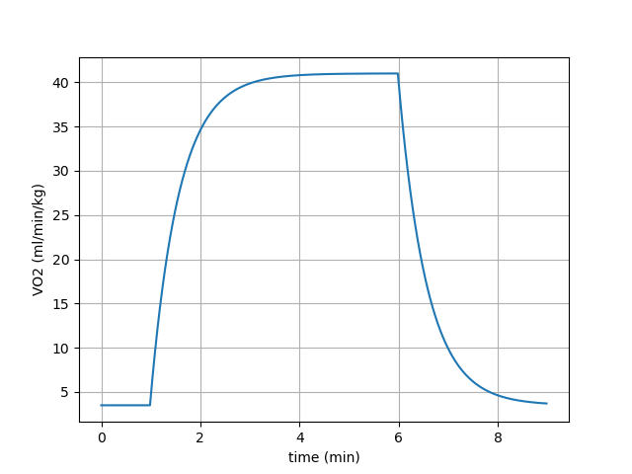
V̇O₂-Kinetics
V̇O₂-onset time
~2.5-3min
Notes:
T = 35s

Slide 29
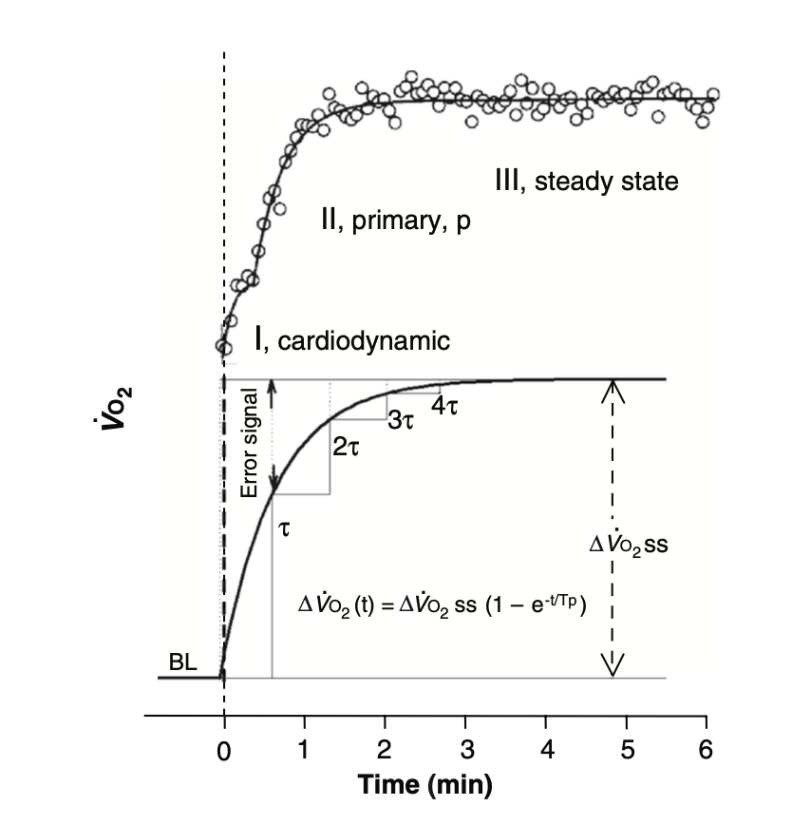
V̇O₂-Kinetics
Poole & Jones, 2012

Slide 30
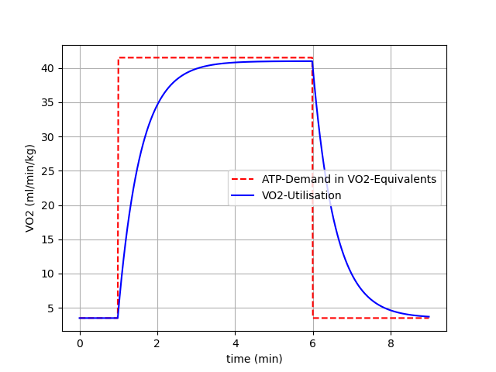
V̇O₂-Kinetics
Notes:
Missing area filled with anaerobic ATP supply (La and PCr)

Slide 31
V̇O₂-Kinetics
Glycolysis
Aerobic
Capacity
Inhibition
Power
H⁺
Activation
Activation
+
PCr
PCr
related to [ADP] & [AMP]
related to [ADP]
ATP

Slide 32
V̇O₂-Kinetics
Glycolysis
Aerobic
Capacity
Inhibition
Power
H⁺
Activation
Activation
+
PCr
PCr
related to [ADP] & [AMP]
related to [ADP]
ATP

Slide 33
V̇O₂-Kinetics
Glycolysis
Aerobic
Capacity
Inhibition
Power
H⁺
Activation
Activation
+
PCr
PCr
related to [ADP] & [AMP]
related to [ADP]
ATP

Slide 34
Summary
V̇O₂-Kinetics
Rest -> Start of exercise -> Start of ATP-Breakdown -> PCr Breakdown to Resphorylate ADP to ATP -> Accumulation of ADP -> Positive Feedback to Aerobic Pathway (with inertia) -> Increase of V̇O₂ until steady state
Time to reach steady state ~2.5 – 3min
V̇O₂ss can be approximate based on efficiency and external load
Phases of V̇O₂-Response (onset):
  (i) Cardiopulmonary
  (ii) primary
  (iii) steady state
  (iv) ?
How can we design a test based on this knowledge to measure V̇O₂max?
External load ?
Duration ?

Slide 35
Test Characteristics V̇O₂max
How can we design a test based on this knowledge to measure V̇O₂max?
External load ?
External Load has to be …
… above V̇O₂max
… low enough that fatigue does not occur V̇O₂max is reached
Example:
V̇O₂max of 60 ml/min/kg is expected
V̇O₂max / V̇O₂ cost of running = Needed velocity
60 / 12.5 = 4.8 m/s
V̇O₂ is limited by work rate –> V̇O₂max is limited by the oxidative pathway

Slide 36
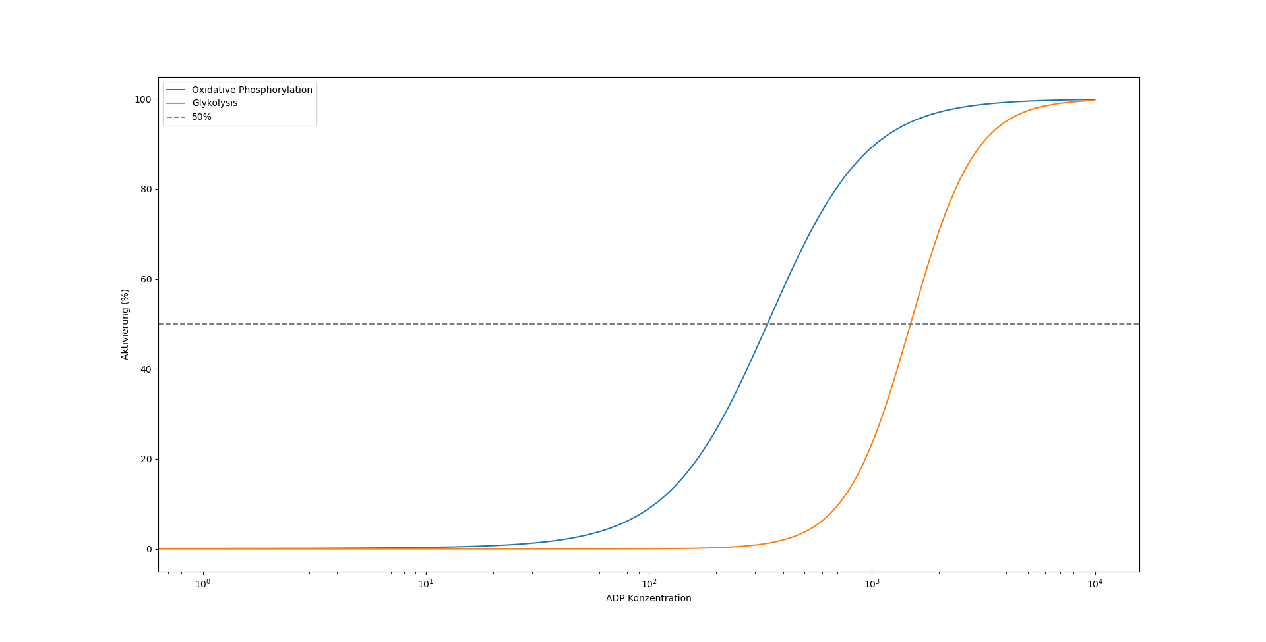
Activation Characteristics
Activation in %
External load high enough to reach V̇O₂max
External load to low to reach V̇O₂max
Concentration of ADP (Decreasing [PCr])
Notes:
ADP/PCr related to work rate

Slide 37
Test Characteristics V̇O₂max
How can we design a test based on this knowledge to measure V̇O₂max?
Duration? (at least 4 min, typically 8 – 12 min)
… longer than time of V̇O₂-inertia response
(… shorter than depletion of substrates affects V̇O₂-response)

Slide 38
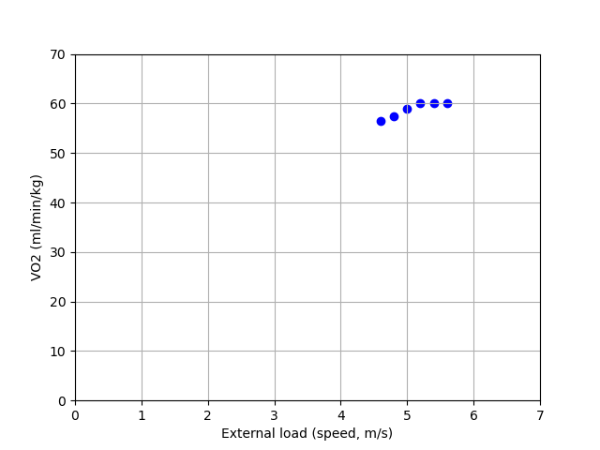
Testing V̇O₂max
Multiple steps
Duration? (at least 4 min, typically 8 – 12 min)
Start with calculated external load for V̇O₂max

Slide 39
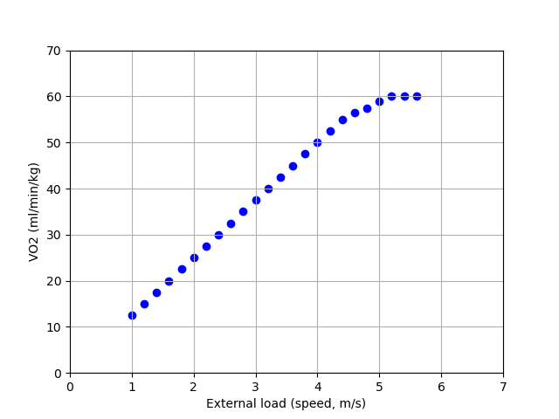
Testing V̇O₂max
Multiple steps
Duration? (at least 4 min, typically 8 – 12 min)
Start with calculated external load for V̇O₂max
Advantage
Very likely to get a „true“ V̇O₂max
Disadvantage
This takes a lot of time!
→ Shorter Protocols were developed

Slide 40
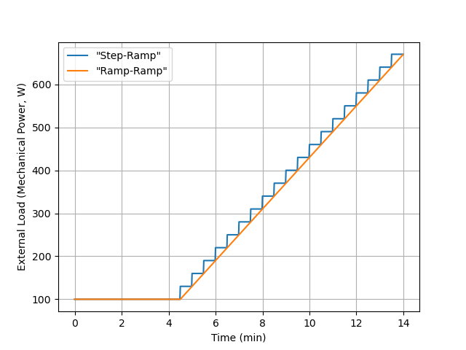
Testing V̇O₂max
Ramp-Test Protocols
Step-Ramp
Increase of 30W every 30s
Ramp
Increase of 1 W every 1 s

Slide 41
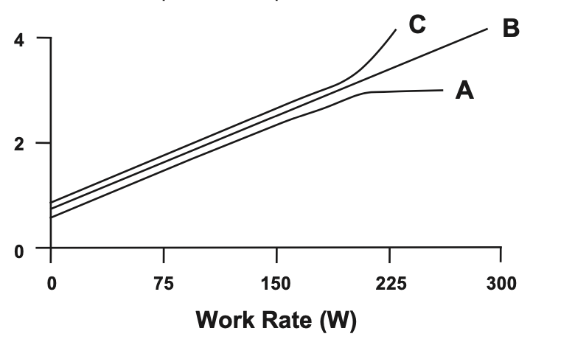
Truly Assessing V̇O₂max
V̇O₂ reaction to exercise
V̇O₂max ?
V̇O₂max !
Criteria for V̇O₂max
Leveling of the V̇O₂ – Work Rate Relationship
HR 5 – 10 beats below prediction, Blood Lactate > 8 mmol/L, RER > 1, 1.1, 1.15
Poole & Jones, 2017

Slide 42
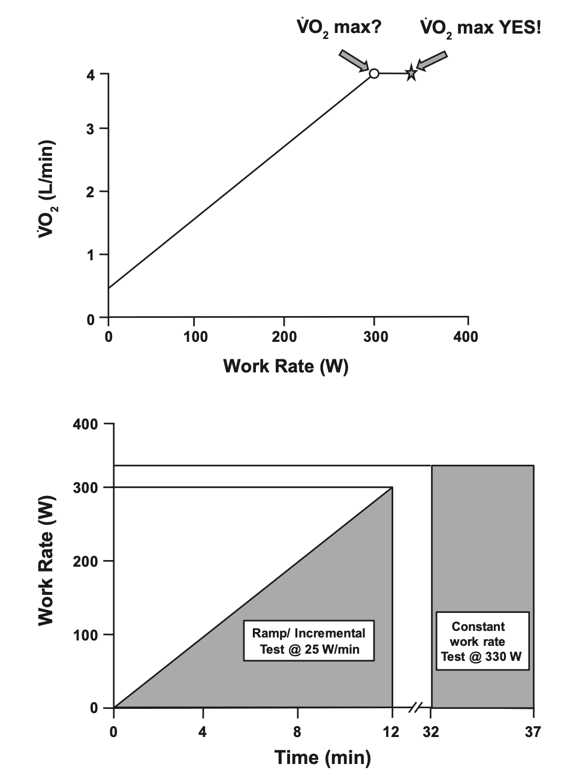
Truly Assessing V̇O₂max
V̇O₂ reaction to exercise
What to do in cases C and B?
Perform a verification test!
What constitutes a true Plateau?
Taylor et al. < 2.1 ml/min/kg
Respect of V̇O₂ – Error (~3%) vs
Expected V̇O₂
Example:
Assumption 12.5 ml/min/W
300 * 12.5 = 3750 ml/min
330 * 12.5 = 4125 ml/min (3% Error 4000ml/min)
Poole & Jones, 2012
Notes:
Critizes Taylor Method with generel rule of a leveling of
Encourage connection between workload and expected V̇O2 is the way to go (also use this relationship for soft calibration, but be aware that more metabolic pathways are at play).

Slide 43
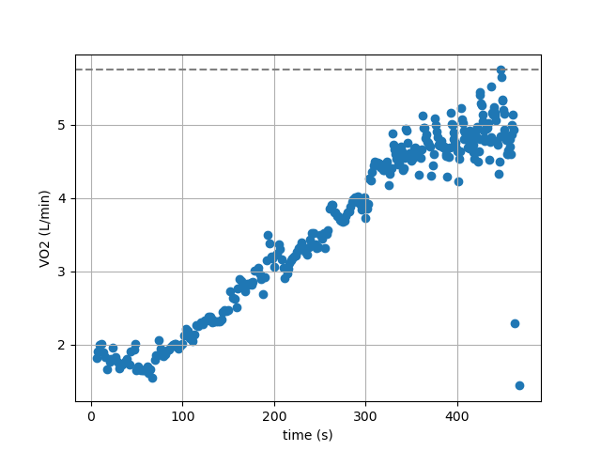
Truly Assessing V̇O₂max
Raw Data Ramp-Test Breath-by-Breath
V̇O₂max ?
We must filter our data!!

Slide 44
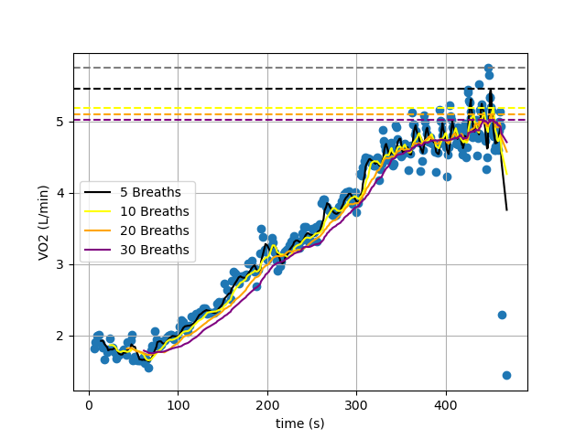
Truly Assessing V̇O₂max
Raw Data Ramp-Test Breath-by-Breath

Slide 45
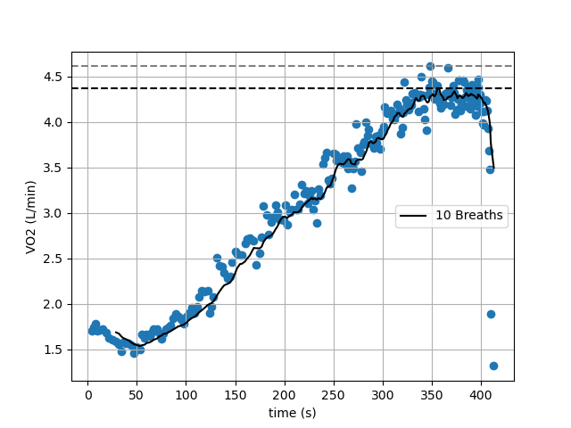
Truly Assessing V̇O₂max
Raw Data Ramp-Test Breath-by-Breath

Slide 46
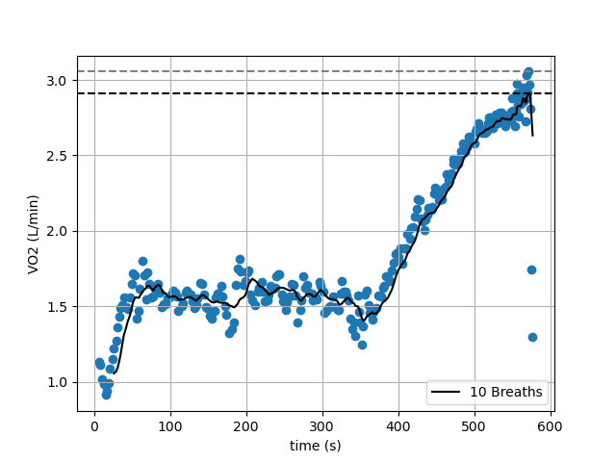
Truly Assessing V̇O₂max
Raw Data Ramp-Test Breath-by-Breath

Slide 47
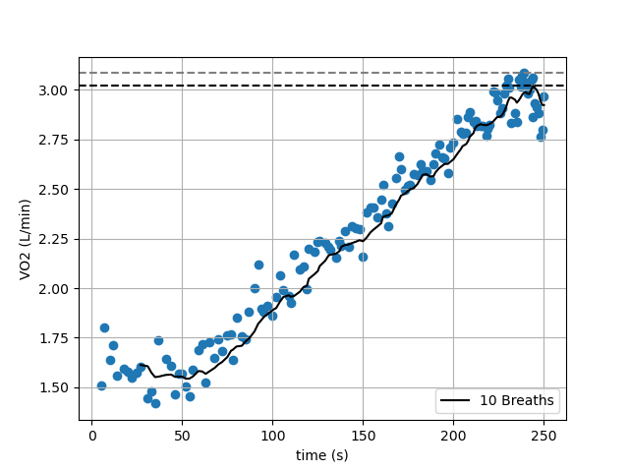
Truly Assessing V̇O₂max
Raw Data Ramp-Test Breath-by-Breath

Slide 48
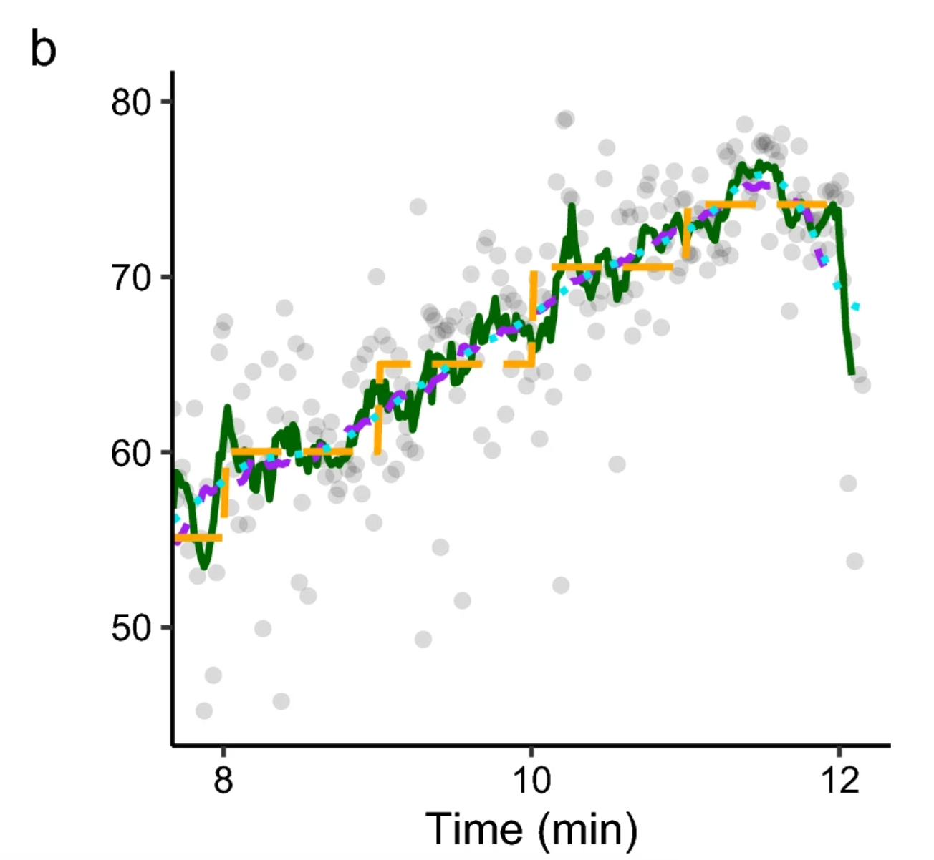
Smoothing Data
Nolte et al., 2023

Slide 49

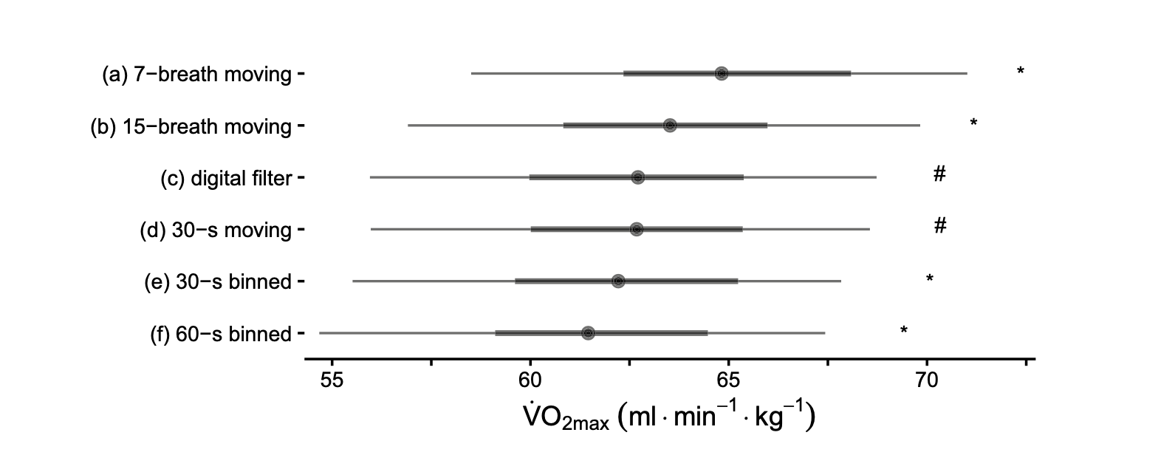
Spirometric Devices
Filtering Data
Always apply a filter to spirometric data !
Nolte et al., 2023
Notes:
Problem: Often in scientific literature it is not reported how this is done!

Slide 50
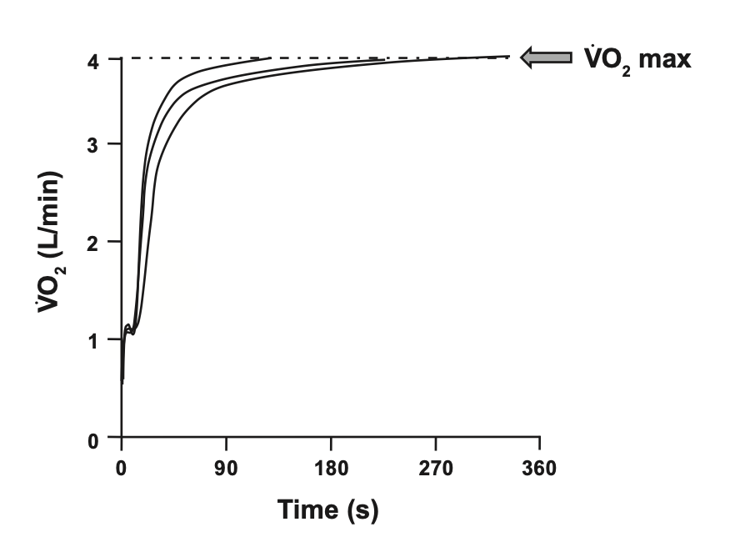
Truly Assessing V̇O₂max
V̇O₂ reaction to exercise
V̇O₂ is limited by work rate –> V̇O₂max is limited by the oxidative pathway
Test lasting 8 – 12min

Slide 51
Summary (i)
Measurement Errors in Spirometry
Filtering Spirometric Data
V̇O₂max testing
... indirect Calorimetrie

Slide 52



Spirometric Devices
Indirect Kalorimetrie
Assessing substrate use from gas exchange
Glucose/Glycogen
Fats (Palmitic Acid)
RQ = 1
RQ = 0.7
*0.69 – 0.70
What does a measured RQ of 0.85 mean?
1 * 0.5 + 0.7 * 0.5 = 0.85 → 50% Carbs & 50% Fats

Slide 53
Spirometric Devices
Indirect Calorimetrie – Relationship RQ and Substrate Use
100
%Carb. Oxidation
Theoretical Relationship!
RQ ≠ RER
0
0.7
1
RQ
Assumptions of indirect Calorimetrie
1.) RQ = RER
2.) Gas exhange at mouth accurately reflects tissue level
Notes:
RQ measured at the muscular level only on the basis of ATP Synthesis processes
RER involves all processes, measured at the mouth level

Slide 54



Spirometric Devices
Indirect Calorimetrie – Relationship RQ and Substrate Use
1.) RQ = RER
2.) Gas exhange at mouth accurately reflects tissue level
V̇O₂
V̇CO₂ -> Only in Presence of a stable bicarbonat Pool
Production of H⁺ leads to increased CO₂ that is not due to substrate oxidation
→ Interferes with the theorethical relationship

Slide 55
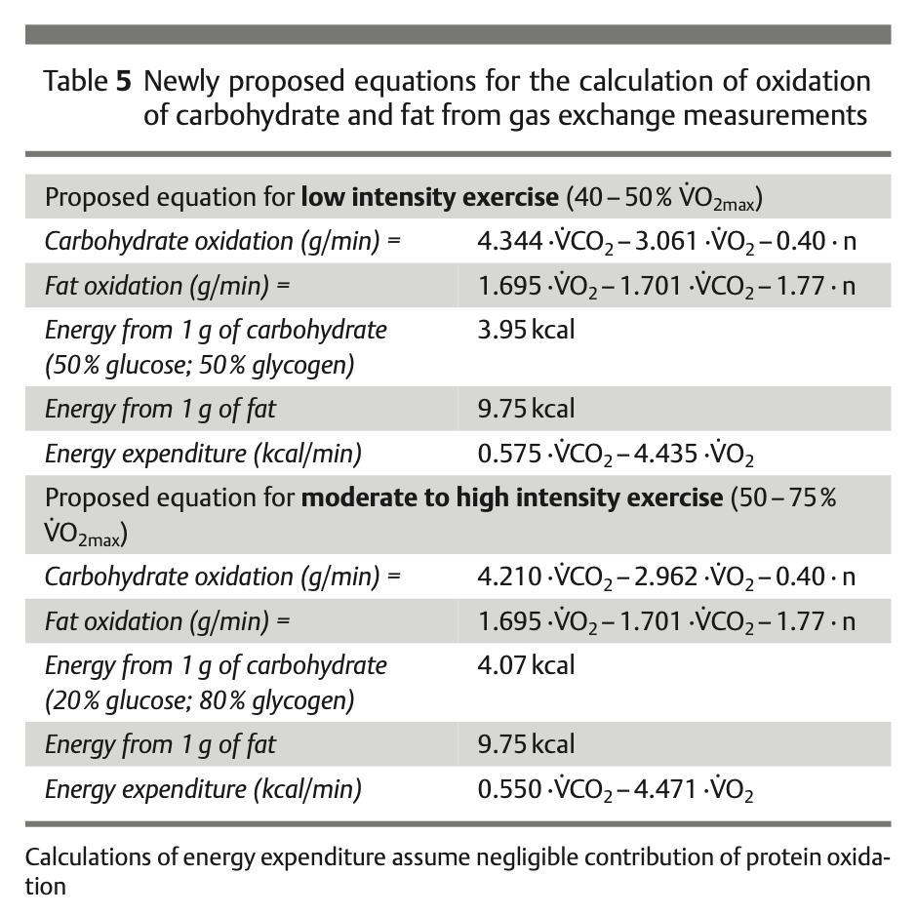
Spirometric Devices
Indirect Calorimetrie – Relationship RQ and Substrate Use
Jeukendrup & Wallis., 2004
Notes:
Focus on different equations for different intensities -> Higher intensities we also have more La Production and thus more buffering and more „non-metabolic“ CO2
-> As a Home work they will need to calculate Substrate use for a step test

Slide 56
Spirometric Devices
Accuracy & Precision
Notes:
Green 3% (good agreement)
Yellow 5% (acceptable agreement)
Outside >5% poor agreement

Slide 57
Summary (ii)
Measurement Errors in Spiroergometry
Filtering Spirometric Data
V̇O₂max testing
Indirect Calormetrie assumptions and pitfalls
Homework:
Analyse the uploaded spirometric data. First choose a filter and afterwards calculate fat and cho utilisation. Prepare you data to present a an athlete (non-sport scientifically educated person).

Slide 58
Literature
Jeukendrup AE, Wallis GA. Measurement of substrate oxidation during exercise by means of gas exchange measurements. Int J Sports Med. 2005 Feb;26 Suppl 1:S28-37. doi: 10.1055/s-2004-830512. PMID: 15702454.
Neufer PD. The Bioenergetics of Exercise. Cold Spring Harb Perspect Med. 2018 May 1;8(5):a029678. doi: 10.1101/cshperspect.a029678. PMID: 28490536; PMCID: PMC5932573.
Nolte S, Rein R, Quittmann OJ. Data Processing Strategies to Determine Maximum Oxygen Uptake: A Systematic Scoping Review and Experimental Comparison with Guidelines for Reporting. Sports Med. 2023 Dec;53(12):2463-2475. doi: 10.1007/s40279-023-01903-3. Epub 2023 Aug 21. PMID: 37603201; PMCID: PMC10687136.
Poole DC, Jones AM. Measurement of the maximum oxygen uptake V̇o2max: V̇o2peak is no longer acceptable. J Appl Physiol (1985). 2017 Apr 1;122(4):997-1002. doi: 10.1152/japplphysiol.01063.2016. Epub 2017 Feb 2. PMID: 28153947.
Priem, S.; Jonckheer, J.; De Waele, E.; Stiens, J. Indirect Calorimetry in Spontaneously Breathing, Mechanically Ventilated and Extracorporeally Oxygenated Patients: An Engineering Review. Sensors 2023, 23, 4143. https://doi.org/10.3390/s23084143
Van Hooren B, Souren T, Bongers BC. Accuracy of respiratory gas variables, substrate, and energy use from 15 CPET systems during simulated and human exercise. Scand J Med Sci Sports. 2024 Jan;34(1):e14490. doi: 10.1111/sms.14490. Epub 2023 Sep 11. Erratum in: Scand J Med Sci Sports. 2024 Mar;34(3):e14607. doi: 10.1111/sms.14607. PMID: 37697640.

