Slide 1
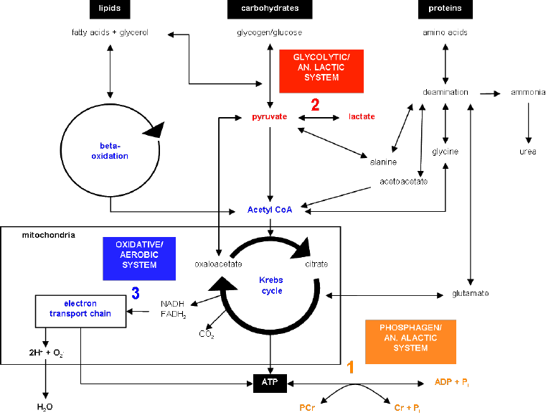
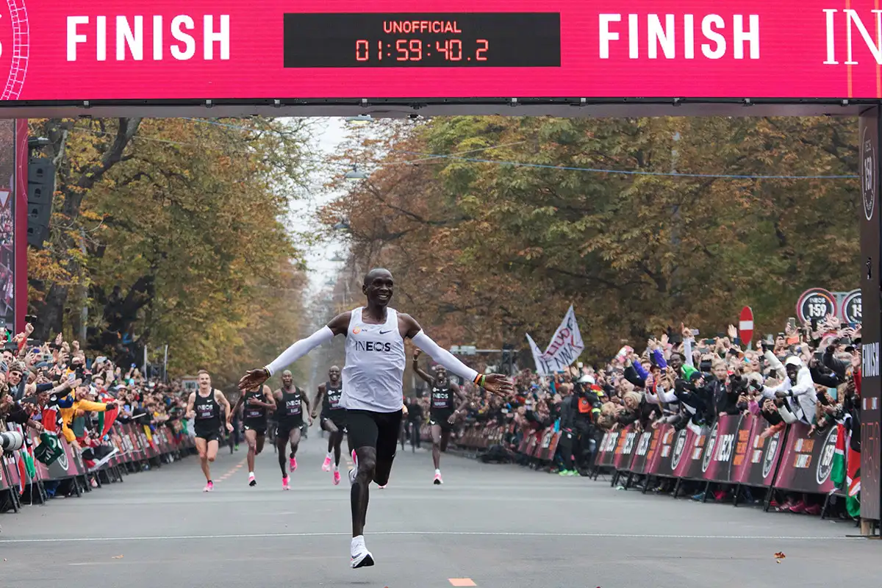
Applied Exercise Physiology & Sports Nutrition for Health & Performance
Model Application
Jasper Suttmeyer

Slide 2

Homework
1.) Prepare to redraw [PCr], [ADP] & [AMP], pH and %vLamax during a GXT and explain the mechanistic link between the figures (similar to slide 35, Seminar 3).
2.) Calculate the ATP yield from two different V̇O₂max and vLamax of your own chosing.
3.) In bullet points: What is the relationship between V̇O₂, [La⁻] and La_{ox}?
4.) Explain the following card:

Slide 3
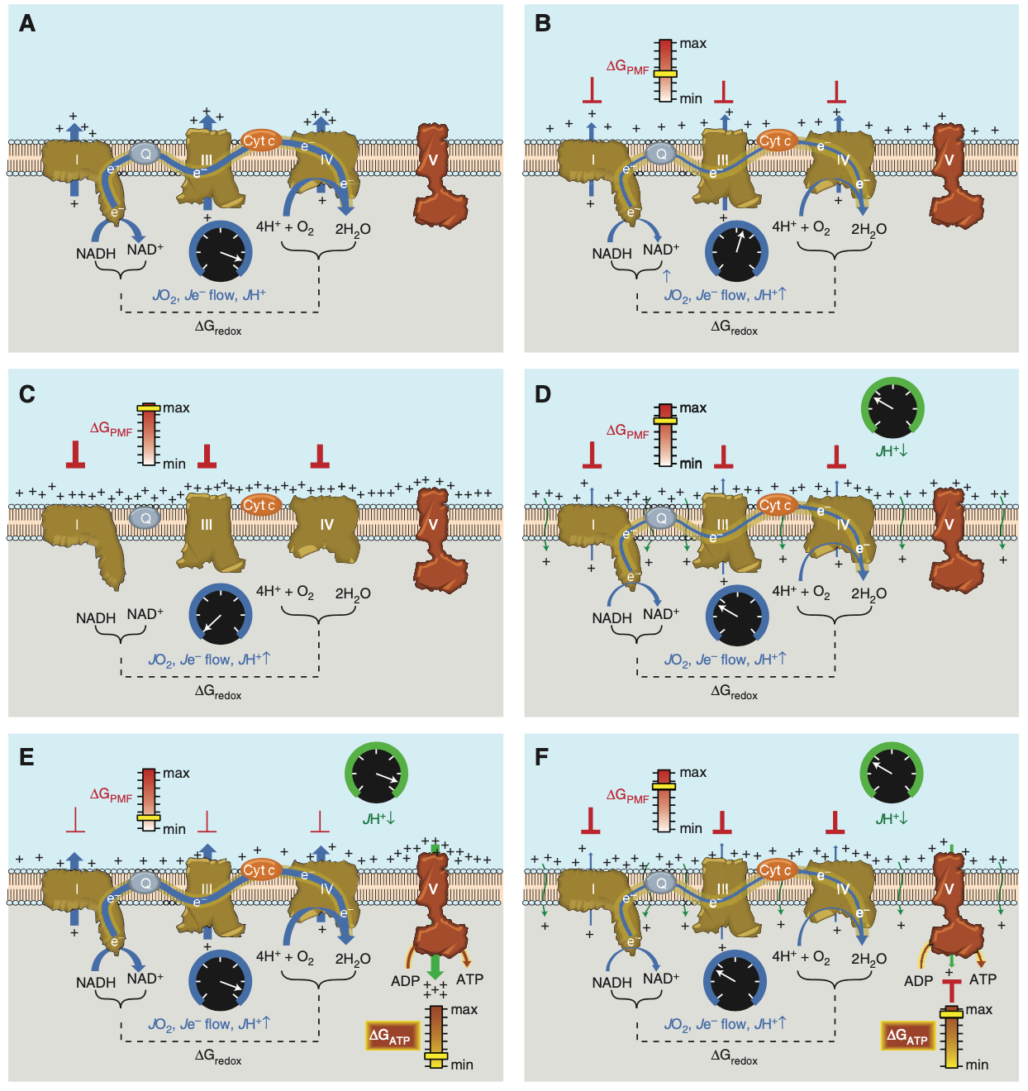
Neufer, 2018
Notes:
Figure 3. Sequential schematic detailing the driving forces governing the control of mitochondrial oxidative phosphorylation. The reader is encouraged to refer to the text for additional details. (A) Conceptual represen- tation of an electron transport system (ETS) embedded within an artificial membrane vesicle. Addition of reducing equivalents (NADH) generates immediate and rapid rates of O2 consumption (JO2), electron flow (Je2 flow), and proton pumping (JHþ ) at complexes I, III, and IV driven by the high DGredox between the O2/ H2O and NADþ/NADH redox couples. (B) As protons accumulate on the outer surface of the membrane, an electrochemical gradient or proton motive force (PMF) begins to build, creating a free energy backpressure (DGPMF) against the pumps, gradually slowing JO2, Je2 flow, and JHþ. (C) Eventually, the backpressure increases to the point that it counterbalances the proton pumps, at which point JO2, Je2 flow, and JHþ decrease to zero. (D) In mitochondria, basal proton conductance back into the matrix (JHþ ) prevents the DGPMF from reaching max, thereby allowing JO2, Je2 flow, and JHþ to proceed at a rate equivalent to the rate of JHþ . (E) Activation of ATP synthase (complex V) by addition of ADP accelerates proton conductance, thereby lowering DGPMF and thus increasing JO2, Je2 flow, and JHþ accordingly. (F) As [ATP]/[ADP]þ[Pi] increases, the free energy associated with ATP hydrolysis (DGATP) increases and creates back pressure on the ATP synthase, gradually slowing the rate of ATP synthesis, causing DGredox to climb and JO2, Je2 flow, and JHþ to slow accordingly back to the rate driven by basal proton conductance. Cyt c, Cytochrome c.

Slide 4
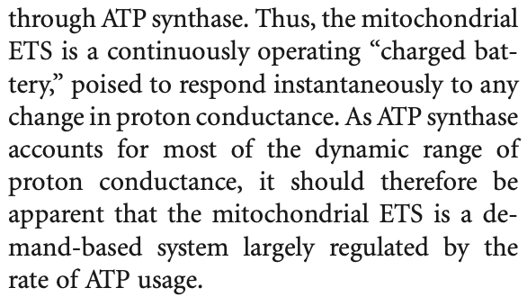
Neufer, 2018

Slide 5
Calculation of steady metabolic profiles
Quantification of so far qualitatively discussed phenomena (4-Steps) (pH=7, neglecting changes)
Variation of PCr
Calculation of ADP and AMP from PCr
Calculation of ATP Resynthesis from glycolysis and oxidative phosphorylation
Converting ATP Resynthesis rate into external load metric

Slide 6
Outline
What steps are needed to build the model?
Quantification of so far qualitatively discussed phenomena (2-Steps)
Variation of PCr
Glycolysis
Aerobic
Capacity
Inhibition
Power
H⁺
Activation
Activation
% V̇O₂max
% vLamax
+
PCr
PCr
related to [ADP] & [AMP]
related to [ADP]
ATP

Slide 7
Outline
What steps are needed to build the model?
Quantification of so far qualitatively discussed phenomena (2-Steps)
Variation of PCr
Glycolysis
Aerobic
Capacity
Inhibition
Power
H⁺
Activation
Activation
% V̇O₂max
% vLamax
+
PCr
PCr
related to [ADP] & [AMP]
related to [ADP]
ATP

Slide 8
Outline
What steps are needed to build the model?
Quantification of so far qualitatively discussed phenomena (2-Steps)
Variation of PCr
Glycolysis
Aerobic
Capacity
Inhibition
Power
H⁺
Activation
Activation
% V̇O₂max
% vLamax
+
PCr
PCr
related to [ADP] & [AMP]
related to [ADP]
ATP

Slide 9
Outline
What steps are needed to build the model?
Quantification of so far qualitatively discussed phenomena (2-Steps)
Variation of PCr
Glycolysis
Aerobic
Capacity
Inhibition
Power
H⁺
Activation
Activation
% V̇O₂max
% vLamax
+
PCr
PCr
related to [ADP] & [AMP]
related to [ADP]
ATP

Slide 10
Outline
What steps are needed to build the model?
Quantification of so far qualitatively discussed phenomena (2-Steps)
Variation of PCr
Glycolysis
Aerobic
Capacity
Inhibition
Power
H⁺
Activation
Activation
% V̇O₂max
% vLamax
+
PCr
PCr
related to [ADP] & [AMP]
related to [ADP]
ATP

Slide 11
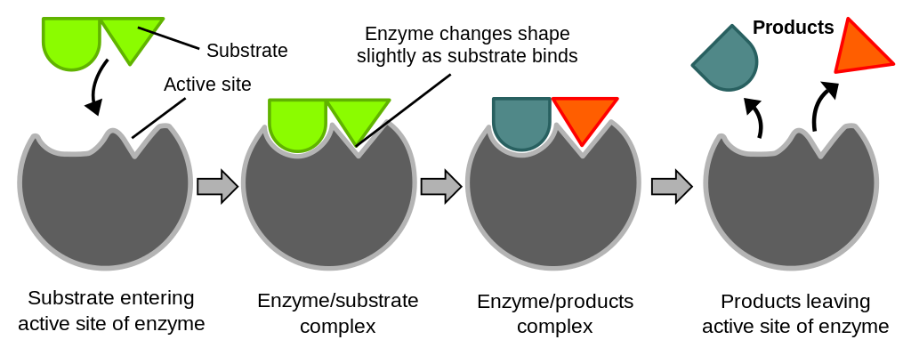
https://courses.lumenlearning.com/wm-biology1/chapter/reading-enzymes/

Slide 12
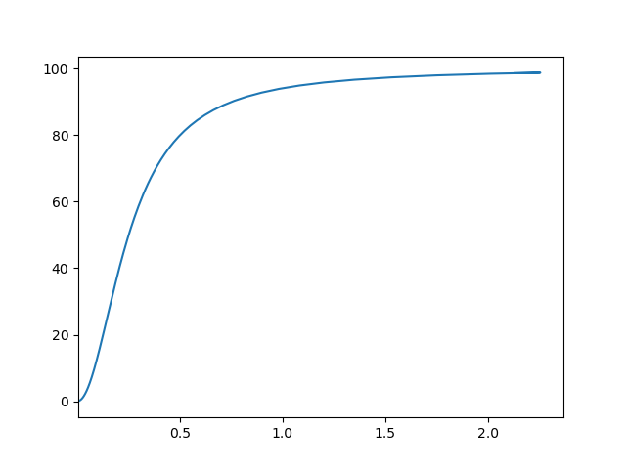
Hill - Equation
Activation of Vmax in %
Concentration (linear)

Slide 13
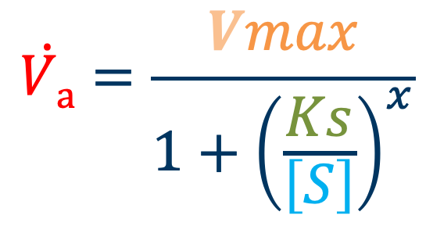
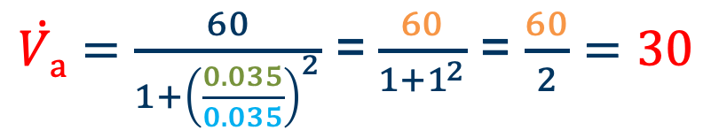
Hill - Equation
$$\dot{Va}=\frac{Vmax}{1+{\left(\frac{Ks}{\left[S\right]}\right)}^{x}}$$
Current Flux
Maximal Flux
Halfmaximal activation (Constant)
Concentration of activating substrates
Time for an example…
Calculate the current flux a given
  Vmax = 60
  Ks = 0.035
  S = 0.035
  Exponent = 2
Exponent
$\dot{Va}=\frac{60}{1+{\left(\frac{0.035}{0.035}\right)}^{2}}$ = $\frac{60}{1+1^{2}}$ = $\frac{60}{2}=30$

Slide 14
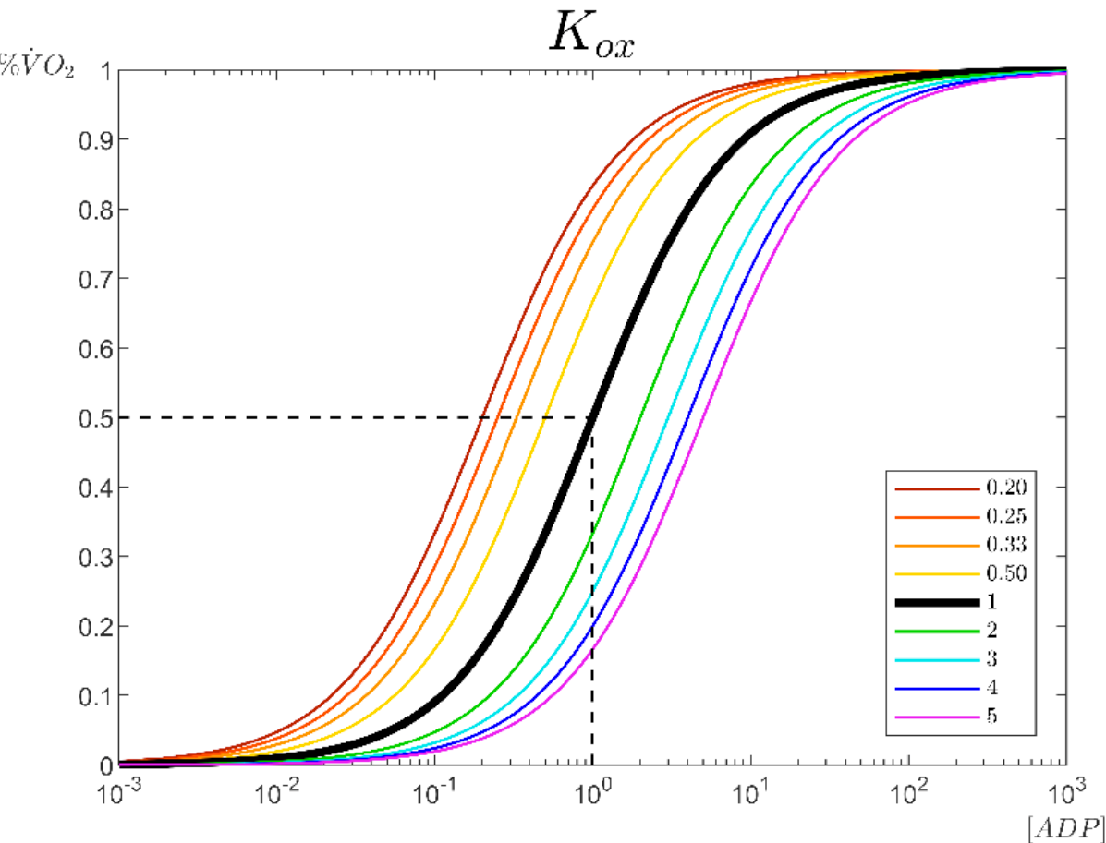
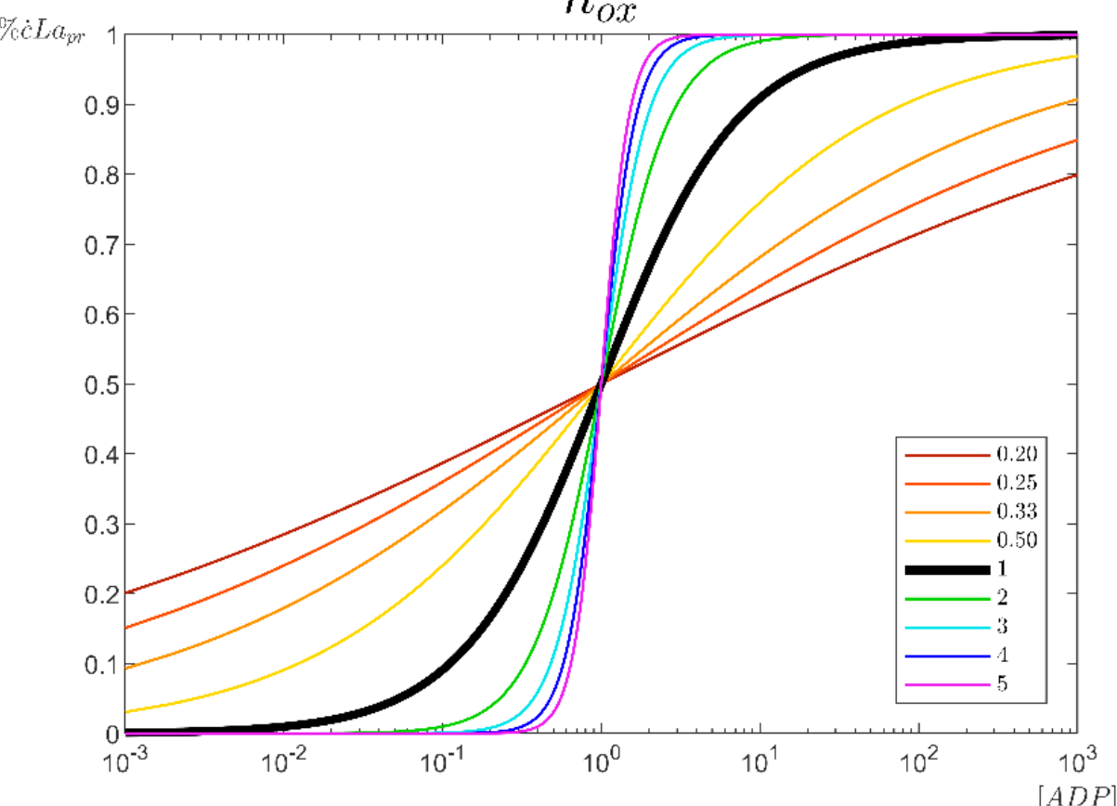
Nolte et al., 2022

Slide 15
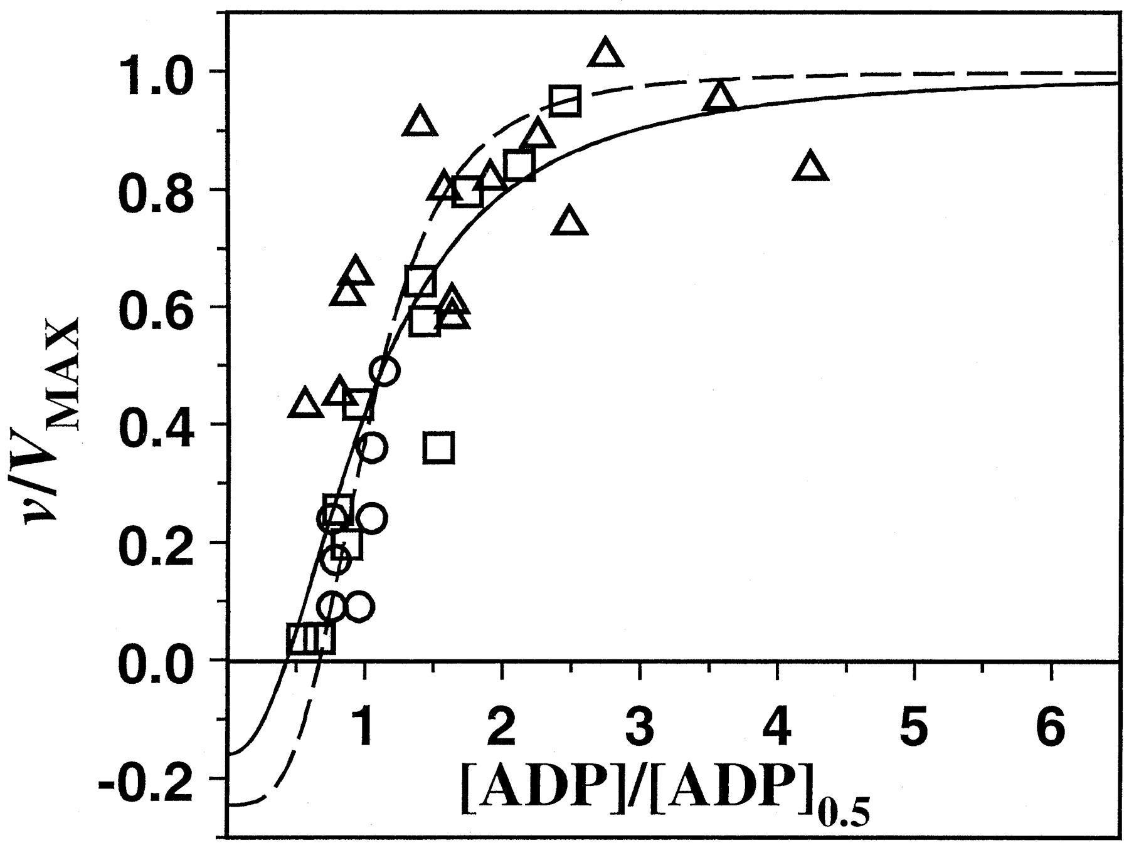
V̇O2-[ADP]
N_{ox} = 2
Ks = 0.035
Jeneson et al.,1996
Notes:
Dependence of specific velocity of MOP (v/V_{max}) on specific ADP concentration ([ADP]/[ADP]_{0.5}) in different mammalian cell types (□, in vivo human skeletal muscle (present study); ∘, in vivo canine heart muscle(14); ▵, ex situ perfused transgenic mouse liver(15)).
https://www.jbc.org/article/S0021-9258(18)35102-0/fulltext#fig1

Slide 16
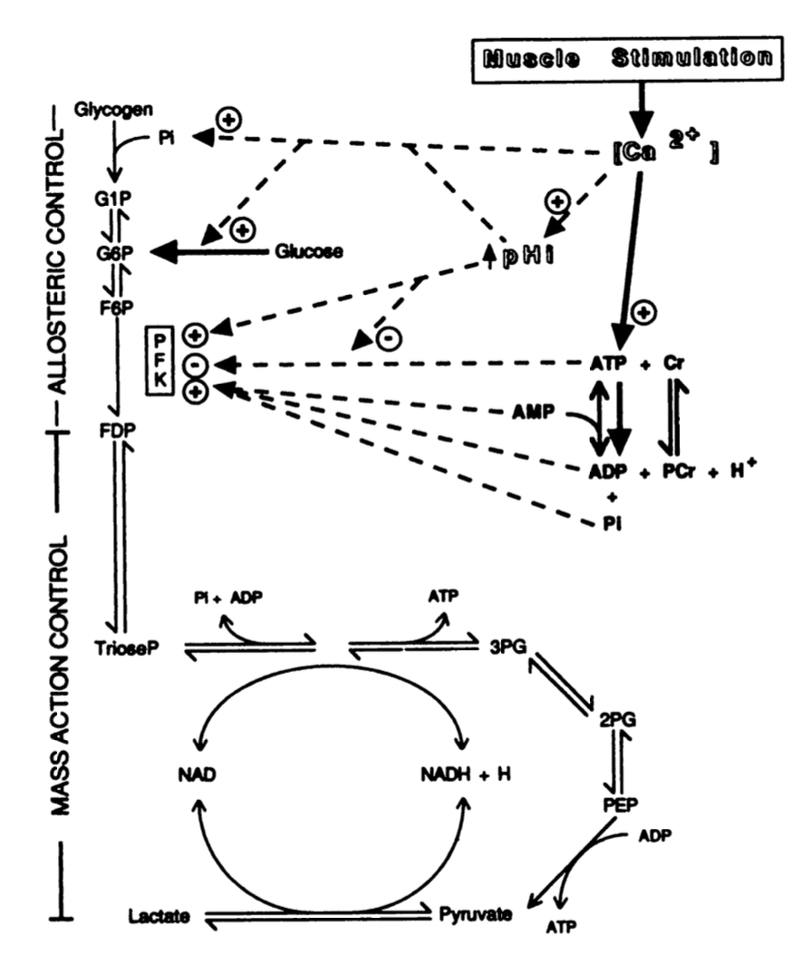
vLa-[ADP]-[AMP]
PFK Activity regulated by concentration of substrate:
Fructose-6-phosphate (F6P)
-> ADP & AMP indirectly control PFK through a series of substeps
Stanley & Connet,1991
Notes:
Regulation of muscle carbohydrate metabolism during exercise
WILLIAM C. STANLEY”2 AND RICHARD J. CONNETTt
“Biodynarnic Laboratory, University of Wisconsin, Madison, Wisconsin 53706, USA; and tDepartmeni of Physiology,

Slide 17
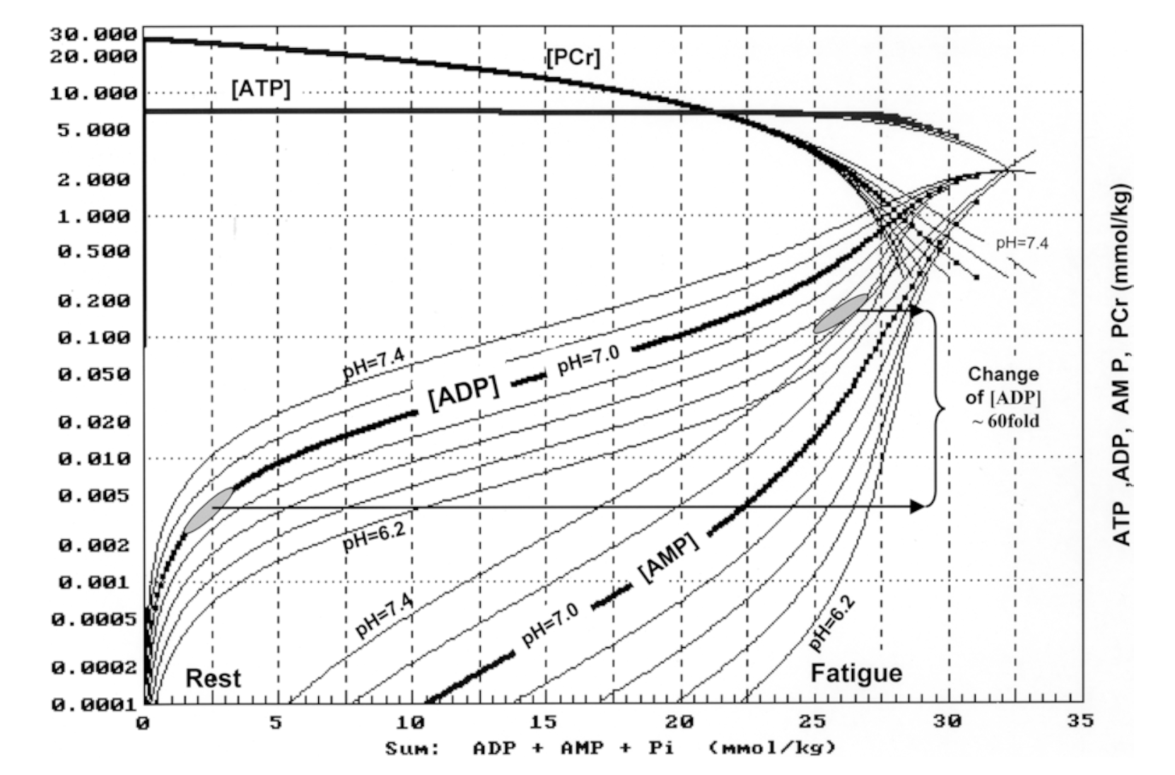
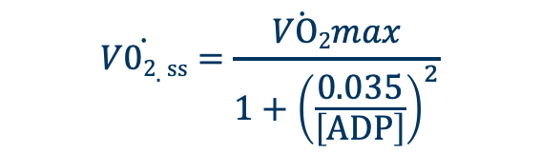
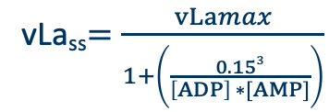
Activating Substrates
Anaerobic
(fast)
Aerobic
(slow)
Carbohydrates
Fats
Glycolysis
VLamax
VO2max
Citric Acid Cycle,
Oxidative Phosphorylation
Pyruvate
combustion
Lactate
vLa_{ss}$=\frac{vLamax}{1+\left(\frac{\begin{aligned} \\ 0.153\end{aligned}}{\left[ADP\right] ∗[AMP]}\right)}$
$$\dot{V02.ss}=\frac{\dot{VO2}max}{1+{\left(\frac{0.035}{\left[ADP\right]}\right)}^{2}}$$

Slide 18
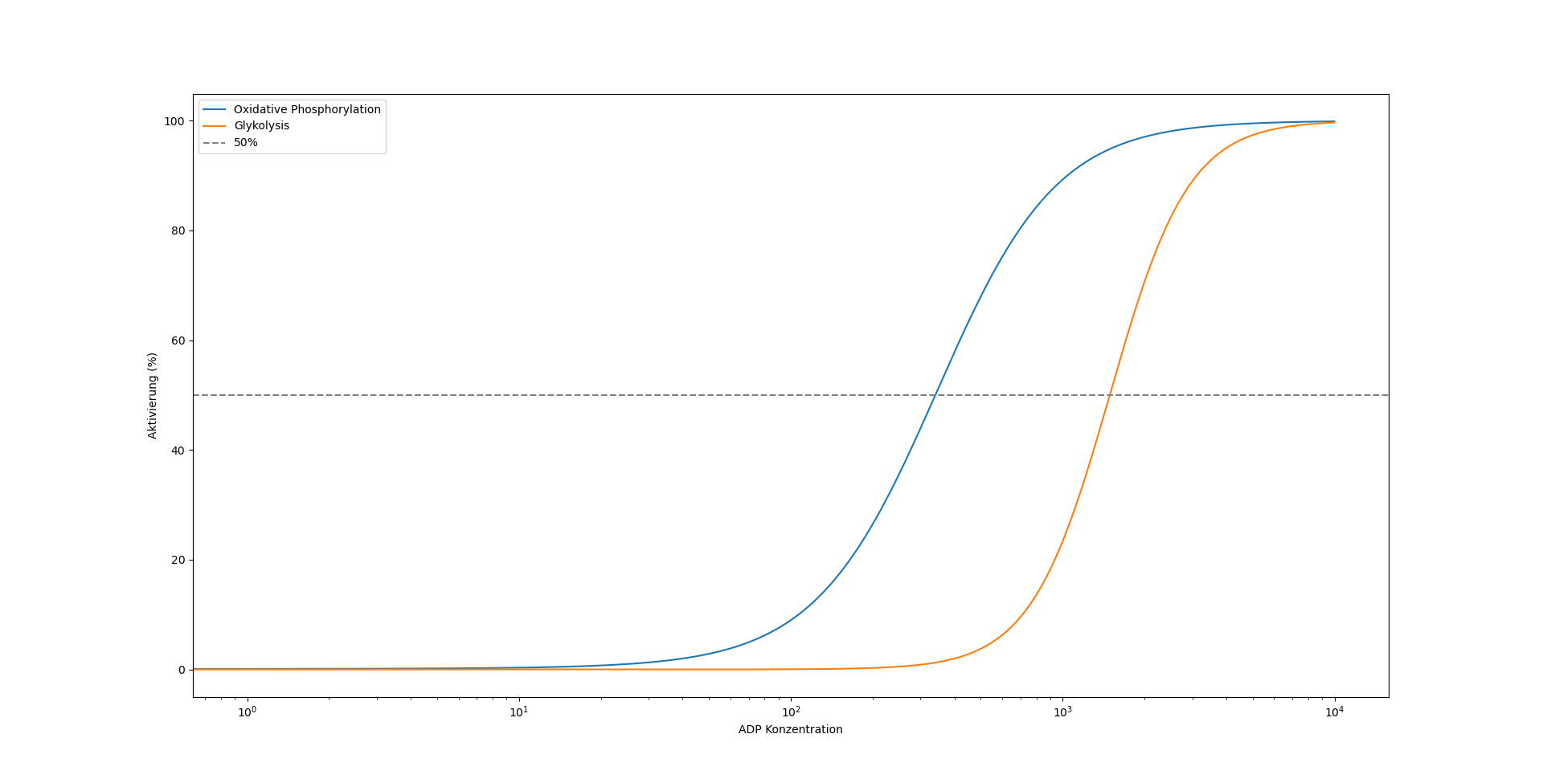
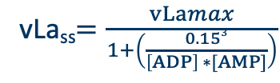
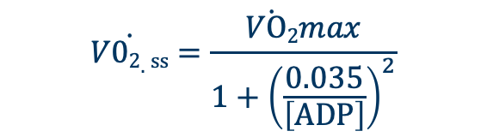
Activation Characteristics
Activation in %
Concentration of ADP (Decreasing [PCr])
vLa_{ss}$=\frac{vLamax}{1+\left(\frac{0.153}{\left[ADP\right] ∗[AMP]}\right)}$
$$\dot{V02.ss}=\frac{\dot{VO2}max}{1+{\left(\frac{0.035}{\left[ADP\right]}\right)}^{2}}$$

Slide 19
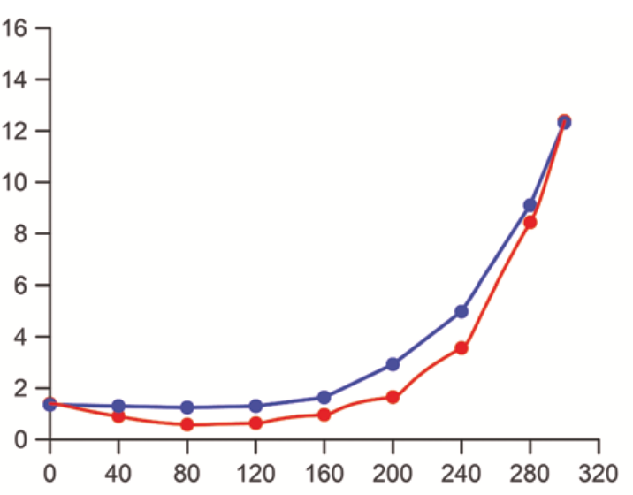
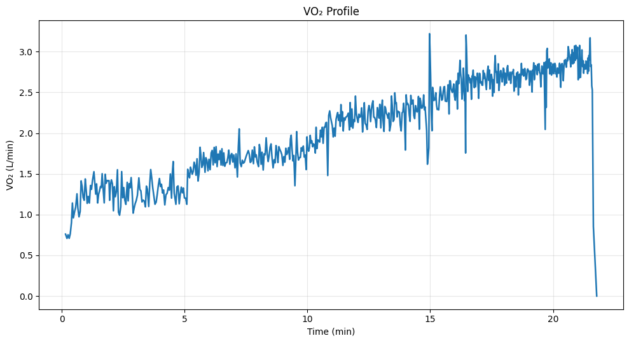
First La constant
[La-] mmol/L
Increases later
Heck et al., 2022
Mechanical Power, Watt
Towards „levelling off“
Very sensitive

Slide 20
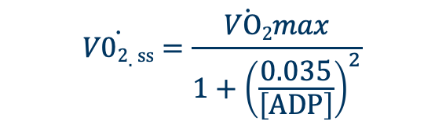
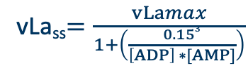
Activation Characteristics
$$\dot{V02.ss}=\frac{\dot{VO2}max}{1+{\left(\frac{0.035}{\left[ADP\right]}\right)}^{2}}$$
vLa_{ss}$=\frac{vLamax}{1+\left(\frac{0.153}{\left[ADP\right] ∗[AMP]}\right)}$
Pathways are interconnected!
mmol/L/min
ml/min/kg
Anaerobic
(fast)
Aerobic
(slow)
Carbohydrates
Fats
Glycolysis
VLamax
VO2max
Citric Acid Cycle,
Oxidative Phosphorylation
Pyruvate
combustion
Lactate

Slide 21
Activation Characteristics
Pathways are interconnected!
1 mmol/L La⁻ needs approximately 28* ml/min/kg of oxygen
Anaerobic
(fast)
Aerobic
(slow)
Carbohydrates
Fats
Glycolysis
VLamax
VO2max
Citric Acid Cycle,
Oxidative Phosphorylation
Pyruvate
combustion
Lactate
* Exact value depends on individual body composition

Slide 22
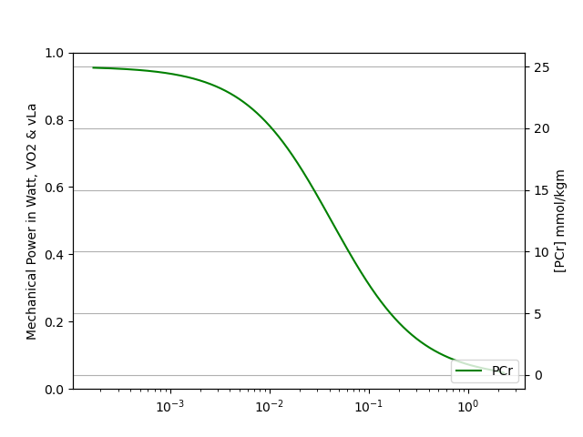


Example calculation for an individual
Body Mass : 70 kg
V̇O₂max : 60 ml/min/kg
vLamax : 0.7 mmol/L/s
Calculate [ADP] & [AMP] from [PCr]
Insert into Equations
$$\dot{V02.ss}=\frac{\dot{VO2}max}{1+{\left(\frac{0.035}{\left[ADP\right]}\right)}^{2}}$$
vLa_{ss}$=\frac{vLamax}{1+\left(\frac{0.153}{\left[ADP\right] ∗[AMP]}\right)}$
[ADP] mmol/kg_{m}

Slide 23
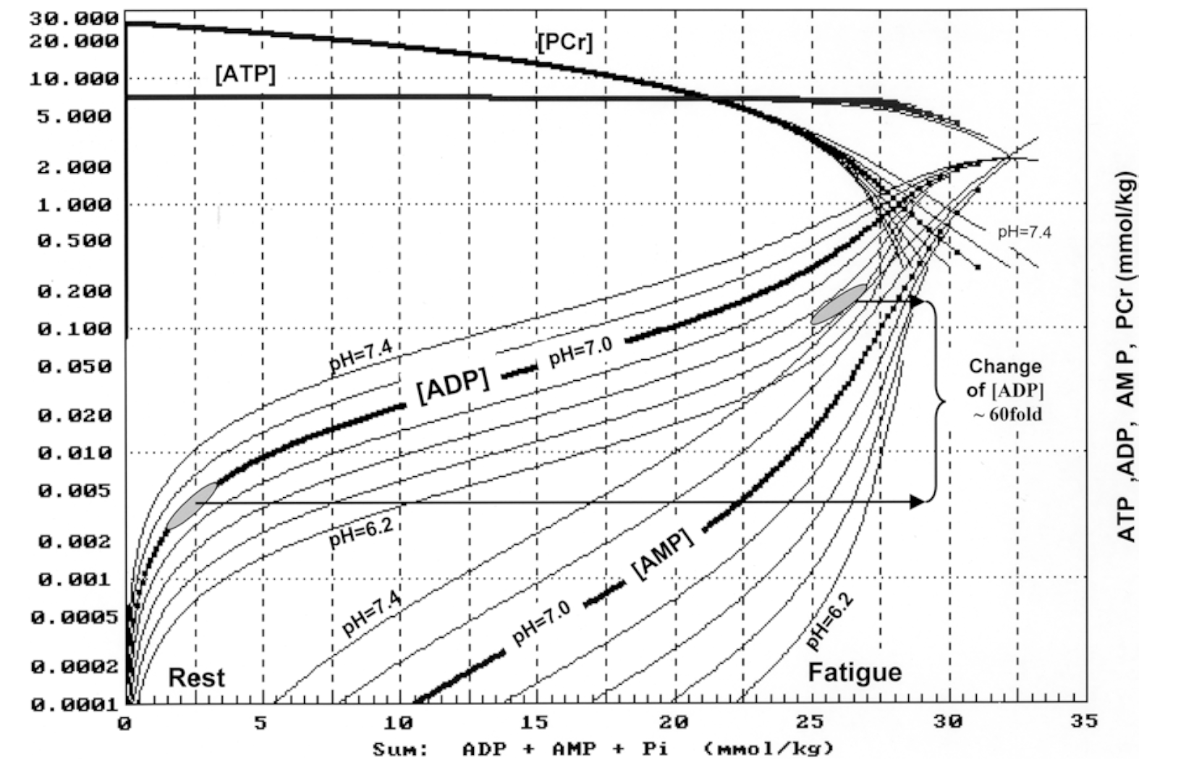
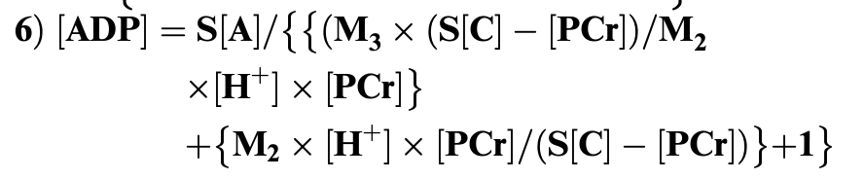

Calculation of [ADP] & [AMP]
Mader, 2003

Slide 24
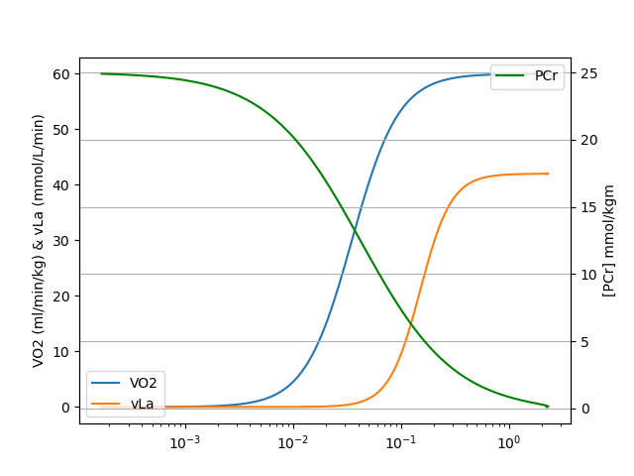


Example calculation for an individual
Body Mass : 70 kg
V̇O₂max : 60 ml/min/kg
vLamax : 0.7 mmol/L/s
Calculate [ADP] & [AMP] from [PCr]
Insert into Equations
$$\dot{V02.ss}=\frac{\dot{VO2}max}{1+{\left(\frac{0.035}{\left[ADP\right]}\right)}^{2}}$$
vLa_{ss}$=\frac{vLamax}{1+\left(\frac{0.153}{\left[ADP\right] ∗[AMP]}\right)}$
[ADP] mmol/kg_{m}
Notes:
Divide V̇O2 by 28 for La combustion to next slide

Slide 25
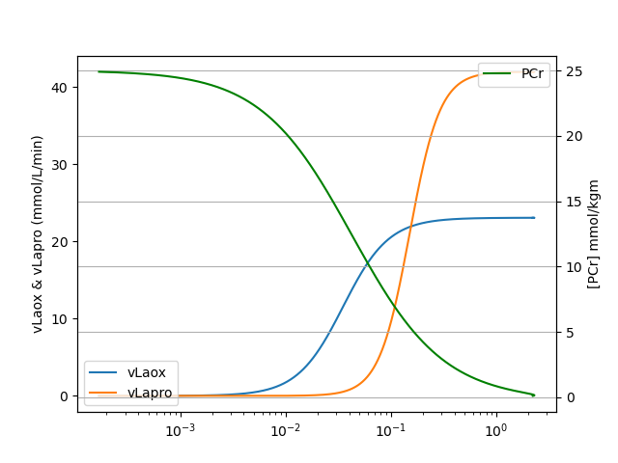
Example calculation for an individual
Body Mass : 70 kg
V̇O₂max : 60 ml/min/kg
vLamax : 0.7 mmol/L/s
Calculate [ADP] & [AMP] from [PCr]
Insert into Equations
$$\dot{V02.ss}=\frac{\dot{VO2}max}{1+{\left(\frac{0.035}{\left[ADP\right]}\right)}^{2}}$$
vLa_{ss}$=\frac{vLamax}{1+\left(\frac{0.153}{\left[ADP\right] ∗[AMP]}\right)}$
[ADP] mmol/kg_{m}
Notes:
We can already see to region
1.) vlaox above vla
2.) vlaox be,ow vla

Slide 26
Example calculation for an individual
2) Linking external/internal load to ATP-breakdown
ATP_{pro} = vLa * La_{ATP} + V̇O₂ * O_{2.ATP}
La_{ATP} = 1.4 (mmol ATP / mmol La⁻)
O_{2.ATP} = 0.233 (mmol ATP / ml O₂)
Also:
0.0484 mmol ATP =
1 Watt (mechanical Power)
[ADP] mmol/kg_{m}

Slide 27
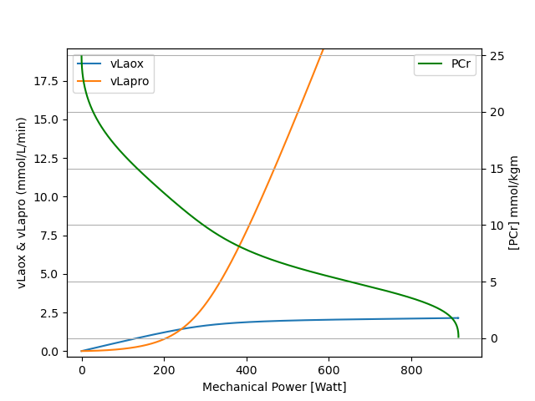
Example calculation for an individual
Notes:
Next Slide abs(vla_ox – vLa_pro)

Slide 28
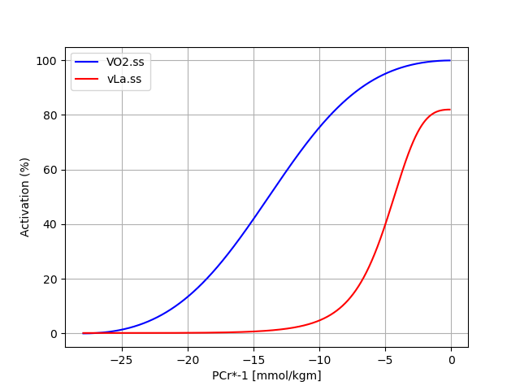
Example
Body Mass = 75kg
La-Space = 45%
VO2max = 60 ml/min/kg
vLamax = 0.60 mmol/L/s
AND:
12.5 ml/min = 1 W/min

Slide 29
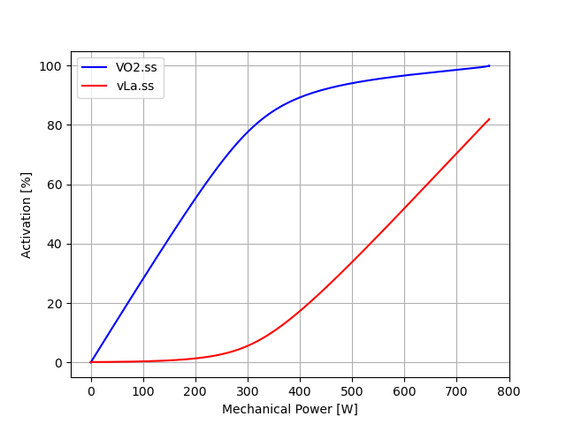
Notes:
Oxidative Contribution and glycolytic contribution together sum to mechanical power;
I could also write runnning velocity if knew the economy of a runner -> any external load parameter is possible when relationship to ATP Turnover is known

Slide 30
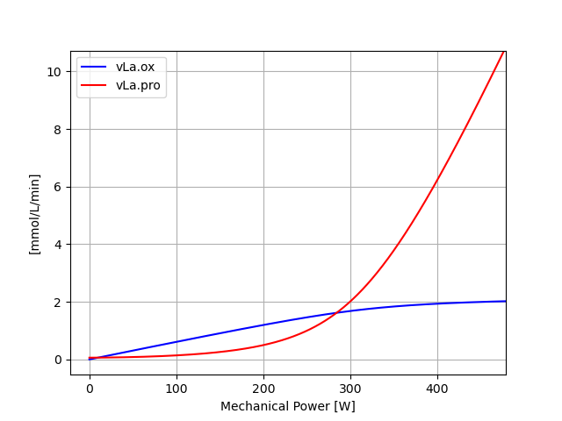
Non-Steady State
Steady State
Transition
Notes:
First lactate production below oxidation, than similar and later lactate production well above oxidation
Talk about theorethical steady state, transition and non steady state area

Slide 31
@ 400W Lactate accumulation roughly 4 mmol/L/min
@ 200W: Lactate deficit roughly 0.5 mmol/L/min
Notes:
Ideas about interval training or also race planning

Slide 32
1. ATP Resynthesis
2. Lactate „oxidation“
Processes of ATP-Synthesis
Anaerobic
Aerobic
Glucose
ß-Oxidation
Non Lactate oxidizing Oxygen must be related to fatty acid breakdown
Glycogen
La production must be related to Glucose/Glycogen Breakdown
⚡ATP ⚡
Citric Acid Cycle
⚡ATP/GTP ⚡
Lactate
⚡ATP ⚡
Electron Transport Chain
Mader & Heck, 1986
Notes:
Lets talk about the bridge between aerobic and glycolytic mechanism
Next slides: During the step test, how much lactate is oxidized and produced? How can we calculate this?

Slide 33
Macronutrient utilisation
La production must be related to Glucose/Glycogen Breakdown
Fat oxidation/Lack of Lactate
Mader & Heck, 1986
Notes:
First lactate production below oxidation, than similar and later lactate production well above oxidation
Talk about theorethical steady state, transition and non steady state area

Slide 34
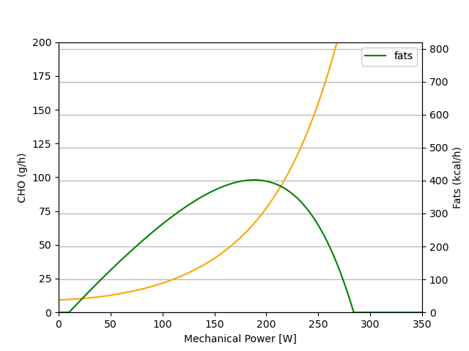
Macronutrient utilisation
Notes:
Talk about the different usages of these substrates on a global scale

Slide 35
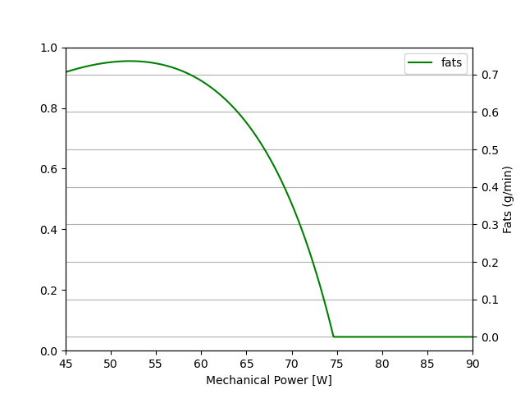
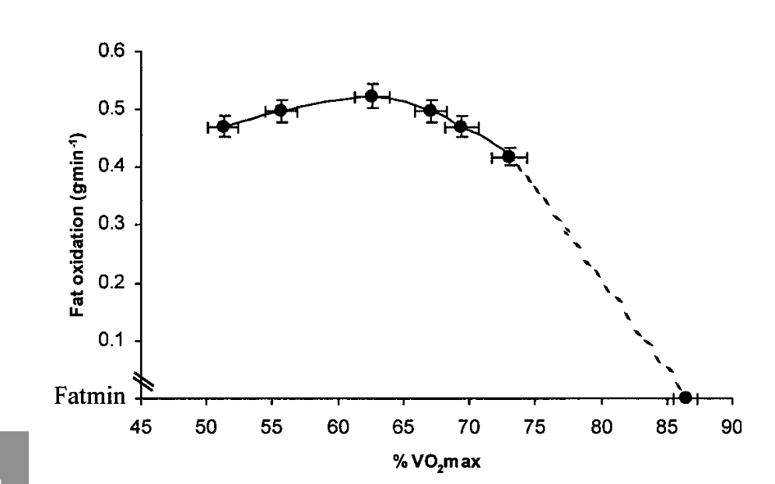
Macronutrient utilisation
% VO2max
Achten & Jeukendrup, 2003
Notes:
Talk about the different usages of these substrates on a global scale
Maximal Fat Oxidation During Exercise in Trained Men,
Jeukendrup 2003

Slide 36
Summary
Calculation of metabolic Profiles as a function mechanical power for one individual
Calculation of macronutrient utilisation
Example
Body Mass = 75kg
La-Space = 45%
VO2max = 60 ml/min/kg
vLamax = 0.60 mmol/L/s
AND:
12.5 ml/min = 1 W/min
How do these parameters
influence the model?

Slide 37
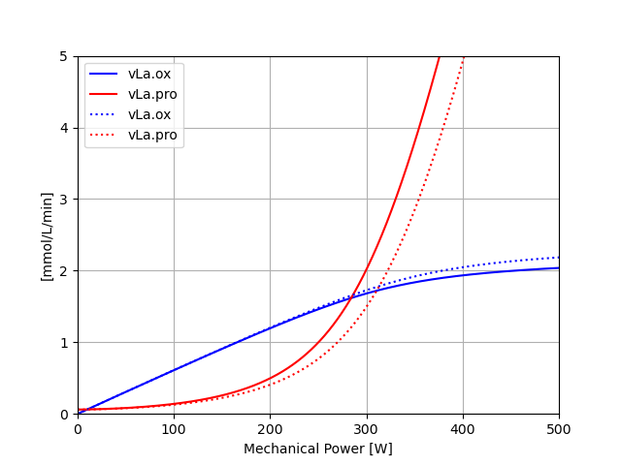
V̇O₂max
60
Crossing Point to higher values
Less Lactate accumulation
Higher Lack of Lactate/Fat
65
Notes:
Ask them what they see, show answer later

Slide 38
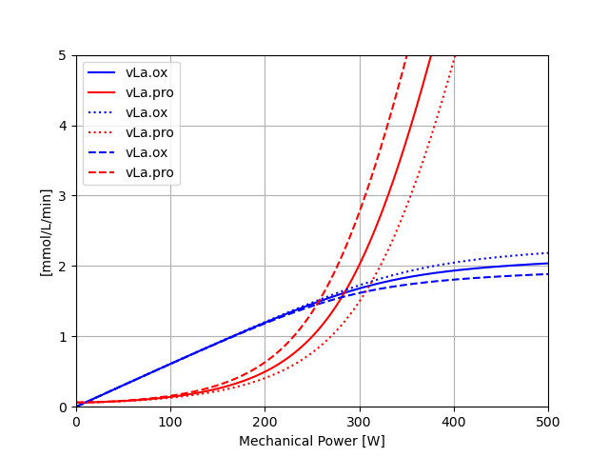
V̇O₂max
60
Crossing Point to higher values
Less Lactate accumulation
Higher Lack of Lactate/Fat
-> And vice versa!
65
55
Notes:
For next slide: What will happen to macros for same manipulation?

Slide 39
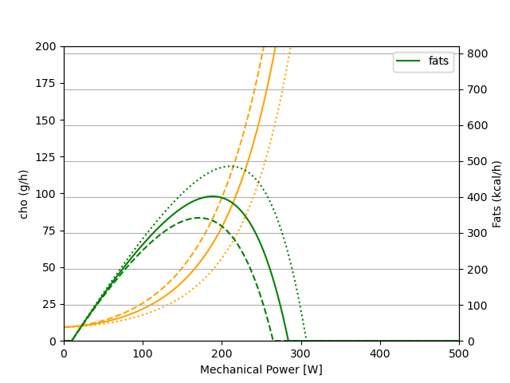
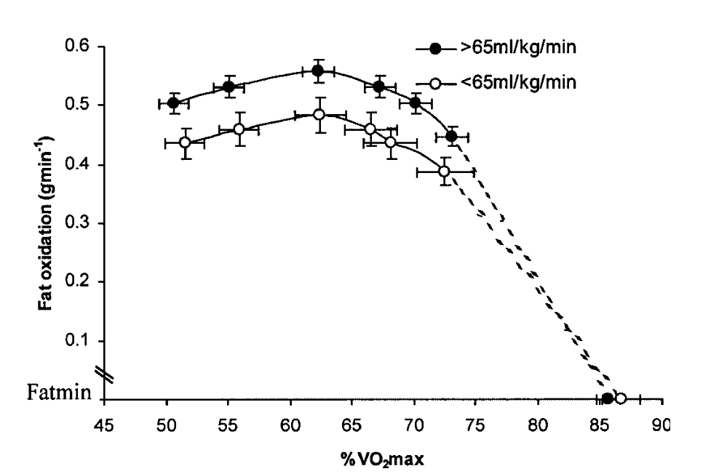
V̇O₂max
65
55
60
Achten &, Jeukendrup, 2003
Notes:
Same manipulation: Which one is VO2max 60, 65, and 55?

Slide 40
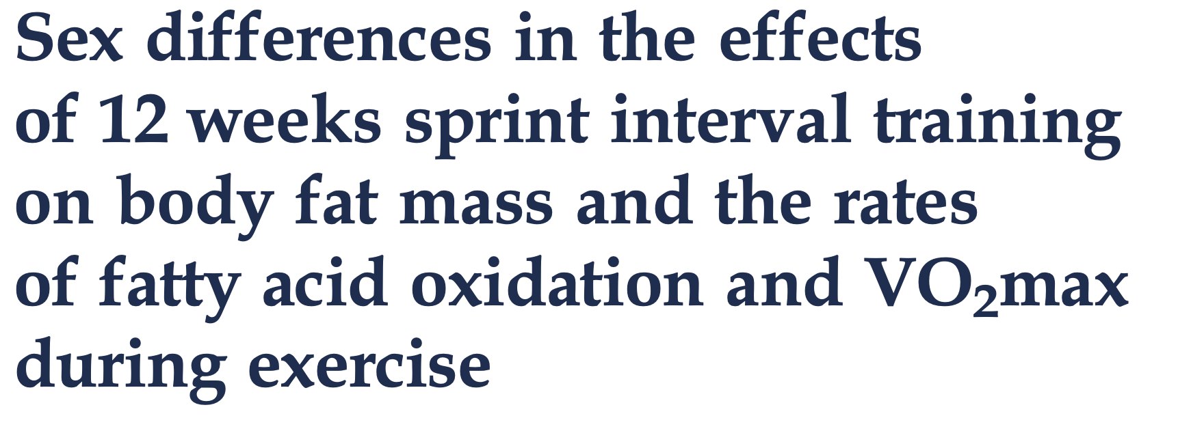
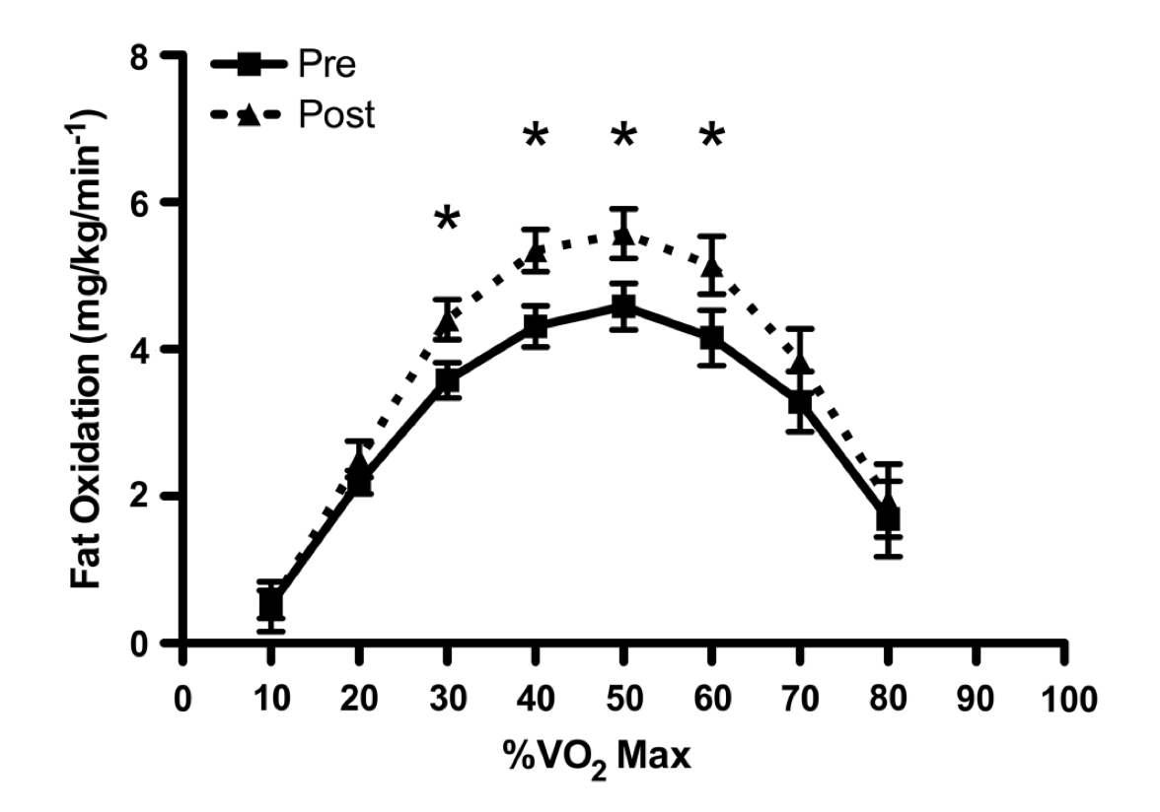
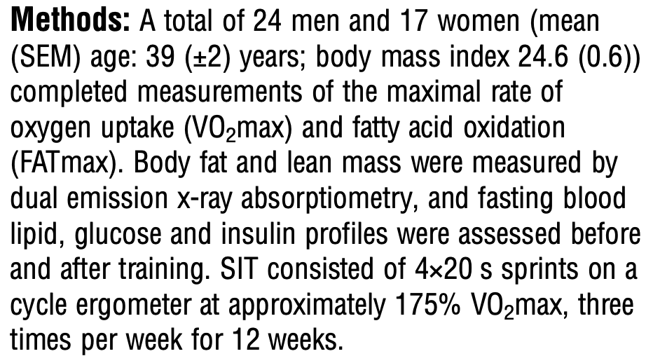
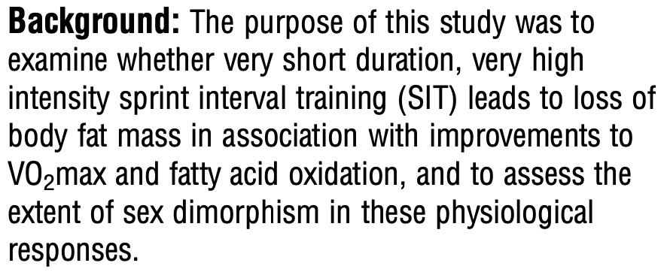
Key Training Principle: Specificity?!
Bagley et al., 2016
Notes:
Also go back one slide and talk about specificity in context of carbohydrate utilisation!

Slide 41
V̇O₂max
vLamax ???
Crossing Point to higher values
Less Lactate accumulation
Higher Lack of Lactate/Fat
-> And vice versa!

Slide 42
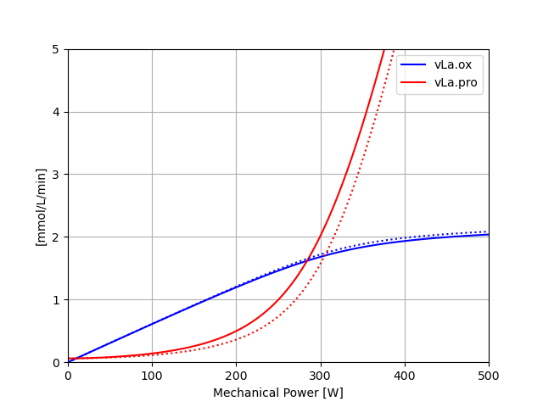
vLamax
Crossing Point to higher values
Less Lactate accumulation
Higher Lack of Lactate/Fat
vLamax
0.6
0.4

Slide 43
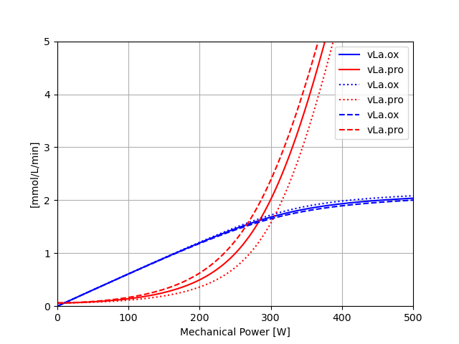
vLamax
Crossing Point to higher values
Less Lactate accumulation
Higher Lack of Lactate/Fat
-> And vice versa!
vLamax
0.8
0.6
0.4

Slide 44

V̇O₂max
vLamax
Crossing Point to higher values
Less Lactate accumulation
Higher Lack of Lactate/Fat
-> And vice versa!
Crossing Point to lower values
More Lactate accumulation
Lower Lack of Lactate/Fat
-> And vice versa!
So a high V̇O₂max and a low vLamax is always best?

Slide 45
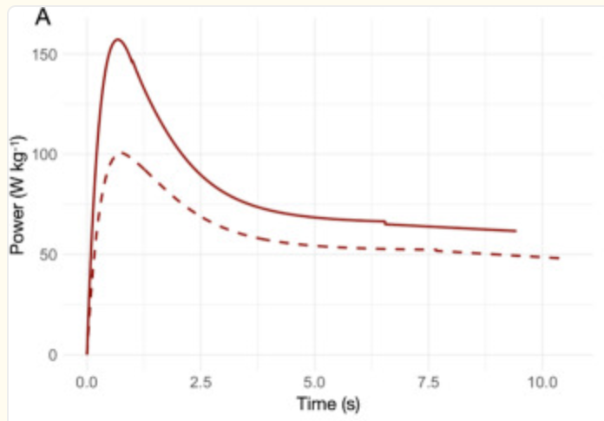

Separate Characterisation of Pathways
Sprinting
100m
Assumptions:
Body Mass 75kg
Body Fat 15%
Watt-O2 = 2.87 ml/min/W
Theorethical V̇O₂max
60.3 * 2.87 = 173.1 ml/min/kg
Theorethical vLamax:
~1.01 mmol/L/s
Average 82.9 W/kg
Metabolic
Average 60.3 W/kg
Briand et al, 2025
The oxidative metabolism cannot provide sufficient energy for sprinting!
Notes:
Same in metabolic power; Metabolic Power is not mechanical Power! Assumed Efficiency of 22.99%

Slide 46
V̇O₂max
vLamax
Crossing Point to higher values
Less Lactate accumulation
Higher Lack of Lactate/Fat
-> And vice versa!
Crossing Point to lower values
More Lactate accumulation
Lower Lack of Lactate/Fat
-> And vice versa!
So a high V̇O₂max and a low vLamax is always best?
High V̇O₂max is a good marker of endurance performance
vLamax must always be finetuned to the sport specific demands!

Slide 47

Notes:
Another example: https://www.youtube.com/watch?v=zUbj_EQjRXo

Slide 48
Draw [PCr], pH, [La⁻], V̇O2, vLa for the following bouts of exercise for this individual
I.)
10min 150W,
10x [30sec 350W, 30sec 150W],
10min 150W
II.)
10min 150W,
3x [2min 310W, 1min 150W],
10min 150W
III.)
10min 150W,
3x [4min 280W, 2min 150W],
10min 150W

Slide 49
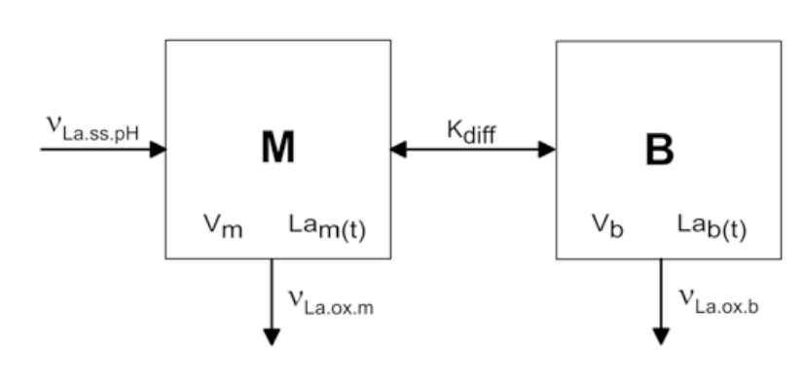
1- vs 2-Compartment Modell
La space
La space
active
La space
passive
vLa
vLa_{ox}
Heck et al., 2022

Slide 50
Literature
Achten J, Jeukendrup AE. Maximal fat oxidation during exercise in trained men. Int J Sports Med. 2003 Nov;24(8):603-8. doi: 10.1055/s-2003-43265. PMID: 14598198.
Bagley L, Slevin M, Bradburn S, Liu D, Murgatroyd C, Morrissey G, Carroll M, Piasecki M, Gilmore WS, McPhee JS. Sex differences in the effects of 12 weeks sprint interval training on body fat mass and the rates of fatty acid oxidation and VO2max during exercise. BMJ Open Sport Exerc Med. 2016 Mar 4;2(1):e000056. doi: 10.1136/bmjsem-2015-000056. PMID: 27900150; PMCID: PMC5117024.
Briand J, di Prampero PE, Osgnach C, Thibault G, Tremblay J. Quantifying metabolic energy contributions in sprint running: a novel bioenergetic model. Eur J Appl Physiol. 2025 Dec;125(12):3521-3541. doi: 10.1007/s00421-025-05831-0. Epub 2025 Jun 19. PMID: 40536521; PMCID: PMC12678604.
Heck, H., Bartmus, U., Grabow, V., Laktat: Stoffwechselgrundlagen, Leistungsdiagnostik, Trainingssteuerung, 2022
Heck, H. (1990a). Laktat in der Leistungsdiagnostik. Schorndorf: Hofmann.
Heck, H., Schulz, H., Bartmus, U., Diagnostics of anaerobic power and capacity. EJSS, 2010, doi: 10.1080/17461390300073302
Jeneson JA, Wiseman RW, Westerhoff HV, Kushmerick MJ. The signal transduction function for oxidative phosphorylation is at least second order in ADP. J Biol Chem. 1996 Nov 8;271(45):27995-8. doi: 10.1074/jbc.271.45.27995. PMID: 8910406.
Neufer PD. The Bioenergetics of Exercise. Cold Spring Harb Perspect Med. 2018 May 1;8(5):a029678. doi: 10.1101/cshperspect.a029678. PMID: 28490536; PMCID: PMC5932573.
Mader, A. (2003). Glycolysis and oxidative phosphorylation as a function of cytosolic phosphorylation state and power output of the muscle cell.
Mader A, Heck H. A theory of the metabolic origin of "anaerobic threshold". Int J Sports Med. 1986 Jun;7 Suppl 1:45-65. PMID: 3744647.
Nolte, S., Quittmann, O., Meden, V,. Simulation of Steady-State Energy Metabolism in Cycling and Running, doi: 10.51224/SRXIV.110, 2022
Stanley WC, Connett RJ. Regulation of muscle carbohydrate metabolism during exercise. FASEB J. 1991 May;5(8):2155-9. doi: 10.1096/fasebj.5.8.1827082. PMID: 1827082.

