Slide 1
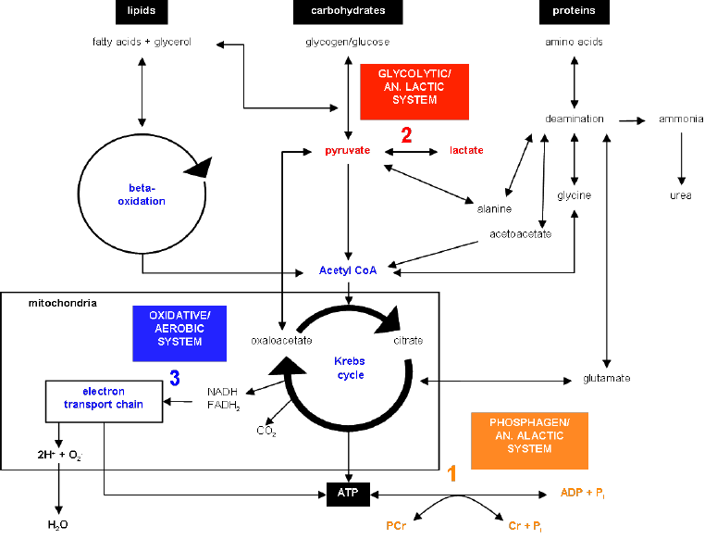
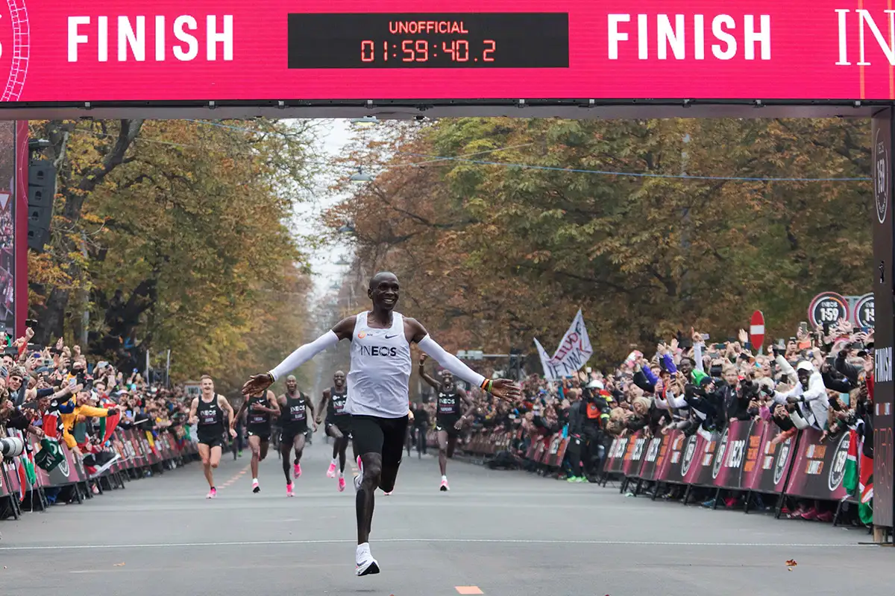
Applied Exercise Physiology & Sports Nutrition for Health & Performance
Aerobic Metabolism
Jasper Suttmeyer

Slide 2
Recap
Lactic-Anaerobic
Aerobic
Capacity
Power
Alactic-Anaerobic (ATP-PCr-System)
Usable
Sum of PCr & ATP
Not Usable
Contraction Insufficiency
Notes:
Summary:
Power and Capacity of different energy systems

Slide 3
Glycolysis
Capacity
Power
H⁺
Activation
Alactic-Anaerobic
(ATP-PCr-System)
PCr
related to [ADP] & [AMP]
+
ATP
Contraction Insufficiency
Notes:
ATP contribution from Glycolysis
Glucose vs Glycogen
Activation of ADP & AMP
Inhibition due to H+
Lets have a look at an actual simulation, Maybe 450W for 30s, preset 60W for 60sec

Slide 4
Processes of ATP-Synthesis
Anaerobic
Aerobic
Glucose
ß-Oxidation
Glycogen
⚡ATP ⚡
Citric Acid Cycle
⚡ATP/GTP ⚡
Lactate
⚡ATP ⚡
Electron Transport Chain
Notes:
Reduced Complexity,
Both Pathways are interconnected!

Slide 5
1. ATP Resynthesis
2. Lactate „oxidation“
Processes of ATP-Synthesis
Anaerobic
Aerobic
Glucose
ß-Oxidation
Glycogen
⚡ATP ⚡
Citric Acid Cycle
⚡ATP/GTP ⚡
Lactate
⚡ATP ⚡
Electron Transport Chain
Notes:
Reduced Complexity,
Both Pathways are interconnected!

Slide 6
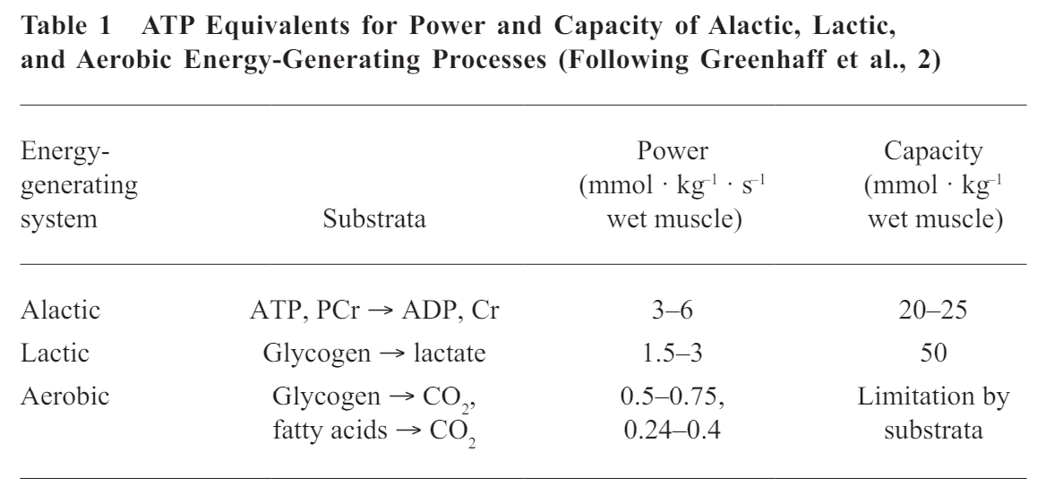
Processes of ATP-Synthesis
Low Power, high Capacity
Heck et al., 2010
Biochemical Steps (roughly), How much ATP per O₂?
How is V̇O₂ regulated?
How much La⁻ is oxidized per O₂?
Regulation of La⁻ oxidation?

Slide 7
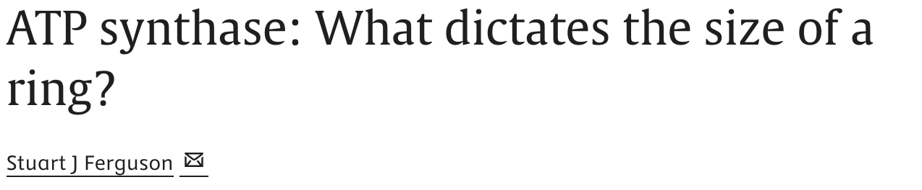
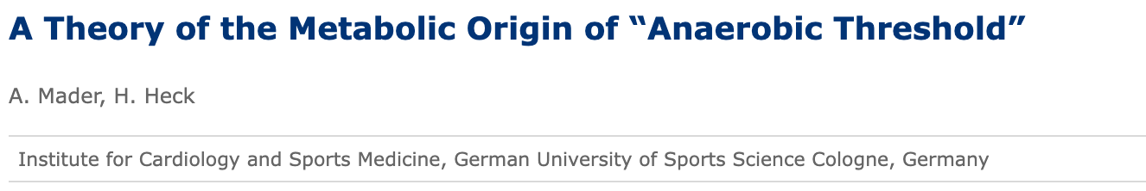
Oxidative Phosphorylation
How is V̇O₂ regulated?
How much ATP per O₂?
How much La is oxidized per O₂?

Slide 8
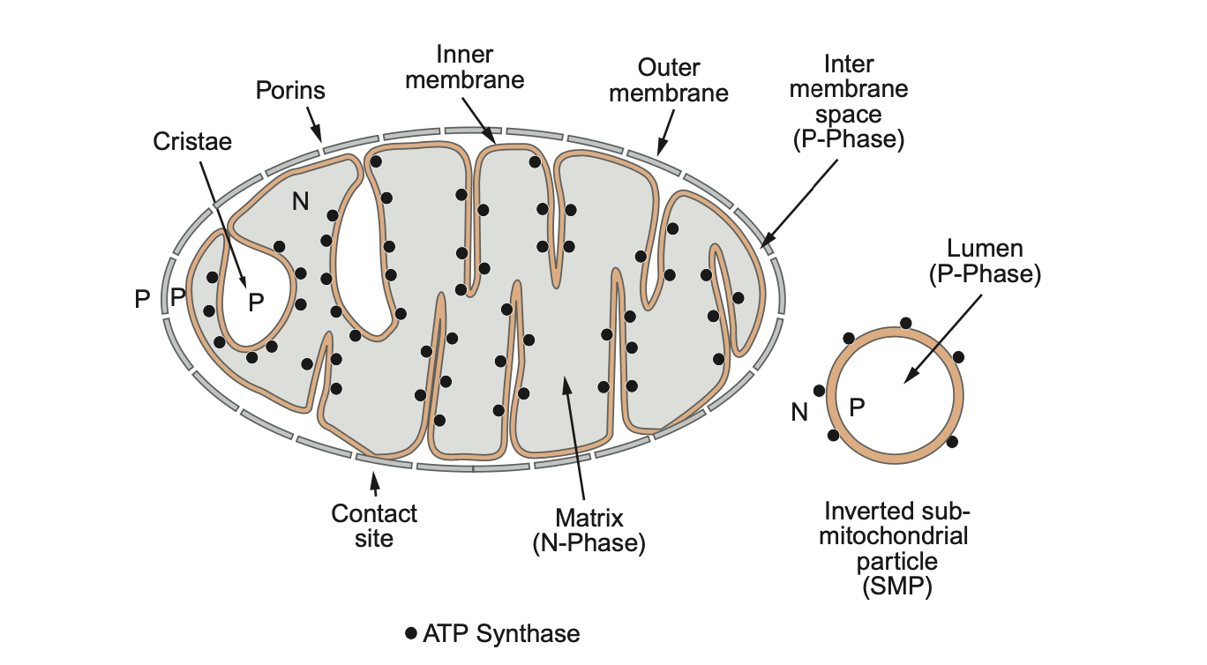
Mitochondrial Structure
Ferguson & Nicholls, 2013, Chapter 1
Notes:
We are starting with the lactate pathway,
1.0 ml Vmit can consume up to 4.5 ml O2min–1

Slide 9
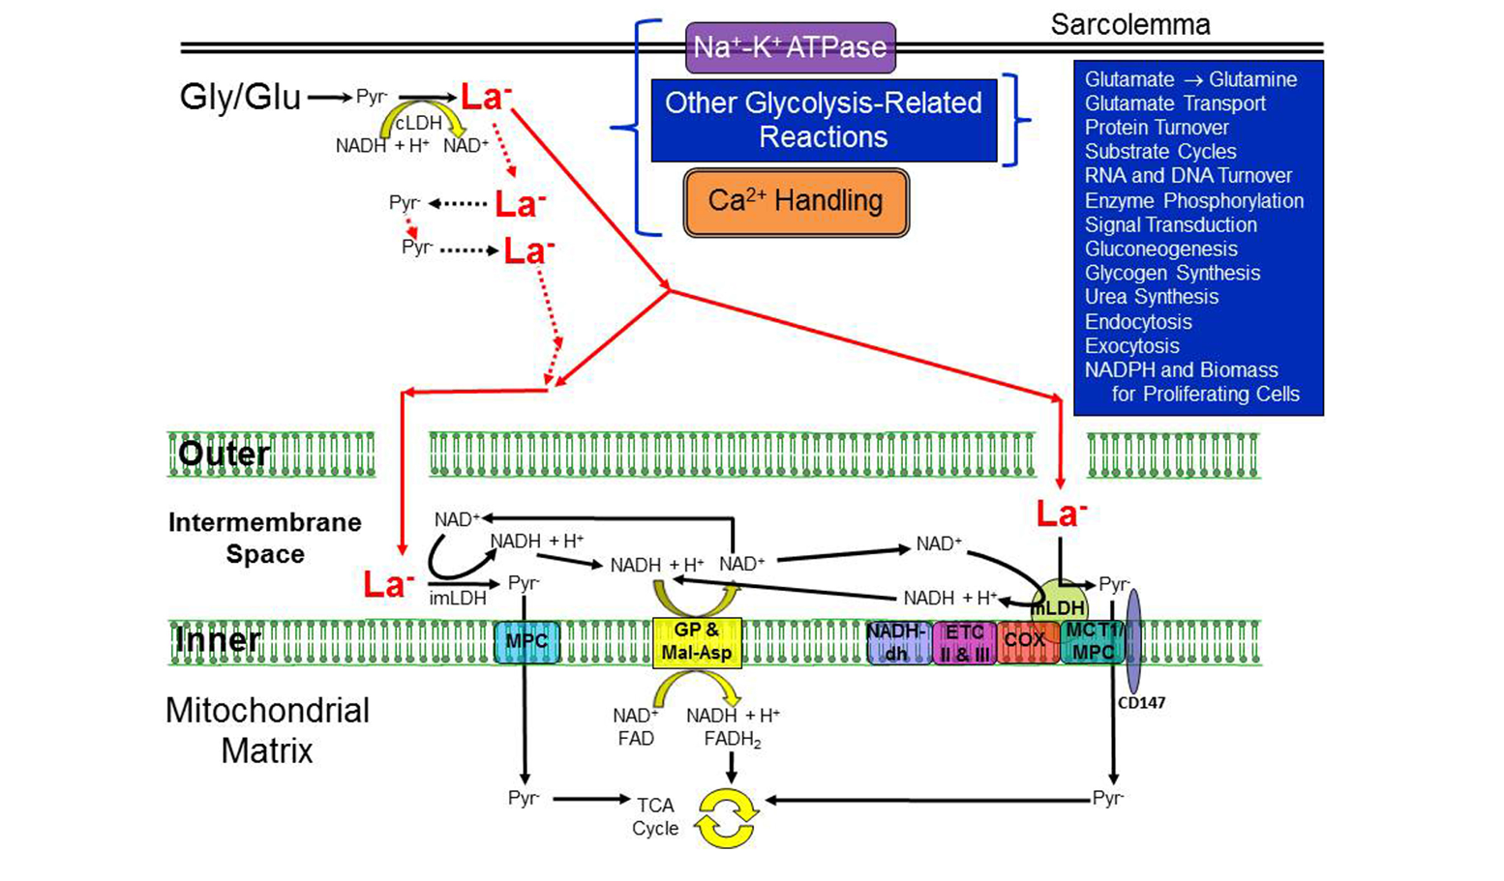
Rogatzki et al., 2015

Slide 10
1. ATP Resynthesis
2. Lactate „oxidation“
Processes of ATP-Synthesis
Anaerobic
Aerobic
Glucose
ß-Oxidation
Glycogen
⚡ATP ⚡
Citric Acid Cycle
⚡ATP/GTP ⚡
Lactate
⚡ATP ⚡
Electron Transport Chain
Notes:
First look at how lactate comes into the equation

Slide 11
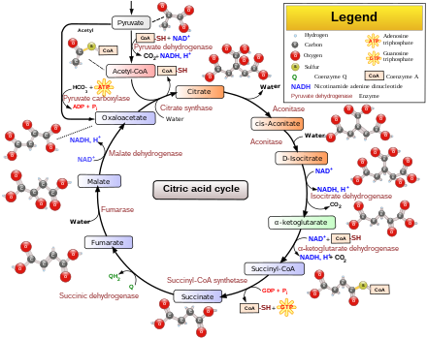
The Citric Acid Cycle
Can also come from fatty acids through ß-oxidation
Notes:
Two CO2 in the citric acid cycle
One CO2 from Pyruvate to Acetyl-CoA

Slide 12
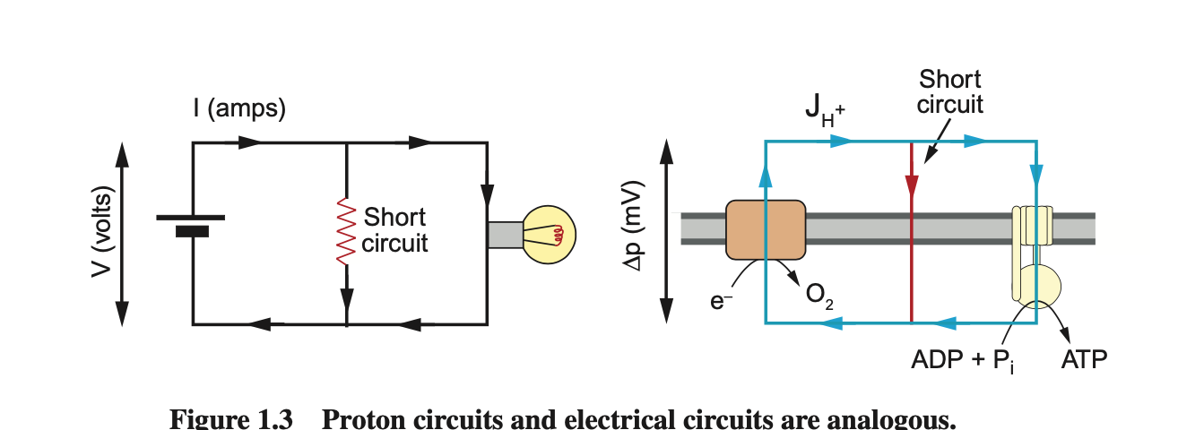
The Electron Transport Chain
Analogy between ATP-Synthesis Process and electrical circuits
NADH
Ferguson & Nicholls, 2013, Chapter 4

Slide 13
The Electron Transport Chain
Analogy between ATP-Synthesis Process and electrical circuits
10 H⁺
4 H⁺
1/2
NADH
10 / 4 = 2.5 -> 2.5 ATP per ½ O₂
1 mmol O₂ = 5 mmol ATP
22.4 ml O₂ = 5 mmol ATP
1ml O₂ = 0.223 mmol ATP
1 mmol O₂ = 22.4 ml (molaric gasvolume)
Ferguson & Nicholls, 2013, Chapter 4
Notes:
Based on the slide, can they work out, how much ATP we will get per piece of O2?
(Mader uses 2.6 instead of 2.5)

Slide 14
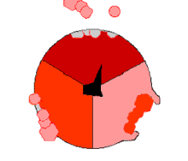
Rotating part of ATP-Synthase

Slide 15

1. ATP Resynthesis
2. Lactate „oxidation“
Processes of ATP-Synthesis
Anaerobic
Aerobic
1 mmol Lactate
1 ml O₂
1.4 mmol ATP
0.233 mmol ATP
1.4 / 0.233 = 6
Energetically in ATP-Equivalents:
Formation of 1 mmol Lactate is equivalent to 6 ml O2 respiration

Slide 16
1. ATP Resynthesis
2. Lactate „oxidation“
Processes of ATP-Synthesis
Anaerobic
Aerobic
1 mmol Lactate
1 ml O₂
1.4 mmol ATP
0.233 mmol ATP
1.4 / 0.233 = 6
Example:
75 kg, 45% La—Space
V̇O₂max = 60 ml/min/kg 60 * 75 * 0.233 = 1049 mmol/min
vLamax = 0.60 mmol/L/s 0.60 * 60 * 75 * 0.45 * 1.4 = 1701 mmol/min

Slide 17
VO2max vs. vLamax
Example:
75 kg, 45% La—Space
V̇O2max ml/min/kg | ATP V̇O2max mmol/min | vLamax mmol/L/s | ATP vLamax mmol/min
30 | 525 | 0.3 | 851
40 | 699 | 0.4 | 1134
50 | 874 | 0.5 | 1417
60 | 1049 | 0.6 | 1701
70 | 1224 | 0.7 | 1654
80 | 1399 | 0.8 | 1890
90 | 1574 | 0.9 | 2126
Generally lactic pathway the strongest - may be subject to individual differences!

Slide 18
VO2max vs. vLamax
Example:
75 kg, 45% La—Space
V̇O2max ml/min/kg | ATP V̇O2max mmol/min | vLamax mmol/L/s | ATP vLamax mmol/min | O2 vLamax ml/min/kg
30 | 525 | 0.3 | 851 | 48.69
40 | 699 | 0.4 | 1134 | 64.93
50 | 874 | 0.5 | 1417 | 81.16
60 | 1049 | 0.6 | 1701 | 97.39
70 | 1224 | 0.7 | 1654 | 113.63
80 | 1399 | 0.8 | 1890 | 129.86
90 | 1574 | 0.9 | 2126 | 146.09
Generally lactic pathway the strongest - may be subject to individual differences!

Slide 19
Summary (i)
Biochemical Steps (roughly)
1ml O₂ = 0.233 mmol ATP
NADH as electron donors to ETC
ATP comes from ETC (ATP-Synthase)
Flow of H⁺ “fuels“ ATP-Synthase
Keyword: Chemiosmotic Theory
Notes:
Next: Reaction of V̇O2 to exercise?

Slide 20
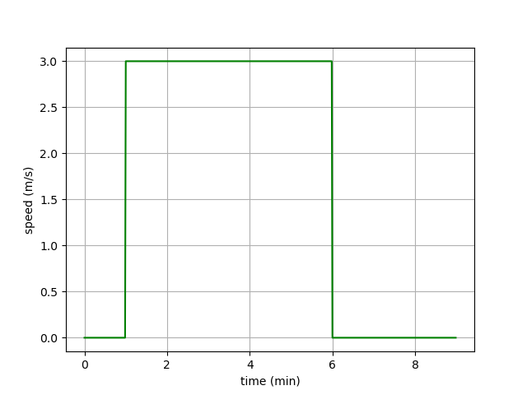
V̇O₂-Kinetics
Notes:
What will the V̇O2 response look like?
Onset and offset kinetics?
Quantitativ steady state response? = 3 * 12.5 + 3.5 = 41 ml/min/kg

Slide 21
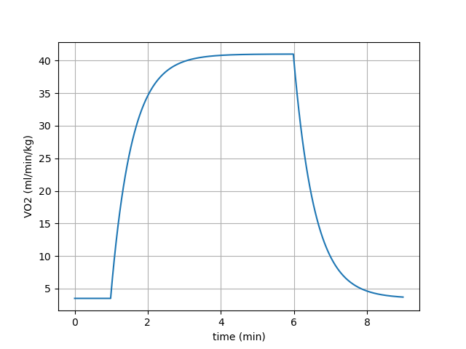
V̇O₂-Kinetics
V̇O₂-onset time
~2.5-3min
Notes:
T = 35s

Slide 22
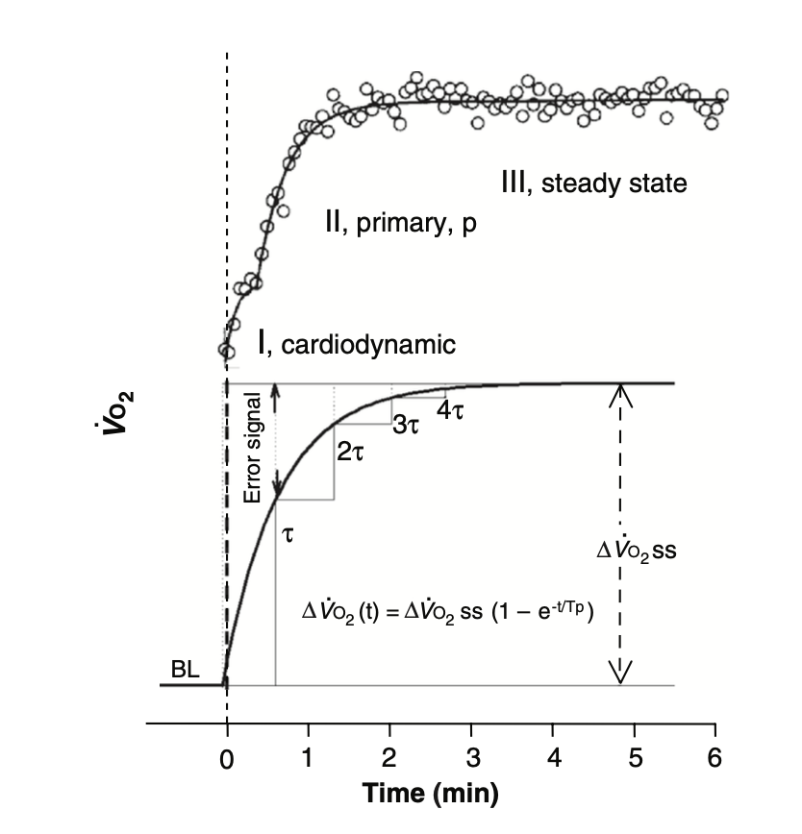
V̇O₂-Kinetics
Poole & Jones, 2012

Slide 23
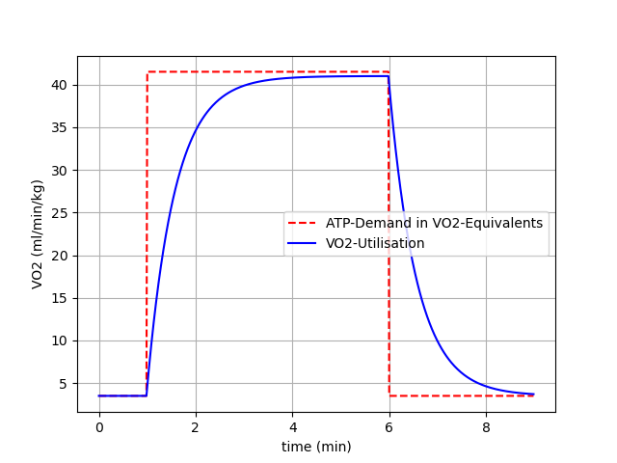
V̇O₂-Kinetics
Notes:
Missing area filled with anaerobic ATP supply (La and PCr)

Slide 24
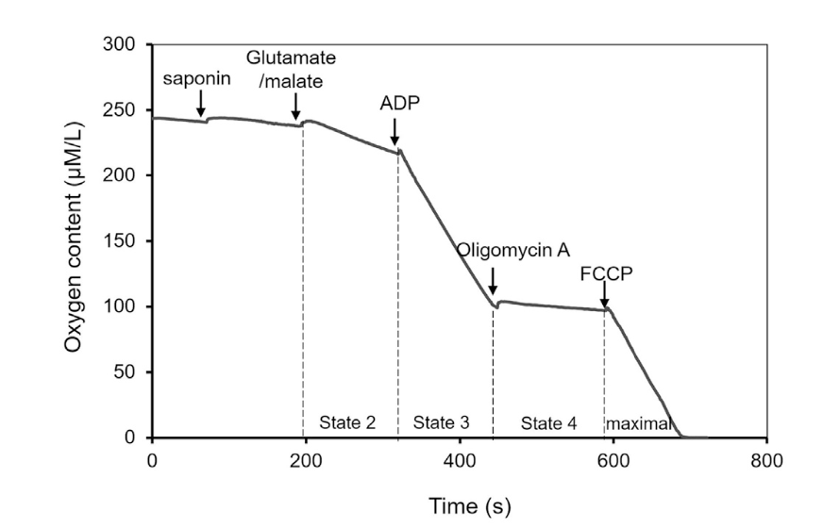
V̇O₂-Kinetics
_{[ADP] Control}
Gao et al., 2020
Notes:
FCCP entkoppler der mitochondrialen atmung von der ATP produktion -> Es wird plötzlich sehr schnell O2 verbraucht aber kein ATP produziert
Oligomycin A -> Gegenteil vom FCCP. Blockiert ATP synthase, sodass pmv sehr hoch wird und keine H+ ionen mehr geshuttelt werden, wodurch O2 zum erliegen kommt

Slide 25
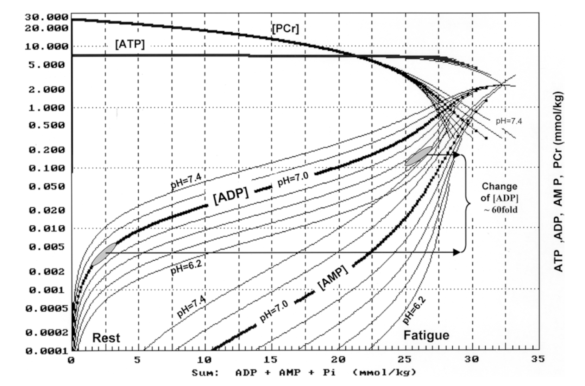
PCr Control for Glycolysis?
Logarithmic Scaling
Mader, 2003
Notes:
ADP and AMP increase by high margins! These molecules are able to fine tune the glycolytic activity!

Slide 26
V̇O₂-Kinetics
Glycolysis
Aerobic
Capacity
Inhibition
Power
H⁺
Activation
Activation
+
PCr
PCr
related to [ADP] & [AMP]
related to [ADP]
ATP

Slide 27
V̇O₂-Kinetics
Glycolysis
Aerobic
Capacity
Inhibition
Power
H⁺
Activation
Activation
+
PCr
PCr
related to [ADP] & [AMP]
related to [ADP]
ATP

Slide 28
V̇O₂-Kinetics
Glycolysis
Aerobic
Capacity
Inhibition
Power
H⁺
Activation
Activation
+
PCr
PCr
related to [ADP] & [AMP]
related to [ADP]
ATP

Slide 29
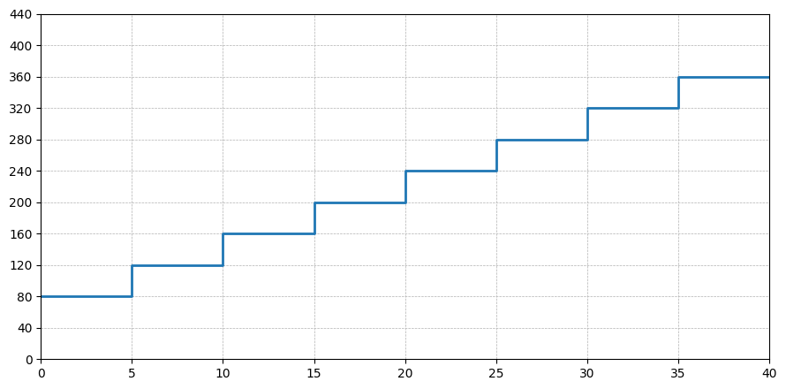
V̇O₂ during GXT
Mechanical Power (W)
Time (min)

Slide 30
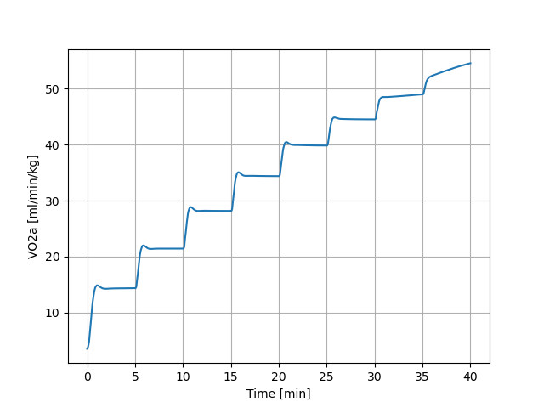
V̇O₂ during GXT

Slide 31
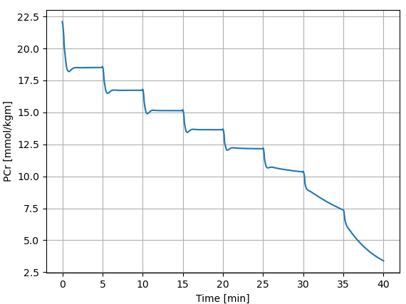
V̇O₂ during GXT

Slide 32
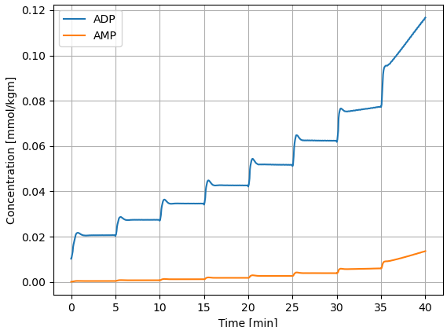
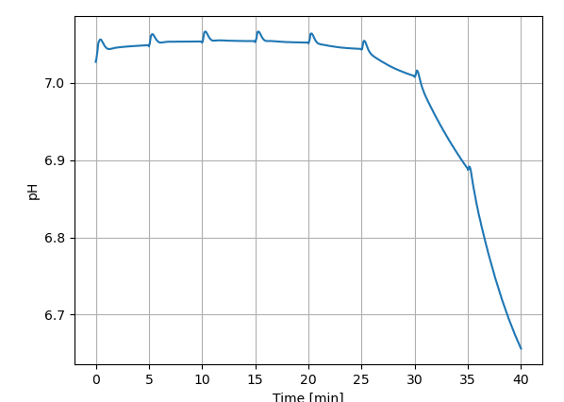
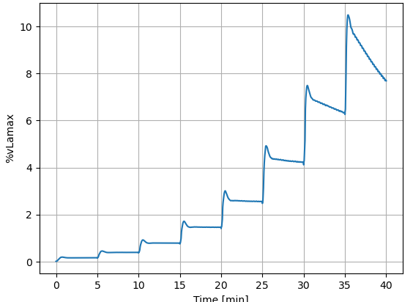
V̇O₂ during GXT

Slide 33
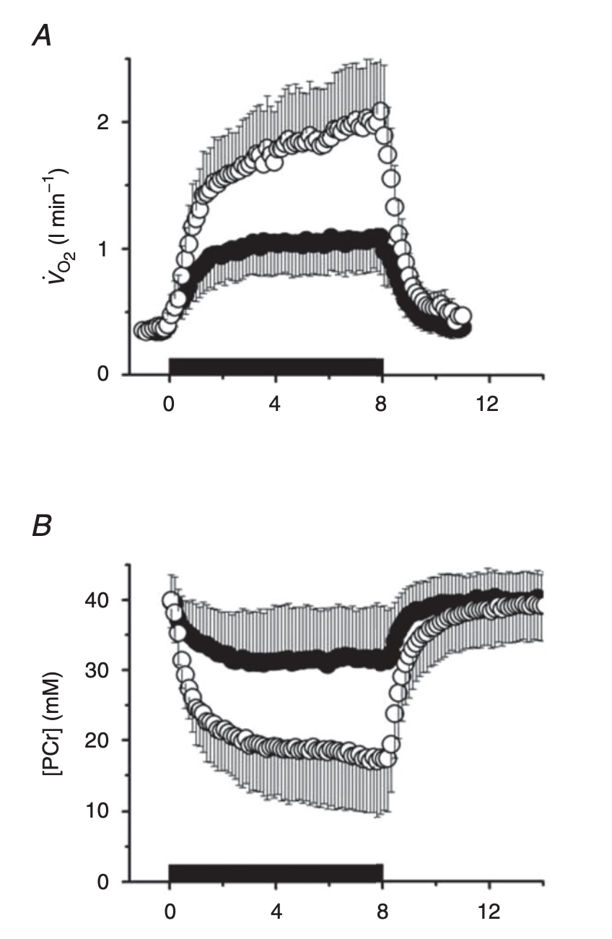
PCr and V̇O₂
Inertia (tau)
ADP
Cannon et al., 2016
Notes:
Knee Extension exercise with 31 PNMR and spirometry; moderate intensity filled circles, high intensity open circles;
magnetic field -> spin of nuclues reacts according to field -> field is turned of -> spins react back -> this is measured

Slide 34
Summary (ii)
V̇O₂-Kinetics
Rest -> Start of exercise -> Start of ATP-Breakdown -> PCr Breakdown to Resphorylate ADP to ATP -> Accumulation of ADP -> Positive Feedback to Aerobic Pathway (with inertia) -> Increase of V̇O₂ until steady state
Time to reach steady state ~2.5 – 3min
V̇O₂ss can be approximate based on efficiency and external load
Phases of V̇O₂-Response (onset):
  (i) Cardiopulmonary
  (ii) primary
  (iii) steady state
  (iv) ?
Notes:
What do they think?
Use this slide for short discussion!

Slide 35
1. ATP Resynthesis
2. Lactate „oxidation“
Processes of ATP-Synthesis
Anaerobic
Aerobic
Glucose
ß-Oxidation
Glycogen
⚡ATP ⚡
Citric Acid Cycle
⚡ATP/GTP ⚡
Lactate
⚡ATP ⚡
Electron Transport Chain
Notes:
Lets talk about the bridge between aerobic and glycolytic mechanism
Next slides: During the step test, how much lactate is oxidized and produced? How can we calculate this?

Slide 36
Oxidative Phosphorylation
How is V̇O₂ regulated?
How much ATP per O₂? 1ml O₂ ~1/4.3 = 0.233 mmol ATP
How much La is oxidized per O₂?

Slide 37
Oxidative Phosphorylation
How is V̇O₂ regulated?
How much ATP per O₂? 1ml O₂ ~1/4.3 = 0.233 mmol ATP
How much La is oxidized per O₂? 0.01576 mmol Lactate / ml O₂

Slide 38
1. ATP Resynthesis
2. Lactate „oxidation“
Processes of ATP-Synthesis
Anaerobic
Aerobic
Glucose
ß-Oxidation
Glycogen
⚡ATP ⚡
Citric Acid Cycle
⚡ATP/GTP ⚡
Lactate
⚡ATP ⚡
Electron Transport Chain
Notes:
Lets talk about the bridge between aerobic and glycolytic mechanism
Next slides: During the step test, how much lactate is oxidized and produced? How can we calculate this?

Slide 39
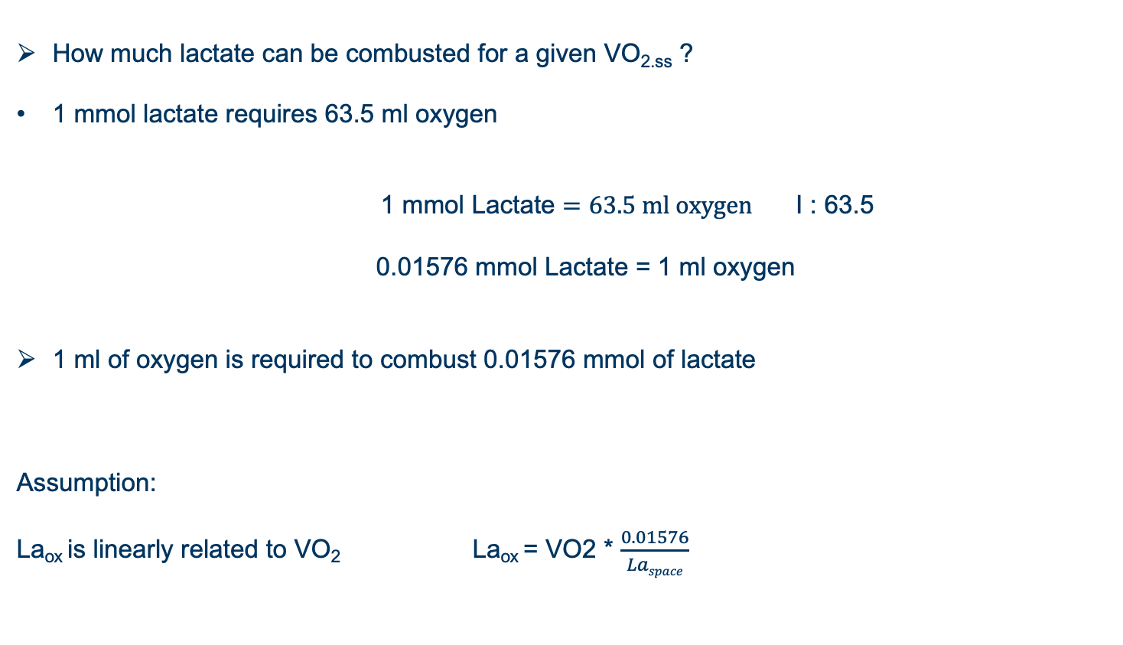
La⁻ Oxidation
How much lactate can be combusted for a given VO_{2.ss} ?
1 mmol lactate requires 63.5 ml oxygen
1 mmol Lactate $=63.5 ml oxygen$ I : 63.5
0.01576 mmol Lactate = 1 ml oxygen
1 ml of oxygen is required to combust 0.01576 mmol of lactate
Assumption:
La_{ox} is linearly related to VO₂ La_{ox} = VO2 * $\frac{0.01576}{Laspace}$
Mader, 2003

Slide 40
V̇O₂ during GXT

Slide 41
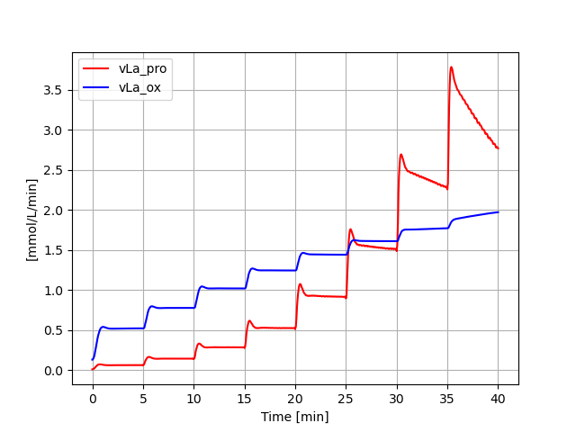
vLa, vLa.ox and Lactate during GXT

Slide 42
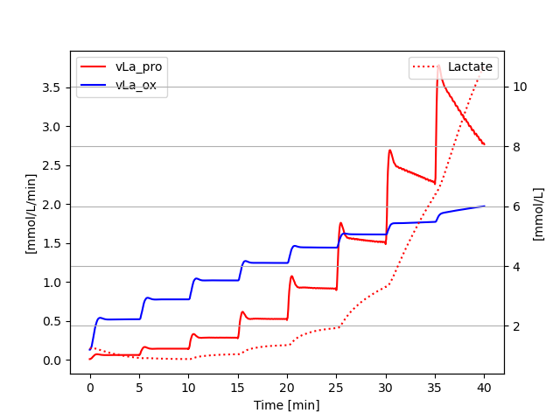
vLa, vLa.ox and Lactate during GXT

Slide 43
Submaximal Endurance Parameters
Metabolic origin of lactate concentration below AT
Lactate concentration result of lactate oxidation and lactate production
Lactate oxidation itself is limited by V̇O₂ss (size of pipe, potential maximum) and lactate concentration (pressure, fractional utilisation of maximum) itself
Lactate production
Lactate concentration
Lactate oxidation

Slide 44
vLa, vLa.ox and Lactate during GXT
Fat oxidation
Steady state
Non-Steady state
Transition

Slide 45
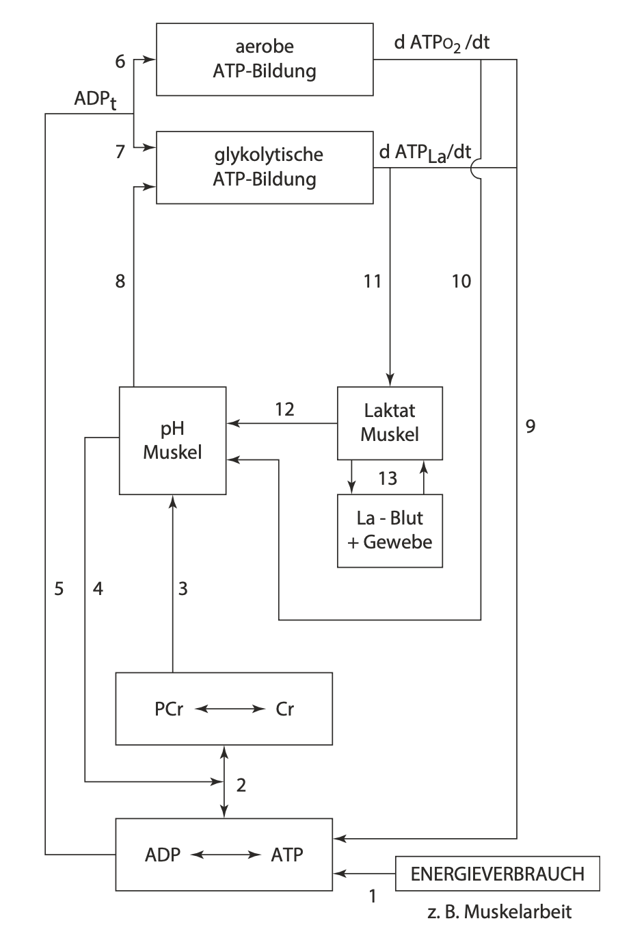
Summary
Aerobic ATP
Kausal chain of metabolic pathway activation/inhibtion as a function of ATP breakdown
How are these processes influenced by individual characteristics?
e.g. high/low V̇O₂max?
Glykolytic ATP
pH Muscle
Lactate active
Lactate passive
Energy utilisation through muscle contraction
Mod. from Heck, 1990 & Heck et al., 2022

Slide 46
Literature
Cannon DT, Bimson WE, Hampson SA, Bowen TS, Murgatroyd SR, Marwood S, Kemp GJ, Rossiter HB. Skeletal muscle ATP turnover by 31P magnetic resonance spectroscopy during moderate and heavy bilateral knee extension. J Physiol. 2014 Dec 1;592(23):5287-300. doi: 10.1113/jphysiol.2014.279174. Epub 2014 Oct 3. PMID: 25281731; PMCID: PMC4262339.
Gao M, Li A, Qin Y, Liu B, Gong G. Protocol for Measurement of Oxygen Consumption Rate In Situ in Permeabilized Cardiomyocytes. STAR Protoc. 2020 Jul 25;1(2):100072. doi: 10.1016/j.xpro.2020.100072. PMID: 33111108; PMCID: PMC7580108.
Heck, H., Schulz, H., Bartmus, U., Diagnostics of anaerobic power and capacity. EJSS, 2010, doi: 10.1080/17461390300073302
Mader, A. (2003). Glycolysis and oxidative phosphorylation as a function of cytosolic phosphorylation state and power output of the muscle cell.
Nicholls, D., Ferguson, S.J. Bioenergetics, 978-0123884251
Poole DC, Jones AM. Oxygen uptake kinetics. Compr Physiol. 2012 Apr;2(2):933-96. doi: 10.1002/cphy.c100072. PMID: 23798293.
Rogatzki MJ, Ferguson BS, Goodwin ML, Gladden LB. Lactate is always the end product of glycolysis. Front Neurosci. 2015 Feb 27;9:22. doi: 10.3389/fnins.2015.00022. PMID: 25774123; PMCID: PMC4343186.

Slide 47
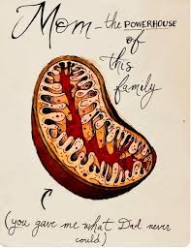
Homework
1.) Prepare to redraw [PCr], [ADP] & [AMP], pH and %vLamax during a GXT and explain the mechanistic link between the figures (similar to slide 35, Seminar 3).
2.) Calculate the ATP yield from two different V̇O₂max and vLamax of your own chosing.
3.) In bullet points: What is the relationship between V̇O2, [La⁻] and La_{ox}?
4.) Explain the following card:
Notes:
Nur frage 1 & 2

