Slide 1
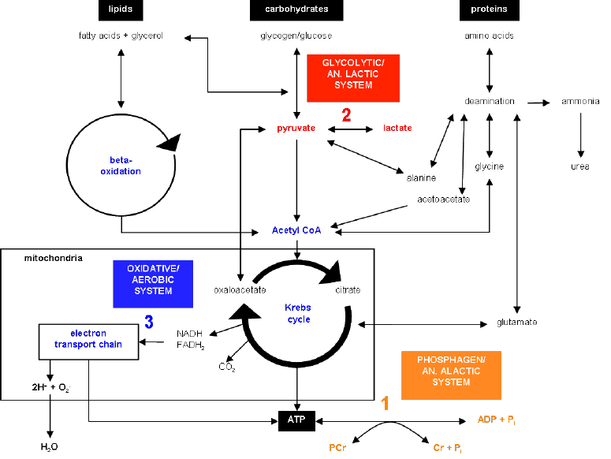
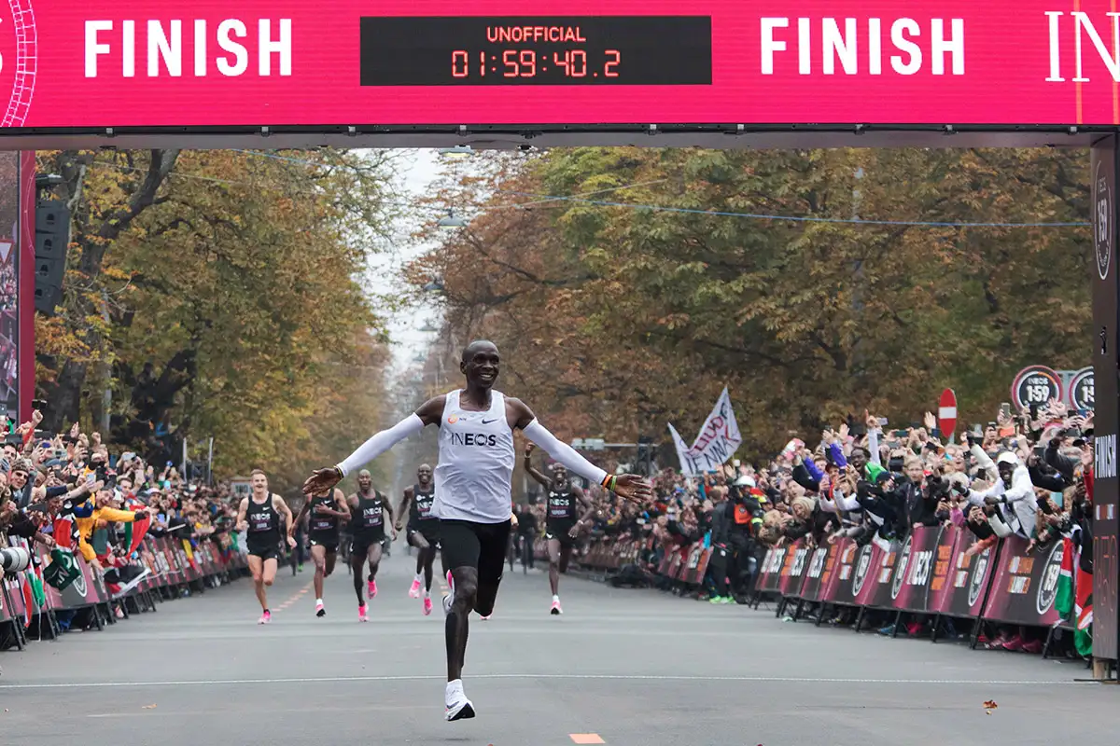
Applied Exercise Physiology & Sports Nutrition for Health & Performance
Anaerobic-Lactic Metabolism
Jasper Suttmeyer

Slide 2
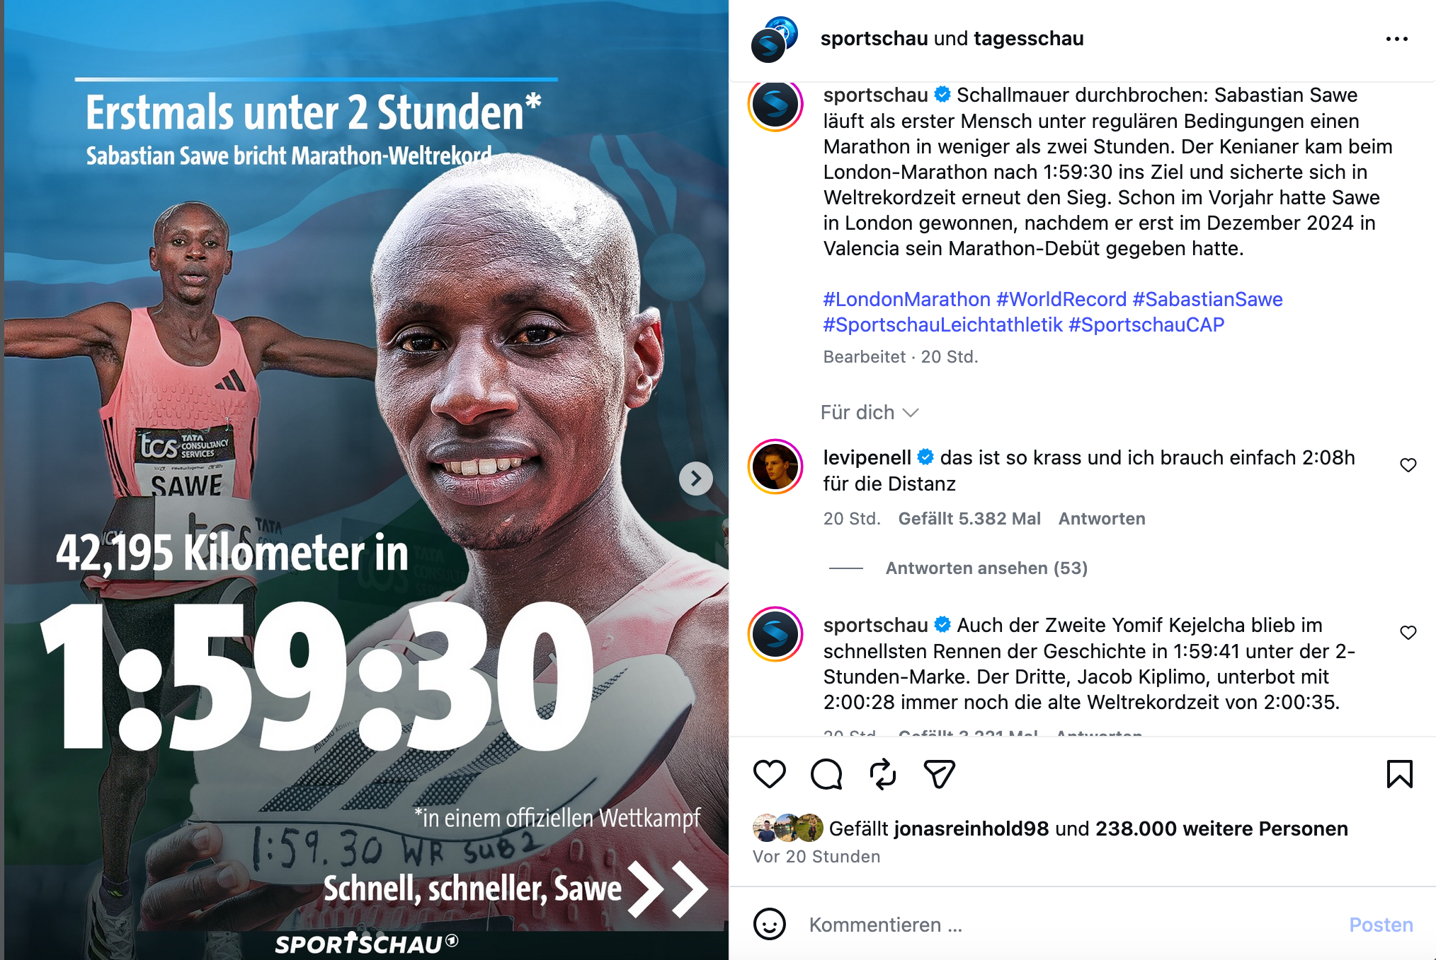
https://www.instagram.com/p/DXmE2Y0Deat/?img_index=1

Slide 3
Homework
1.) Calculate the metabolic demand in V̇O₂ (ml/min) equivalents on a bicycle ergometer for:
a.) 200W
b.) 400W
c.) 600W
2.) Make an educated guess regarding an athletes V̇O₂max that was able to push 420W for 4-minutes (body mass 75kg).
3.) Calculate the metabolic demand in vLa (mmol/L/s) equivalents on a bicycle ergometer for:
a.) 200W
b.) 400W
c.) 600W
4.) Describe the reason for contraction insufficiency once low values of [PCr] are reached.
5.) Make an educated guess: For each energy system, in which sport will it have the highest relevance?
Session 2, Slide 24
* 12.5 = 2500 ml/min
* 12.5 = 5000 ml/min
* 12.5 = 7500 ml/min
420 * 12.5 / 75 = 70 ml/min/kg -> - anaerobic contribution
Session 2, Slide 28
= 2500 / 75 / 2.7 / 60 = 0.21 mmol/L/s
= 5000 / 75 / 2.7 / 60 = 0.42 mmol/L/s
= 7500 / 75 / 2.7 / 60 = 0.63 mmol/L/s

Slide 4
Recap
Lactic-Anaerobic
Aerobic
Capacity
Power
Alactic-Anaerobic (ATP-PCr-System)
Usable
Sum of PCr & ATP
Not Usable
Contraction Insufficiency

Slide 5

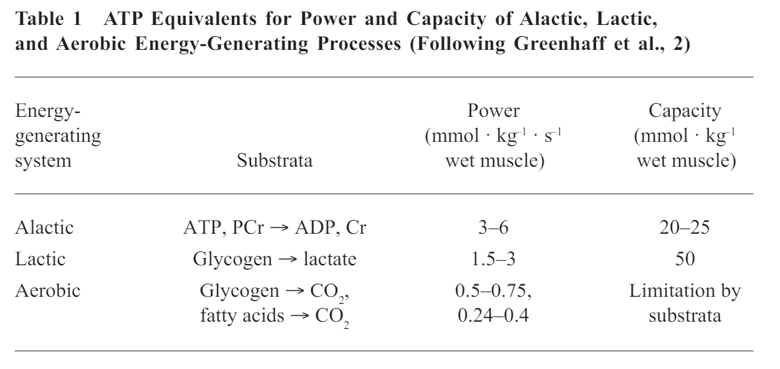
Recap
Todays Topic:
Deep Dive into Lactic Metabolism
„Keep it simple"
Aerobic
Lactic-Anaerobic
Capacity
Power
Alactic-Anaerobic
(ATP-PCr-System)
Heck et al., 2010

Slide 6
Complexity of biochemical pathways
Notes:
For us: Lets Try to reduce the complexity!

Slide 7
Processes of ATP-Synthesis
Anaerobic
Aerobic
Glucose
ß-Oxidation
Glycogen
⚡ATP ⚡
Citric Acid Cycle
⚡ATP/GTP ⚡
Lactate
⚡ATP ⚡
Electron Transport Chain
Notes:
Reduced Complexity,
Both Pathways are interconnected!

Slide 8
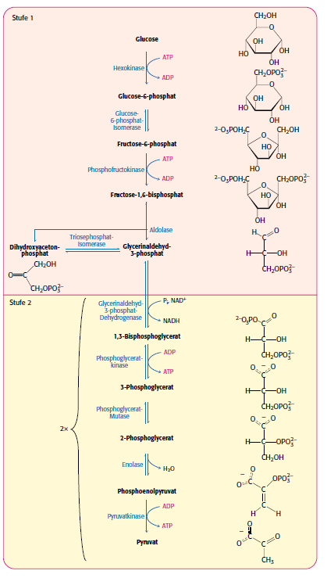
Glucose and Glycolysis
La⁻-
Stryer et al., 2018

Slide 9

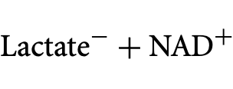
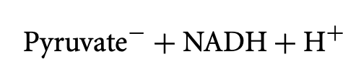

Glucose and Glycolysis
Historically Pyruvate has been treated as the endpoint of Glycolysis!
Lactate Dehydrogenase (LDH)
The biochemical equilibrium heavily
lies on the side of Lactate
Almost all Pyruvate is converted to Lactate!
LDH
K_{eq}= 1.62 * 10¹¹
1 mmol Pyruvate -> 162 000 000 000 mmol Lactate
(1s -> 5 000 years)
Rogatzki et al., 2015
Notes:
Pyruvate vs Lactate introduction!
162 000 000 000 -> billion

Slide 10
Glucose and Glycolysis
Regeneration of NADH to keep Glycolysis
running!
La⁻-
Rogatzki et al., 2015
Notes:
Pyruvate vs Lactate introduction!

Slide 11
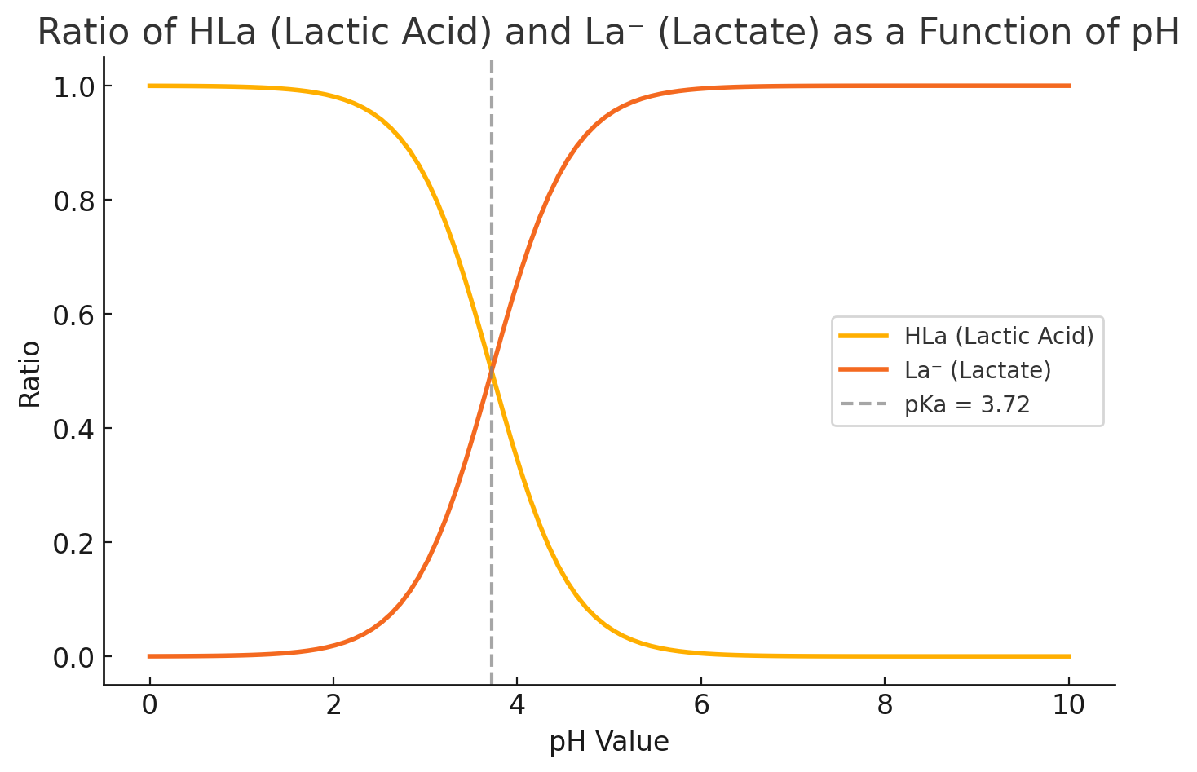
Side Note: Lactate vs Lactic Acid
Lactic Acid: HLa
Lactate: La⁻
1 Glucose
-1 ATP
1 Glycogen*
HLa La⁻ + H⁺
pKs = 3.72
-1 ATP
+2 ATP
+2 ATP
2 Lactic Acid
Physiological Range (intramuscular)
Notes:
Pyruvate vs Lactate introduction!

Slide 12
Glucose and Glycolysis
La⁻-
Stryer et al., 2018

Slide 13
Glucose and Glycolysis
2 ATP
+ 4 ATP
___________
+ 2 ATP
1 ATP
La⁻-
Stryer et al., 2018

Slide 14
Glucose and Glycolysis
2 ATP
+ 4 ATP
___________
+ 2 ATP
1 ATP
+ 1 ATP / La
La⁻-
Stryer et al., 2018

Slide 15
Glucose and Glycolysis
Glycogen
2 ATP
+ 4 ATP
___________
+ 2 ATP
1 ATP
+ 4 ATP
___________
+ 3 ATP
1 ATP
+ 1 ATP / La
La⁻-
Stryer et al., 2018

Slide 16
Glucose and Glycolysis
2 ATP
+ 4 ATP
___________
+ 2 ATP
Glycogen
1 ATP
+ 4 ATP
___________
+ 3 ATP
1 ATP
La⁻-
Stryer et al., 2018

Slide 17
Glucose and Glycolysis
2 ATP
+ 4 ATP
___________
+ 2 ATP
1 ATP
+ 4 ATP
___________
+ 3 ATP
1 ATP
+ 1.5 ATP / La
+ 1 ATP / La
La⁻-
Stryer et al., 2018
Notes:
Glycogen phosphorlytically
Glucose hydrolytically

Slide 18
Glucose and Glycolysis
ATP yield depends on glucose or glycogen use
Good estimate: 1.4 ATP / Lactate

Slide 19
Rate Limitation of Glycolysis
Heck et al., 2010
What is the rate limiting factor of ATP Production in Glycolysis?
Need to look at the different steps of glycolysis isolated and find the slowest one!
PFK is the key regulatory enzyme in the Pathway!
La⁻-
Stryer et al., 2018
Notes:
Does anybody have an Idea how we can find this?

Slide 20
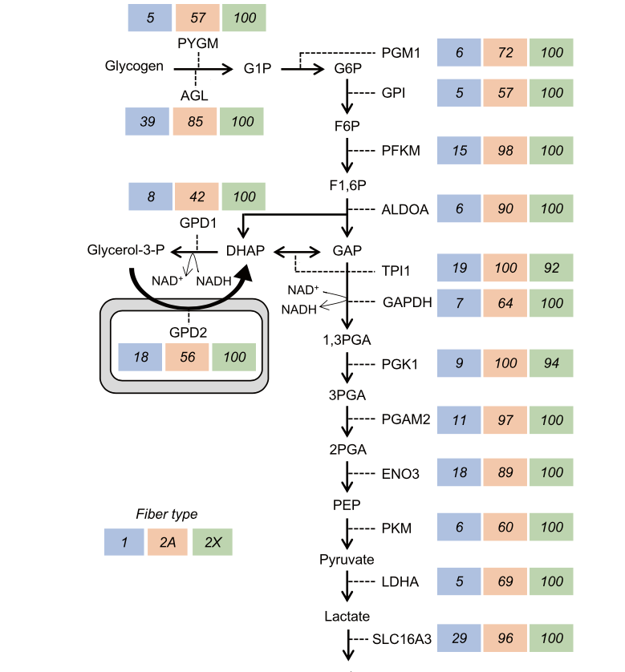
Most abundant in Type IIx fibres
Murgia et al., 2021
Notes:
Relative quantity of enzymes based on fibres

Slide 21
Glucose and Glycolysis
What is the rate limiting factor of ATP Production in Glycolysis?
More Enzymes -> More ATP Production
More Process can occur in parallel
When looking at the enzyme level PFK will give the best index of the anerobic pathway!
1 Glucose
-1 ATP
-1 ATP
Key Enzyme:
Phosphofruktokinase (PFK)
+2 ATP
Activation
+2 ATP
ADP, AMP, P_{i}
2 Lactate + 2 H⁺
Inhibition
ATP, H⁺

Slide 22
Integration into our Model
Lactic-Anaerobic
Aerobic
Capacity
Power
Alactic-Anaerobic (ATP-PCr-System)
Usable
Sum of PCr & ATP
Not Usable

Slide 23
Integration into our Model
Glycolysis
Capacity
How is the ATP Production of Glycolysis controlled?
Power
Feedback-Control
PCr Concentration indirectly controls glycolytic activity
Alactic-Anaerobic
(ATP-PCr-System)
PCr
ATP
Contraction Insufficiency
Notes:
Ask if they have any idea what the control could look like?

Slide 24
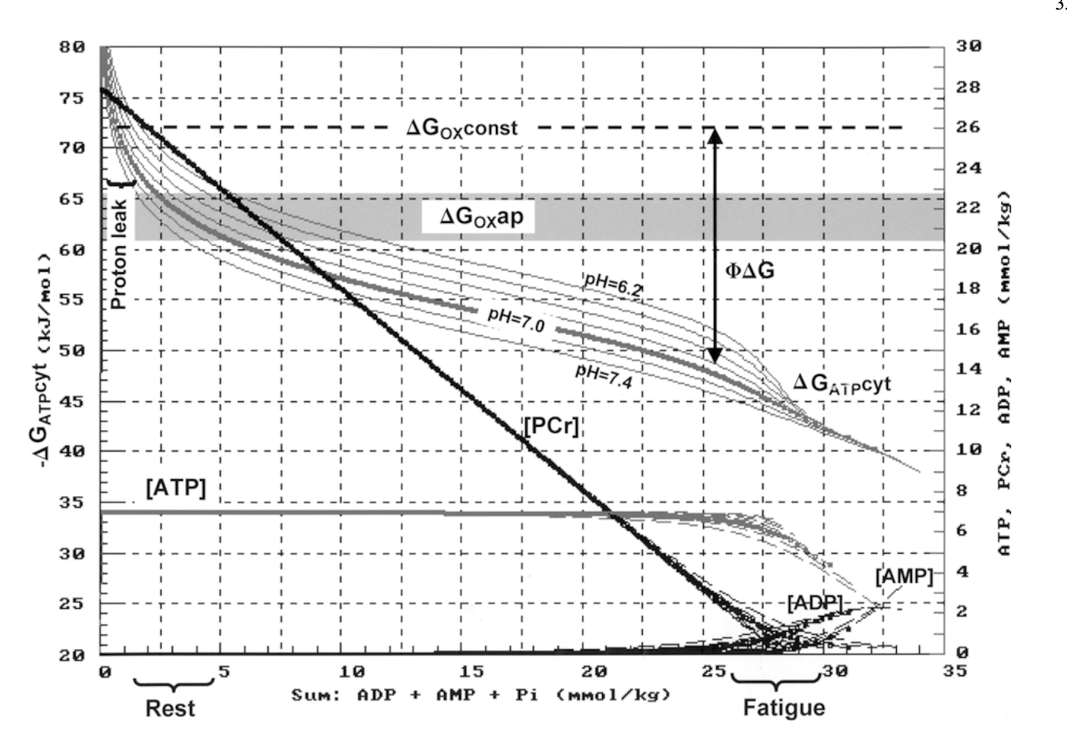
PCr Control for Glycolysis?
ATP Energy yield
PCr Range
Mader, 2003
Notes:
PCr Range from 4 – 23 mmol/kgm (5-6 Times increase, this is not enough for a fine tuned metabolic control) -> not possible!

Slide 25
PCr Control for Glycolysis?
ATP Energy yield
What is happening with ADP and AMP here?
Mader, 2003
Notes:
Problem with the scaling of the axis…

Slide 26
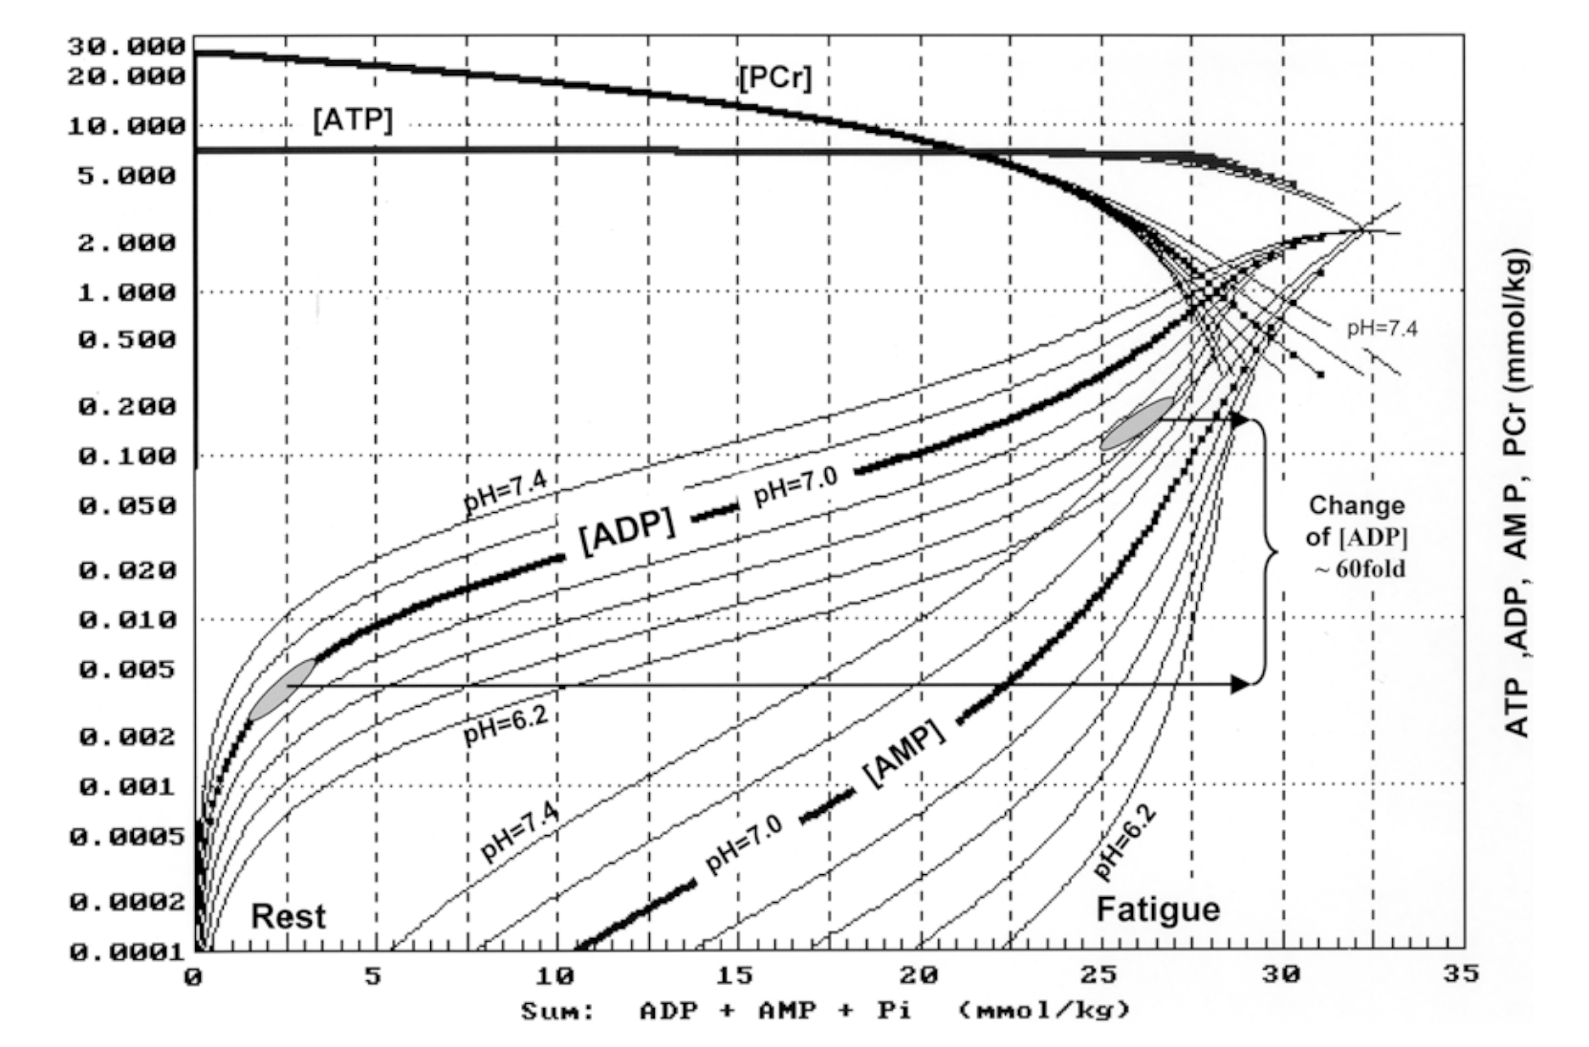
PCr Control for Glycolysis?
Logarithmic Scaling
Mader, 2003
Notes:
ADP and AMP increase by high margins! These molecules are able to fine tune the glycolytic activity!

Slide 27
Integration into our Model
Glycolysis
Capacity
Power
Feedback-Control
Alactic-Anaerobic
(ATP-PCr-System)
PCr
related to [ADP] & [AMP]
ATP
Contraction Insufficiency
Notes:
Limit of C

Slide 28
Integration into our Model
Glycolysis
How is the ATP Production of Glycolysis controlled?
PCr Concentration indirectly controls glycolytic activity
Capacity
Power
Feedback-Control
Alactic-Anaerobic
(ATP-PCr-System)
PCr
related to [ADP] & [AMP]
ATP
Heck et al., 2010
Notes:
Nur bis hierhin gekommen

Slide 29

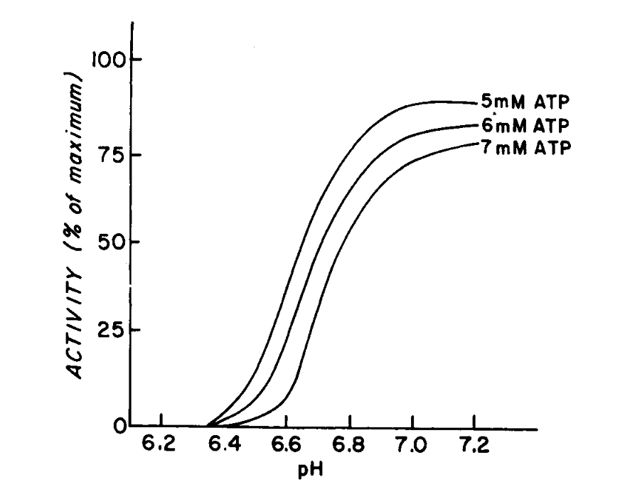
Regulating effect of pH on Glycolysis
Activation
ADP & AMP
H⁺
1 Glucose
1 Glycogen
-1 ATP
Inhibition
-1 ATP
Key Enzyme:
Phosphofruktokinase (PFK)
+2 ATP
Inhibition!
+2 ATP
2 Lactate + 2 H⁺
Danforth, 1965

Slide 30
Integration into our Model
Glycolysis
Capacity
Inhibition
H⁺ Concentration
Power
H⁺
Activation
Alactic-Anaerobic
(ATP-PCr-System)
PCr
related to [ADP] & [AMP]
+
ATP
Contraction Insufficiency
Notes:
Limit of C

Slide 31
Integration into our Model
Glycolysis
Capacity
Inhibition
H⁺ Concentration
Power
H⁺
Activation
Alactic-Anaerobic
(ATP-PCr-System)
PCr
related to [ADP] & [AMP]
+
ATP
.
.
.
PCr = ATP_{Glycolysis} - ATP_{used}
Contraction Insufficiency
Notes:
Limit of C

Slide 32
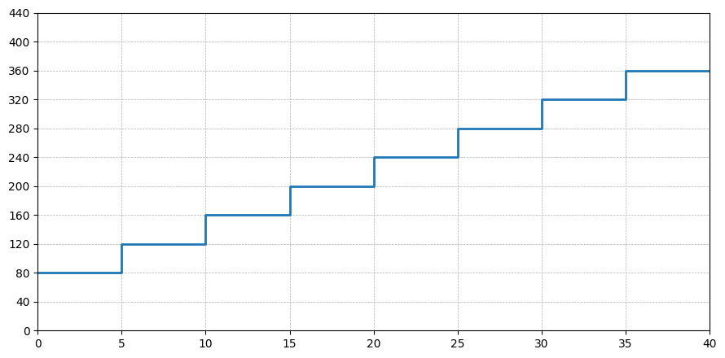
Glycolytic Activity during GXT
Mechanical Power (W)
Time (min)

Slide 33
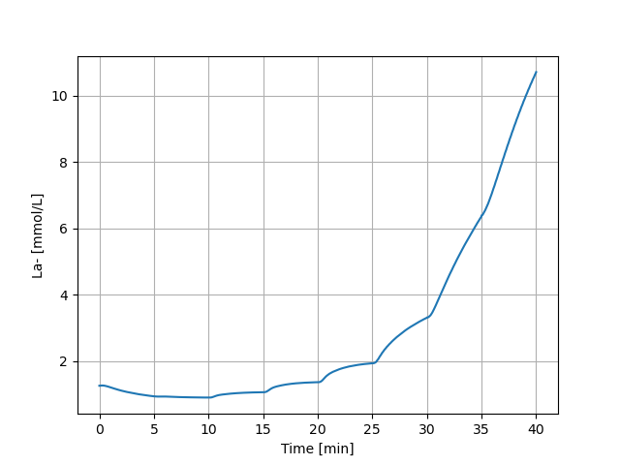
Glycolytic Activity during GXT

Slide 34
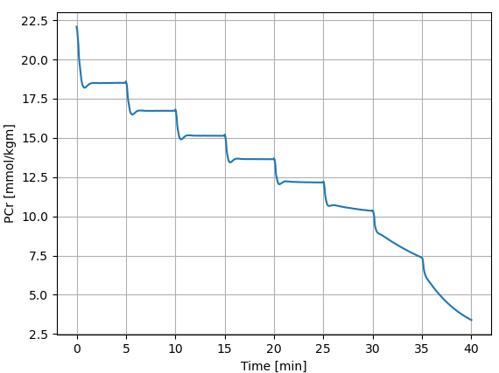
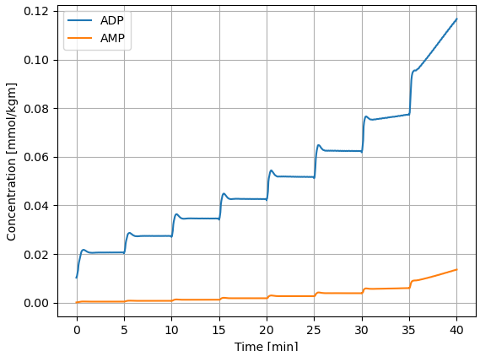
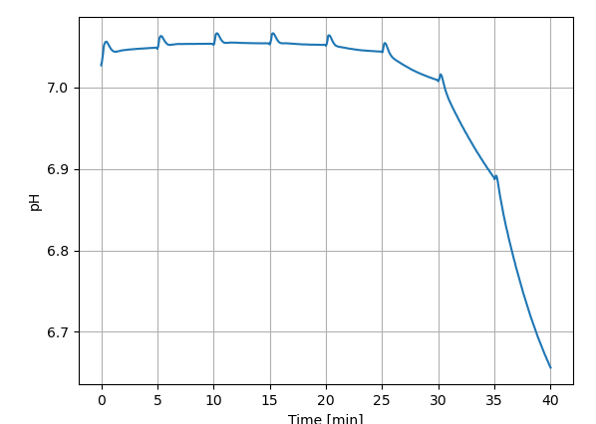
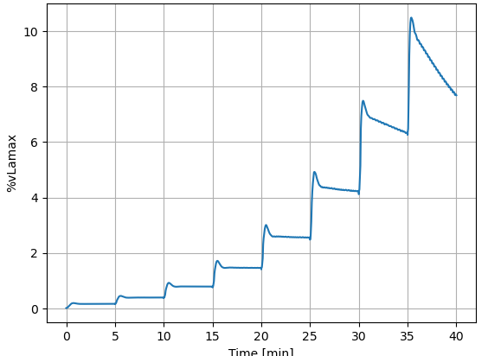
Glycolytic Activity during GXT

Slide 35
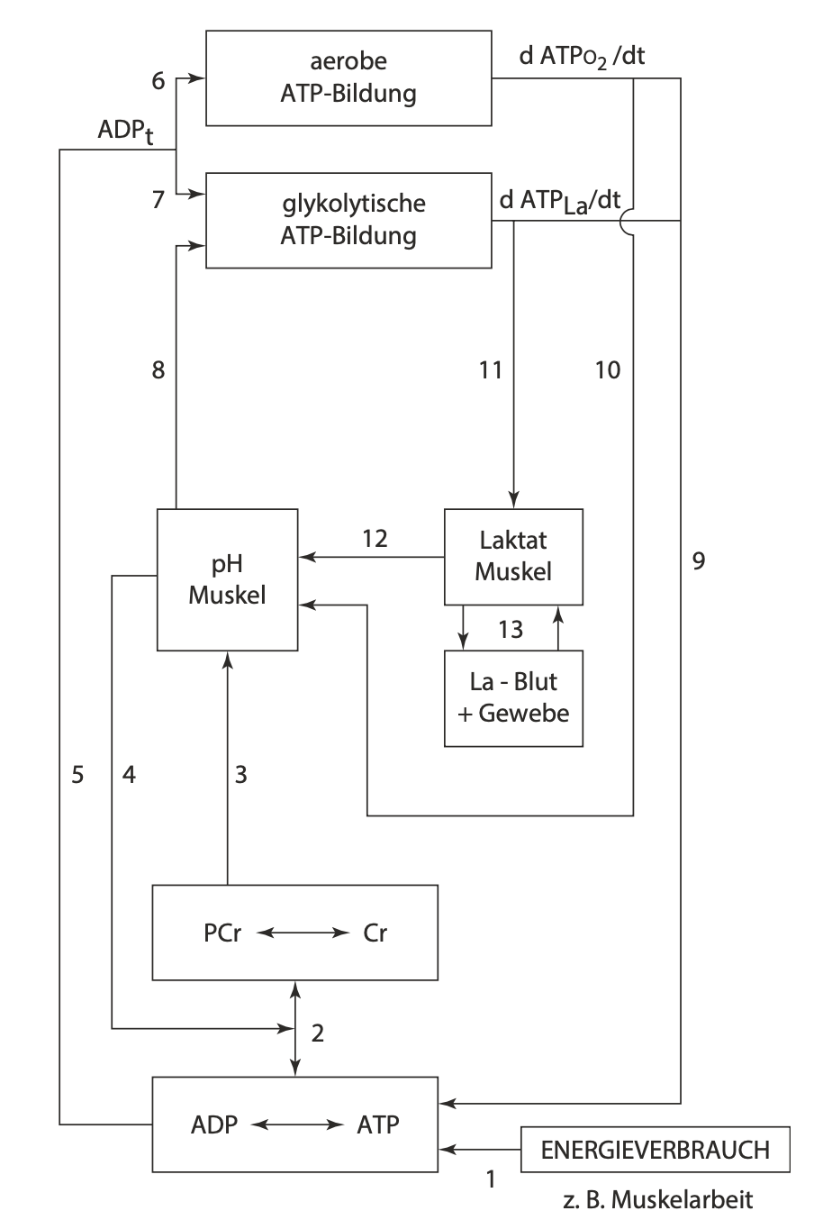
Release of Energy
How is the release of energy controlled during exercise?
Aerobic ATP
Glykolytic ATP
pH Muscle
Lactate active
Lactate passive
Energy utilisation through muscle contraction
Mod. from Heck, 1990 & Heck et al., 2022

Slide 36

Summary
ATP yield depends on glucose or glycogen use
Good estimate: 1.4 ATP / Lactate
Lactate vs Lactic Acid
Key Regulator of Glycolysis
ATP, H⁺, ADP, AMP on Glycolysis (PFK)
Integration of Glycolysis to sophisticated model

Slide 37
Literature
Heck, H., Schulz, H., Bartmus, U., Diagnostics of anaerobic power and capacity. EJSS, 2010, doi: 10.1080/17461390300073302
Mader, A. (2003). Glycolysis and oxidative phosphorylation as a function of cytosolic phosphorylation state and power output of the muscle cell.
Murgia M, Nogara L, Baraldo M, Reggiani C, Mann M, Schiaffino S. Protein profile of fiber types in human skeletal muscle: a single-fiber proteomics study. Skelet Muscle. 2021 Nov 2;11(1):24. doi: 10.1186/s13395-021-00279-0. PMID: 34727990; PMCID: PMC8561870.
Rogatzki MJ, Ferguson BS, Goodwin ML, Gladden LB. Lactate is always the end product of glycolysis. Front Neurosci. 2015 Feb 27;9:22. doi: 10.3389/fnins.2015.00022. PMID: 25774123; PMCID: PMC4343186.
Stryer (2018). Stryer Biochemie, https://doi.org/10.1007/978-3-662-54620-8

Slide 38
Homework
1.) Answer in your own words: Can Lactate act as a buffer to stabilize pH under physiological conditions in the human muscle?
2.) Why is the overall ATP-yield during glycolysis higher with glycogen compared to glucose?
3.) Prepare to redraw [PCr], [ADP] & [AMP], pH and %vLamax during a GXT and explain the mechanistic link between the figures (similar to slide 30).
Notes:
Nur frage 1 & 2

Slide 39
Appendix -> Breakdown of Glycogen,
Further Reading: Stryer Biochemie Chapter 21 „Der Glykogenstoffwechsel“ / „Glycogen Metabolism“ (I have the 8. Edition, may be a different chapter in newer/older versions)
(should be available at the faculties library)

Slide 40
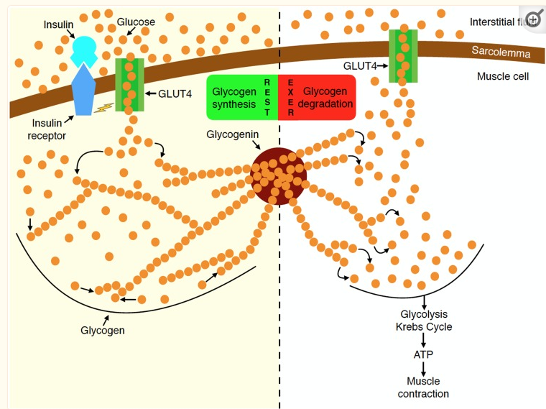
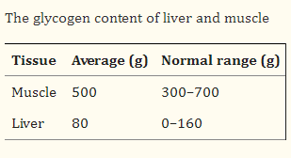
Glucose and Glycogen
Glucose is the monomer of glycogen
Glycogen is therefore a more efficient way
of storing glucose
Unlike glucose, glycogen is not osmotically
active
Glycogenin forms the center of Glycogen
>50 000 glucose molecules per particle of
glycogen
Each gramm of glycogen is stored with at
least 3g of water
Murray & Rosenbloom, 2018
Notes:
Transfer from one muscle to the other not possible

Slide 41
Breakdown of Glycogen
= Glucose-residues
alpha-1,6-Bond
alpha-1,4-Bond
Glycogen-Phosphorylase
Notes:
Can break 1,4-bonds but not 1,6 bonds;
Every 8 - 12 bonds one alpha-1,6-bond

Slide 42
Breakdown of Glycogen
Glucose - 6 - Phosphat
Enzyme:
Glucosephosphat-Mutase
(no ATP needed)
alpha-1,6-Bond
alpha-1,4-Bond
Glycogen-Phosphorylase
Notes:
Can break 1,4-bonds but not 1,6 bonds

Slide 43
Breakdown of Glycogen
Glycogen-Phosphorylase
Alpha-1,6-Glucosidase
Transferase
alpha-1,6-Bond
alpha-1,4-Bond
Notes:
Can break 1,4-bonds but not 1,6 bonds

Slide 44
Breakdown of Glycogen
Glycogen-Phosphorylase
Transferase
Alpha-1,6-Glucosidase
alpha-1,6-Bond
alpha-1,4-Bond
Notes:
Can break 1,4-bonds but not 1,6 bonds

Slide 45
Breakdown of Glycogen
Glycogen-Phosphorylase
Alpha-1,6-Glucosidase
alpha-1,6-Bond
Transferase
alpha-1,4-Bond
Notes:
Can break 1,4-bonds but not 1,6 bonds

Slide 46
Breakdown of Glycogen
Alpha-1,6-Glucosidase
Glycogen-Phosphorylase
alpha-1,6-Bond
Transferase
alpha-1,4-Bond
Notes:
Can break 1,4-bonds but not 1,6 bonds

Slide 47
Breakdown of Glycogen
1 ATP needed
Glucose - 6 - Phosphat
Alpha-1,6-Glucosidase
Glucose
alpha-1,6-Bond
Transferase
alpha-1,4-Bond
Glycogen-Phosphorylase
Notes:
Can break 1,4-bonds but not 1,6 bonds

Slide 48
Overall ATP-Gain from Glycolysis per
Pyruvate/Lactate
Glucose: 1 ATP per Lactate
Glycogen: 1.5 ATP per Lactate
If only glycogen is metabolized...
Every 8 - 12 bonds an alpha-1,6-bond occurs, therefore we can make the following calculation
(n_{Glycogen} * 1.5 + n_{Glucose} * 1) / (n_{Glycogen} + n_{Glucose}) = ATP per Lactate
Every 8 bonds
Every 12 bonds
(7 * 1.5 + 1 * 1) / (7 + 1) = 1.44 ATP per Lactate
(11 * 1.5 + 1 * 1) / (12) = 1.46 ATP per Lactate

