Slide 1
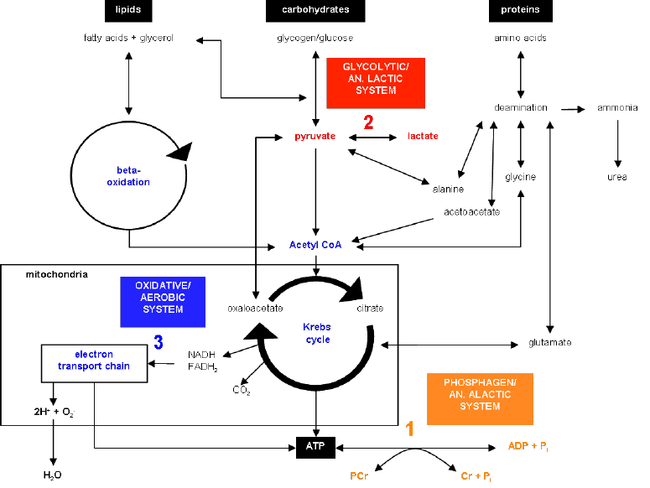
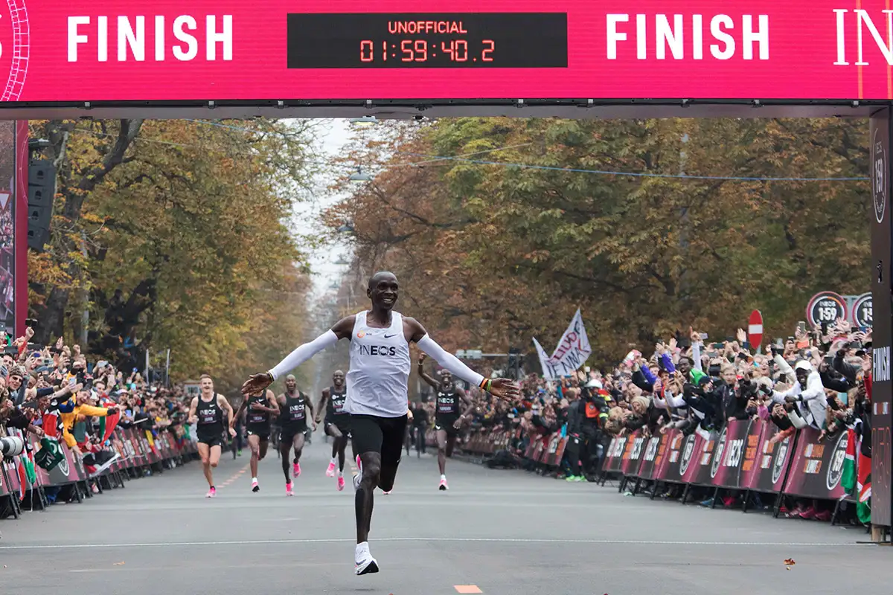
Applied Exercise Physiology & Sports Nutrition for Health & Performance
Introduction to Energy Metabolism
Jasper Suttmeyer

Slide 2


Summary Joyner Model
V̇O₂max
%V̇O₂max
at LT
Running Economy
Marathon Performance
Physiological Basis for the input Parameters?
Underlying Assumptions?
How is Fatigue induced?
Can the model also predict other distances?
Focus purely on aerobic pathways?
Need for a more sophisticated evaluation of endurance performance!
Yet helpful due to its simplicity
Notes:
What is the physiological basis of the different input parameters? What are the underlying assumptions? How is Fatigue induced? What is happening with different distances? Fokus purely on aerobic pathways?
What is the basis of movement? What do we need?

Slide 3
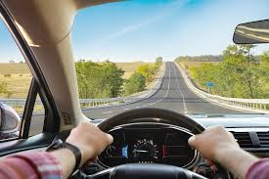
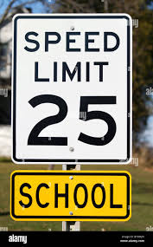
Release of Energy
How does a closed-loop-feedback mechanism work?

Slide 4
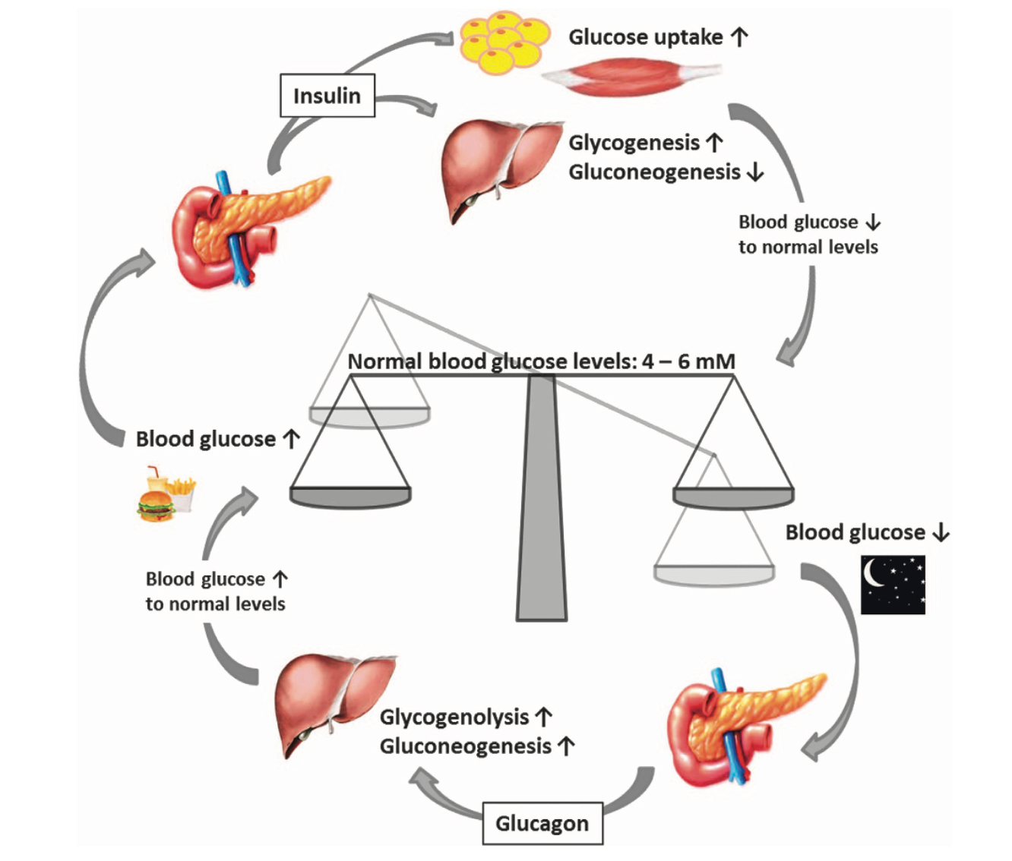
Release of Energy
How does a closed-loop-feedback mechanism work?
Röder et al., 2016

Slide 5
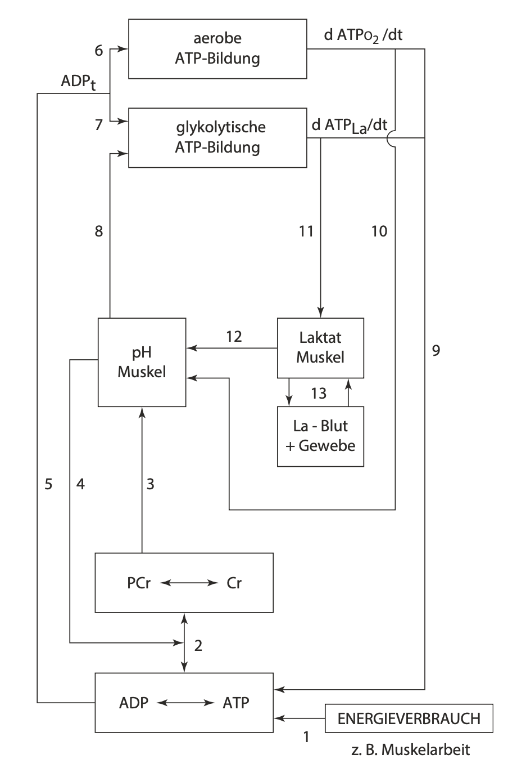
Release of Energy
How is the release of energy controlled during exercise?
Aerobic ATP
Glykolytic ATP
pH Muscle
Lactate active
Lactate passive
Energy utilisation through muscle contraction
Mod. from Heck, 1990 & Heck et al., 2022
Notes:
Do not talk so much about this. Rather make clear that it is the goal of the session to understand this

Slide 6
Release of Energy
Reactant
Product
ATPase
ATP
ADP + P_{i}
Reaction yields 45 – 65 kJ/mol
(10.7 – 15.5 kcal/mol)
Storage Capacity of ATP
~7 mmol/kgm
ATP Turnover can increase ~150-fold during exercise
Average grown man produces around 100kg ATP per day
Heck et al., 2022
Notes:
Answer Gibbs Energy and Displacement from equilibrium

Slide 7
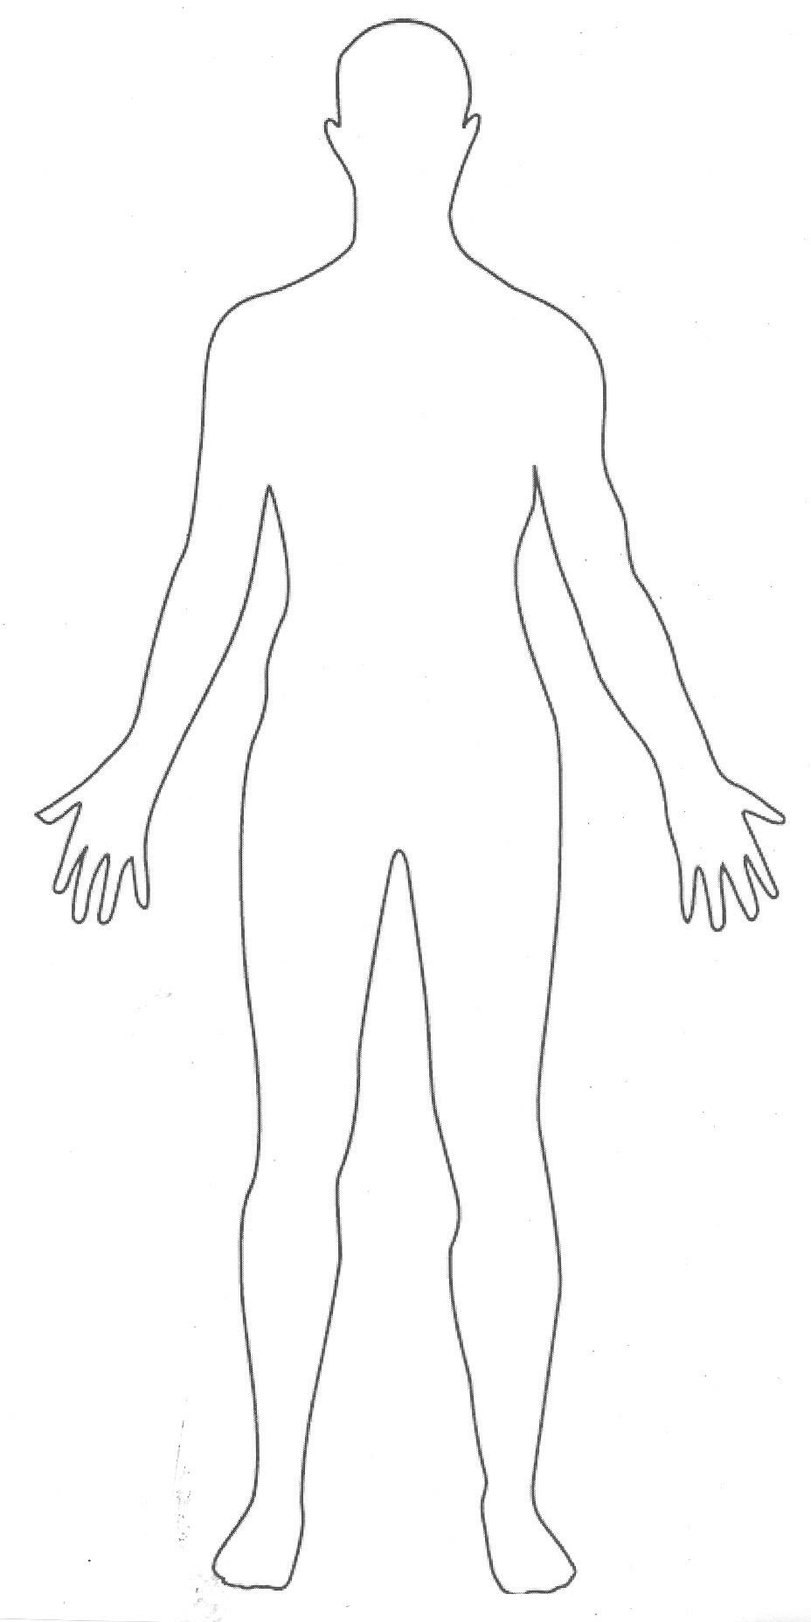
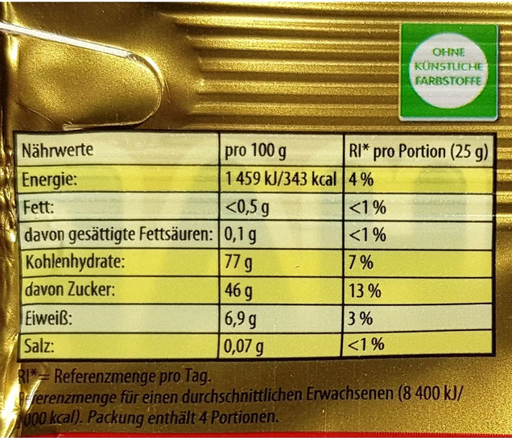
Storage Capacity ATP
Assumptions
70kg Athlete
40% Muscle Mass
Calculation of ATP Storage Capacity
70 * 0.4 * 7 = 196 mmol ATP
196 * 55/1000 = 10.78 kJ
Notes:
Answer Gibbs Energy and Displacement from equilibrium, One can refill their ATP stores energetically equivalent with one gummy bear three times

Slide 8
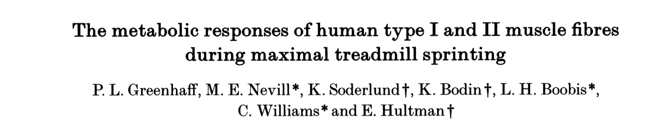


ATP Pool
What happens after ATP Pool is empty?
1st Biopsy
30sec Sprint
2nd Biopsy

Slide 9
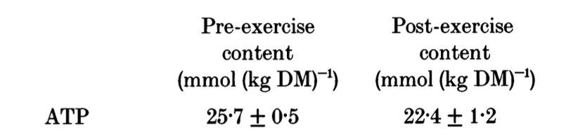

ATP Pool
What happens after ATP Pool is empty?
1st Biopsy
30sec Sprint
2nd Biopsy
ATP-Concentration remains relatively constant!
Greenhaff et al., 1994

Slide 10
ATP Pool
Resting Condition
ca. 196 mmol ATP
(7 mmol/kgm)
How much ATP is needed for 30s Sprint? (Assumption 200m)
ca. 84 ATP mmol/s (or 3 mmol/kgm/s)

Slide 11
ATP Pool
Resting Condition
ca. 196 mmol ATP
(7 mmol/kgm)
How much ATP is needed for 30s Sprint? (Assumption 200m)
ca. 84 ATP mmol/s
-> Empty within 2.3s
Greenhaff et al., 1994

Slide 12
ATP Pool
Constant resynthesis of ATP tuned to ATP breakdown is needed!
+
Feedback?
ATP Breakdown = ATP Production
Notes:
Looking at both Sides of the Equations ATP Breakdown and ATP Production, ATP Breakdown depends on training intensity and can be „qualitatively“ controlled. ATP Production must be automatically regulated within the body/muscle cell.
Also: If ATP Breakdown higher than ATP Production -> Contraction insuffieciency will occur! Therefore it makes sense focusing on training the ATP Production side in order to increase endurance capabililties

Slide 13
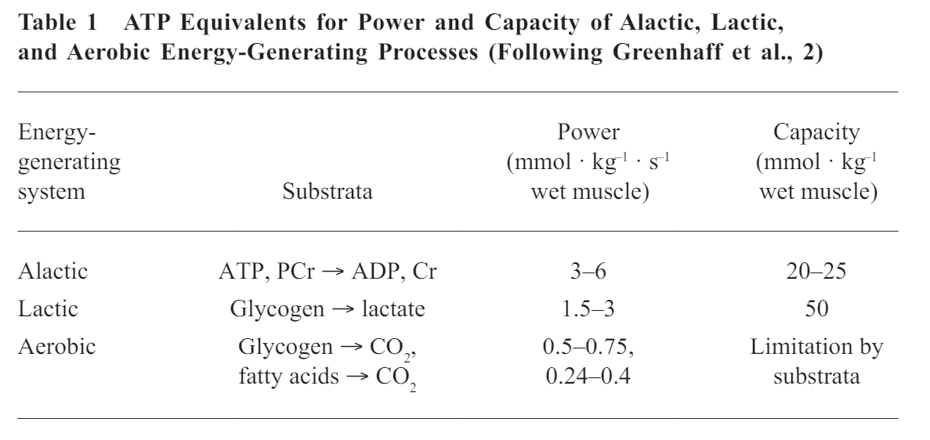
ATP Pool
Constant resynthesis of ATP tuned to ATP breakdown is needed!
Aerobic
Lactic-Anaerobic
Alactic-Anaerobic
Heck et al., 2010
Notes:
Discuss differences between Power and Capacity, Transition to the three different energy systems

Slide 14
Alactic-Anaerobic
Stochiometrie
Aerobic
Lactic-Anaerobic
Alactic-Anaerobic
PCr + ADP ← CK → ATP + Cr
Muscular Contraction!
Preen et al., 2003
Notes:
Discuss differences between Power and Capacity, Transition to the three different energy systems

Slide 15
Alactic-Anaerobic
Stochiometrie
Aerobic
Lactic-Anaerobic
Alactic-Anaerobic
PCr + ADP ← CK → ATP + Cr
Muscular Contraction!
Remember:
Highly limited Capacity
Very fast at producing ATP
Reversible Reaction
1 PCr yields 1 ATP (and vice versa)
Preen et al., 2003
Notes:
Also stress that everything that is needed for this process to occur is already present inside the cell

Slide 16
Alactic-Anaerobic
How much ATP is needed for 30s Sprint? (Assumption 200m)
ca. 84 ATP mmol/s
-> Empty within 2.3s (purely ATP Store)
Calculation of PCr-Pool
Assumptions:
70kg Athlete
40% Muscle
25 mmol/kgm PCr
70 * 0.4 * 25 = 700 mmol PCr
-> Empty within 8.3s
Aerobic
Lactic-Anaerobic
Alactic-Anaerobic
Contraction Insufficiency
Notes:
If the entire PCr-Store can be used… (Assumption)

Slide 17
Adaptations to the Model
Pooling ATP and PCr
Lactic-Anaerobic
Aerobic
Alactic-Anaerobic (ATP-PCr-System)
Usable
Sum of PCr & ATP
Not Usable
Contraction Insufficiency
Notes:
If the entire PCr-Store can be used… (Assumption)

Slide 18
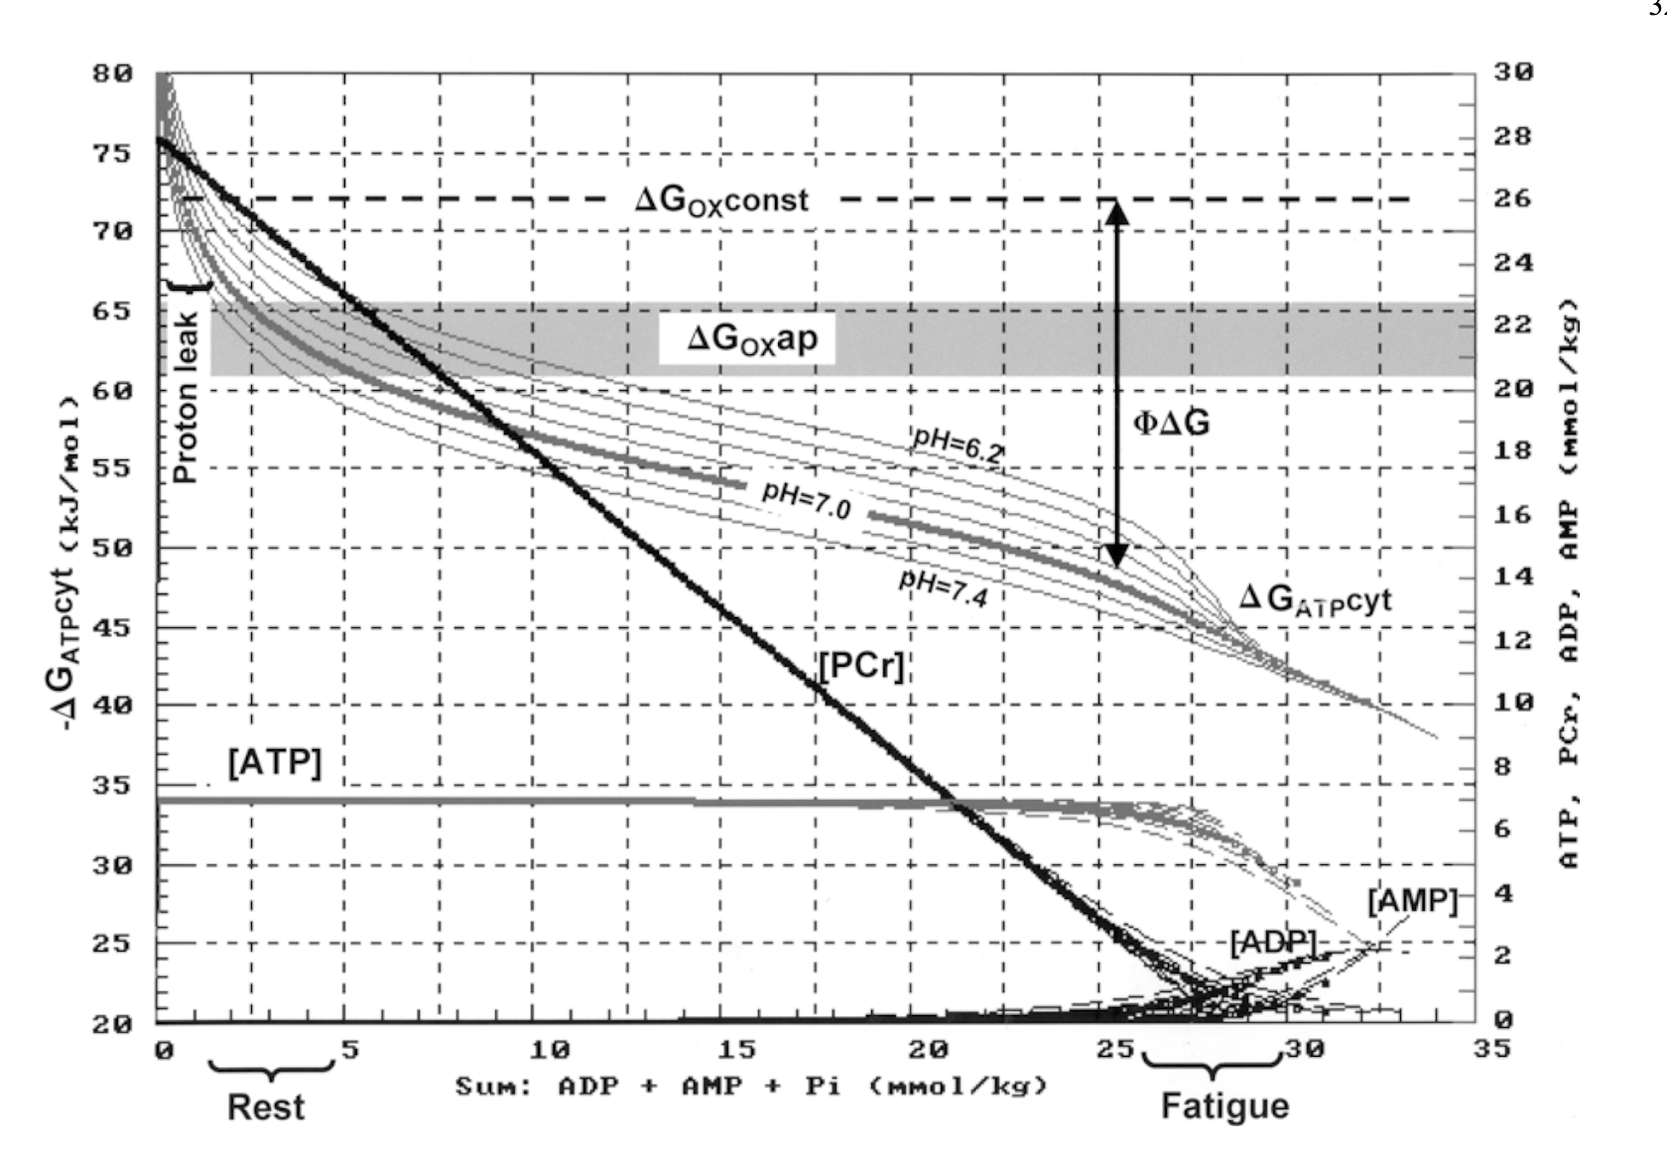
Gibbs Energy of ATP-Hydrolysis
ATP Energy yield
Mader, 2003
Notes:
Analogy to battery powered drill,
Consider going back to the slide before to reshow this phenomenom

Slide 19
Lactic Anaerobic Metabolism
Lactic-Anaerobic
Aerobic
Alactic-Anaerobic
(ATP-PCr-System)
Back to our 30s Sprint Example
ca. 84 ATP mmol/s (or 3 mmol/kgm/s)
Capacity / Breakdown-Rate = Time to Exhaustion
50 / 3 = 16.6 s
(Also we can add the 8.3s from PCr Breakdown = 24.9s)
Notes:
Also indicate that it becomes a question not only of capacity but of Power! Running velocity will decrease in a real live example; So far we have assumed that running velocity in sprint was constant! (or ATP/s demand)

Slide 20
Aerobic Metabolism
Lactic-Anaerobic
Aerobic
Alactic-Anaerobic
(ATP-PCr-System)
Even less powerful
However: Vastly increased capacity
Rough Estimation of Capacity
1g CHO = 4.1 kcal
1g FAT = 9.1 kcal
4.1 * 500 + 9.1 * 70 * 0.1 * 1000 = 2050 + 63700 = 64750 kcal
Notes:
70kg * 10% body fat * 1000 to correct kg to g,
See relative to the few kcal that the body can store in form of ATP -> We cant store ATP really well but we are to store precessor particles in large quantities. However there is a tradeoff between production velocity and storage capacity!

Slide 21
Summary Metabolic Pathways
vLamax
V̇O₂max
v : velocity
La : Lactate
Max : Maximal
V̇ : Flow
O2 : Oxygen
Max : Maximal
What are typical experimentally observed values?

Slide 22
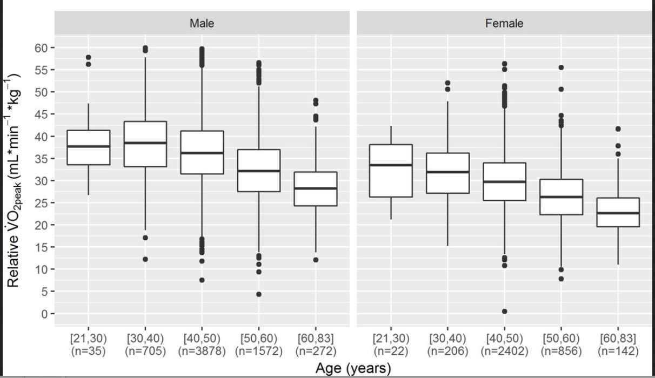
Norm Values V̇O₂max
Rapp, 2018

Slide 23
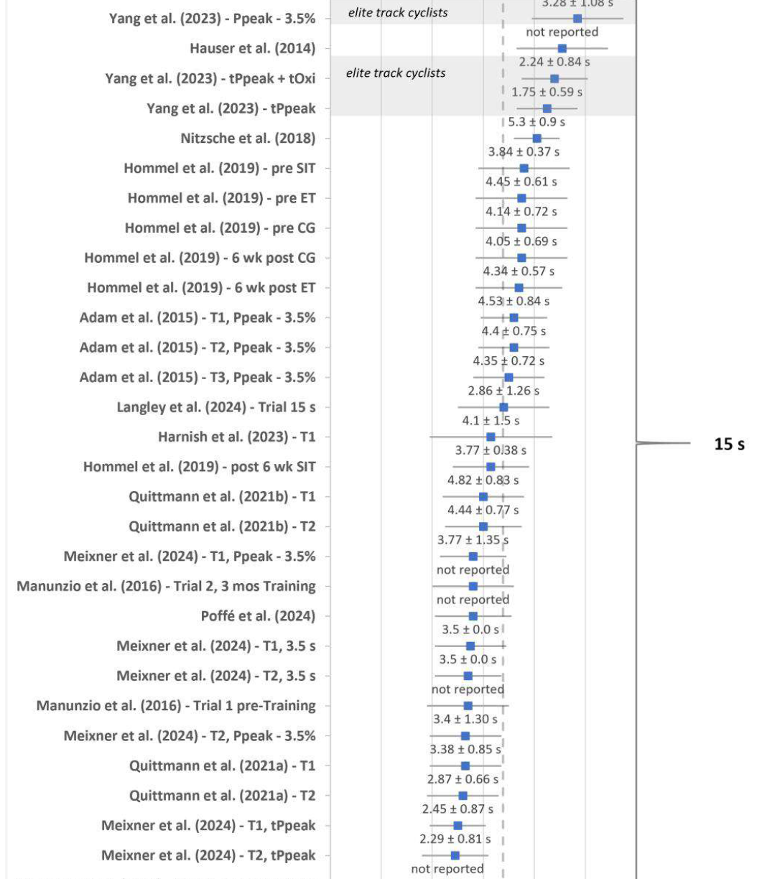
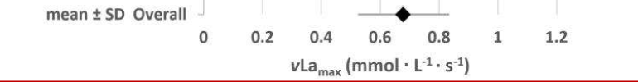
Norm Values vLamax
Experimentally we find values between 0.20 – 1.2 mmol/L/s
Meaning: During 1s glycolysis can produce up to 1.2 mmol/L/s
Langley et al., 2025

Slide 24
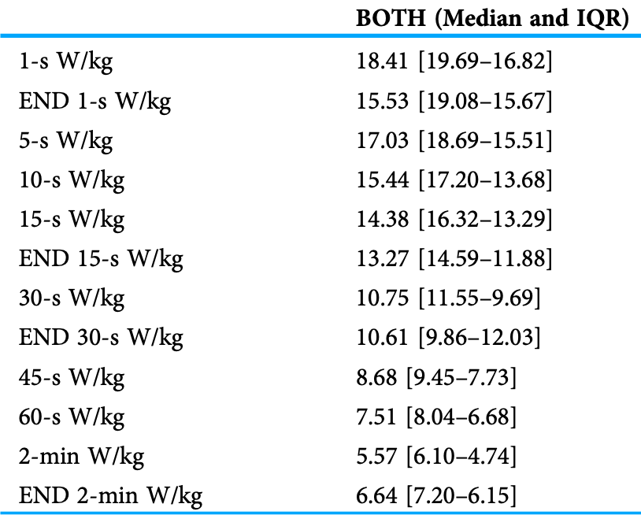
Separate Characterisation of Pathways
Sprinting
Assumptions:
Body Mass 75kg
Body Fat 15%
Watt-O2 = 12.5 ml/min/W
Median absolute Power
14.38 * 75 = 1078.5 W
Median O2-Demand
1078.5 * 12.5 = 13481.25 ml/min
Theorethical V̇O₂max
13481.25 / 75 = 179.75 ml/min/kg
Ferguson et al, 2023
Notes:
Track cycling sprint sex differences using power data ,ferguson 2023
Do the calculation together...

Slide 25
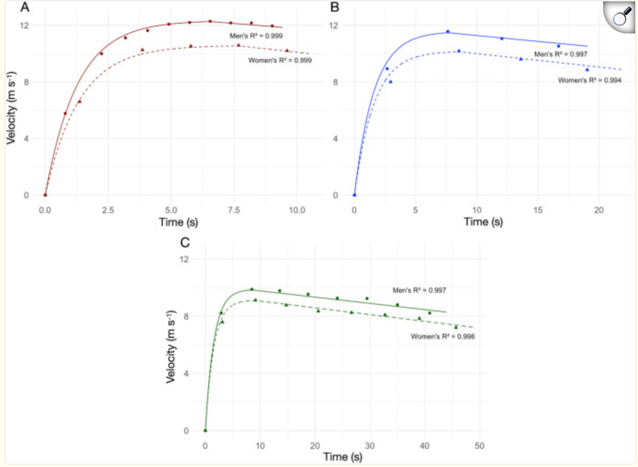
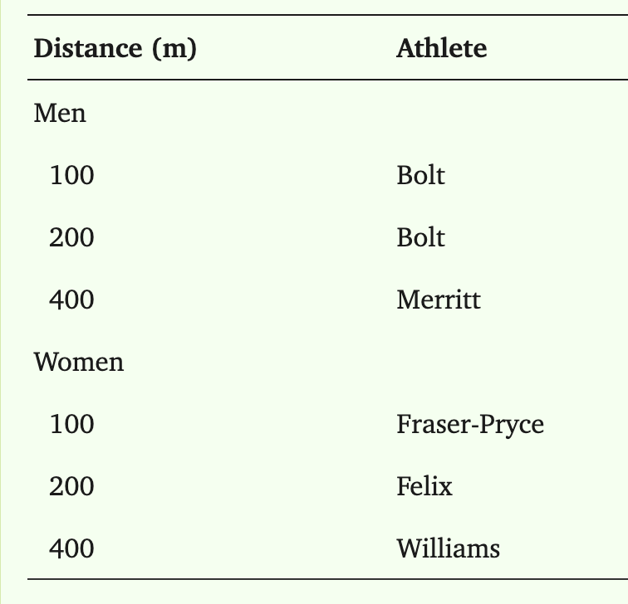
Separate Characterisation of Pathways
Sprinting
100m
200m
400m
Briand et al, 2025
Notes:
Derived from performances at the 2009 World Athletics Championships in Berlin;
Quantifying metabolic energy contributions in sprint running: a novel bioenergetic model; 2025

Slide 26
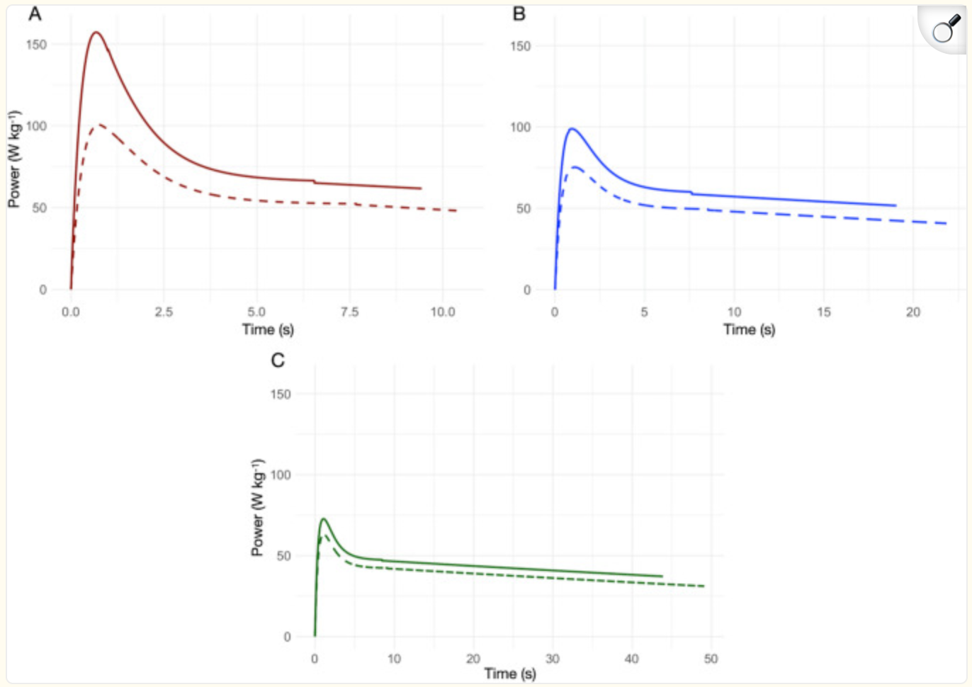
Separate Characterisation of Pathways
Sprinting
100m
200m
Metabolic
400m
Notes:
Same in metabolic power; Metabolic Power is not mechanical Power! Roughly divide by 4 to account for efficiency.

Slide 27
Separate Characterisation of Pathways
Sprinting
100m
Assumptions:
Body Mass 75kg
Body Fat 15%
Watt-O2 = 2.87 ml/min/W
Theorethical V̇O₂max
60.3 * 2.87 = 173.1 ml/min/kg
Average 82.9 W/kg
Metabolic
Average 60.3 W/kg
Briand et al, 2025
The oxidative metabolism cannot provide sufficient energy for sprinting!
Notes:
Same in metabolic power; Metabolic Power is not mechanical Power! Assumed Efficiency of 22.99%

Slide 28
Separate Characterisation of Pathways
Marathon Running
Assumptions:
Body Mass 75kg
Body Fat 15%
1mmol/L La = 2.7 ml/kg
Last weeks example:
5.58 m/s * 11.48 ml/min/kg/m/s = 64.06 ml/min/kg
64.06 / 2.7 / 60 = 0.40 mmol/L/s
Glycolytic flux rate if all ATP came from glycolysis
In Terms of Power: Not a Problem, but…

Slide 29
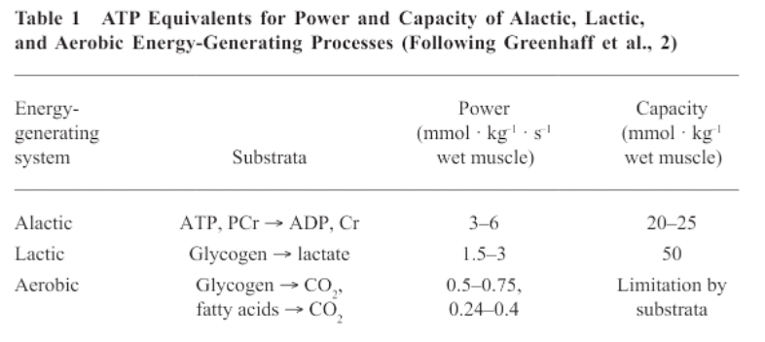
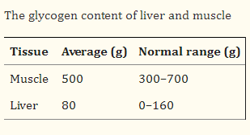
Separate Characterisation of Pathways
Marathon Running
1
2
700g Glycogen = 4320 mmol Glucose
Glucose Breakdown rate:
0.40 * 75 * 0.45 / 2 = 6.75 mmol/s
4320 mmol / 6.75 = 640s = 10.7min
AND: 257 mmol/L La pH ~2.5
Murray & Rosenbloom, 2018

Slide 30
Separate Characterisation of Pathways
Marathon Running
In Terms of Power: Not a Problem, but…
Capacity is not enough!
700g Glycogen = 4320 mmol Glucose
Glucose Breakdown rate:
0.40 * 75 * 0.45 / 2 = 6.75 mmol/s
4320 mmol / 6.75 = 640s = 10.7min
AND: 257 mmol/L La pH ~2.5
Murray & Rosenbloom, 2018

Slide 31
Summary
Aerobic
Lactic-Anaerobic
Capacity
Power
Each Metabolic Pathway is specifically designed for different tasks!
For needs Analysis of different sports:
How are energy system contributing?
Bottlenecks?
Alactic-Anaerobic
(ATP-PCr-System)

Slide 32

Outlook
Functioning of the different metabolic Pathways
Regulation of ATP Production
Building a mathematical model to put our knowledge to practical use!

Slide 33
Literature
Briand J, di Prampero PE, Osgnach C, Thibault G, Tremblay J. Quantifying metabolic energy contributions in sprint running: a novel bioenergetic model. Eur J Appl Physiol. 2025 Dec;125(12):3521-3541. doi: 10.1007/s00421-025-05831-0. Epub 2025 Jun 19. PMID: 40536521; PMCID: PMC12678604.
Ferguson H, Harnish C, Klich S, Michalik K, Dunst AK, Zhou T, Chase JG. Track cycling sprint sex differences using power data. PeerJ. 2023 Jul 10;11:e15671. doi: 10.7717/peerj.15671. PMID: 37456896; PMCID: PMC10340095.
Greenhaff PL, Nevill ME, Soderlund K, Bodin K, Boobis LH, Williams C, Hultman E. The metabolic responses of human type I and II muscle fibres during maximal treadmill sprinting. J Physiol. 1994 Jul 1;478 ( Pt 1)(Pt 1):149-55. doi: 10.1113/jphysiol.1994.sp020238. PMID: 7965830; PMCID: PMC1155653.
Heck, H. (1990a). Laktat in der Leistungsdiagnostik. Schorndorf: Hofmann.
Heck, H., Bartmus, U., Grabow, V., Laktat: Stoffwechselgrundlagen, Leistungsdiagnostik, Trainingssteuerung, 2022
Heck, H., Schulz, H., Bartmus, U., Diagnostics of anaerobic power and capacity. EJSS, 2010, doi: 10.1080/17461390300073302
Langley, J.,. Haase, R., Nitzsche, N., Porter, M., Methodological Approaches in Testing Maximal Lactate Accumulation Rate - νLamax: A Systematic Review, 2025
Mader, A. (2003). Glycolysis and oxidative phosphorylation as a function of cytosolic phosphorylation state and power output of the muscle cell.
Preen D, Dawson B, Goodman C, Beilby J, Ching S. Creatine supplementation: a comparison of loading and maintenance protocols on creatine uptake by human skeletal muscle.
Rapp D, Scharhag J, Wagenpfeil S, Scholl J. Reference values for peak oxygen uptake: cross-sectional analysis of cycle ergometry-based cardiopulmonary exercise tests of 10 090 adult German volunteers from the Prevention First Registry. BMJ Open. 2018 Mar 5;8(3):e018697. doi: 10.1136/bmjopen-2017-018697. PMID: 29506981; PMCID: PMC5855221.
Röder, P., Wu, B., Liu, Y. et al. Pancreatic regulation of glucose homeostasis. Exp Mol Med 48, e219 (2016). https://doi.org/10.1038/emm.2016.6

Slide 34
Homework
1.) Calculate the metabolic demand in V̇O₂ (ml/min) equivalents on a bicycle ergometer for:
a.) 200W
b.) 400W
c.) 600W
2.) Make an educated guess regarding an athletes V̇O₂max that was able to push 420W for 4-minutes (body mass 75kg).
3.) Calculate the metabolic demand in vLa (mmol/L/s) equivalents on a bicycle ergometer for:
a.) 200W
b.) 400W
c.) 600W
4.) Describe the reason for contraction insufficiency once low values of [PCr] are reached.
5.) Make an educated guess: For each energy system, in which sport will it have the highest relevance?

