Slide 1
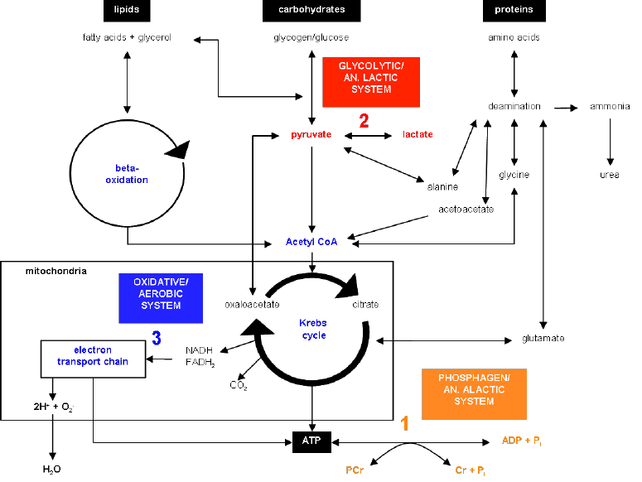
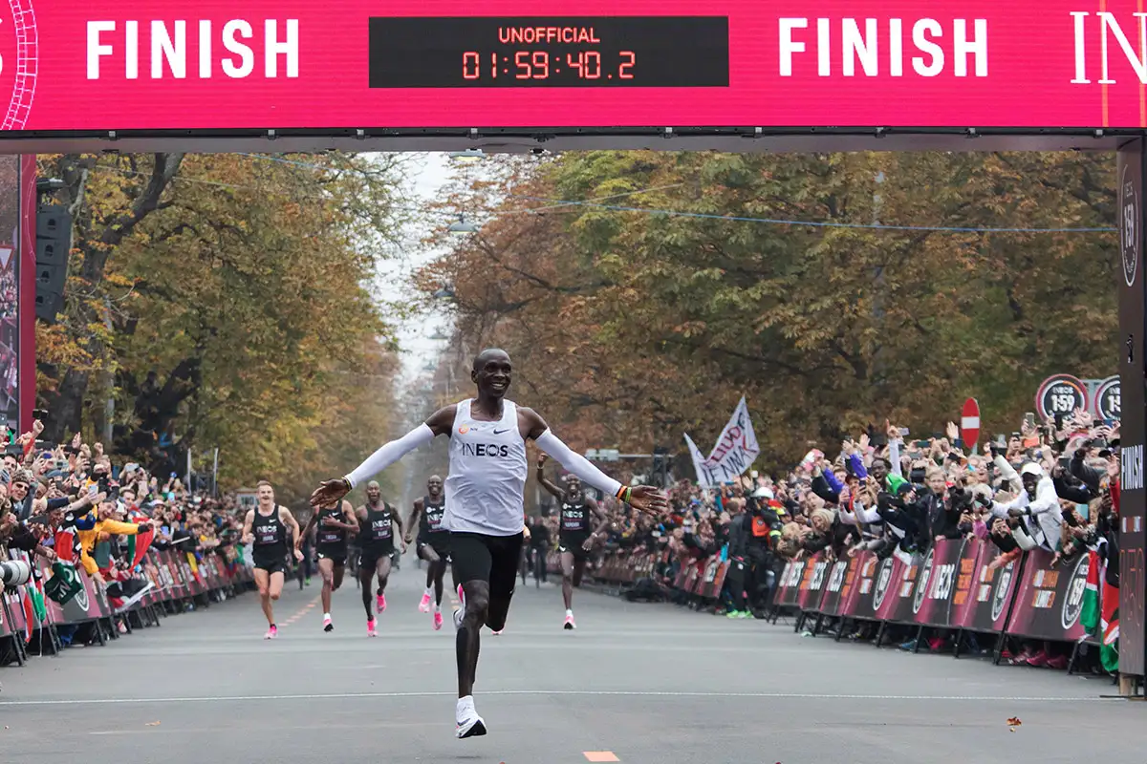
Applied Exercise Physiology & Sports Nutrition for Health & Performance
Organisation & Modelling Marathon Performance
Jasper Suttmeyer

Slide 2
Introduction
Jasper Suttmeyer
Bachelor of Arts (Angewandte Sportwissenschaft, Universität Paderborn, 2019)
Master of Science (Sports and Exercise Sciences for Health and Performance, Ruhr-Universität Bochum, 2021).
Since 2019: Dr. Ralf Lindschulten, Institute for Performance Testing & Planning Training (Endurance Disciplines: Running, Cycling, Triathlon & Handcycling)
Area of research: Computersimulation of energy metabolism

Slide 3
Todays Topics
Object of the seminar
Requirements for exam participation
Joyner‘s Model of Endurance Performance

Slide 4
Object of the seminar
Fundamental biochemical concepts of the energy metabolism
Thinking critically about the evaluation of human performance
Projecting needed physiological capabilities for specific performance
Writing training plans for endurance athletes

Slide 5
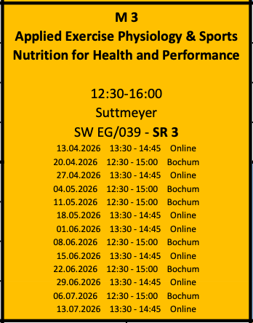
Object of the seminar
Block 1.)
- Basics of the energy metabolism and model application

Slide 6
Processes of ATP-Synthesis
Anaerobic
Aerobic
Glucose
ß-Oxidation
Glycogen
⚡ATP ⚡
Citric Acid Cycle
⚡ATP/GTP ⚡
Lactate
⚡ATP ⚡
Electron Transport Chain

Slide 7
Object of the seminar
Block 1.)
- Basics of the energy metabolism and model application
Block 2.)
- Performance Testing

Slide 8
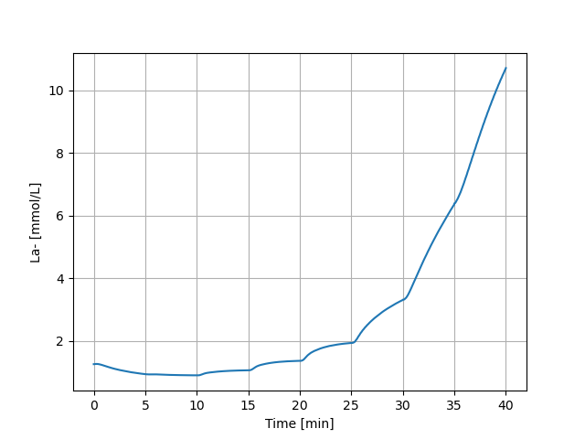
Glycolytic Activity during GXT

Slide 9
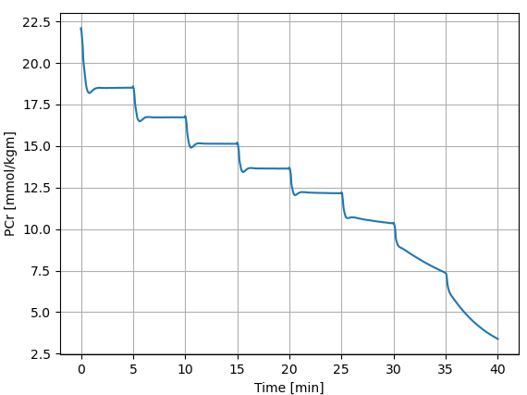
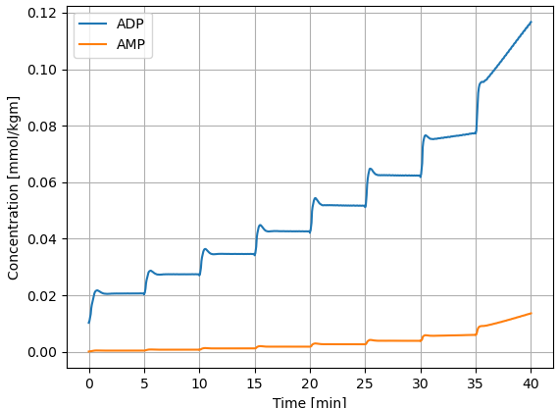
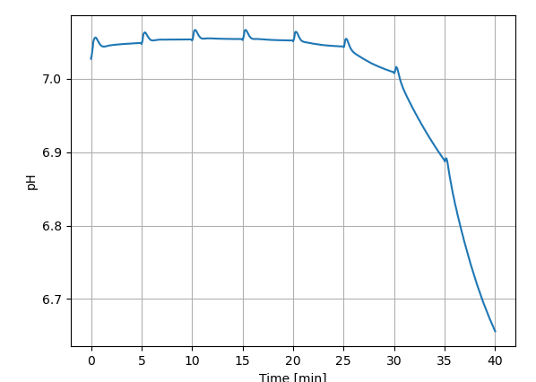
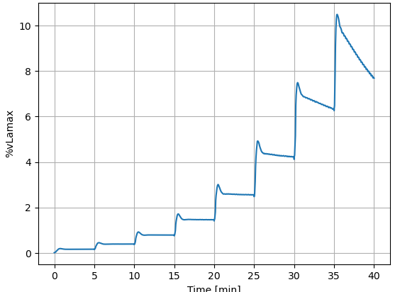
Glycolytic Activity during GXT

Slide 10
Object of the seminar
Block 1.)
- Basics of the energy metabolism and model application
Block 2.)
- Performance Testing
Block 3.)
- Adaptation and Implementation

Slide 11





What is Training?
Response Matrix
Signal Transduction
External Stimulus
Internal Stimulus
metabolic hormonal
neuronal mechanical
Adapting
Processing
Detecting
Adaptational Effect
mod. from Toigu & Boutellier, 2006
Notes:
Layers of response matrix: muskuloskeletal adaptations, proteins (enzymes, structural proteins),
Principles of adaptation induced stimuli

Slide 12
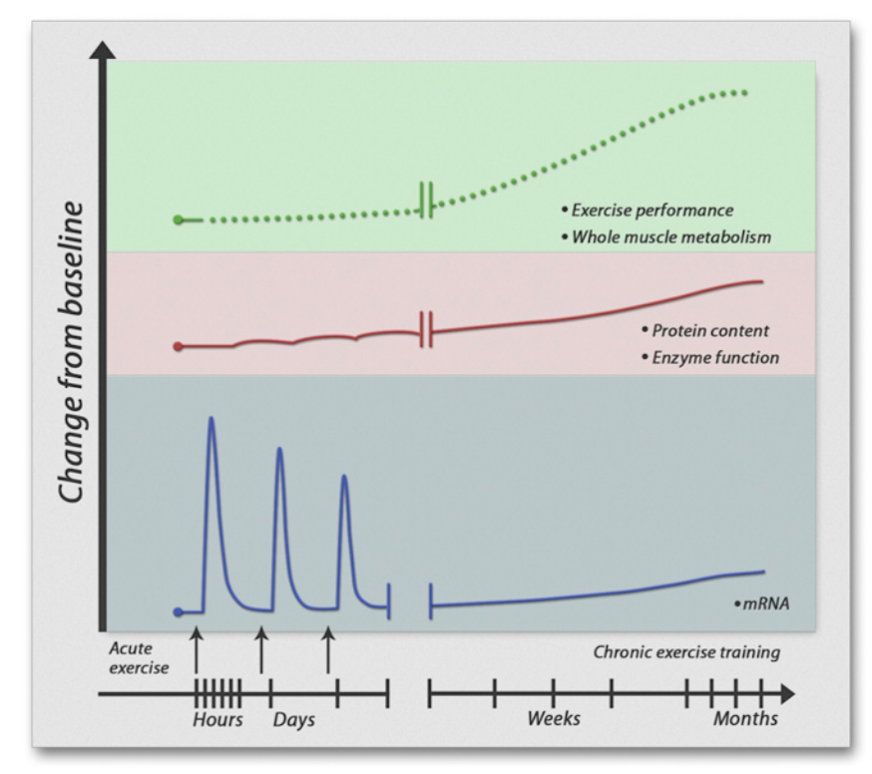

What is Training?
Engan & Zierath, 2013

Slide 13
What you have to do…
Requirements for exam participation:
… attend to at least 80% of all classes
… complete all homeworks
… actively participate in discussions during the seminar!
What you can do:
... reach out if you want to prepare a small presentations regarding any seminar related topic

Slide 14

Let‘s start with some actual sport science ;)

Slide 15

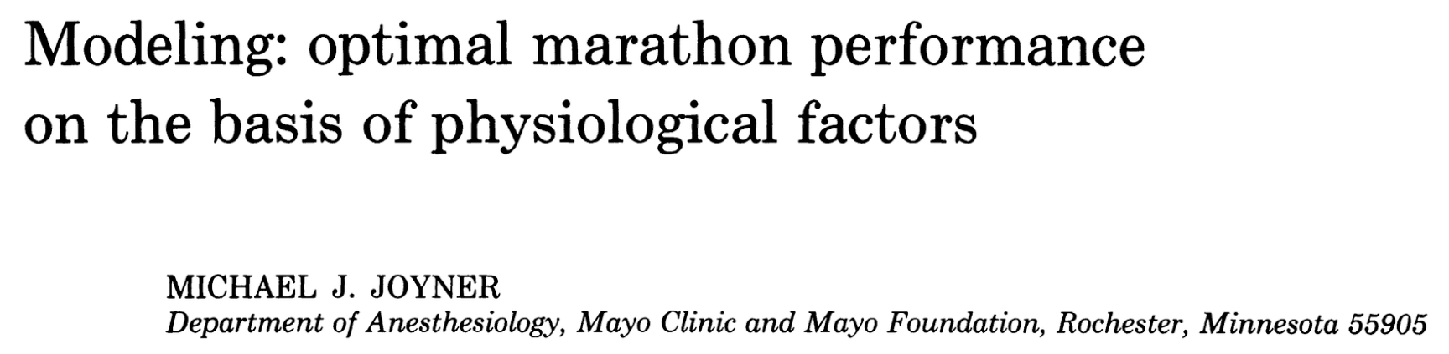
Marathon Performance Petros
Amanal Petros – german champion in marathon running (2024)
Finishing Time: 02:06:05
Average speed: 20.1 km/h or 5.58 m/s
What kind of physiology is needed to achieve such an performance?
What are the „bottlenecks“ of human performance in a marathon
race?
Notes:
bring up the questionaire

Slide 16
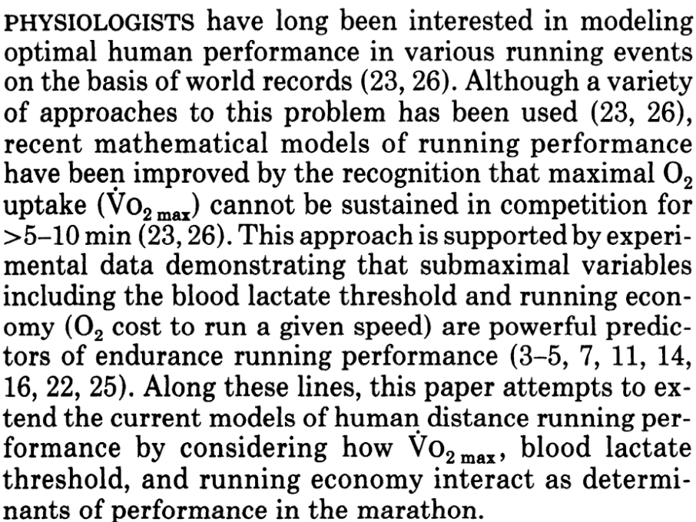
First paragraph of Joyner 1991 Paper

Slide 17
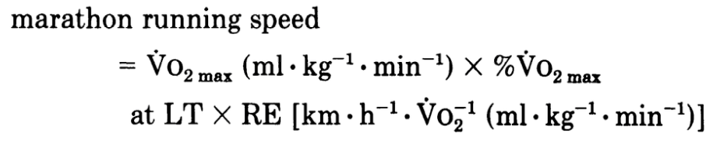
First paragraph of Joyner 1991 Paper

Slide 18
V̇O₂max
%V̇O₂max
at LT
Running Economy
Marathon Performance
V̇O₂max * % V̇O₂max at LT
Marathon Performance =
Running Economy
Joyner (1991)

Slide 19
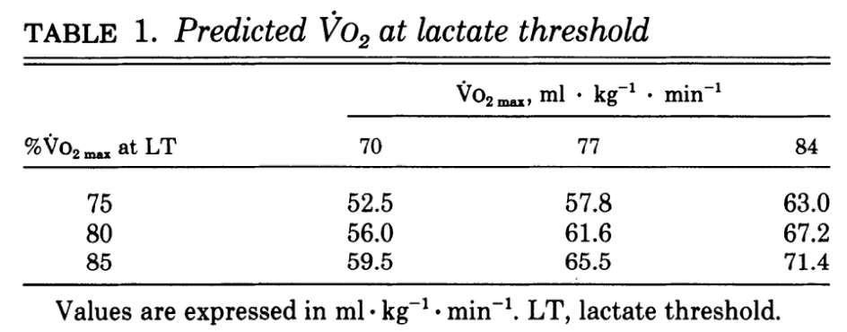
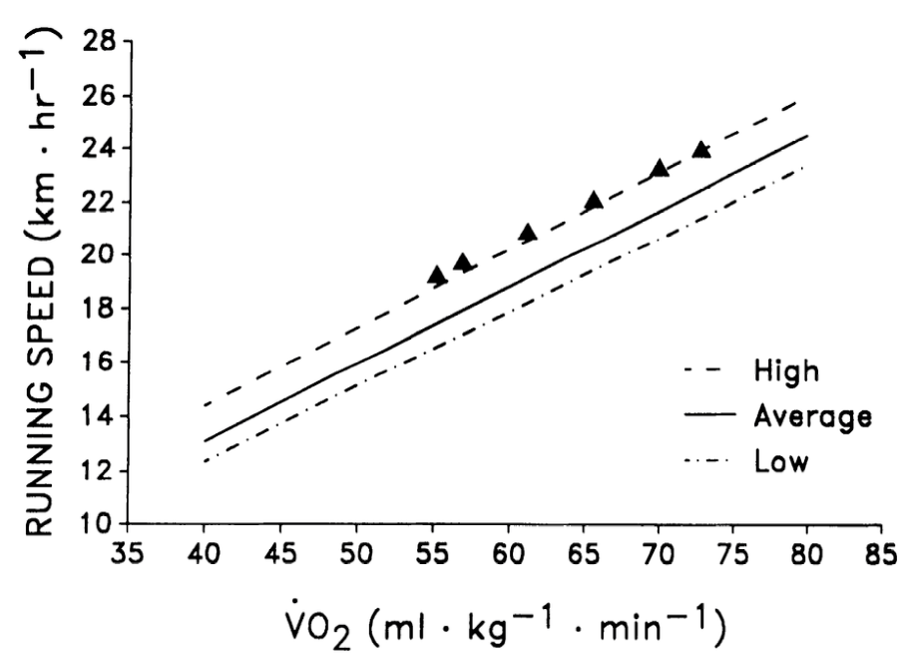

Slide 20
V̇O₂max
%V̇O₂max
at LT
Running Economy
Values for High Performance Athletes
70 – 84 ml/min/kg 75 – 85 % 11 – 13.5 ml/min/kg/m/s
Marathon Performance
Joyner (1991)

Slide 21
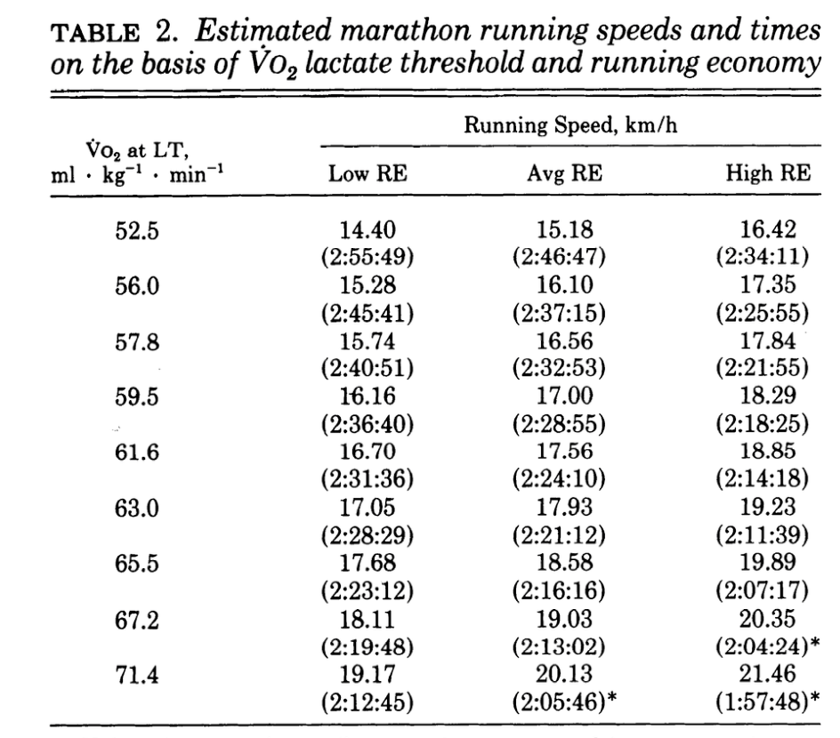

Slide 22
Marathon Performance Amanal Petros (2024)
V̇O₂max
%V̇O₂max
at LT
Running Economy
Values for High Performance Athletes
70 – 84 ml/min/kg 75 – 85 % 11 – 13.5 ml/min/kg/m/s
Marathon Performance = 80 * 0.8 / 11.46 = 5.58 m/s
Marathon Performance
V̇O₂max * % V̇O₂max at LT
Marathon Performance =
Finishing Time: 02:06:05 -> 5.58 m/s
Running Economy
Joyner (1991)

Slide 23
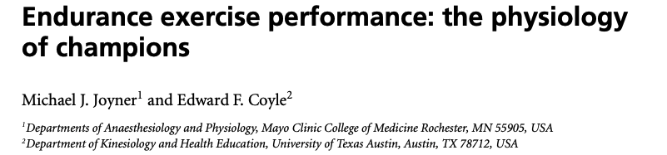
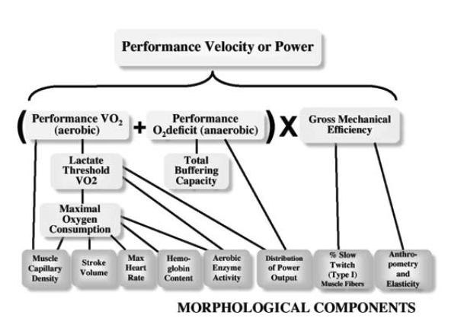
Notes:
Update came in 2008

Slide 24


Joyner Model
V̇O₂max
%V̇O₂max
at LT
Running Economy
Marathon Performance
Physiological Basis for the input Parameters?
Underlying Assumptions?
How is Fatigue induced?
Can the model also predict other distances?
Focus purely on aerobic pathways?
Need for a more sophisticated evaluation of endurance performance!
Yet helpful due to its simplicity

Slide 25
Further Reading and Homework
Further Reading:
Joyner, 1991
Joyner & Coyle, 2008
Jones, 2023
Homework:
Pick results from three different marathon finishers and calculate a possible combination of V̇O₂max, %@LT & RE
https://www.marathon-hannover.de/ergebnisse-1/2026.html
-> Visualize your calculations for a 60sec presentation!
Preparation for next class (mandatory reading):
Heck, 2003
(Only Introduction + Capacity and Power of Muscular Energy Metabolism)

