Slide 1
Stabsstelle Arbeitssicherheit und Umweltschutz / Occupational Safety and Environment Protection Unit
Information regarding safety measures at RUB –
a short introduction for students
SHORT INTRODUCTION for students

Slide 2

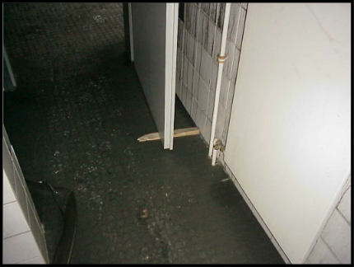
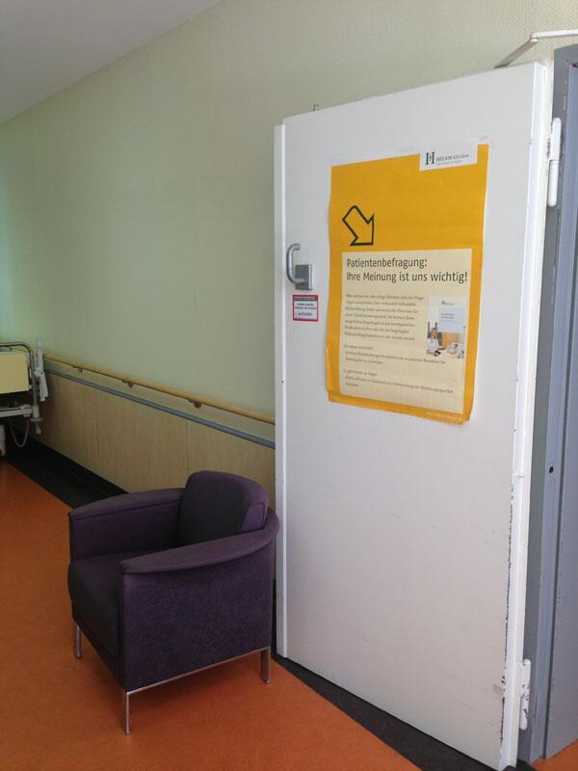

Stabsstelle Arbeitssicherheit und Umweltschutz / Occupational Safety and Environment Protection Unit
Escape and Rescue Routes, Emergency Exits
Circulation areas (e.g. hallways, corridors) as well as escape and rescue routes may not be restricted and must be kept clear at all times. Never store objects or items here (not even temporarily!)
Keep smoke / fire control doors and emergency exits closed but not locked. They must be easy to open from the inside at any time without tools.
Do not leave smoke / fire control doors wedged open.
Emergency exits, escape and rescue routes shall be visibly and permanently marked.
SHORT INTRODUCTION for students

Slide 3
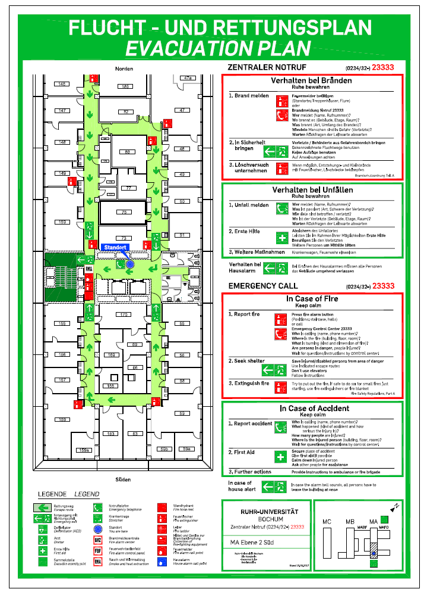
Stabsstelle Arbeitssicherheit und Umweltschutz / Occupational Safety and Environment Protection Unit
Escape and Rescue Routes
Example of an Evacutation Plan:
Where can you find these plans?
e.g. in corridors and lift/ elevator lobbies
SHORT INTRODUCTION for students

Slide 4
Stabsstelle Arbeitssicherheit und Umweltschutz / Occupational Safety and Environment Protection Unit
Starting the rescue chain at RUB
RUB Control Room „Leitwarte“ for emergencies on RUB Campus
Telephone number for the RUB Control Room 0234/32-23333*
* Please store this number in your mobile phone!!!
The RUB Control Room starts the rescue chain. The RUB Control Room staff inform the according emergency services (fire service/ambulance and/or police) and ensure that the emergency service(s) arrive at the scene as quickly as possible. Depending on the emergency, the RUB Control Room staff will also send company paramedics to the scene. The RUB Control Room is available around the clock every day.
Attention: For RUB facilities/building which are located off Campus:
Telephone number 112 (fire service /ambulance)
Telephone number 110 (Police)
Please also inform RUB Control Room afterwards.
SHORT INTRODUCTION for students

Slide 5
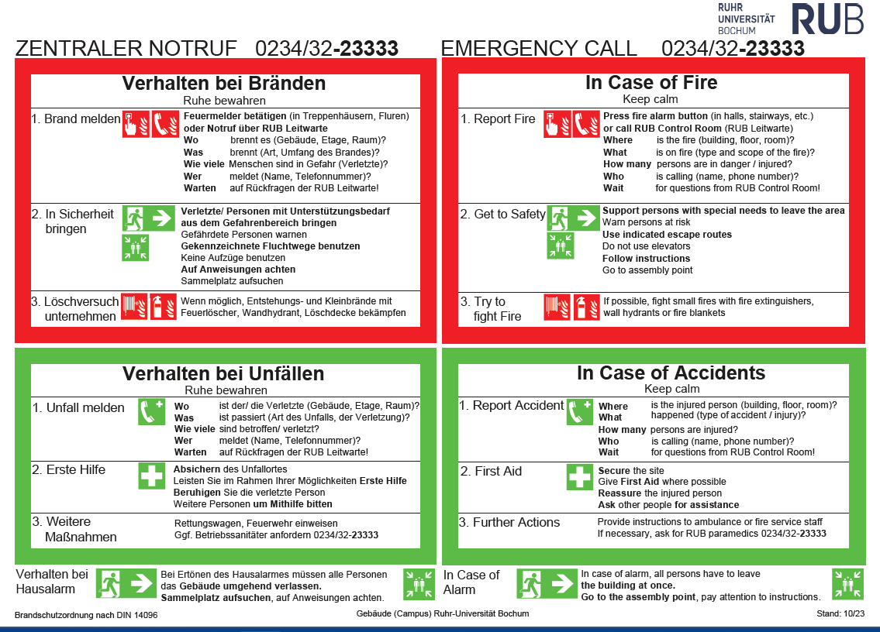
Stabsstelle Arbeitssicherheit und Umweltschutz / Occupational Safety and Environment Protection Unit
Fire safety code of practice part A (Brandschutzordnung Teil A)
SHORT INTRODUCTION for students

Slide 6
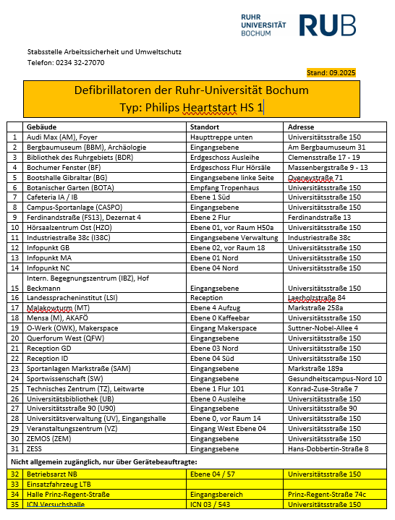

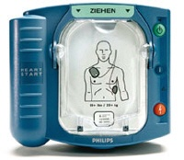
Stabsstelle Arbeitssicherheit und Umweltschutz / Occupational Safety and Environment Protection Unit
Automated External Defibrillators AED – for laypersons
On RUB Campus: Phone number 0234-32-23333 (RUB Control Room)!
SHORT INTRODUCTION for students

Slide 7

Stabsstelle Arbeitssicherheit und Umweltschutz / Occupational Safety and Environment Protection Unit
In case of a fire alarm
>>> Keep calm and keep an overview!
If the alarm (bell or voice) sounds, all persons must leave the building immediately.
Warn people who may have overheard the alarm.
When leaving the rooms, doors and windows must be closed but not locked.
Take your personal belongings with you, such as ID cards, clothing, bags and keys, but only if they are in your immediate vicinity.
Leave the building via the signposted escape routes.
Do not use elevators!
Help people with disabilities. Notify the emergency services if people are unable to leave the building on their own.
Go to the assembly point indicated for your building.
Follow the instructions of the emergency services RUB employees in charge.
SHORT INTRODUCTION for students

Slide 8
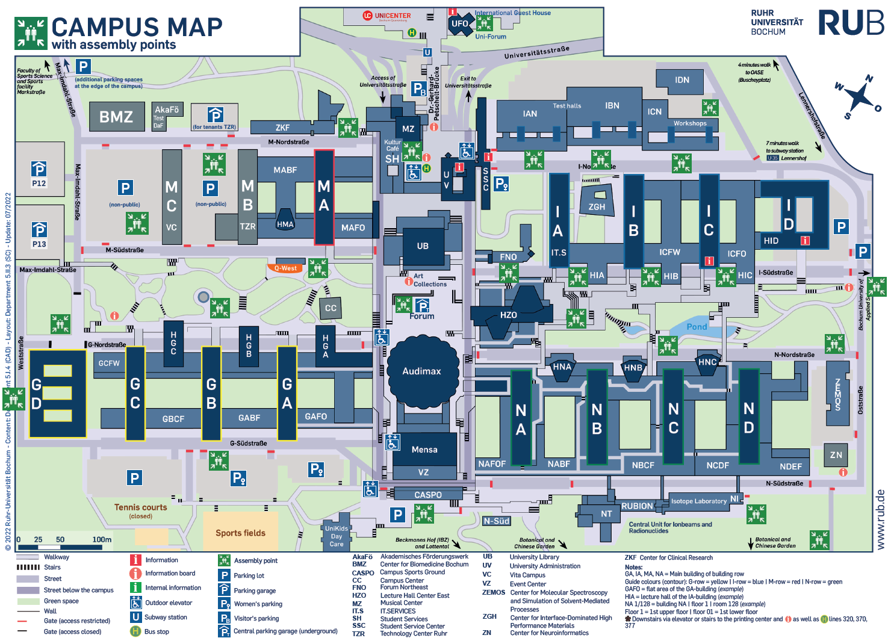
Stabsstelle Arbeitssicherheit und Umweltschutz / Occupational Safety and Environment Protection Unit
Assembly points at RUB
SHORT INTRODUCTION for students

Slide 9
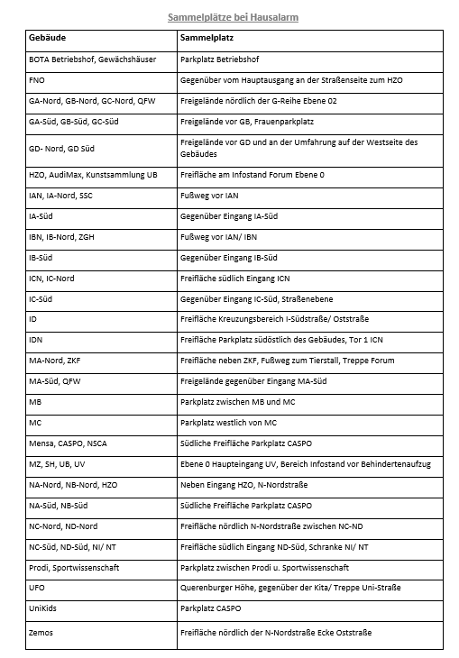

Stabsstelle Arbeitssicherheit und Umweltschutz / Occupational Safety and Environment Protection Unit
Assembly points at the RUB
The assembly points are marked with this sign:
Make sure in advance that you know where the assembly point for your current building is located!
SHORT INTRODUCTION for students

Slide 10
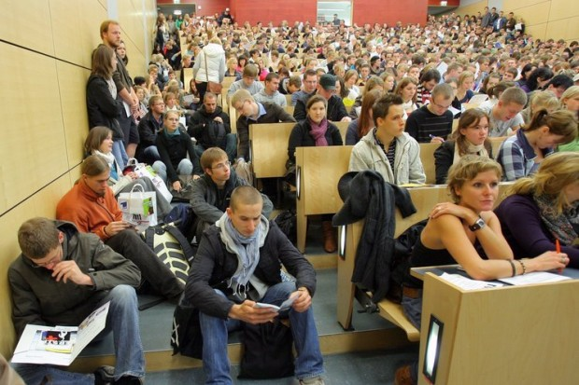
Stabsstelle Arbeitssicherheit und Umweltschutz / Occupational Safety and Environment Protection Unit
Escape Routes: Lecture halls and seminar rooms
Stairs in lecture halls must be kept free at all times, do not put bags etc. down there.
do not add additional chairs to seminar rooms and lecture halls
all doors of lecture halls and seminar rooms must be kept free at all times
Please listen to the instructions of your lecturers, this is important for your own safety!
SHORT INTRODUCTION for students

Slide 11
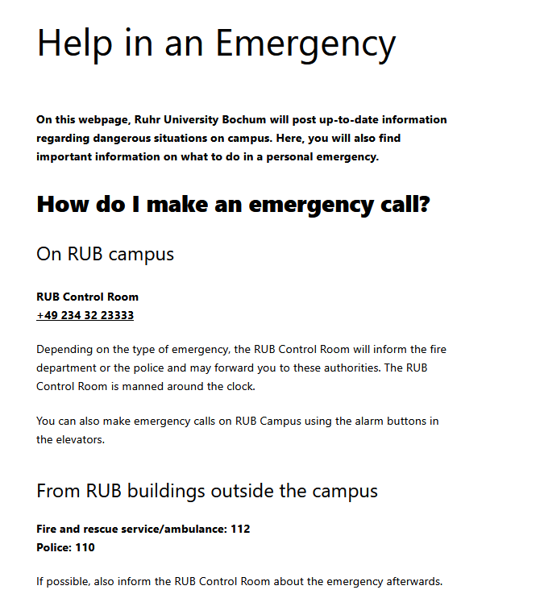
Stabsstelle Arbeitssicherheit und Umweltschutz / Occupational Safety and Environment Protection Unit
Website for dealing with emergencies at the RUB
Should there be a major emergency at the RUB, information would be provided via the website https://notfall.ruhr-uni-bochum.de/en/
SHORT INTRODUCTION for students

Slide 12

Stabsstelle Arbeitssicherheit und Umweltschutz / Occupational Safety and Environment Protection Unit
Pregnant students at the Ruhr-Universität Bochum
The „Mutterschutzgesetz“ (law for the protection of expectant and nursing mothers) also applies to pregnant students
Therefore obligations to report, on rention periods and the duty to evaluate possible hazards do apply for pregnant students
Pregnant students are asked to report the pregnancy using the RUB website of the student services (see below). Supervisors should also be informed!
Additional information is available on this website: https://www.ruhr-uni-bochum.de/studierendensekretariat/.
SHORT INTRODUCTION for students

Slide 13

Stabsstelle Arbeitssicherheit und Umweltschutz / Occupational Safety and Environment Protection Unit
Statutory accident insurance when studying at RUB
In case of an accident at a RUB location, employees and students are insured by “Unfallkasse NRW“
Accidents while commuting to and from RUB are covered as well
Students should report all accidents to: AKAFÖ, E-Mail: Unfallanzeige-RUB-Studierende@akafoe.de
SHORT INTRODUCTION for students

Slide 14
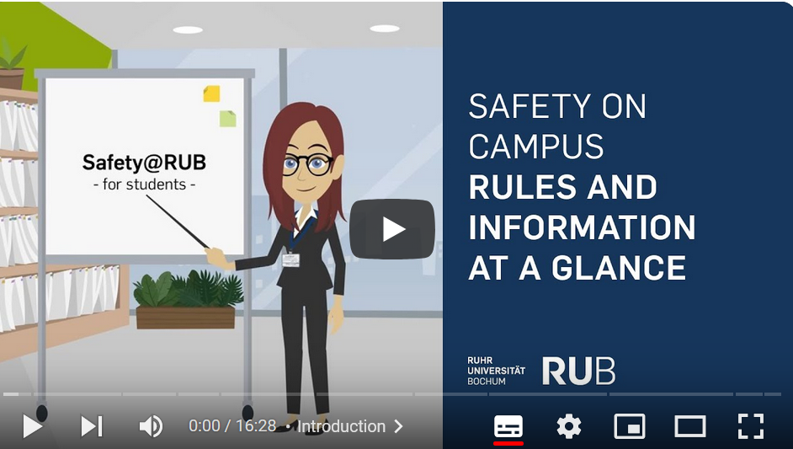
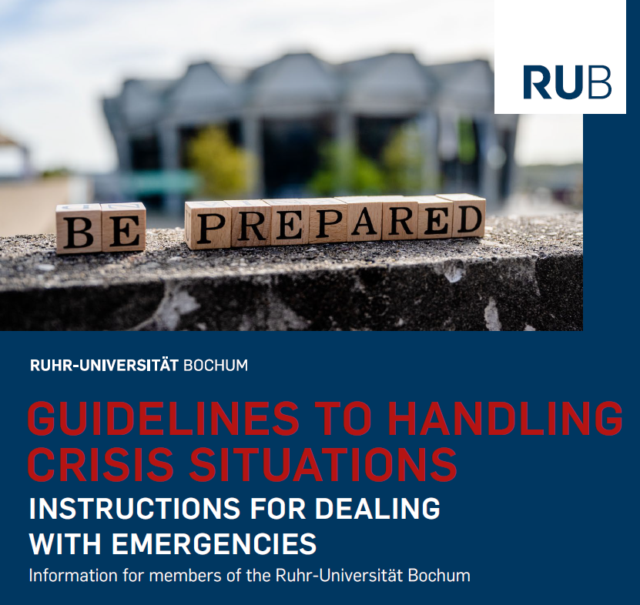
Stabsstelle Arbeitssicherheit und Umweltschutz / Occupational Safety and Environment Protection Unit
Further sources for information
The Occupational Safety and Environment Protection Unit has produced a video with the most important instructions for dealing with emergencies. The video lasts approx. 15 minutes. You can find the video here: https://youtu.be/IGeEIyAwEmQ.
A detailed emergency manual for all RUB members was published in fall 2023. The RUB Emergency Manual describes emergency scenarios of all kinds and provides recommendations on what should be done when and by whom. You can find the emergency manual here: https://www.ruhr-uni-bochum.de/notfallhandbuch/RUB-Emergency-Manual.pdf
Please note: To download the RUB Emergency Manual, you must enter your RUB login ID and password.
SHORT INTRODUCTION for students

Slide 15
Stabsstelle Arbeitssicherheit und Umweltschutz
Further support
RUB security personnel – accompanying service
You can request the service 24 hours a day, 7 days a week by calling
+49 234 32 27001. A member of the RUB security staff will accompany you.
The service is free of charge for all students, employees, researchers, lecturers and guests of the RUB.
Further information on the escort service can be found here: https://services.ruhr-uni-bochum.de/de/begleitschutz
SHORT INTRODUCTION for students

Slide 16
Stabsstelle Arbeitssicherheit und Umweltschutz
Social and psychological support
In cases of sexual harassment, exhibitionism, (digital) violence, stalking
On campus: In urgent cases, call the RUB Control Room on +49 234 32 23333 (depending on the threat, the RUB Control Room will forward you directly to the police).
Off campus: Telephone number 110 (police)
>>> The RUB Legal Department will assist you in filing a report.
Psychological counselling for RUB students
Telephone consultation hours: +49 234 32 22317 (Mondays 13-14 pm)
Anti-Discrimination Office
Central counselling, mediation and information centre for all persons and institutions at the university who experience or observe discrimination or need support on this issue. Counselling is provided by individual appointment, which can be made by registering at: antidiskriminierung@rub.de
SHORT INTRODUCTION for students

