Slide 1
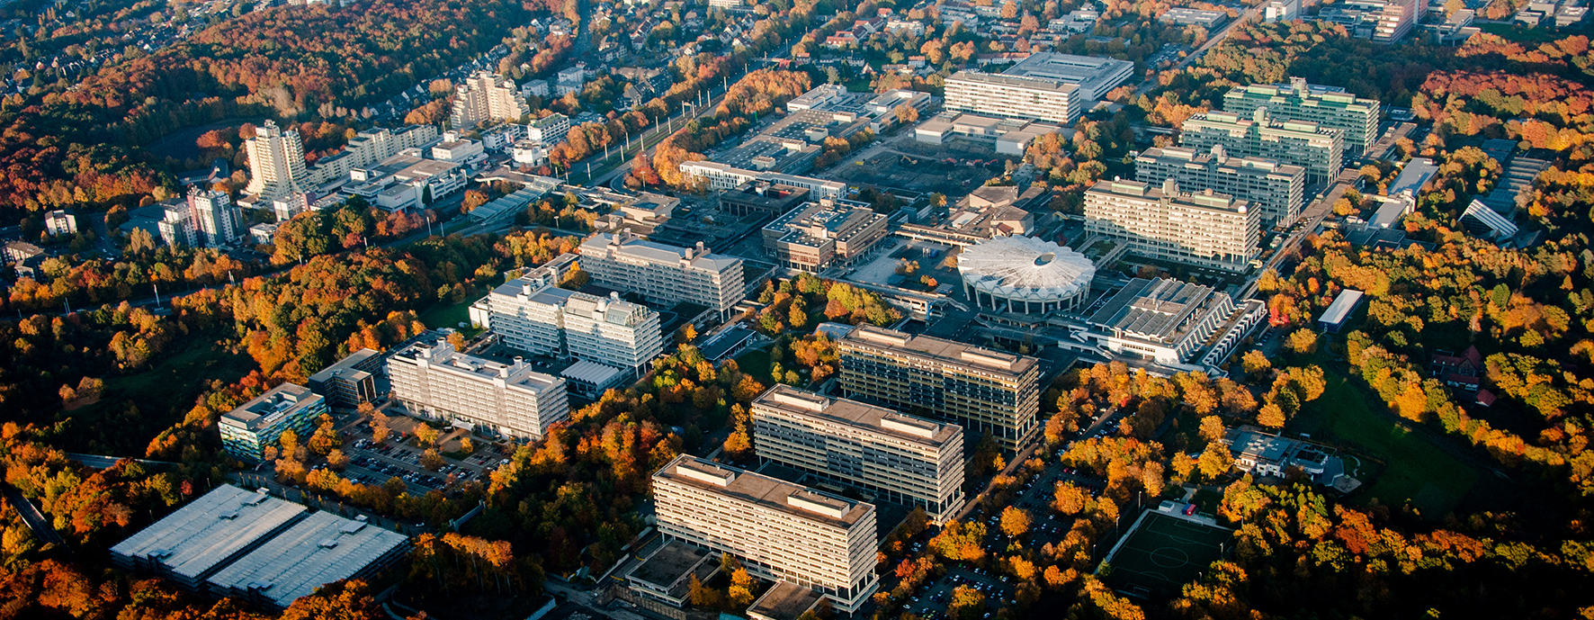
Green Methanol Production
Computer-aided Process Design

Slide 2
Advantages and Disadvantages Power-to-X
Advantages:
Integration of renewable energy: PtX enables the efficient storage and use of surplus renewable energy
Energy storage: PtX can serve as a form of long-term energy storage
Flexibility: PtX technology can be adapted to different forms of energy, such as synthetic natural gas, methanol, etc...
Disaadvantages:
Energy losses: The conversion of electrical energy into chemical energy takes place in several steps
Infrastructure and costs: The implementation of PtX projects on a large scale requires considerable investment in infrastructure

Slide 3
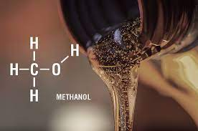
Beispielprozess Power to Methanol
Basic chemical
Simple alcohol
Liquid at ambient temperature and pressure
Advantage:
  Polar liquid, rapidly degradable anaerobically and aerobicallyLow toxicity compared to petroleum

Slide 4
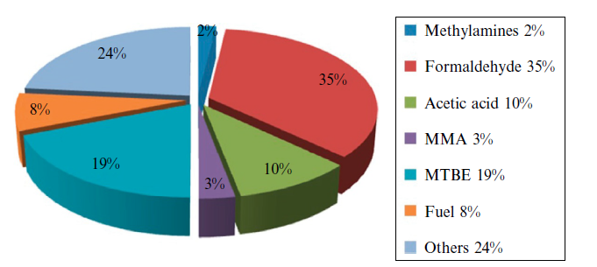
Beispielprozess Power to Methanol
Kraftstoff für Hochleistungsmotoren mit Funkenzündung
chemischer Rohstoff
      z. B. Kunststoffindustrie, Methanol-zu-Olefin-Prozesse
Chemischer Speicher: Power-to-Liquid
      Dt. 2050: prognostizierter Überschussstrom 24 TWh/a
      potentielle Methanolmenge von 1,9 mio t/a)

Slide 5
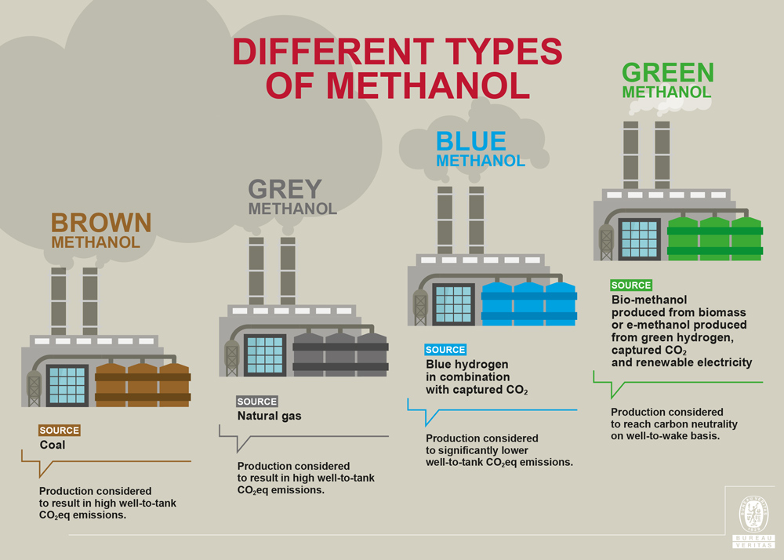
Beispielprozess Power to Methanol

Slide 6
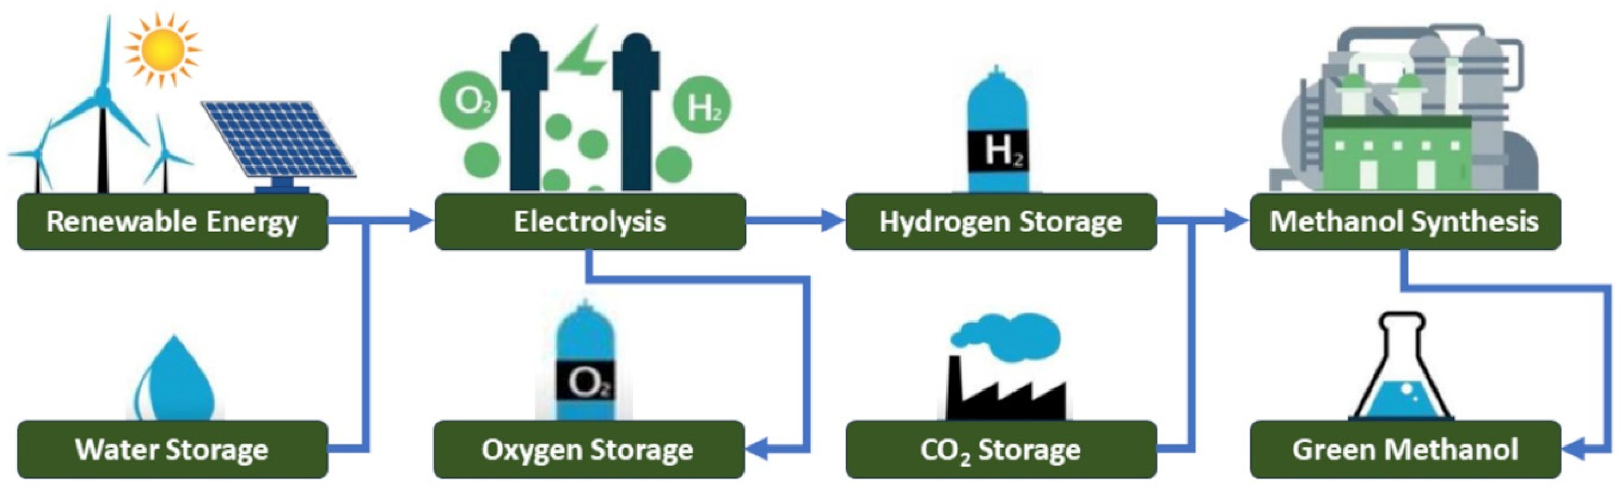
Beispielprozess Power to Methanol
Power-To-Methanol
    Determination of the operating parameters of all sub-processes:
      H₂ Production
      CO₂ Production
      Methanolsynthese

Slide 7
Beispielprozess Power to Methanol
Power-To-Methanol
    Framework conditions:
      Production volume von 250.000 t pro Jahr
      8.500 h/a
    Literature research and subsequent implementation in Aspen Plus

Slide 8
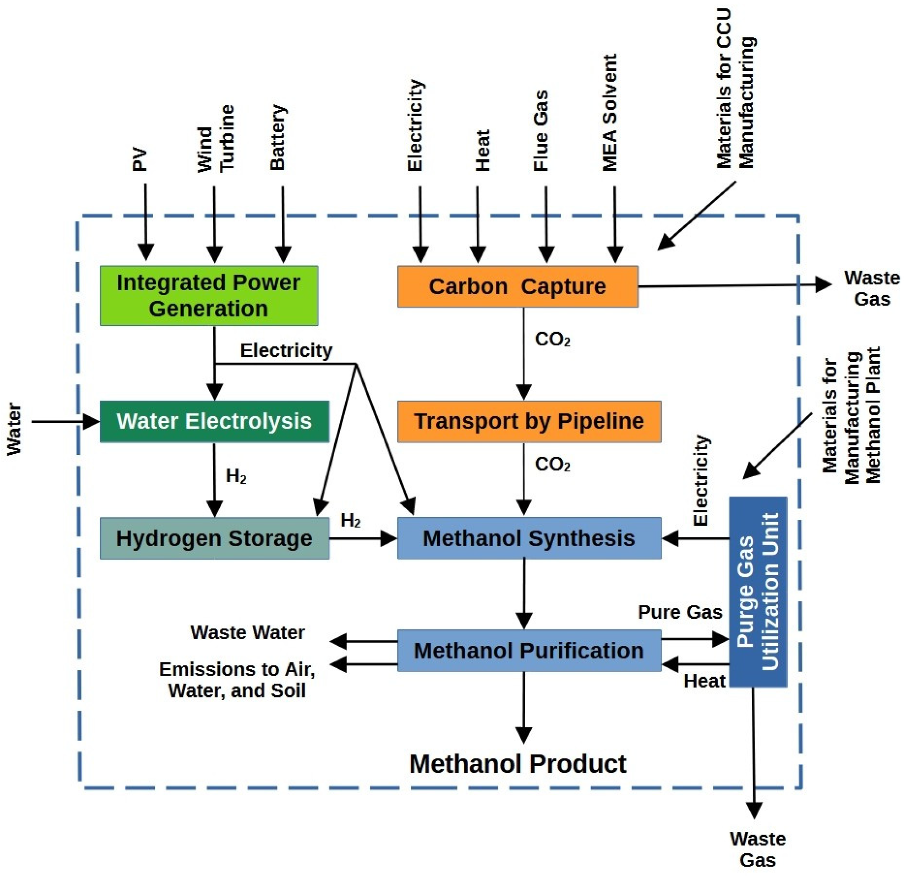
Beispielprozess Power to Methanol

Slide 9
Beispielprozess Power to Methanol
Presentation Literature Research (07.08.2025)
    Each group presents their results of the literature research on the 07.08
    Some questions that can help you to structure the presentation:
      How should the annual production volume from the task be classified?
      What is the critical component in the chain?
      Which CO2 source is selected?
      Which separation method for CO2 capture?
      Critical evaluation of the results

Slide 10
    Bekanntgabe des Prozessbeispiels und Gruppeneinteilung: 23. Juli, 14 - 16 Uhr in IC 3/156
    Einführung Aspen Plus 04.08-07.08
    Blockveranstaltung: 07.08-15.08, ganztägig im CIP Pool

