Slide 1





FAMSE: Fundamental Aspects of Material Science and Engineering
Exercise questions of catalyst oxide materials
Biao He
Atomic-scale Characterisation Institute for Materials
Department of Mechanical Engineering Ruhr-University Bochum
tong.li@rub.de | Bochum

Slide 2
1. What are the anode and cathode reactions for water electrolysis?
Acidic electrolyte
Alkaline electrolyte
tong.li@rub.de | Bochum

Slide 3
2. What reactions occurs at the anode and cathode side respectively? What is cell potential? What is Gibbs free energy?
If the total reaction is 𝑍𝑛 𝑠 + 𝐶𝑢²⁺(𝑎𝑞) → 𝑍𝑛²⁺(𝑎𝑞) + 𝐶𝑢(𝑠)
what reactions occurs at the anode and cathode side
respectively?
What is cell potential?
What is Gibbs free energy?
tong.li@rub.de | Bochum

Slide 4
3. Why uses catalyst?
tong.li@rub.de | Bochum

Slide 5
4. What are the subprocess of oxygen evolution reaction in alkaline solution ?
tong.li@rub.de | Bochum

Slide 6
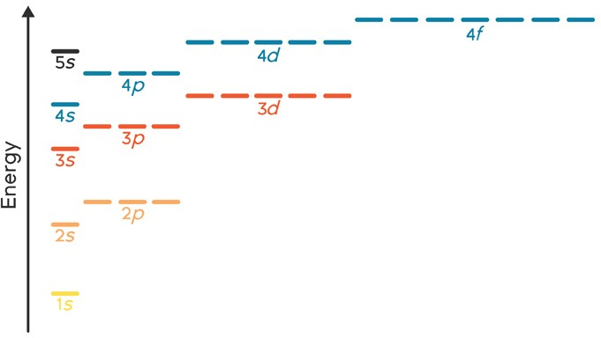
5. 1) What is electronic configuration of Co²⁺
Co: 1s2s2p3s3p4s3d
tong.li@rub.de | Bochum

Slide 7
6. What is radius trend of a) O, F, Na, Mg and Al? b) O²⁻, F⁻, Na⁺, Mg²⁺Al³⁺?
tong.li@rub.de | Bochum

Slide 8




7. Draw octahedral and tetrahedral sites in a FCC crystal?
tong.li@rub.de | Bochum

Slide 9
8. What is atomic structure of ABO₃ perovskite? What are A, B sites located? What is oxygen? What are the oxidation of A and B in e.g., CaTiO₃?
tong.li@rub.de | Bochum

Slide 10
9. What are the oxidation of state A and B of AB₂O₄ spinel? Where are the A and B sites respectively?
What is oxidation state of AB₂O₄ inverse spinel? Where are the A and B sites respectively
tong.li@rub.de | Bochum

Slide 11
10. What is electronic configuration in e_{g} and t_{2g} of weak ligand [Co(H₂O) ₆]²⁺
and strong ligand [Co(CN)₆]²⁺ ?
tong.li@rub.de | Bochum

