Slide 1

FAMSE - Exercise
Thermodynamics

Slide 2

Part I
Thermodynamics in materials science, high entropy alloys

Slide 3

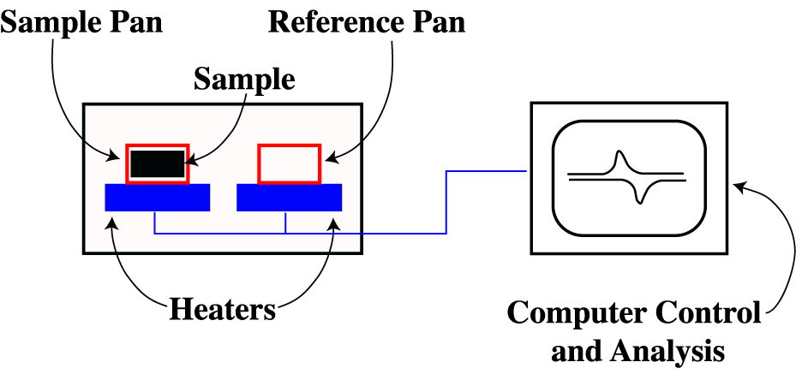
1.6 How does differential scanning calorimetry (DSC) work?

Slide 4


To obtain an ideal solution, 15 g Au and 25 g Ag are being mixed.
a) Calculate the molar entropy of mixing with the given atomic weights of Au = 197u and Ag = 108u.
𝑚
𝑀
𝑛 =
𝑛₁
𝑥 =
1
𝑛 + 𝑛
1
2

Slide 5
b) How would ΔS mix change if the alloy was equiatomic?

Slide 6
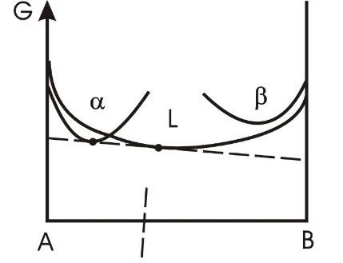


G(x)-diagrams and the tangent rule
Which phases are stable at a given temperature depending on the
chemical composition?
•
x_{B}

Slide 7
The enthalpy of formation of the ordered intermetallic compound NiAl is -60 kJ/mol. Estimate whether the equiatomic alloy AlCrFeCoNi will form a single phase solid solution after annealing at 800°C for a long time.

Slide 8
Calculate the entropy of mixing for the equiatomic alloys: CrCoNi,
CrFeCoNi, CrMnFeCoNi.

