Slide 1
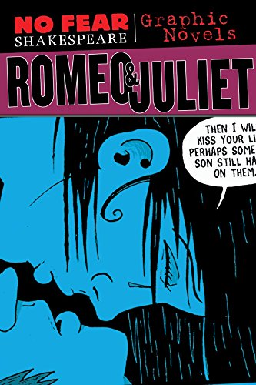
Describe what you can see on the picture?
Interpret what you can see on the picture?
What could our lesson be about?

Slide 2
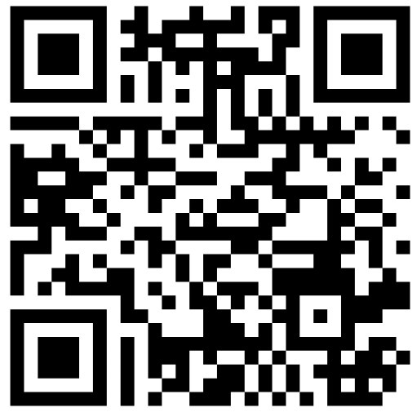
Menti
Task: Please use the following link to write down what you already know about graphic novels! Please also add any graphic novel you already know!
https://www.menti.com/alo69d8e4rsk

Slide 3
Euer Lernziel für heute!
Text- und Medienkompetenz = Du sollst dir diese Kompetenz aneignen, indem du eine Szene aus einer Graphic Novel schrittweise analysierst.

Slide 4
Analysis of the “balcony” scene
Look at your work sheet for the task!
Groups:
Katharina, Celine, Laura, Nina (Group: Character)
Michelle, Nele, Alina, Justin (Group: Plot/Imagery)
Anna, Jilan, Hannah (Group: Language)

Slide 5
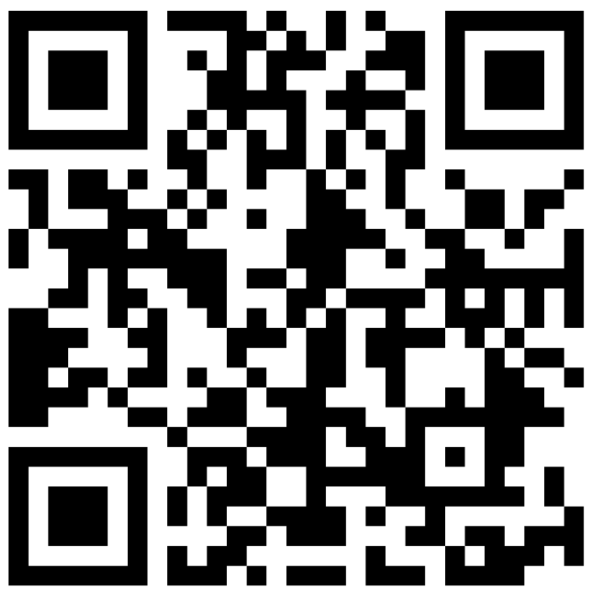
Padlet
Please use the following link to summarize your results!
https://padlet.com/eskiciali07/analysis-of-the-balcony-scene-jd4rb1c5u3l56fjg

Slide 6
Reflection - Did you reach your lesson goal?
Task: Write a short reflection on what you learned about graphic novels. Please answer at least two of the following three questions for yourself! Be prepared to present your answers to the class.
a) Which form of narrative do you find more entertaining? Please provide reasons for your answer!
b) What makes graphic novels special? Name at least two attributes!
c) How does visual storytelling enhance a narrative compared to traditional text-only novels? You can use Romeo and Juliet as an example.

