Slide 1







Short Stories
Michelle Bölling

Slide 2

Warm Up

Slide 3

Warm up - Simon says
If I say “Simon says raise your arm” -> you raise your arm!
But if I only say “put it down” and you put your arm down you have to sit down and are out!
Try to follow as many correct instructions as you can!

Slide 4
Mentimeter

Slide 5
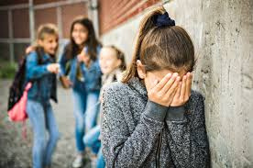

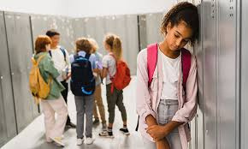
Mentimeter
Go to Mentimeter and write down assumptions/feelings that come into your mind when looking at these pictures!
CODE: 8635 9173

Slide 6
Lapbook and Story Time

Slide 7



Time to work on our lapbook!
In our previous lessons we already created parts of our lapbook.
Today is all about creative writing!

Slide 8


Tasks for today!
Open up the worksheet on moodle. Read the task carefully. Take a pen and start reading.
After reading and highlighting important words relevant for a diary entry/instagram post talk to your partner and see what they marked as important.
Start writing either an instagram post (can be a campaign against bullying, a personal post, news etc.) or a diary entry either written by Karen or Miriam
10 minutes
5 minutes
20 minutes

Slide 9



Tasks for today!
Attention! I will use a random number generator to choose who will present at the end! Be prepared to present your work! ;)
Start writing either an instagram post (can be a campaign against bullying, a personal post, news etc.) or a diary entry either written by Karen or Miriam
20 minutes

Slide 10
Reading your work

Slide 11


Random number generator time!
I will now choose students who will read out their blog post by using a random number generator!
If you don’t feel comfortable reading out loud, you can also give me your texts and I will read them aloud. :)

Slide 12
Homework

Slide 13
Finish your lapbooks!
Is there anything that you would like to add to your lapbook? That you didn’t get to finish during the lessons?
Finish your lapbook at home so we can do a gallery walk next week!

Slide 14
YouTube

Slide 15
Watch the video and answer the following questions:
How do you feel when you watch the video?
https://www.youtube.com/watch?v=WAEvLJqIG_0

Slide 16

Thank you!
See you next week

