Slide 1


THEORY PART: POETRY
Grundlagen der Textdidaktik I SoSe 2024

Slide 2
Today´s Content
Features of Poetry
Definition of Poetry
Pros and Cons of Teaching Poetry
Typical Approaches to Teaching Poetry
What should Teachers take into Account?
Bibliography

Slide 3
1. Features of Poetry

Slide 4


Features of Poetry
What do you think are features of poetry?
Menti.com
5460 5920

Slide 5
Features of Poetry
Brevity
Density of content/subject matter
Increased subjectivity and individual experience
Often display emotions, individual thoughts or mirror a certain moment in time
Musicality
Complexity
  structure (lines, metre, stanza)
  phonological (sounds, rhyme)
  morphological (words, word formation)
  syntactic (arrangement of sentences)
  semantic (figurative language)

Slide 6
2. Definition of Poetry

Slide 7
2. Definition of Poetry
Poetry defines a literary form that evokes ideas, feelings, emotions, and vivid imagery through carefully chosen and arranged language, including metre, rhyme, verse and rhetorical and metaphorical style.

Slide 8
3. Pros and Cons of Teaching Poetry

Slide 9
3. Pros and Cons of Teaching Poetry
Pros | Cons
Flexible use → various goals and levels | Complexity and accessibility
Focus on essential information/density | Student engagement → abstract
Close reading required | Emotional sensitivity → triggers
Foster personal reader’s response | Interpretation challenges → subjectivity
Intercultural learning
Activation of different senses → songs
Language awareness and stylistic analysis
Offer interpretational openness and creative activities

Slide 10
4. Typical Approaches of Teaching Poetry

Slide 11
4. Typical Approaches of Teaching Poetry
Structure:
Process Stage | Activities
PRE | Introduction to author Explanation of communicative situation Discussion of title Creative writing Using media
WHILE | Reading whole text Reading incomplete text Reading changed text
POST | First response General understanding Detailed analysis Integrating background information Evaluation Recitation Creating/Creative writing
Thaler, 2016, p. 117

Slide 12
5. What should Teachers take into Account?

Slide 13
5. What should Teachers take into Account?
Language proficiency levels
Cultural context
Engagement and motivation
Listening and speaking skills
Reading and writing skills
Analytical skills
Support and scaffolding (pre-/post-reading activity)
Technological integration
Assessment and feedback
Respect for opinions (respect for diverse opinions)

Slide 14
6. Bibliography
Thaler, Engelbert. Teaching English literature. UTB, 2016.
Rothman, David J., and Spear, Susan Delaney. Learning the Secrets of English Verse: The Keys to the Treasure Chest. Schweiz, Springer International Publishing, 2022.
Furniss, Tom, and Bath, Michael. Reading Poetry: An Introduction. Vereinigtes Königreich, Pearson Longman, 2007.

Slide 15
3rd Part -

Slide 16
Today´s Plan
Lesson Plan
Additional Worksheets - Poem Analysis
Feedback
Grundlagen der Textdidaktik I SoSe 2024

Slide 17
1. Lesson Plan

Slide 18
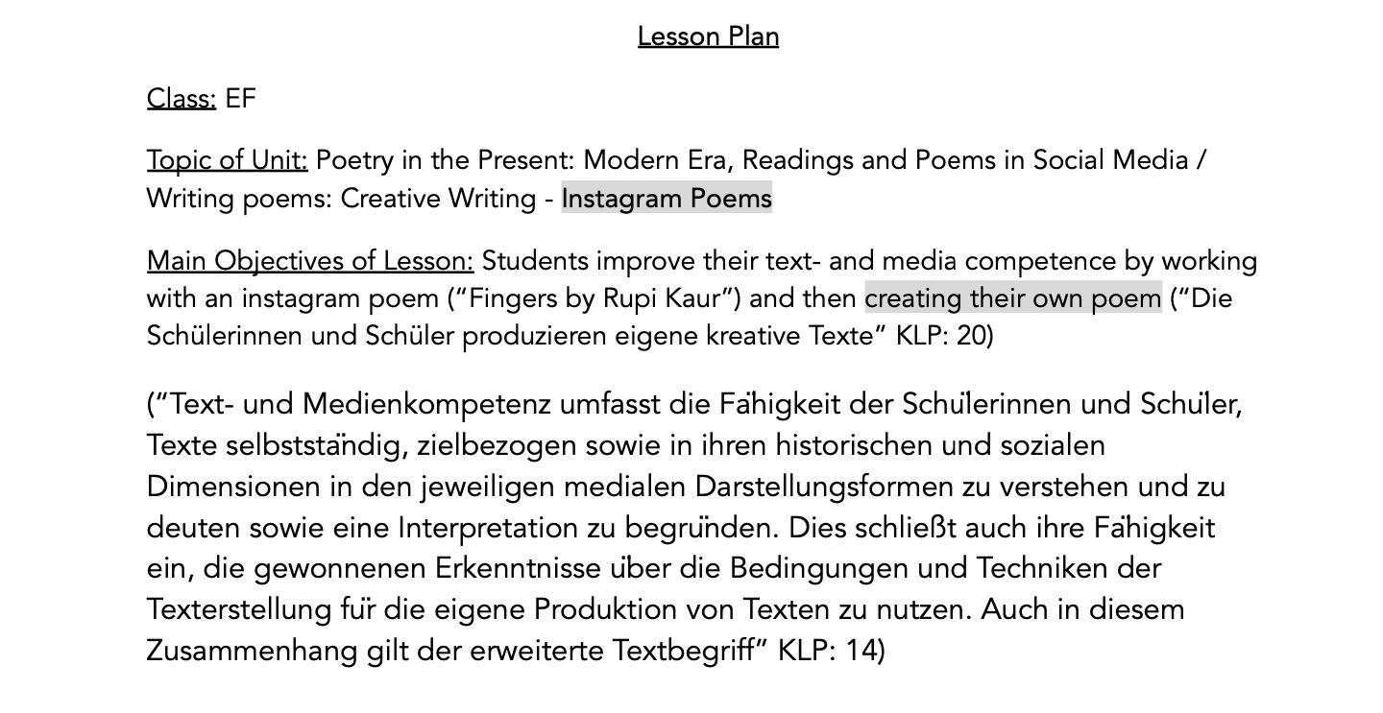
1. Lesson plan

Slide 19
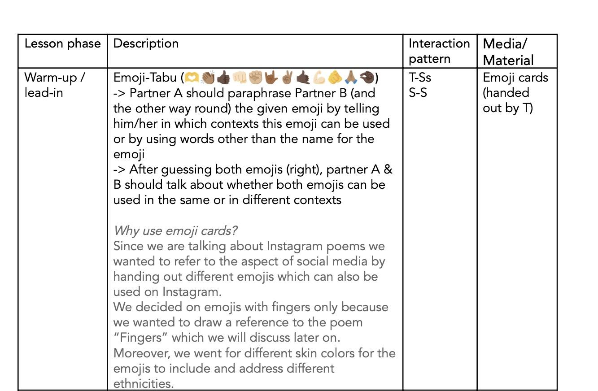
Lesson plan

Slide 20
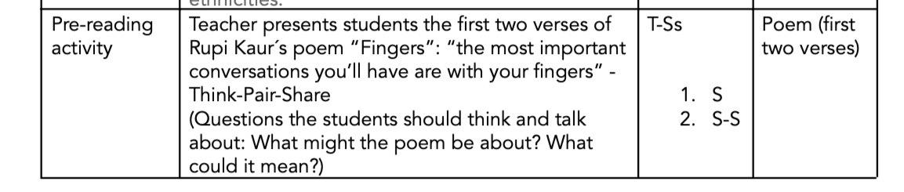

Slide 21
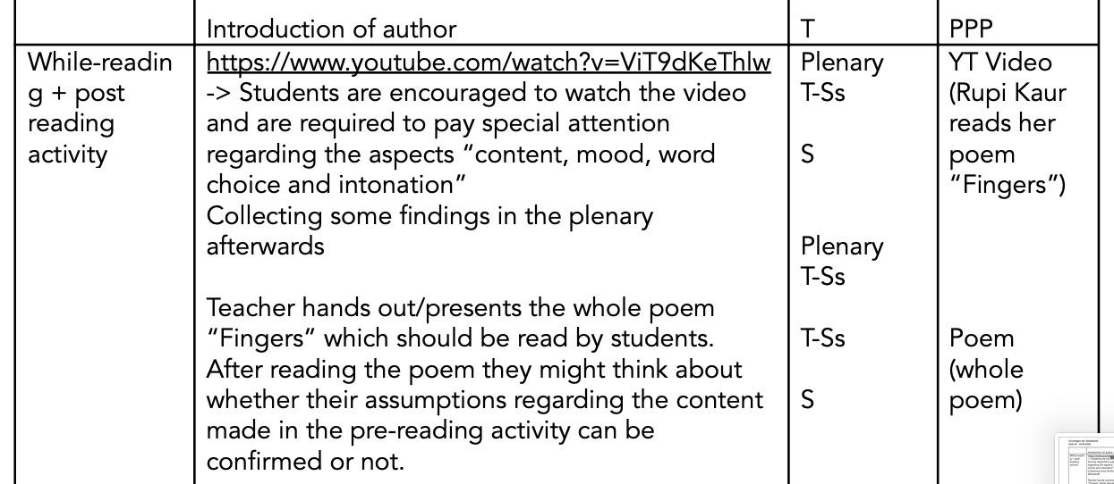

Slide 22
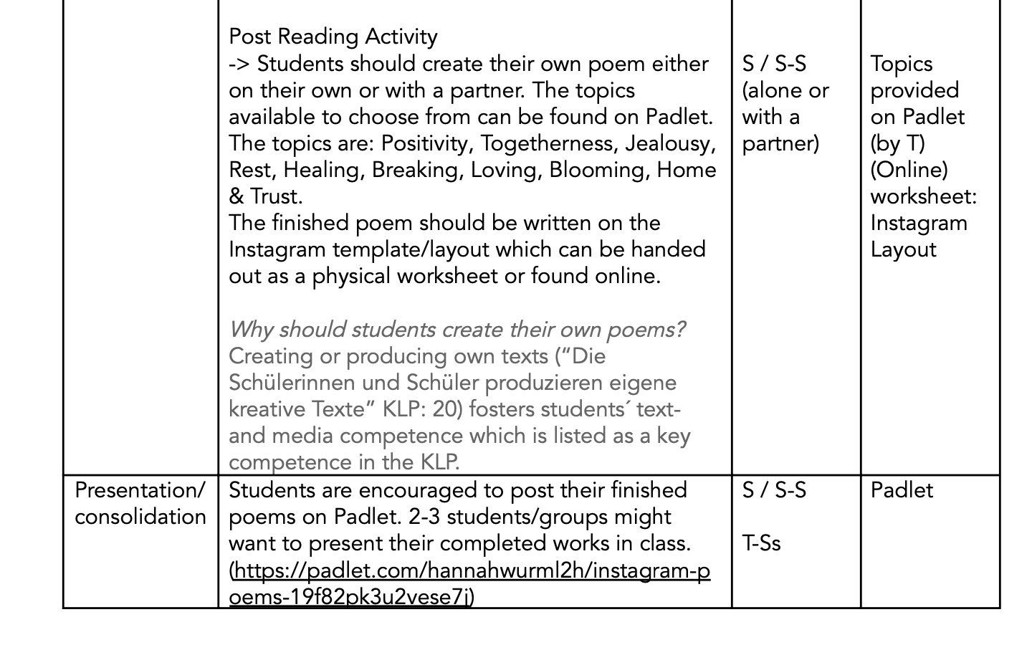

Slide 23
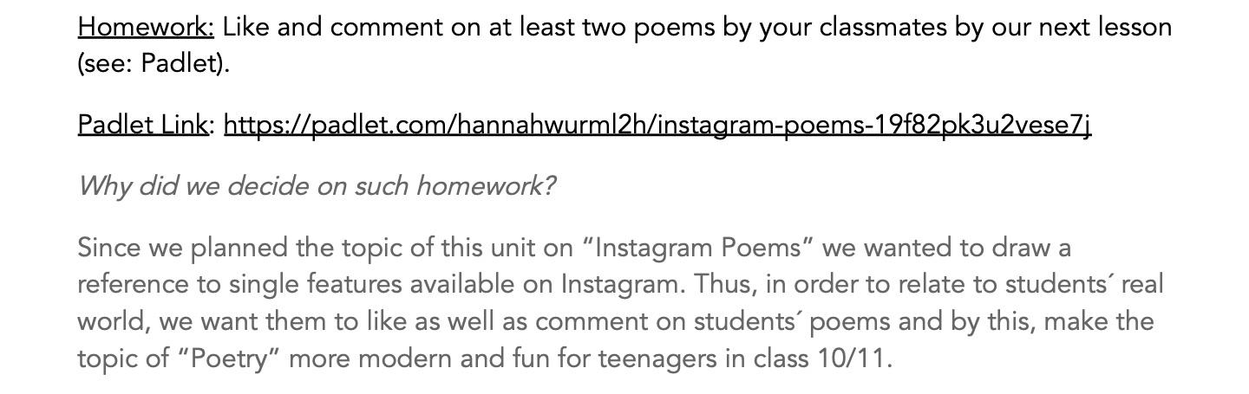

Slide 24
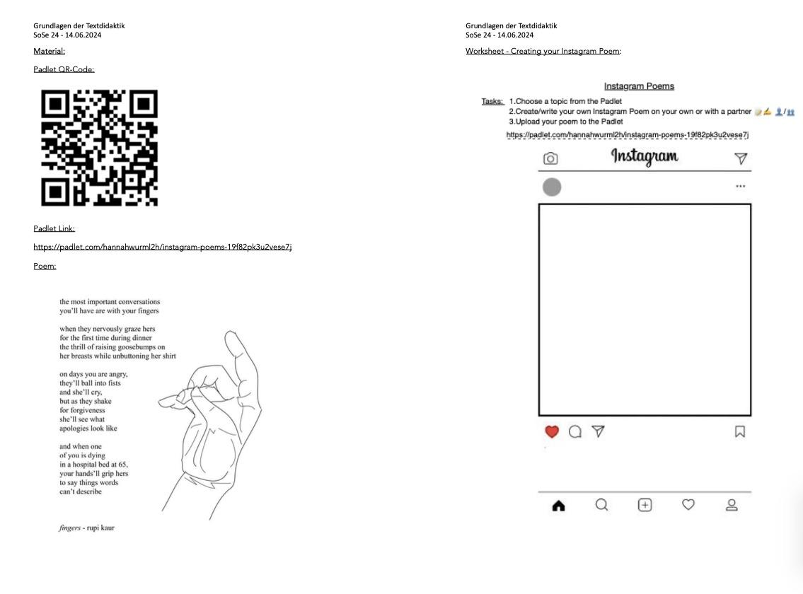

Slide 25
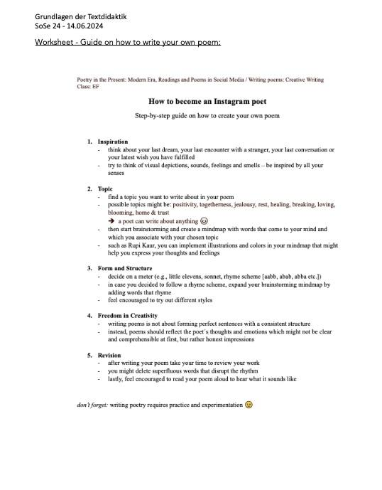

Slide 26
2. Additional Worksheets
Poem Analysis

Slide 27
3. Feedback

Slide 28
Thank you for your participation & attention!
Alina, Hannah, Laura C. & Nele

