Slide 1
Freedom of Speech in Higher Education
Professor Dominic McGoldrick
University of Nottingham

Slide 2
Freedom of Expression/ Speech in the UK
Fundamental common law right
Can say anything unless it is prohibited
Article 10 ECHR
Human Right Act 1998
Notes:
Cf privacy
2, Cf Sedley…

Slide 3
Applicable Law in Higher Education: Complexity
Devolution
2017 Act – Office for Students (OfS)
Charity Law – Students Unions
Equality Act 2006… non-discrimination; harassment; public sector equality duties
Human Rights Act 1998
Universities’ FoS Policies
Notes:
Education is a devolve matter. 4 separate education regimes.
2017 Act – institutional autonomy. OfS – wide ranging and increasing powers.
Charity Law – Universities are charities but they are regulated by OfS rather than the Charity Commission; SU’s are charities
Charity law -
Eq Act - non-discrimination; harassment – defined; PSED = duty to take account ... [fostering good relations]
HRA 1998 – s. 19 statement of compatibility; Convention rights – Art 10;
FoS policies – Nottingham has one.

Slide 4
The Issue?
FS in Universities being chilled/ restricted

Slide 5
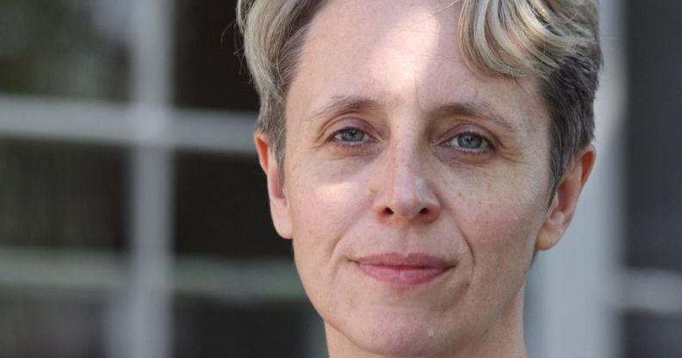
Professor Kathleen Stock, University of Sussex
gender critical feminist
seeks to exclude trans women from the category ‘woman’ and advocates for single sex spaces that would exclude trans women
Opposed by (majority) Trans inclusive academic feminists
Her views met with protests (and death threats) from students and criticisms from other academics
Union Declared support for trans students
Other academics supported her.
University ‘vigorously and unequivocally defended her right to exercise her academic freedom and lawful freedom of speech, free from bullying and harassment of any kind’.
Awarded an Honour in New Years List 2021 for ‘services to higher education’
Eventually she resigned in 2021.
Notes:
Honours list: But more than 600 academics criticised the decision, signing an open letter that criticised Stock’s comments on trans and gender non-conforming people. The letter said her “harmful rhetoric” reinforced “the patriarchal status quo”. 6 from Univ Nottingham. 5 from Ruhr-Universität Bochum
Goodwin: For every Kathleen Stock, there are 50 other gender-critical academics.

Slide 7
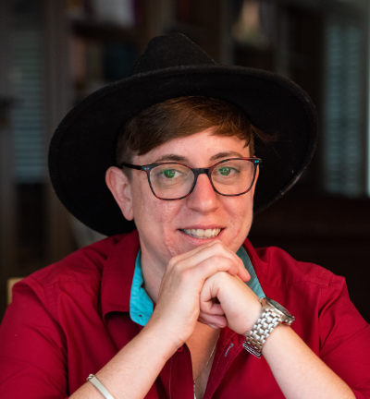
Professor Rosa Freedman
Was invited to talk about anti-semitism at The Holocaust Memorial Week event at University of Essex in 2020
Complaints had been made to the effect that she had published viewpoints which were “hate speech”,
Invitation was rescinded - deciding factor was her views on gender identity
She complained to Universities minister and her Member of Parliament
Invitation was re-instated – event took place.

Slide 8
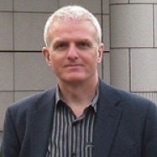
Professor Greer, Bristol University
Accused by Bristol Islamic Student Society of being Islamophobic in his teaching.
Independent review - 8 month inquiry
Exonnerated
Module - changes made - new conveners wished to deliver the material in a context that was both broad-reaching and respectful of sensitivities of students on the course
Notes:
. It is of particular interest because it exemplifies the power on online campaigns against academies, the lengthy periods required for investigation of complaints, the significant impact on the individual concerned (again a senior academic in this case), and the desire of Universities to be respectful of the sensitivities of students.
allowing a level of flexibility in the development of new teaching material to match students' current interests, the specialisms of the course's new conveners and their wish to deliver the material in a context that was both broad-reaching and respectful of sensitivities of students on the course [MEANS]

Slide 9
Systemic Evidence
Chilling effect: (2017) UCU survey says that 35% of academics self-censor. versus 19% in the EU.
a King’s study, 25% of students claim that they will not say what they believe
Policy Exchange (2020): Many academics choose to self-censor.

Slide 10
Evaluating the Evidence
OfS. Only 0.002% of events were cancelled—that is under 100 of the 43,000 events
But OfS supported the Act, Thought it was necessary.

Slide 11
What the Act Does: Duty to take steps to secure freedom of speech
The governing body of a registered higher education provider must take the steps that, having particular regard to the importance of freedom of speech, are reasonably practicable for it to take in order to achieve the objective in s. A1(2), namely ‘securing freedom of speech within the law’ for staff, members and students of the provider, and visiting speakers.

Slide 12
Freedom of Speech?
In this Part, references to freedom of speech are to the freedom to impart ideas,
opinions or information (referred to in Article 10(1) of the Convention as it has effect for the purposes of the Human Rights Act 1998) by means of speech, writing or images (including in electronic form).
Hate Speech?
Speech on Trans rights?

Slide 13
‘Within the Law’
Residual common law system
Article 10 ECHR under HRA
Criminal Prohibitions
Civil Prohibitions
Equality Act: Harassment

Slide 14
Duty on HE provider
having particular regard to the importance of freedom of speech
steps that, …. are reasonably practicable for it to take [to secure objective of freedom of speech]

Slide 15
A2 Code of practice
The governing body of a registered higher education provider must,
… maintain a code of practice setting out:
(a) the provider’s values relating to freedom of speech and an
explanation of how those values uphold freedom of speech,
(b) the procedures to be followed by staff and students / students’ union for students at the provider in connection with the organisation of—
(i) meetings/ activities/ conduct/ criteria on use of premises (d) the criteria to be used by the provider in making decisions about
whether to allow the use of premises / the initiation of disciplinary measures in order to secure compliance with its code of practice.
The governing body must, at least once a year, bring—
(a) the provisions of section A1, and (b) its code of practice under this section, to the attention of all of its students.

Slide 16
A3 Duty to promote the importance of freedom of speech and academic freedom

Slide 17
Other Key Provisions
Duties of constituent institutions
Duties of students’ unions
Non-Disclosure agreements

Slide 18
Increased functions for OfS
The OfS must promote the importance of— (a) freedom of speech within the law, and (b) academic freedom for academic staff
Regulation of duties of registered higher education providers and student unions (can impose monetary penalties on them)
Free Speech Complaints Scheme (free to sue)
Monitoring of risks to freedom of speech and academic freedom from overseas funding

Slide 19
‘The Director for Freedom of Speech and Academic Freedom’
Includes overseeing the performance of the OfS’s free speech functions

Slide 20
Thematic issues
Changing the Culture?
New Civil action for Tort – Backstop; Risks?
Important Role of Codes of Practice and OfS Guidance
Enhanced Role for OfS – implications for institutional autonomy?
Next Big Issue: University ideologies?

