Slide 1
Mary Ann Röthig

Slide 2
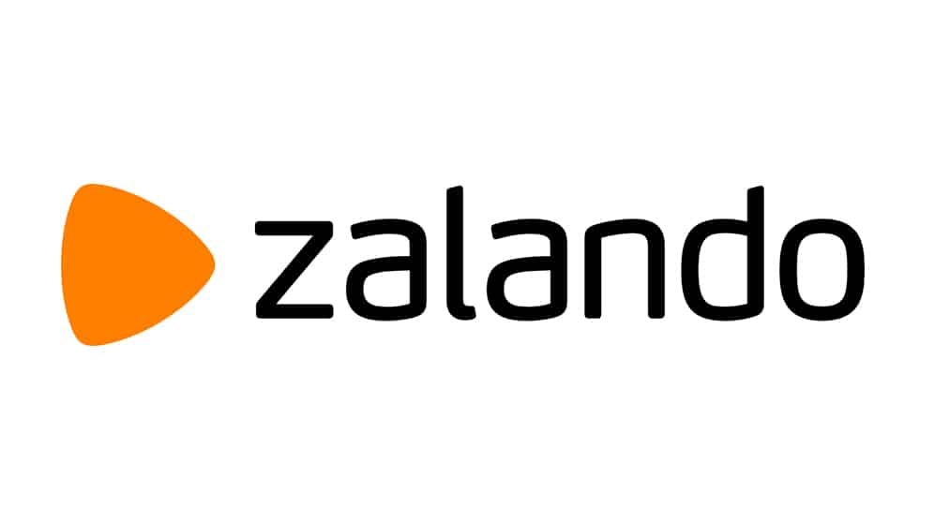
Content
General information
History
Platform strategy
Work and culture
Sustainability
Sources

Slide 3
General information
Founded in 2008 in Berlin by David Schneider & Robert Gentz
Management by Astrid Arndt, David Schröder, Jim Freeman, Robert Gentz, David Schneider
Europe‘s leading online fashion platform
16.000 employees
23 countries
7.89 billion Euro sales

Slide 4
History
was founded in fall 2008
Started as a online shoe shop
A small team worked from a shared apartment in Berlin
Private cell phone numbers became customer hotlines
They took all packages to the post office themselves
New standards – by offering free delivery and up to 100-day right of return

Slide 5
history
Zalando conquered international markets -> launch in Austria and Switzerland
The Netherlands became the first non-German-speaking market in 2010
Zalondo is now active in 20 European markets
Twelve fulfillment centers in Europe

Slide 6
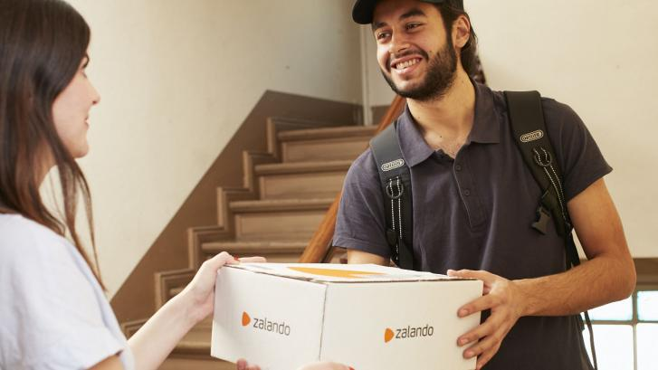
Platform strategy
The European fashion market is one of the largest and most attractive global consumer markets
Radical change due to digitization
New technologies connect all participants in the fashion ecosystem -> opens new channels for consuming producing and doing business
Best way for Zalando to achieve growth and at the same time continue to drive forward digitization in the industry is with a platform-based business model
The focus on the requirements of the fashion industry enables them to create unique and captivating fashion experiences

Slide 7
Platform strategy
The profound knowledge of local markets is one of the competitive advantages
Three areas that are essential for the success of the platform strategy →customers, infrastructure and partners
Customers: they want to offer the most extensive assortment of the current season‘s trends with the maximum availability
Brand partners: the chance to draw on the customer base is a fantastic business opportunity, which they can take advantage of by becoming part of their platform structure
Infrastructure: Internally developed technology solutions are the backbone of Zalando and are behind all their processes

Slide 8
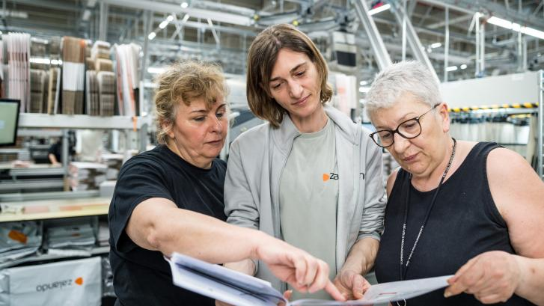
Work and culture
employees are the key to their success
company is what every one of them makes of it
Top priority: provide an environment where everyone is heard and able to participate in shaping Zalando‘s future
Zalando has numerous employee representation bodies and well-established participative formats
All initiatives across the company work closely together and nurture an active exchange between the company and its employees

Slide 9
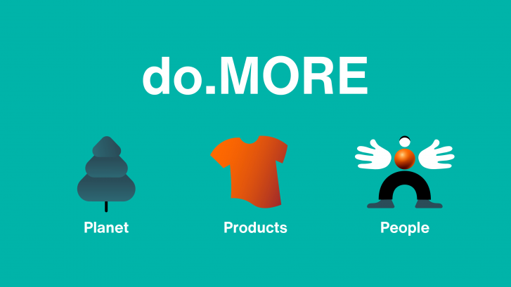
sustainabilitiy
The bold vision of Zalando is to be a sustainable fashion platform with a net-positive impact on people and the planet
Three focus areas: Planet, Products, and People

Slide 10
Sources
https://corporate.zalando.com/en/company/employee-participation-and-representation-zalando
https://corporate.zalando.com/en/sustainability/domore-zalandos-sustainability-strategy
https://corporate.zalando.com/en/company
https://corporate.zalando.com/en/company/work-and-culture

