Slide 1
Seasonal Effects on Sales in Germany
Mary Ann Röthig

Slide 2
Contents
Black Friday
Valentine´s Day
Christmas
Other examples
Consequences of Covid
Conclusion
Sources

Slide 3
The Friday after Thanksgiving
Start of Christmas shopping
Different assumptions about the origin
2018 revenue in Germany: € 2,4 billion
2020 revenue in the USA: $ 9 billion
Criticism: consumers buy unnecessary products, non-transparent prices

Slide 4
Valentine´s Day
Became popular due to US-soldiers stationed in Germany after WW2
14th of February
2020 revenue in Germany: €1 billion
20% of people buy products for Valentine´s Day
Florists sales rise up to +500%

Slide 5
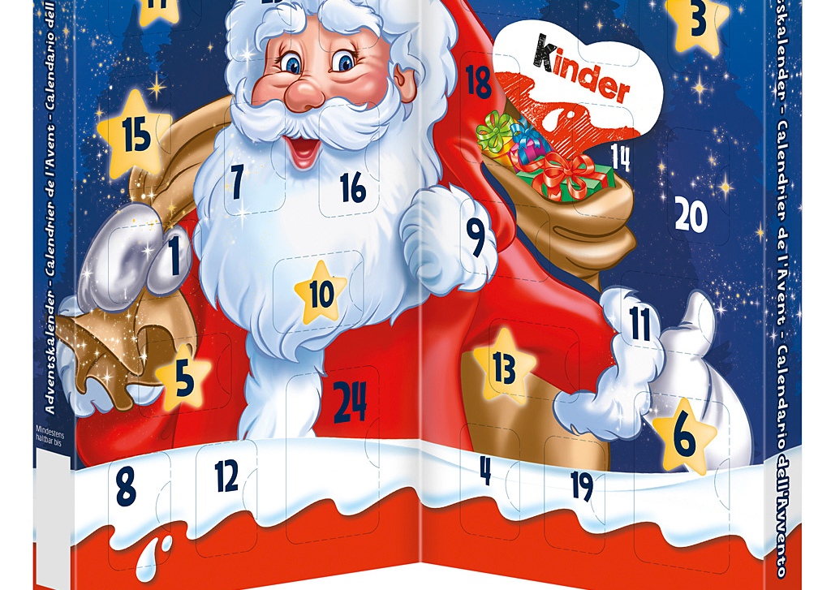
Christmas (Advent calendars)
High revenues in this season
Advent calendars were first used by Germans in the 19th century
Today popular across Europe
In 2020, ~60% of Germans planned on having an Advent calendar
~50% of people are willing to spend up to 20€

Slide 6
Other examples
Singles Day (China):
revenue 2019: 38,4 billion $, highest revenue day worldwide
Cyber Monday:
Monday after Black Friday, online shops, mainly Amazon
Start of a new year:
up to 50% more new gym memberships compared to other months

Slide 7
Consequences of Covid
Pandemic affected supply and demand of several products
Rising demand and decreasing supply -> price hikes
Limited supply due to closed productions and warehouses
Rising demand for essential products and hobby supplies
Decreasing demand for the cosmetic industry
50% fewer lipsticks sold, profit losses of 15-60%

Slide 8
Conclusion
Seasons or holidays have a huge impact on sales
Companies take advantage of consumers behavior
Companies not participating lose potential revenue
Unplanned events can ruin or save whole industries

Slide 9
Sources
https://financesonline.com/black-friday-statistics/
https://www.it-business.de/deutsche-sind-spendabel-am-black-friday-a-660195/
https://www.cnbc.com/2020/11/28/black-friday-2020-online-shopping-surges-22percent-to-record-9-billion-adobe-says.html
https://www.handelsblatt.com/finanzen/maerkte/anleihen/handel-das-sind-die-sieben-groessten-fehler-beim-black-friday-shopping/25252974.html
https://einzelhandel.de/presse/aktuellemeldungen/12549-valentinstag-bringt-handel-1-milliarde-euro-umsatz
https://einzelhandel.de/Valentinstag
https://www.valentinstagblumen.de/blumenversand-warum-ist-er-praktisch/jaehrlicher-umsatz-mit-blumen/
https://www.sueddeutsche.de/wirtschaft/kosmetik-corona-maske-1.5023288
https://de.statista.com/statistik/daten/studie/948671/umfrage/umfrage-in-deutschland-zum-besitz-eines-adventskalenders/
https://wirtschaft.com/adventskalender-sorgen-fuer-starken-umsatz/
https://www.presseportal.de/pm/111715/4758226
https://www.stern.de/wirtschaft/news/adventskalender---das-lukrative-geschaeft-mit-den-tuerchen-6574498.html
https://www.glofox.com/blog/6-new-years-resolution-gym-statistics-you-need-to-know/

