Slide 1
RUHR-UNIVERSITÄT
HUMANE – ACCOMPLISHED – OPEN TO THE WORLD

Slide 2
PROFILE
High-flyer among the first “new” universities
Opened in 1965 as Germany’s first new university
Now one of Germany’s ten largest universities
University with research focus in many disciplines
One of the eight finalists for the title “top university” in the Excellence Initiative
Up-to-date approach to B.A./M.A. degree courses
Easy walking distances on the campus

Slide 3
BUDGET
High-performance profile
600 million €
BUDGET 2018 (incl. medicine; excl. clinic)

Slide 4
BUDGET
High-performance profile
600 million €
BUDGET 2018 (incl. medicine; excl. clinic)
WITH
127 million €
SUPPLIED VIA THIRD-PARTY FUNDING

Slide 5
STUDENTS
Vibrant and open to the world
42,954
MORE THAN
STUDENTS 2018/2019

Slide 6
STUDENTS
Vibrant and open to the world
42,954
MORE THAN
AMONG THEM:
6,312
STUDENTS 2018/2019
INTERNATIONAL STUDENTS

Slide 7
BOCHUM’S LARGEST EMPLOYER
The people who shape the face of RUB
5,900
APPROX.
EMPLOYEES
HUMANE – ACCOMPLISHED – OPEN TO THE WORLD

Slide 8
BOCHUM’S LARGEST EMPLOYER
The people who shape the face of RUB
483
5,900
APPROX.
OF THEM PROFESSORS
(INCLUDING JUNIOR PROFESSORS)
EMPLOYEES
HUMANE – ACCOMPLISHED – OPEN TO THE WORLD

Slide 9
BOCHUM’S LARGEST EMPLOYER
The people who shape the face of RUB
483
5,900
APPROX.
OF THEM PROFESSORS
(INCLUDING JUNIOR PROFESSORS)
EMPLOYEES
2,411
OF THEM MAINTENANCE AND
ADMINISTRATION STAFF
HUMANE – ACCOMPLISHED – OPEN TO THE WORLD

Slide 10
BOCHUM’S LARGEST EMPLOYER
The people who shape the face of RUB
483
5,900
APPROX.
OF THEM PROFESSORS
(INCLUDING JUNIOR PROFESSORS)
2,985
EMPLOYEES
2,411
OF THEM RESEARCH ASSISTANTS
OF THEM MAINTENANCE AND
ADMINISTRATION STAFF
HUMANE – ACCOMPLISHED – OPEN TO THE WORLD

Slide 11
STUDY

Slide 12
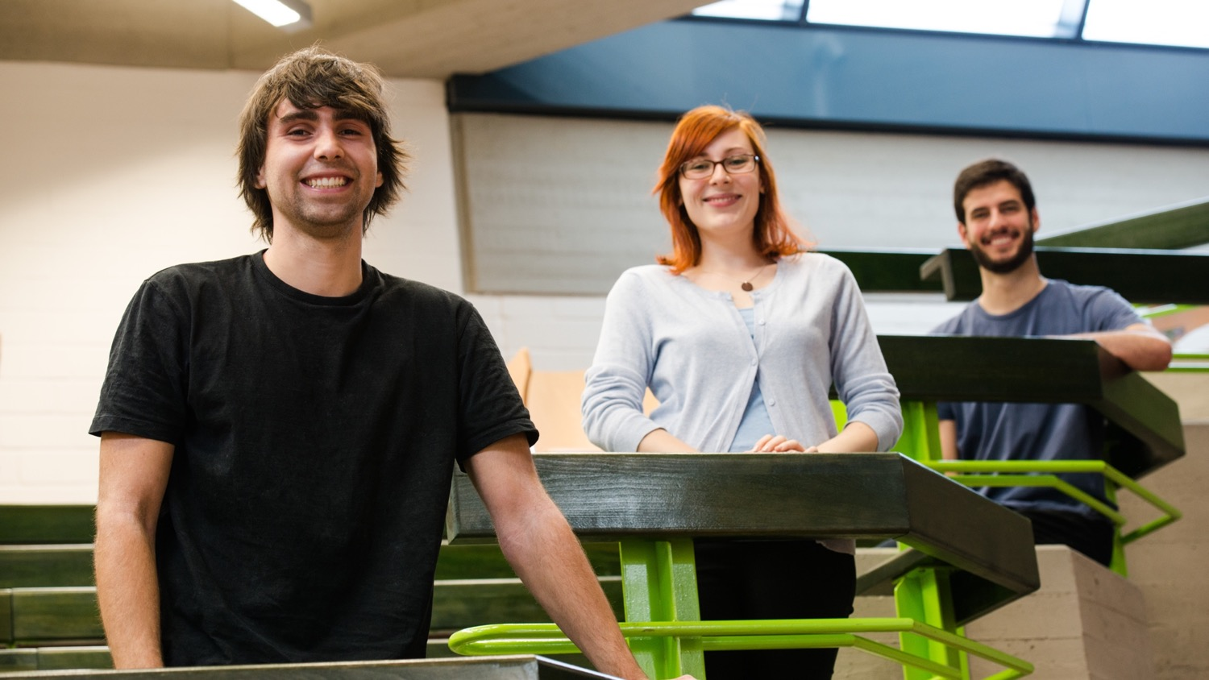

Slide 13
20 FACULTIES
The world of science under one roof
RUB comprises 20 Faculties in:
Humanities and Social Sciences
Engineering Sciences
Natural Sciences
Medicine

Slide 14
FULL DIVERSITY
The right combination for every mind:
more than 170 degree programmes, comprising 66 Bachelor's and 110 Master’s degrees
countless possible combinations
Master of Education prepares for careers in teaching
Professional School of Education offers teaching qualifications and training
comprehensive education programmes

Slide 15
REFORMING UNIVERCITY DEGREES
From the Bologna Process to research-based studies
RUB played a pioneering role in the implementation of the B.A./M.A. degree system:
1993 Reforms launched with the aim of restructuring the Magister degree programme
2001 Implementation of the Bachelor/Master system on the entire campus begins
2008 Bachelor/Master system fully implemented
2009 Implementation of the future teaching concept under the motto “research-based learning”

Slide 16
TEACHING AT RUB
Where research is experienced, learned and lived
Development and introduction of new forms of teaching and learning
Continuous optimisation of the teaching infrastructure
Learning to teach: numerous offers for (further) teaching qualifications
From 2011 to 2020: Funding the teaching projects inSTUDIES (multidisciplinary and inter-faculty) and ELLI (Excellent Teaching and Learning in Engineering Sciences) with 21 million euros

Slide 17
SCORING WITH BACHELOR’S AND MASTER’S DEGREES
On the fast track to better degrees with B.A./M.A.
fast track to graduation

Slide 18
SCORING WITH BACHELOR’S AND MASTER’S DEGREES
On the fast track to better degrees with B.A./M.A.
fast track to graduation
informed decisions

Slide 19
SCORING WITH BACHELOR’S AND MASTER’S DEGREES
On the fast track to better degrees with B.A./M.A.
fast track to graduation
informed decisions
practical additional qualifications

Slide 20
SCORING WITH BACHELOR’S AND MASTER’S DEGREES
On the fast track to better degrees with B.A./M.A.
fast track to graduation
informed decisions
practical additional qualifications
international comparability

Slide 21
SCORING WITH BACHELOR’S AND MASTER’S DEGREES
On the fast track to better degrees with B.A./M.A.
fast track to graduation
informed decisions
practical additional qualifications
international comparability
continuous assessments

Slide 22
MAKING INFORMED DECISIONS
The Y-model provides for all contingencies

Slide 23
MEDICINE IN BOCHUM
Rebranding the medical profession
The RUB clinic incorporates ten hospitals – four of them in Ostwestfalen-Lippe
The RUB clinic: with more than 5,000 beds, it’s one of the largest in Europe
“The new doctor”:
Problem-centred learning on concrete cases
Separation of clinic and pre-clinic has been abolished
Teamwork is key

Slide 24
RESEARCH

Slide 25
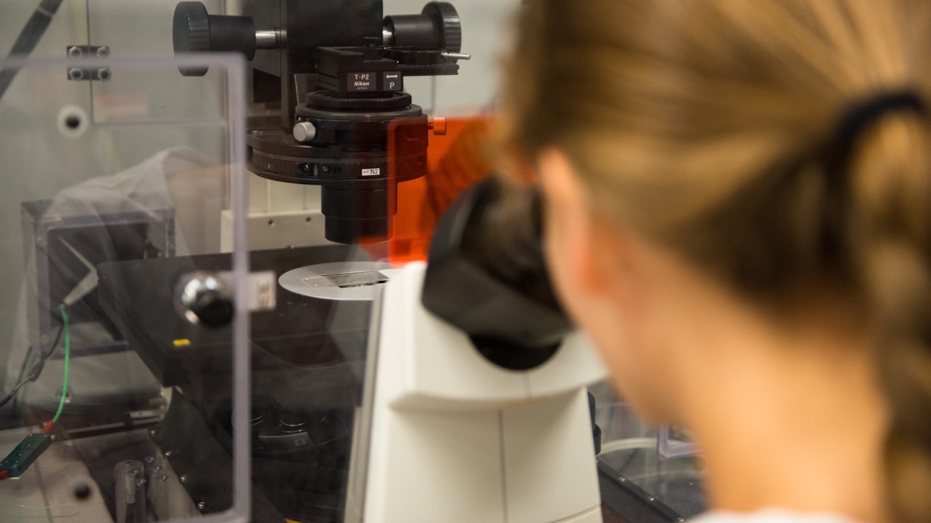

Slide 26
RESEARCH CAMPUS RUB
Interdisciplinary Research Departments:
Solvation Science
IT Security
Materials Research Department
Neuroscience
Closed Carbon Cycle Economy
Plasmas with complex interactions
Protein Research
Religious Studies
Subsurface Modelling and Engineering

Slide 27
RESEARCH SCHOOL
Think tank for elite researchers of today and tomorrow
awarded in the Excellence Initiative by the Federal State authorities
interdisciplinary Research School
open to PhD students from all disciplines
more than 4,000 registered PhD students

Slide 28
JOINT RESEARCH
Excellence on an international level
11 Collaborative Research Centres including 5 joint ventures
9 research groups + 12 joint ventures
Two Clusters of Excellence – RESOLV and CaSa – as part of the Excellence Strategy
RESOLV: Ruhr Explores Solvation – international cutting-edge research into solvation processes
CaSa: Cyber Security in the Age of Large-Scale Adversaries

Slide 29
INTERNATIONAL

Slide 31
EXCELLENT NETWORKING
Cosmopolitan spirit at a glance
Hundreds of collaborations with partner universities worldwide
6,312 international students from all over the world, 1,948 of them students with migration background
Approx. 900 international PhD holders and visiting lecturers
Member in the Utrecht Network
UA Ruhr Liaison Offices in:
New York (North America)
Moscow (Eastern Europe/Central Asia)
Rio de Janeiro and São Paolo (Latin America)

Slide 32
WELCOME!
Services in the International Office
Supporting international researchers – “Welcome Centre” awarded by the Humboldt Foundation
International Lounge in the Mensa building
RUBiss – International Student Services: Advice and culture programmes for international students and exchange students as well as for refugees interested in studying in Germany
Outgoing-Services: Advice regarding exchange programmes abroad

Slide 33
STUDY ABROAD
“Incomings and Outgoings” – the way has been paved
Erasmus+
350 cooperation agreements with partner institutions in more than 20 countries in Europe
Student, lecturer and staff exchange programmes
Grants for studies, internships, teaching and continuing education

Slide 34
STUDY ABROAD
“Incomings and Outgoings” – the way has been paved
Partnerships
Active exchange with more than 40 partner institutions in Europe, Asia, North and Latin America
Special programmes with American partners
REACH: Research Internship Program

Slide 35
STUDY ABROAD
“Incomings and Outgoings” – the way has been paved
Utrecht Network
European exchange, summer schools, grants
Collaboration with exchange networks in the USA and Australia

Slide 36
STUDY ABROAD
“Incomings and Outgoings” – the way has been paved
DAAD programmes
PROMOS grants
40 DAAD young-engineer scholarship holders from Latin America per annum
Grants for double degrees

Slide 37
BINATIONAL DEGREES
One programme, two degrees
China – Tongji University, Shanghai (Financial Services, Mechanical Engineering, Transformation of Urban Landscapes)
South Africa – U of the Western Cape, Cape Town (Development Management)
Russia – RGGU Moscow (Russian Culture)

Slide 38
BINATIONAL DEGREES
One programme, two degrees
France – U Tours (Economic Law, History, French Philology)
The Netherlands – U Amsterdam (German Philology)
Italy – U Bergamo (Comparative Literature)
United Kingdom – U East Anglia, Norwich (Management/Economics)

Slide 39
INFORMATION SERVICES

Slide 41
FINDING YOUR WAY AROUND
No question unanswered
Central Student Advice Centre and discipline-related student guidance
Student portal for beginners and advanced students
International Office
BAföG advisory services
Career service and alumni

Slide 42
STUDY GUIDANCE
Good advice in every situation
General Infopoint
Finding accommodation
Equal opportunity office
Service centre for students with disabilities
Self-help centre OASE
Social services

Slide 43
LEISURE AND RECREATION

Slide 45
CULTURE AND RECREATION AT THE CAMPUS
Creating and enjoying
boskop student-run culture initiative in Bochum
Fine Arts Centre photography, music, theatre, art, orchestra and choir, concerts in the Audimax, exhibitions
Art collection/campus museum modern art collection, ancient art collection, coin collection
Situation Kunst (for Max Imdahl)

Slide 46
SPORT AT RUB
Playing field for sport enthusiasts
Partner university of professional sports
University sports department in Bochum from aikido to yoga and zumba: more than 80 types of sport taught in courses open to all students and members of staff
Unifit: fitness centre in the city of Bochum (opened 2016)
Uni-Run around Kemnader See
…and the collaboration partner VfL Bochum plays Bundesliga football just around the corner

Slide 47
RELAXING & THRILLING: EXPLORE THE NEIGHBOURHOOD
What Bochum has to offer
Ruhr valley
Botanical Garden
Chinese Garden
Bermuda-Dreieck
Schauspielhaus

Slide 48
RELAXING & THRILLING: EXPLORE THE NEIGHBOURHOOD
What Bochum has to offer
Starlight Express
Bochum Symphony Orchestra
Deutsches Bergbaumuseum
Route Industriekultur
Ruhr-Triennale location

Slide 49
HISTORY AND PERSPECTIVE

Slide 50
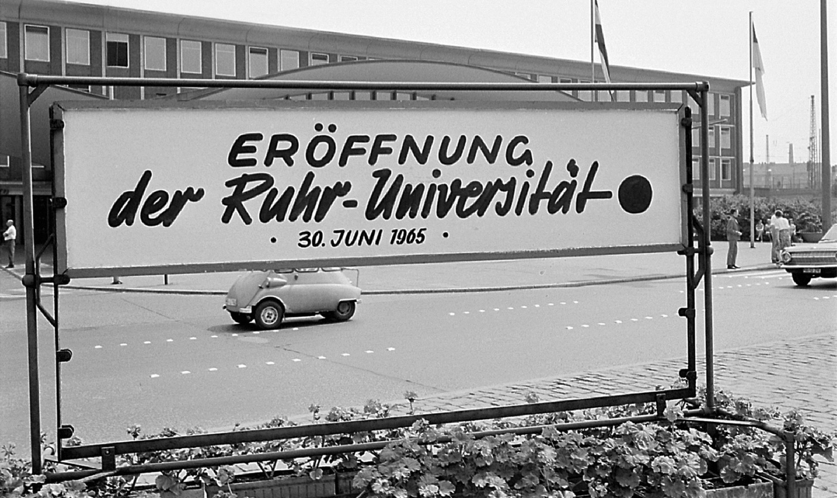

Slide 51
THE EARLY YEARS
The reform university establishes its reputation
1961 NRW state parliament chooses Bochum as the university’s location
1965 Launch of RUB, first lectures commence
1975 “Unikontakt” founded, the first German university transfer service

Slide 52
THE EARLY YEARS
The reform university establishes its reputation
1977 “Bochum Model” for medical training
1988 Institute for International Law of Peace and Armed Conflict
1993 Launch of the Magister reform model

Slide 53
THE WAY TO THE TOP
Open to new ideas
2003 RUB becomes partner university for professional sport
2004 Awarded Best Practice University
2006 Research School funded by the Excellence Initiative

Slide 54
THE WAY TO THE TOP
Open to new ideas
2007 University Alliance Ruhr (UA Ruhr) founded
2007 Humboldt Foundation promotes the “Welcome Centre” concept
2007 and 2012 Participation as a top university in the final of the Excellence Initiative
2019 Participation as a top university in the final of the Excellence Strategy

Slide 55
THE ROOMS FOR THE IDEAS OF TOMORROW
Campus modernisation is in progress
2007 Campus modernisation begins
2010 First new building (ID) opened
2013 Modernisation of IC building completed
2014 Inauguration of SSC building – all student services under one roof

Slide 56
THE ROOMS FOR THE IDEAS OF TOMORROW
Campus modernisation is in progress
2014 IA and IB buildings demolished
2015 Construction of the replacement buildings IA and IB commences (until 2018)
2015 Reconstruction of GD building commences
2016 First research building (ZEMOS) opens
2019 Research building ProDi opens

Slide 57
ELITE RESEARCH LOCATIONS
New research buildings at RUB
ZEMOS – Center for Solvation Science (44 million €) – launched in May 2016
ZGH – Center for Interface-dominated High-Performance Materials (40 million €)

Slide 58
ELITE RESEARCH LOCATIONS
New research buildings at RUB
PRODI – Centre for Molecular Protein Diagnostics (48 million €) – launched in June 2019
ZESS – Centre for Engineering of Smart Product Service Systems (28 million €)
THINK – Centre for Theoretical and Integrative Neuroscience and Cognitive Science

Slide 59
CONTACT
Published by
Ruhr-Universität Bochum Corporate Communications Department on behalf of the Rectorate Universitätsstr. 150
44801 Bochum, Germany Phone: +49 234 32 22830 Fax: +49 234 32 14136
pr@rub.de | www.rub.de

